Slide 1
Estimating Lp Norms
Piotr Indyk
MIT

Slide 2
Recap/Today
Recap: two algorithms for estimating L₂ norm of a stream
  A stream of updates (i,1) interpreted as
  x_{i}=x_{i}+1
  (fractional and negative updates also OK)
  Algorithm maintains a linear sketch Rx, where R is a k*m random matrix
  Use ||Rx||₂² to estimate ||x||₂²
  Polylogarithmic space
Today:
  Yet another algorithm for L₂ estimation!
    Generalizes to any L_{p}, p∈(0,2]. In particular, to L₁
    Polylogarithmic space
  An algorithm for L_{k} estimation, k≥2
    Works only for positive updates
    Uses sampling, not sketches
    Space: O(k m^{1-1/k} /ε²) for (1±ε)-approximation with const. probability

Slide 3
L₂ estimation, version 3.0

Slide 4
Median Estimator
Again we use a linear sketch Rx=[Z₁…Z_{k}], where each entry of R has distribution N(0,1), k=O(1/ε²)
  Therefore, each of Z_{i} has N(0,1) distribution with variance ∑_{i} x_{i} ²=||x||₂²
  Alternatively, Z_{i} = ||x||₂ G_{i} , where G_{i} drawn from N(0,1)
How to estimate ||x||₂ from Z₁…Z_{k} ?
In Algorithms I, II, we used Y=[Z₁² + … +Z_{k}²]/k to estimate ||x||₂²
But there are many other estimators out there…
E.g., we could instead use
Y=median*[ |Z₁|, … , |Z_{k}| ]/ median**[|G|]
to estimate ||x||₂ (G drawn from N(0,1))
The rationale:
  median [ |Z₁|, … , |Z_{k}| ] = ||x||₂ median [ |G₁|, … , |G_{k} | ]
  For “large enough” k , median [ |G₁|, … , |G_{k} | ] is “close to” median[|G|]
  (next two slides)
* median of an array A of numbers is the usual number in the middle of the sorted A
** M is the median of a random variable U if Pr[U≤M]=½

Slide 5
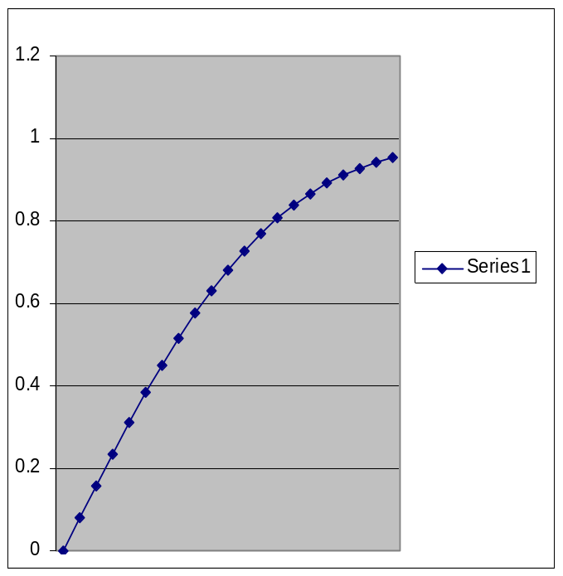
Closeness in probability
Lemma 1: Let U₁ … U_{k} be i.i.d. real random variables chosen from any distribution having continuous c.d.f. F and median M
  I.e., F(t)=Pr[U_{i} <t] and F(M)=1/2
Define U=median [U₁,…,U_{k}]. Then, for some absolute const. C>0
Pr[F(U)∈(1/2-ε,1/2-ε)]≥1-e^{-Cε2k}
Proof:
  Assume k odd (so that median well defined)
  Consider events E_{i}: F(U_{i})<1/2-ε
  We have p=Pr[E_{i}]=1/2-ε
  F(U)<1/2-ε iff at least k/2 of these events hold
  By Chernoff bound, the probability that at least k/2 of the events hold is at most e^{-Cε2k}
  Therefore, Pr[F(U)< 1/2-ε] is at most e^{-Cε2k}
  The other case can be dealt with in an analogous manner
F
½+ε
½
½-ε

Slide 6

Closeness in value
Lemma 2: Let F be c.d.f of a random variable |G|, G drawn from N(0,1).
There exists a C’>0 s.t. if for some z we have
F(z)∈(1/2-ε,1/2+ε)
then
z = median(g) ± C’ ε
Proof: Use calculus or Matlab.
F(z)
½
z

Slide 7
Altogether
Theorem: If we use median estimator
Y=median[ |Z₁|, … , |Z_{k}|] / median[|g|]
(where Z_{j}=∑_{i} r_{ij} x_{i} , r_{ij} chosen i.i.d. from N(0,1) ),
then we have
Y = ||x||₂ [ median(g) ± C’ ε ] / median[|g|] = ||x||₂ (1 ± C” ε)
with probability 1-e^{-Cε2k}
How to extend this to ||x||_{p} ?

Slide 8

Other norms
Key property of normal distribution:
  If U₁ … U_{k} indep., U normal
  Then x₁U₁ + …+x_{m}U_{m} is distributed as
  (|x₁|^{p}+…+|x_{m}|^{p})^{1/p}U , p=2
Such distributions are called “p-stable” and exist for any p∈(0,2]
For example, for p=1, we have Cauchy distribution :
  Density function: f(x)=1/[π(1+x²)]
  C.d.f.: F(z)=arctan(z)/π+1/2
  1-stability: x₁U₁ + …+x_{m}U_{m} is distributed as (|x₁|+…+|x_{m}|)U

Slide 9
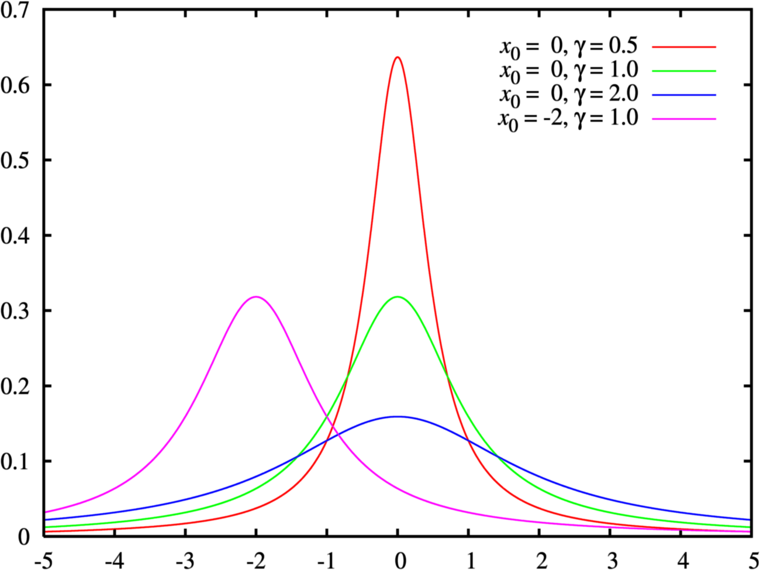
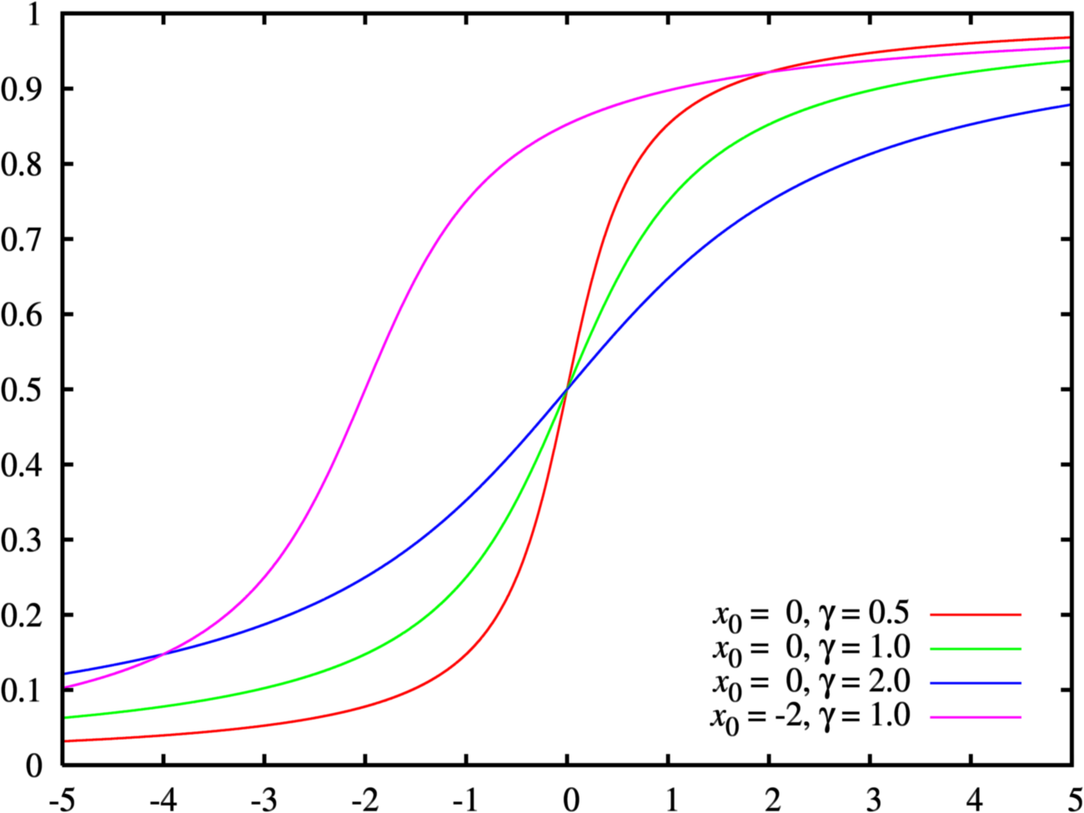
Cauchy (from Wiki)
Cauchy density functions
Cauchy c.d.f.’s
The median estimator arguments go through
Can generate random Cauchy by choosing a random u∈[0,1] and computing F⁻¹(u)
L1 estimation goes through
Similar story for L_{1/2} (Levy distribution)

Slide 10
p-stability for p≠1, 2 , 1/2
Basically, it is a mess
  No closed form formula for density/c.d.f.
  Not clear where the median is
  Not clear what the derivative of c.d.f. around the median is
Nevertheless
  Can generate random variables
  Moments are known (more or less)
  Given samples of a*|g| , g p-stable, can estimate a up to 1±ε [Indyk, JACM’06; Ping Li, SODA’08]
  (using various hacks and/or moments)
For more info on p-stable distributions, see:
V.V. Uchaikin, V.M. Zolotarev,
Chance and Stability. Stable Distributions and their Applications.
http://staff.ulsu.ru/uchaikin/uchzol.pdf

Slide 11
Summary
Maintaining L_{p} norm of x under updates
  Polylogarithmic space for p≤2
Issues ignored:
  Randomness
  Discretization (but everything can be done using O(log (m+n)) bit numbers)
See [Kane-Nelson-Woodruff’10] on how to fix this (and get optimal bounds)

Slide 12
L_{k} norm, k≥2

Slide 13
L_{k} norm
Algorithm for estimating L_{k} norm of a stream
  A stream of elements i₁…i_{n}
  Each i can be interpreted as x_{i}=x_{i}+1
  Note: this algorithms works only for these updates
  Space: O(m^{1-1/k} /ε²) for (1±ε)-approximation with const. probability
  Sampling, not sketching

Slide 14

L_{k} Norm Estimation: AMS’96
Useful notion: F_{k} = ∑_{i=1}^{m} x_{i}^{k} = ||x||_{k}^{k}
(frequency moment of the stream i₁…i_{n} )
Algorithm A: two passes
  Pass 1: Pick a stream element i=i_{j} uniformly at random
  Pass 2: Compute x_{i}
  Return Y=n x_{i}^{k-1}
Alternative view:
  Little birdy that samples i and returns x_{i}
  (Sublinear-Time Algorithms class)
xi

Slide 15
Analysis
Estimator Y=n x_{i}^{k-1}
Expectation
E[Y]= ∑_{i} x_{i}/n * nx_{i}^{k-1} = ∑_{i} x_{i}^{k} =F_{k}
Second moment (≥variance)
E[Y²]= ∑_{i} x_{i}/n * n²x_{i}^{2k-2} = n ∑_{i} x_{i}^{2k-1} = n F_{2k-1}
Claim (next slide):
n F_{2k-1} ≤ m^{1-1/k} (F_{k})²
Therefore, averaging over O(m^{1-1/k} /ε²) samples + Chebyshev does the job (Lecture 2)

Slide 16
Claim
Claim: n F_{2k-1} ≤ m^{1-1/k} (F_{k})²
Proof:
n F_{2k-1}
= n ||x||_{2k-1}^{2k-1}
≤ n ||x||_{k}^{2k-1}
= ||x||₁ ||x||_{k}^{2k-1}
≤ m^{1-1/k} ||x||_{k} ||x||_{k}^{2k-1}
= m^{1-1/k} ||x||_{k}^{2k}
= m^{1-1/k} F_{k}²

Slide 17
One Pass
Cannot compute x_{i} exactly
Instead:
  Pick i=i_{j} uniformly at random from the stream
  Compute r=#occurrences of i in the suffix i_{j}…i_{n}
  Use r instead of x_{i} in the estimator
  Clearly r≤x_{i}
  ..but E[r]=(x_{i}+1)/2, so intuitively things should work out up to a constant factor
  Even better idea: use estimator
  Y’ = n (r^{k} – (r-1)^{k})

Slide 18
Analysis
Expectation:
E[Y’] = n E[(r^{k} – (r-1)^{k})]
= n * 1/n ∑_{i} ∑_{j=1}^{xi} [j^{k} – (j-1)^{k}]
= ∑_{i} x_{i}^{k}
Second moment:
  Observe that Y’ = n (r^{k} – (r-1)^{k}) ≤ n k r^{k-1} ≤ k Y
  Therefore E[Y’² ] ≤ k² E[Y²] ≤ k² m^{1-1/k} F_{k}²
  (can improve to k m^{1-1/k} F_{k}² for integer k)
Altogether, it proves:
  One pass algorithm for F_{k} (positive updates)
  Space: O(k²m^{1-1/k} /ε²) for (1±ε)-approximation

Slide 19
Notes
The analysis in AMS’96, as is, works only for integer k
(but is easy to adapt to any k>1)
The analysis* in these notes is somewhat simpler (but yields k² m^{1-1/k} space)
m^{1-1/k} is not optimal, can achieve m^{1-2/k} log^{O(1)} (mn)[Indyk-Woodruff’05, …, Braverman-Katzman-Seidell-Vorsanger’14]
Sampling - quite general
  Empirical entropy, i.e., ∑_{i} x_{i} /n log(x_{i} /n), in polylog n space [Chakrabarti-Cormode-McGregor’07]
* Contributed by David Woodruff

