Slide 1
Section 2 - Kubernetes architecture

Slide 2
K_S2_one_master_3workers_nodes.png
Master
Node
Worker
Node
Worker
Node
Worker
Node
Network layer

Slide 3


K_etcd_db.png

Slide 4
Section 4 - First kubectl commands

Slide 5
pod.yml
apiVersion: v1
kind: Pod
metadata:
name: pod-nginx
spec:
containers:
- image: nginx
name: container-nginx
s

Slide 6
Section 5 - Kubernetes object definition file - yaml

Slide 7
yml
apiVersion:
kind:
metadata:
spec:
s

Slide 8
kind | apiVersion
Pod | v1
Service | v1
ReplicaSet | apps/v1
Deployment | apps/v1

Slide 9
pod.yml
apiVersion: v1
kind: Pod
metadata:
name: pod-nginx
labels:
app: my-app
env: production
tier: frontend
spec:
containers:
- name: container-nginx
image: nginx
s

Slide 10
pod.yml
...
spec:
containers:
- name: container-nginx
image: nginx
s

Slide 11
pod.yml
...
spec:
containers:
- name: container-nginx
image: nginx
- name: log-shipper
image: alpine
s

Slide 12
Line Spacing 0 - Example No space between line
apiVersion: apps/v1
kind: ReplicaSet
metadata:
name: nginx-rs
spec:
replicas:
selector:
template:

Slide 13
apiVersion: v1 kind: Pod metadata: name: nginx-pod labels: app: my-app spec: containers: - name: nginx-container image: nginx
Line Spacing 0 - Example No space between line
apiVersion: apps/v1
kind: ReplicaSet
metadata:
name: nginx-rs
spec:
replicas: 1
selector:
matchLabels:
app: my-app
template:
metadata:
labels:
app: my-app
spec:
containers:
- name: nginx-container
image: nginx

Slide 14
apiVersion: v1 kind: Pod metadata: name: nginx-pod labels: app: my-app spec: containers: - name: nginx-container image: nginx
Line Spacing 1
apiVersion: apps/v1
kind: ReplicaSet
metadata:
name: nginx-rs
spec:
replicas: 1
selector:
matchLabels:
app: my-app
template:
metadata:
labels:
app: my-app
spec:
containers:
- name: nginx-container
image: nginx

Slide 15
apiVersion: apps/v1
kind: ReplicaSet
metadata:
name: nginx-rs
spec:
replicas: 1
selector:
matchLabels:
app: my-app
template:
metadata:
labels:
app: my-app
spec:
containers:
- name: nginx-container
image: nginx

Slide 16
deployment.yml
apiVersion: apps/v1
kind: Deployment
metadata:
name: nginx-deploy
spec:
replicas:
selector:
template:

Slide 17
deployment.yml
rs.yml
apiVersion: apps/v1
kind: Deployment
metadata:
name: nginx-deploy
spec:
replicas: 1
selector:
matchLabels:
app: my-app
template:
metadata:
labels:
app: my-app
spec:
containers:
- image: nginx
name: nginx-container
apiVersion: apps/v1
kind: ReplicaSet
metadata:
name: nginx-rs
spec:
replicas: 1
selector:
matchLabels:
app: my-app
template:
metadata:
labels:
app: my-app
spec:
containers:
- name: nginx-container
image: nginx

Slide 18
apiVersion: apps/v1
kind: Deployment
metadata:
name: nginx-deploy
labels:
env: dev
spec:
replicas: 1
selector:
matchLabels:
app: my-app
template:
metadata:
labels:
app: my-app
spec:
containers:
- image: nginx
name: nginx-container
This labels section applies to the Deployment object
This labels section applies to the Pod object that is managed from the Deployment

Slide 19
apiVersion: apps/v1
kind: Deployment
metadata:
name: nginx-deploy
labels:
env: dev
spec:
replicas: 1
selector:
matchLabels:
app: my-app
template:
metadata:
labels:
app: my-app
spec:
containers:
- image: nginx
name: nginx-container
This spec section applies to the Deployment object
This spec section applies to the Pod object that is managed from the Deployment

Slide 20
Section 6 - Kubernetes Services

Slide 21
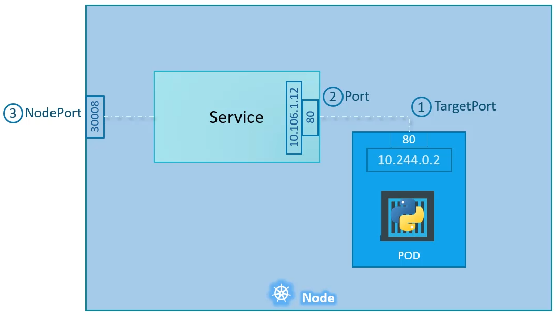
service.yml
apiVersion: v1
kind: Service
metadata:
name: myapp-service
spec:
type: NodePort
ports:
- port: 80
targetPort: 80
nodePort: 30008
selector:
app: myapp
type: front-end

Slide 22
service.yml
pod.yml
apiVersion: v1
kind: Service
metadata:
name: myapp-service
spec:
type: NodePort
ports:
- port: 80
targetPort: 80
nodePort: 30008
selector:
app: myapp
type: front-end
apiVersion: v1
kind: Pod
metadata:
name: myapp-pod
labels:
app: myapp
type: front-end
spec:
containers:
- name: nginx-container
image: nginx

Slide 23
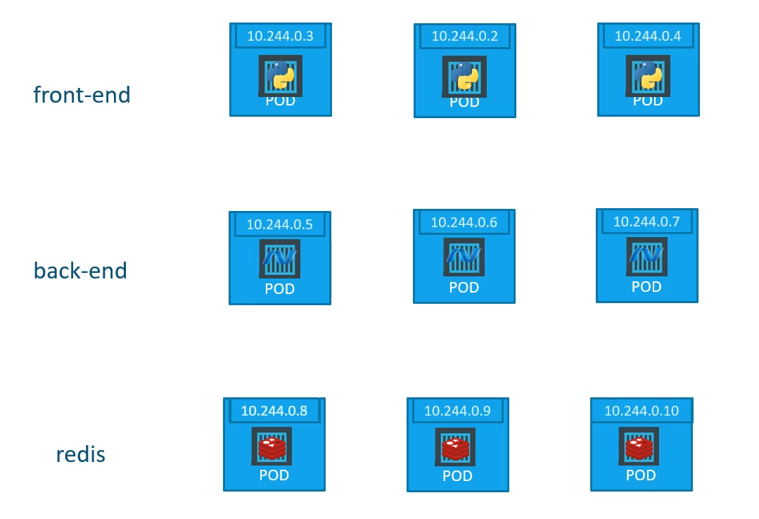

Slide 24
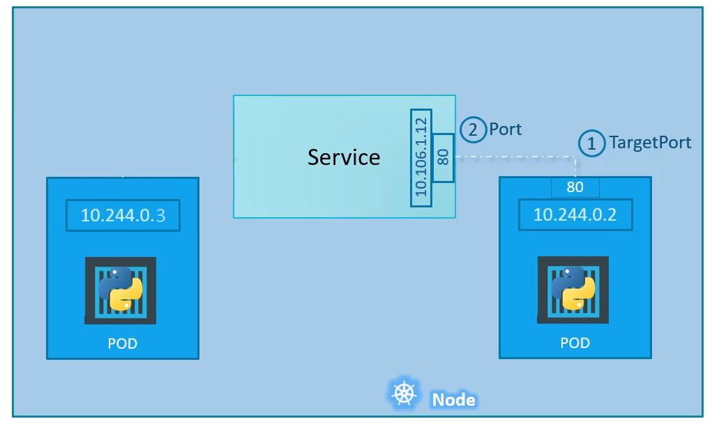
service.yml
apiVersion: v1
kind: Service
metadata:
name: back-end
spec:
type: ClusterIP
ports:
- port: 80
targetPort: 80
selector:
app: myapp
type: back-end

Slide 25
service.yml
pod.yml
apiVersion: v1
kind: Service
metadata:
name: back-end
spec:
type: ClusterIP
ports:
- port: 80
targetPort: 80
selector:
app: myapp
type: back-end
apiVersion: v1
kind: Pod
metadata:
name: myapp-back-end-pod
labels:
app: myapp
type: back-end
spec:
containers:
- name: nginx-container
image: nginx

Slide 26
Section 7

Slide 27
pod.yml
apiVersion: v1
kind: Pod
metadata:
name: ubuntu-sleeper-pod
spec:
containers:
- name: ubuntu-sleeper
image: ubuntu-sleeper
command: [sleep3.0]
args: ["15"]
s

Slide 28
pod.yml
apiVersion: v1
kind: Pod
metadata:
name: simple-webapp-color
spec:
containers:
- name: simple-webapp-color
image: simple-webapp-color
env:
- name: APP_COLOR
value: "blue"
- name: APP_PORT
value: "8080"
s

Slide 29
env:
- name: APP_COLOR
value: "blue"
s
env:
- name: APP_DB_USER
valueFrom:
configMapKeyRef:
env:
- name: APP_DB_USER
valueFrom:
secretKeyRef:

