Slide 1
TITLE of PROJECT
Team Name & Members
Report as of [date]

Slide 2
About Me/Us
Optional photos
Name(s)
Country
Job title(s) and workplaces(s)
Areas of focus/interest

Slide 3
Introduction/Background
Disease/ Health Issue Overview
[Name of disease/health Issue]
Facts about disease/health issue
Define and describe the current status of the health condition/ issue/ concern
Who is affected
How are their lives affected
Importance to Country
[Why the disease/health issue is important for your country to study]

Slide 4
Research Question
Describe the decision problem you are trying to solve in one sentence using the PICOT format
P (population) I (intervention) C (comparison) O (outcome) T (time)
To assess ______ to compare decreases in mortality rates
To compare ____ and assess cost effectiveness
A reduction/increase in _____ to compare economic/clinical outcomes

Slide 5
Strategy Options
Describe current standard of care/ status quo
Strategy 1
Strategy 2
How do the strategies differ?

Slide 6
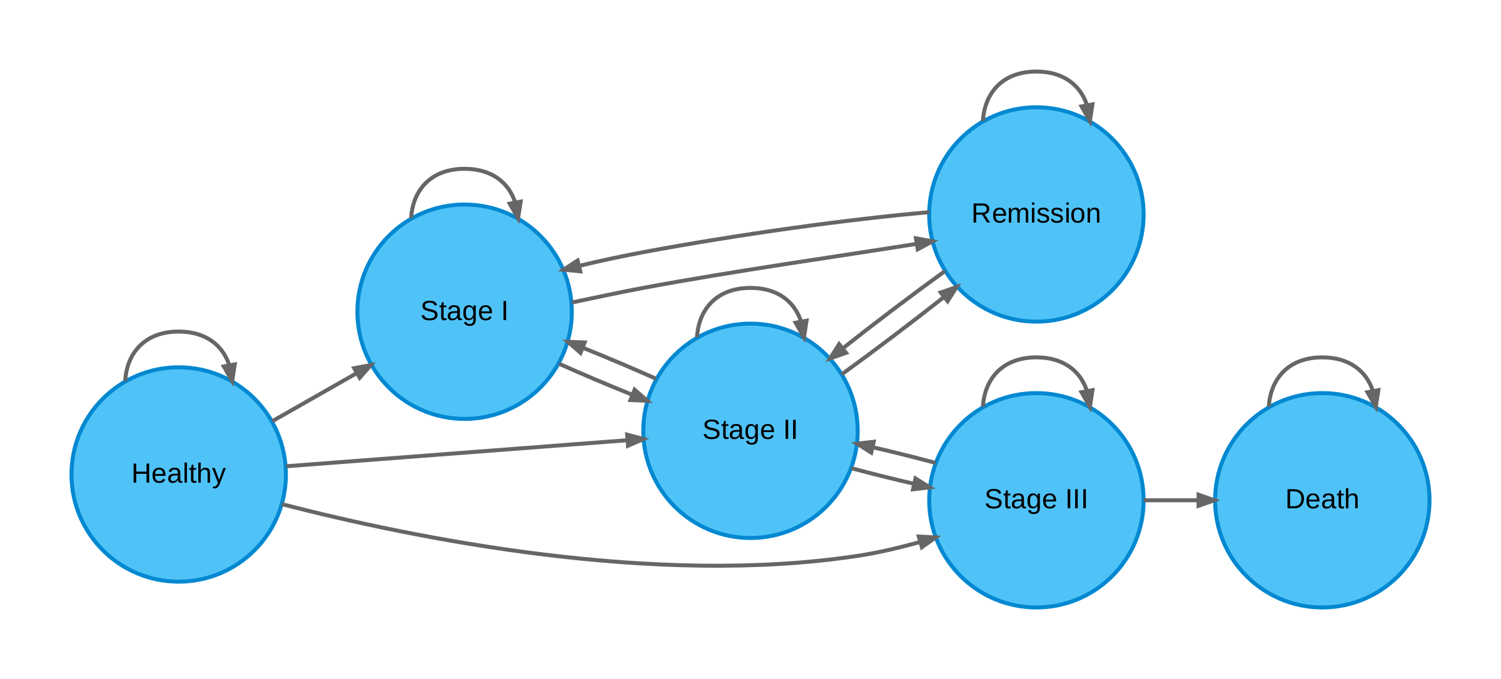
Markov Model Bubble Schematic (if Markov)
Examples:

Slide 7
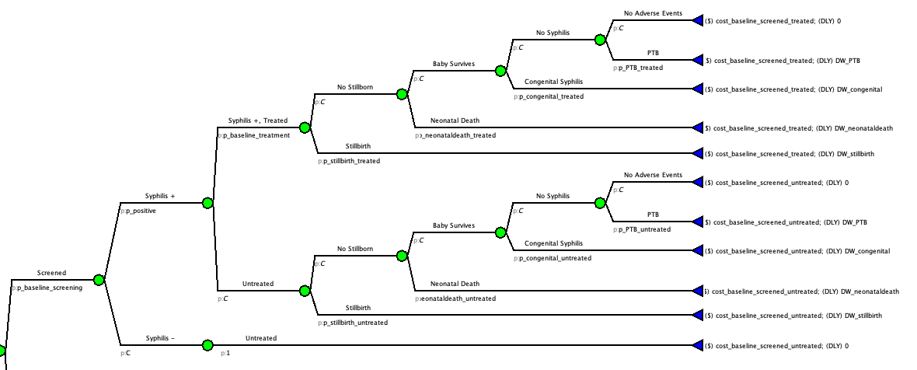
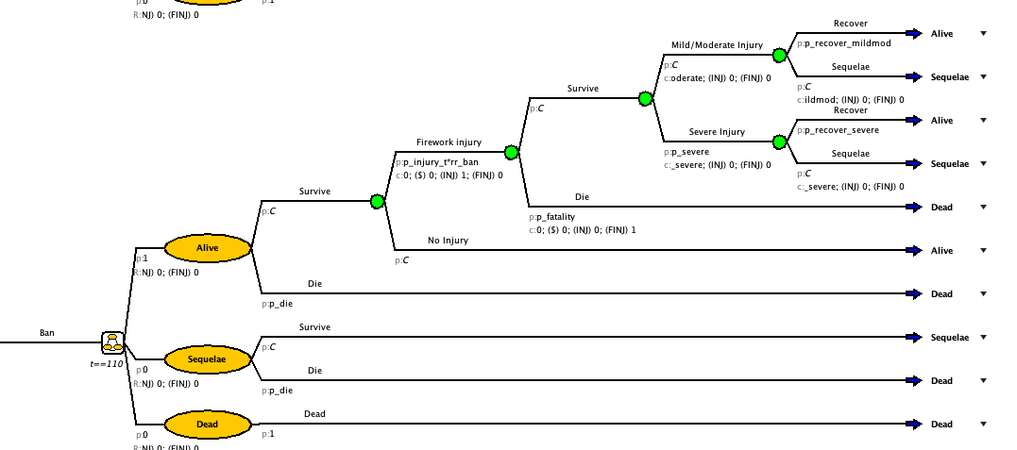
Model Graphic
Example:

Slide 8
Parameter Table & Transition Matrix Estimates
Examples
Parameter Table
param | Base_case | description | notes | distribution | source
n_age_init | 25.00 | Age at baseline |  |  | Modeling parameter
n_age_max | 100.00 | Maximum age of followup |  |  | Modeling parameter
c_S | 1000.00 | Annual cost of sick(S) |  | gamma (shape=44.4, scale=22.5) | Graves et al. (2022)
r_mortality | 0.15 | Rate of mortality |  |  | Assumption
Transition Matrix
 | Healthy | Sick | Dead
Healthy | 0.856 | 0.138 | 0.007
Sick | 0 | 0.982 | 0.018
Dead | 0 | 0 | 1

Slide 9
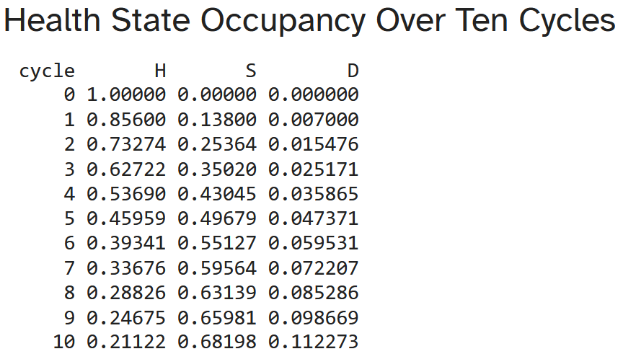
Run Results
Examples
Outcome
Name of outcome
How you defined this outcome
Why is this outcome important to your research question
Strategy | Cost | DALY | ICER | Notes
------------ | ------ | ------ | -------- | --------
Baseline | 0.8701 | 0.2022 | --- | Baseline
Intervention | 9.3686 | 0.1267 | 112.5506

