Slide 1

The Cost-Effectiveness of Social and Behavior Change Campaign (SBCC) and Cessation Services in Reducing Alcohol-Related Harms in the Philippines
ANDREA MARGRETH S. ORA-CORACHEA, MDE, MPH, RN
Health Promotion Bureau
Department of Health - Philippines
Notes:
Alcohol-related harm continues to strain our health systems.
This study assesses whether investing in social and behavior change interventions—and cessation services—is cost-effective.
Good morning! I am Andrea Corachea from the Philippine Department of Health.

Slide 2

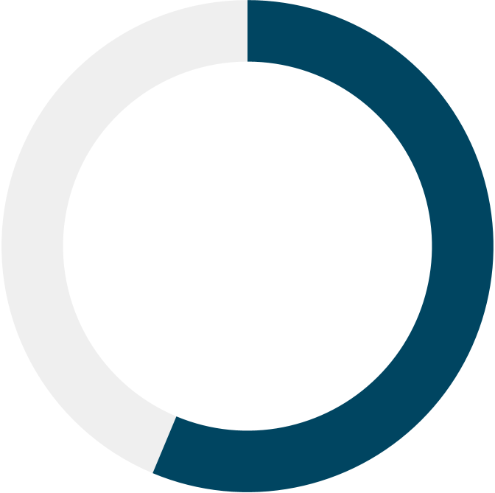
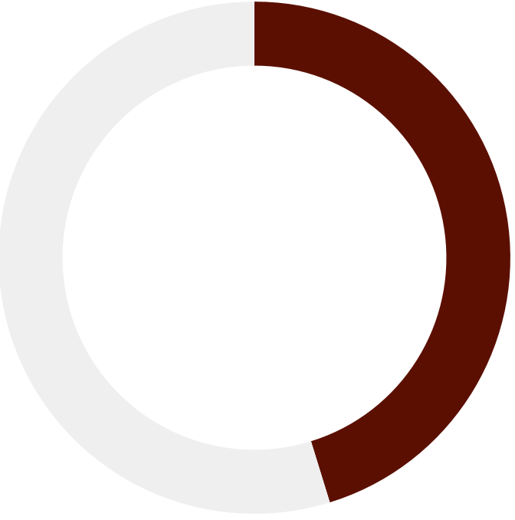
Every 20 MINUTES,
a Filipino dies from alcohol-attributable causes, including cancers, liver diseases, and cardiovascular diseases.
56.3%
36.1%
Filipino adults consume alcohol
Filipino adults unaware of the health harms of alcohol consumption
Notes:
Every 20 minutes, a Filipino dies from alcohol-related causes including cancers, liver, and cardiovascular diseases.
Half of Filipino adults drink, and one in three are unaware of the health risks, highlighting gaps in prevention.

Slide 3
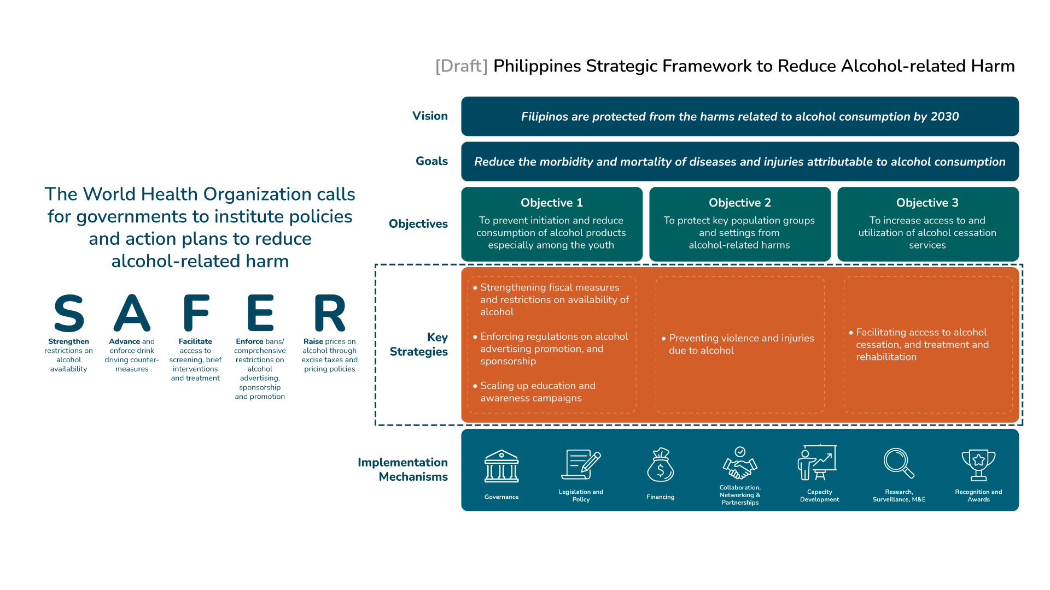
Scaling up education and awareness campaigns
Facilitating access to alcohol cessation, and treatment and rehabilitation
Notes:
The WHO recommends that governments adopt policies to reduce alcohol-related harm.
In response, the Philippine DOH is developing national guidelines to implement cost-effective best buys—highlighting SBCC and cessation services.

Slide 4




Research Question:
Is it cost-effective to implement social and behavior change campaigns (SBCC) and alcohol cessation services to avert alcohol-related harm?
Department of Health Perspective
Lifetime Analytic Horizon
Filipino 20y.o. and above
3.66%
discount rate
Data Sources:
• GBD, Country Surveys (Prevalence of Alcohol Consumption, Health Literacy Survey), Discount Rate and WTP threshold from Philippines-HTA Unit, Administrative Data on the Cost of Implementing the Interventions, Literature on the Effectiveness of SBC and Cessation Services
Notes:
This study asks: From the DOH perspective, over a lifetime horizon, and using a 3.66% discount rate, is it cost-effective to invest in SBCC and cessation services to avert alcohol-related harm among Filipino adults?

Slide 5



Policy Options
Policy Option 1 (Baseline): Ad hoc education campaign as part of major celebrations/holidays
Policy Option 2
Policy Option 3
Policy Option 4
Social and Behavior Change Communication (Above-the line and Below-the-line)
Alcohol Cessation Program
(delivered through key settings: communities, schools, workplaces)
Combination of
Policy Options 2&3
(SBCC +
Alcohol Cessation Program)
Notes:
We assessed four policy options: status quo is adhoc education campaigns on alcohol harms, usually during public celebrations; Option 2 is SBCC; Option 3 is cessation services; and Option 4 combines Options 2 and 3

Slide 6
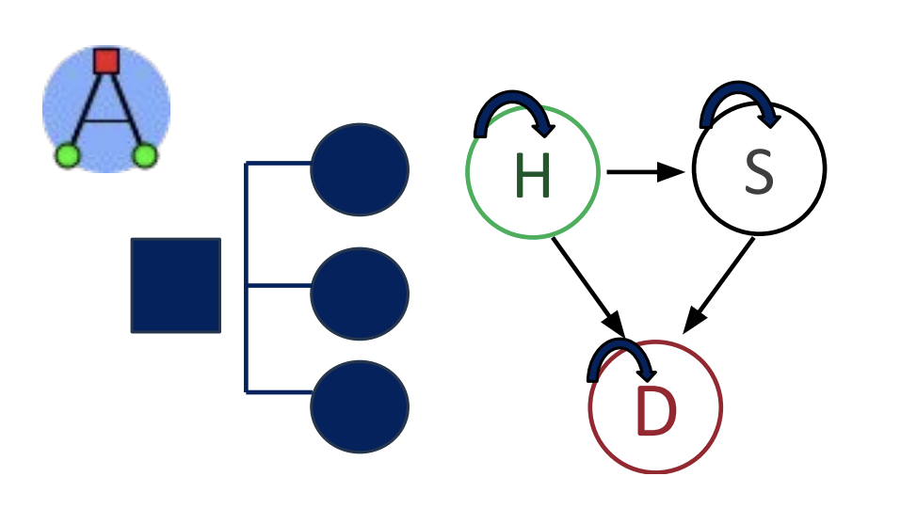
Methodology
?
Public Health Impact
?
Operational Feasibility
?
Political Feasibility
Decision Tree + Markov Model
using the AMUA software
?
Budget Impact
Policy Analysis
(CDC’s Policy Analytical Framework)
Cost-Effectiveness Analysis
(USD/DALY averted)
Notes:
We used a mixed-method approach. Policy analysis looked at public health impact, feasibility, and budget implications, while cost-effectiveness was assessed using a decision tree and Markov model, measured in US dollars per DALY averted

Slide 7
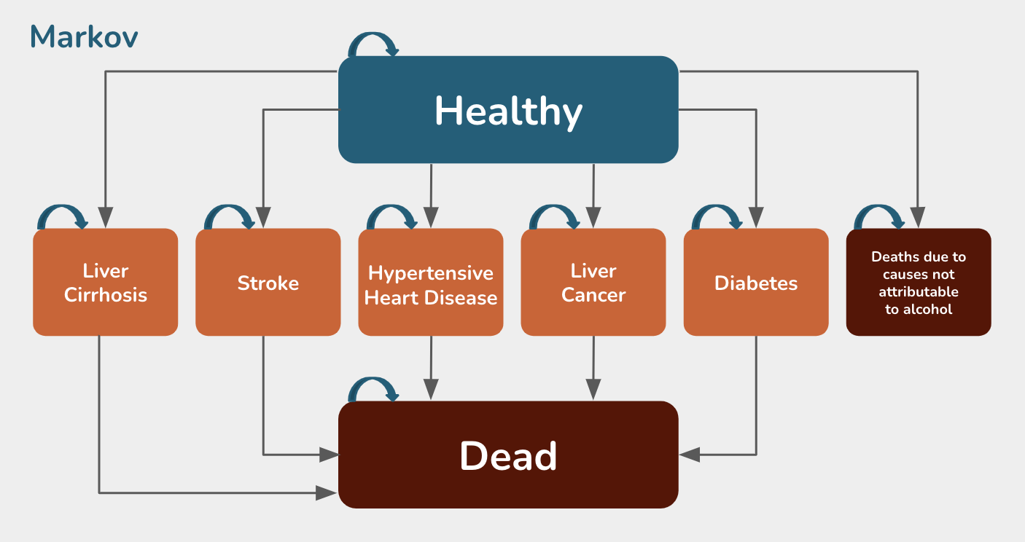
Cost-Effectiveness Analysis: Model Structure
Analytical Horizon: Lifetime Cycle: 1 year
Discounting rate: 3.66% (based on Philippine HTA guide)
Markov
Drink
M
Healthy
Status quo
Not Drink
M
Liver Cirrhosis
Stroke
Hypertensive Heart Disease
Liver Cancer
Diabetes
Deaths due to causes not attributable to alcohol
Drink
M
SBCC
Filipinos aged 20 years and older
Not Drink
M
Dead
Drink
M
Cessation
Main Assumptions:
Alcohol users will only suffer from one disease in their lifetime
The risk of transitioning to alcohol-attributable diseases remain constant over time
Transitioning from Healthy to Sick, and Sick to Death states are irreversible
Not Drink
M
SBCC + Cessation
Drink
M
Not Drink
M
* Model only included the top five alcohol-attributable deaths
Notes:
The economic model combines decision tree—capturing intervention effects on alcohol consumption—
with Markov model simulating transitions between Healthy, Sick, and Dead states.
This study includes the top five alcohol-attributable NCDs.

Slide 8




Policy Analysis
Strategy |  | Public Health Impact | Operational Feasibility | Political Feasibility | Budget Impact*
 | Policy Option 1 Educational campaign as part of major celebration | Low | High | High | Low (no significant resource requirement)
 | Policy Option 2 Social and Behavior Change Campaign (SBCC) | High | High | High | Medium ($2.57M annual implementation cost)
 | Policy Option 3 Alcohol Cessation Program | High | High | High | Medium ($25.14M annual implementation cost)**
 | Policy Option 4 Combination of SBCC and Cessation Program | High | High | High | Medium ($18.88M annual implementation cost)**
*Budget impact assessment considered whether implementation costs could be covered by existing program funds or required additional funding ** Cost requirement includes fixed cost for program implementation and variable cost for individual counselling (different between drinkers and non-drinkers)
Notes:
Compared to the status quo, policy analysis shows that SBCC, cessation services, and their combination yield greater public health impact—with significant resource requirement estimated to be within the government’s funding capacity.

Slide 9
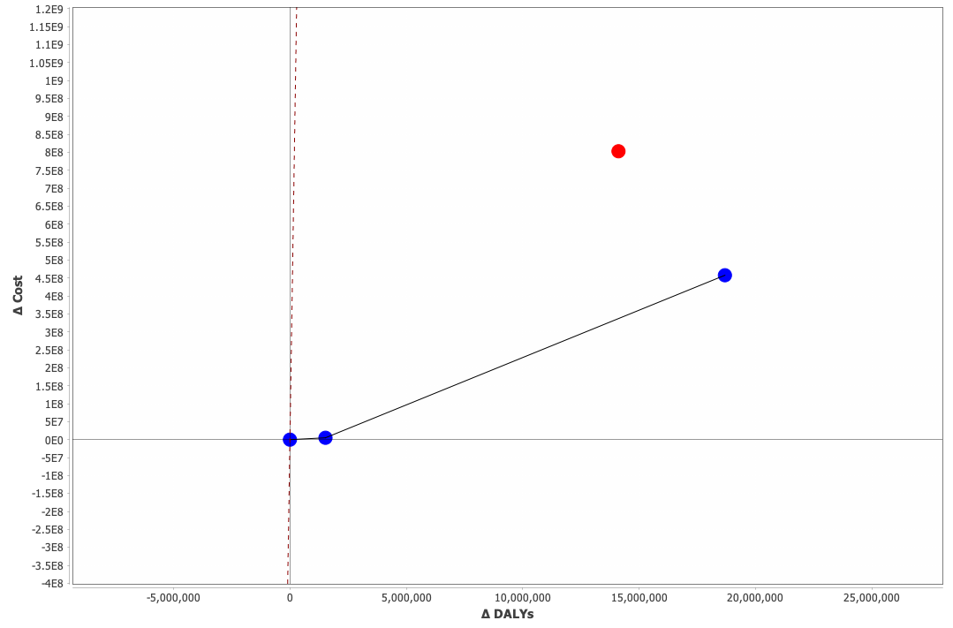
Policy Option 4, which combines SBCC and cessation services,
Resulted in the highest ICER that is within the Willingness-to-Pay threshold*
Policy Option | ICER (WTP: USD 4, 183.52)*
1 | -
2 | USD 3.37 / DALY averted
4 | USD 26.38 / DALY averted
3 | Strongly dominated
Policy Option 3:
Alcohol cessation program
Policy Option 4:
SBCC and cessation program
Policy Option 1:
Baseline scenario
Policy Option 2:
SBCC
*Willingness-to-Pay threshold: USD 4,183.52 derived from the Philippine HTA methods guide of using 1x GDP/capita per DALY averted
Notes:
Of the four strategies, policy option 4 - the combination of SBCC and alcohol cessation services—yield the highest ICER at 26.38 US dollar per DALY averted that is within the willingness-to-pay threshold.

Slide 10
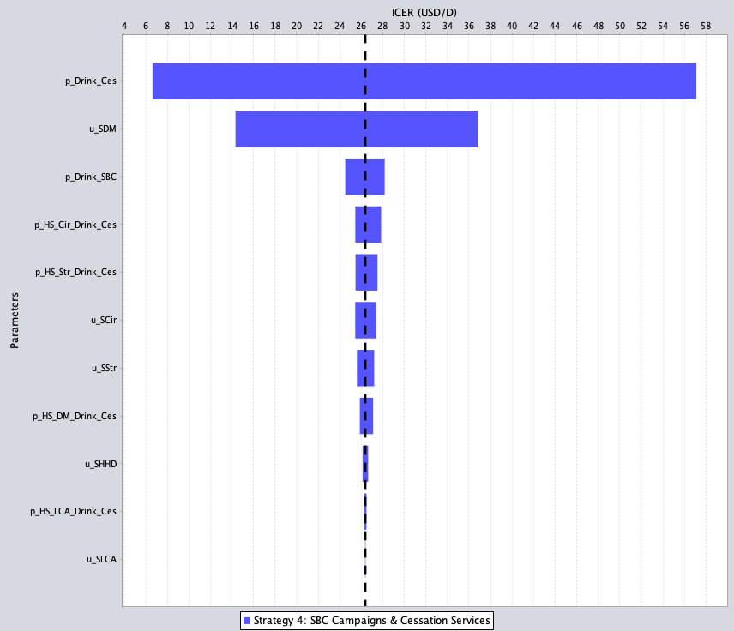
Sensitivity Analysis
Drinking among individuals in cessation program
Findings remained robust across a range of sensitivity scenarios
Severity of diabetes mellitus (disability weight)
Drinking among individuals reached by the SBCC
Most sensitive parameters:
Probability of consuming alcohol among individuals who availed of the cessation service
Severity of disease (disability weight for diabetes mellitus)
Probability of consuming alcohol among individuals reached by the SBCC
Prob. of cirrhosis among drinkers who availed of cessation service
Prob. of stroke among drinkers who availed of cessation service
Severity of liver cirrhosis (disability weight)
Severity of stroke
(disability weight)
Prob. of DM among drinkers who availed of cessation service
Severity of hypertensive heart disease (disability weight)
Notes:
Sensitivity analysis showed that the findings remained robust across a range of scenarios.
It identified parameters influencing results—highlighting the need to monitor and ensure that messages and services effectively reach the target population.

Slide 11

Implementing social behavior change communication alongside cessation services is a cost-effective
strategy for reducing alcohol-related harms.

Slide 12
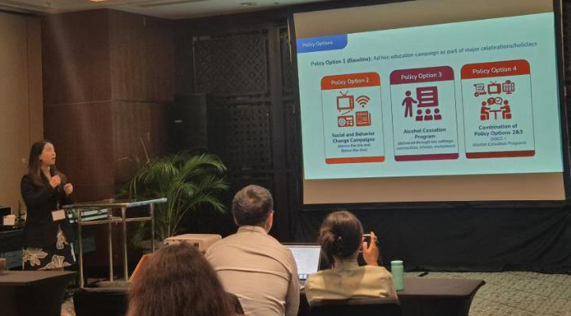
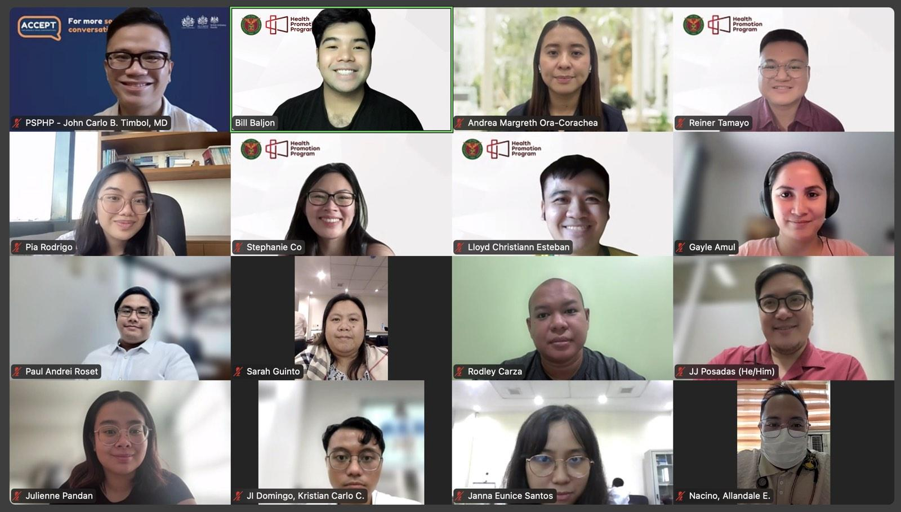
Presentation of the Capstone Project at the 2025 International Health Economics Congress (July 2025)
Presentation of Findings to the Alcohol, Substance Use, and Addictive Behaviors Community of Practice (August 2025)
Presentation of findings to DOH Assistant Secretary Domingo (*clearance to proceed with revision of previous version of alcohol policy)
(October 2025)

Slide 13
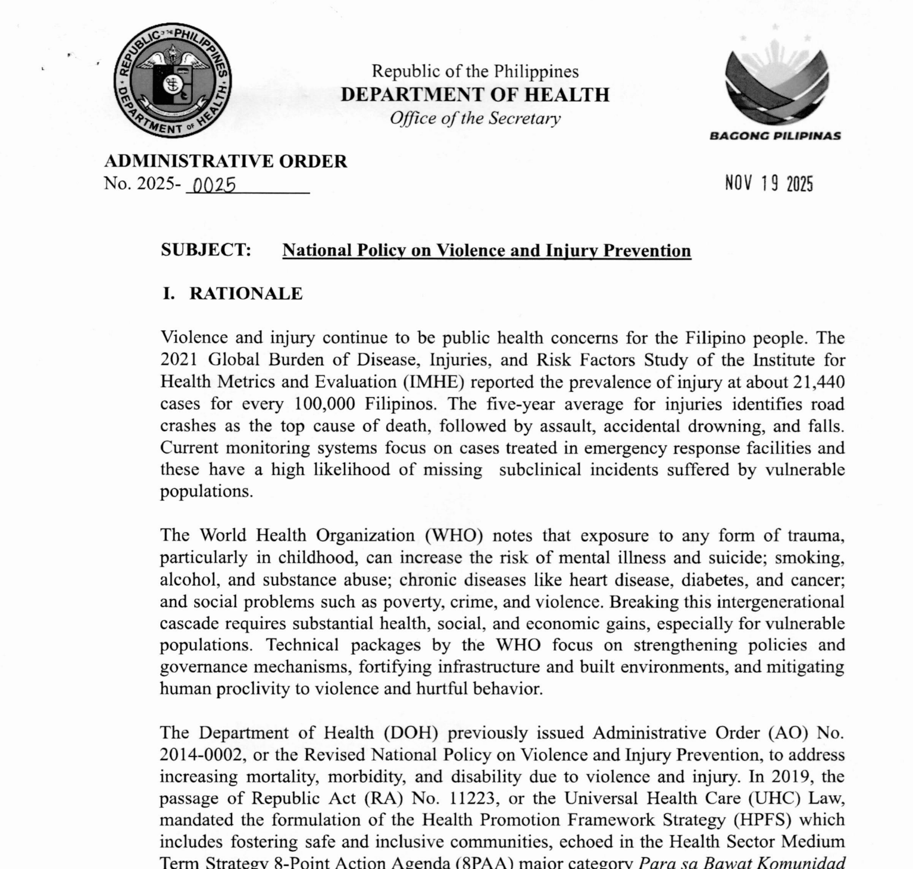
Policy Advancement
National Policy on
Violence and Injury Prevention
(Administrative Order 2025–0025)
Shift the norm from drunk-driving to drink-driving
Implementation of Social and behavior change communication
Development of benefit package on cessation services

Slide 14
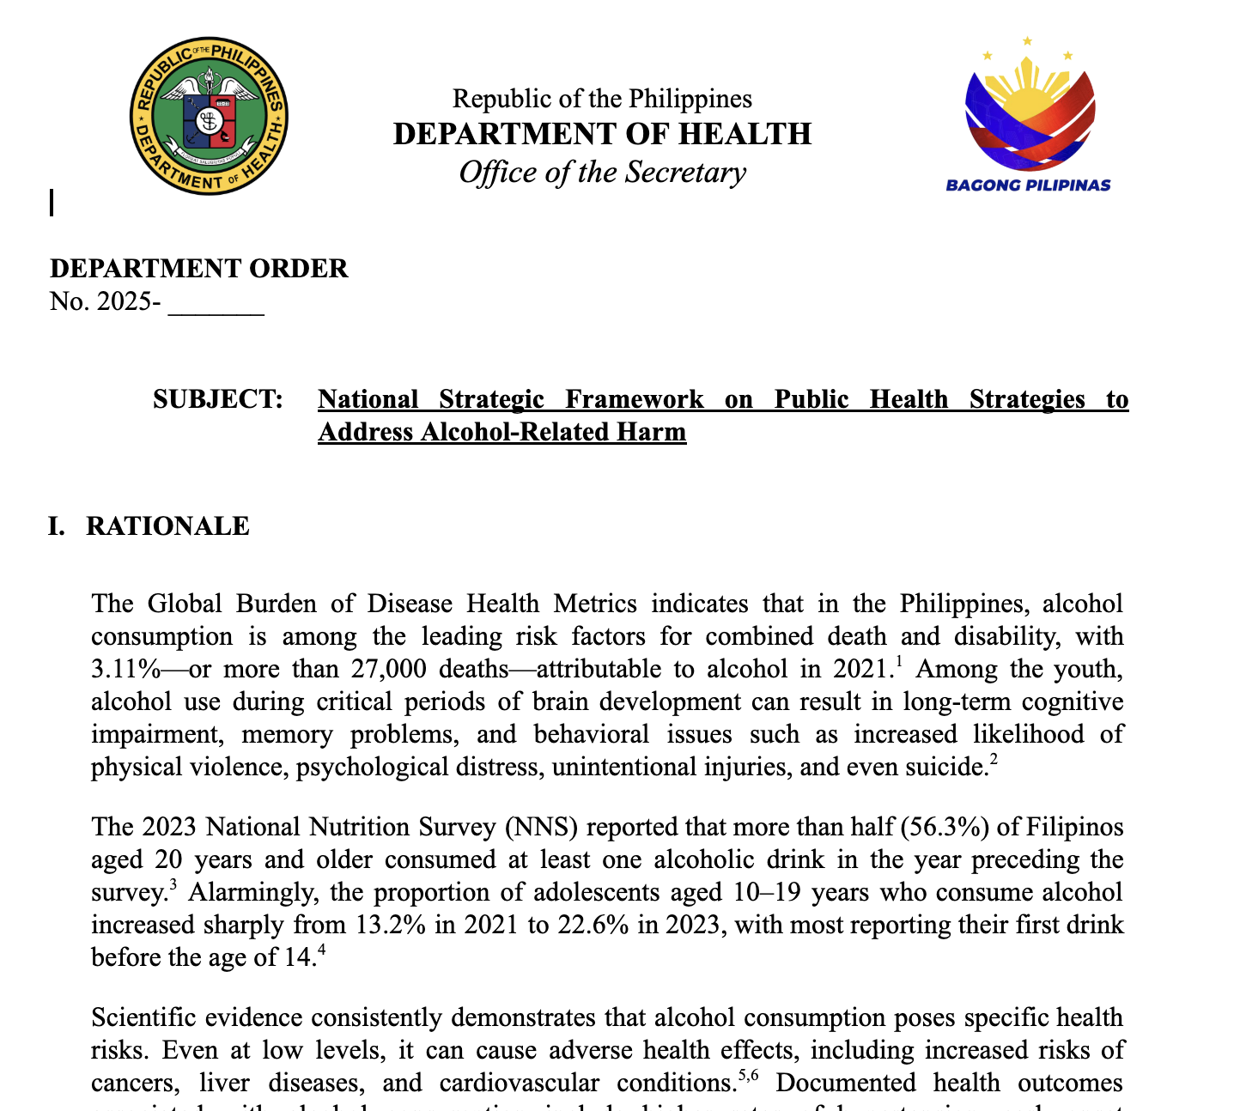
Policy Advancement
National Strategic Framework
to Address Alcohol-Related Harm
(Draft under final review of the
Office of the Health Secretary)
Emphasize on SBCC and Cessation Service
Cessation services integrated into existing and future service protocols of related health programs, including but not limited to prenatal and post-natal care, adolescent health, oral health, mental health, and non-communicable diseases, among others
Plan for SBCC includes issuance of a Presidential Proclamation Declaring the Month of September of Every Year as “Alcohol Harms Awareness Month”

Slide 15
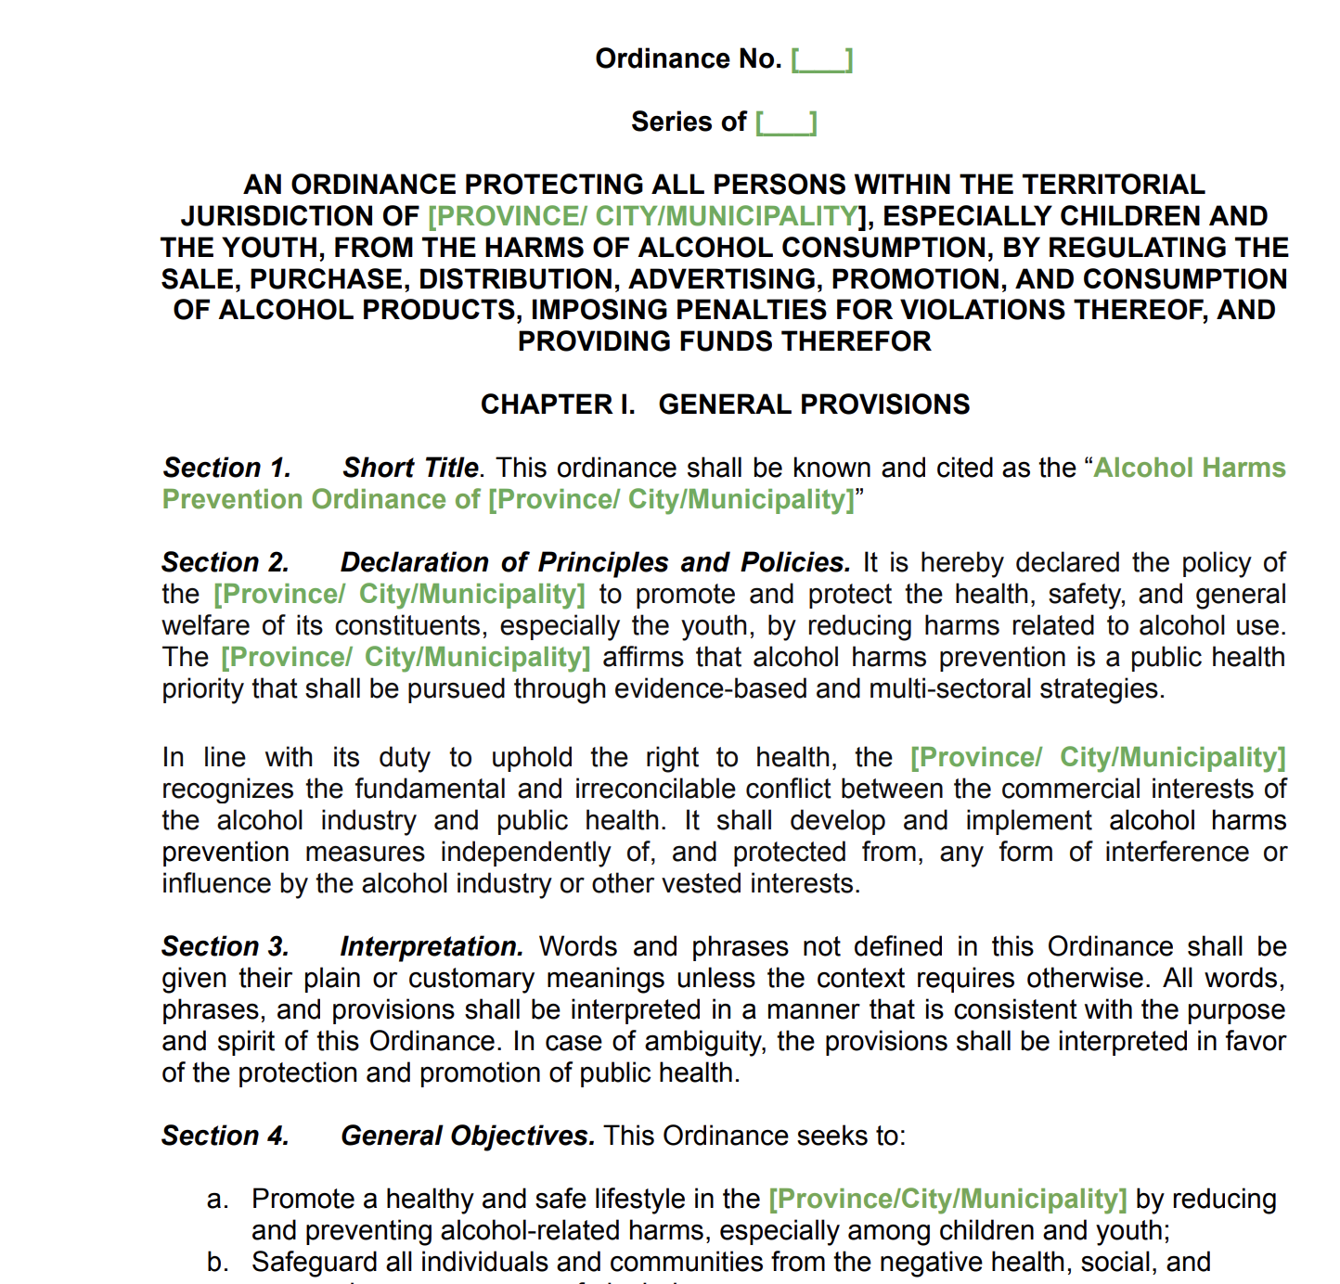
Policy Advancement
Template Local Ordinance
on Alcohol Harms Prevention
Calls local governments to develop and implement a localized social and behavioral change campaign to raise awareness on the harms of alcohol consumption
Promotes the implementation of an Alcohol Use Screening, Brief Intervention, Referral to Treatment, and Cessation Program

Slide 16






Thank you!
ANDREA MARGRETH S. ORA-CORACHEA, MDE, MPH, RN
Chief, Policy, Planning, Standard and Research
Health Promotion Bureau
Department of Health - Philippines
For questions or clarifications:
Special thanks to:
acorachea@doh.gov.ph
corachea.andrea@gmail.com
+63 977 853 9871
www.doh.gov.ph
Notes:
Thank you for your attention. This study, shaped with the support of Bloomberg Philanthropies, Vital Strategies, and Vanderbilt University, provides critical evidence to advance policy and guide strategic investments in reducing alcohol-related harm in the Philippines.
This research and conference presentation were supported by Vital Strategies and the CDC Foundation, partners in the Bloomberg Philanthropies Data for Health, and Vanderbilt University Medical Center Thank you for your attention.Terima kasih

