Slide 1
TITLE
Team Name & Members

Slide 2
Background
Define and describe the current status of the health condition/ issue/ concern
Who is affected
How are their lives affected
Why is this problem a good candidate for decision analysis

Slide 3
Objective & Outcomes
Describe the decision problem are you trying to solve
To assess ______ to compare decreases in mortality rates
To compare ____ and assess cost effectiveness
A reduction/increase in _____ to compare economic/clinical outcomes

Slide 4
Strategy Options
Describe current standard of care/ status quo
Strategy 1
Strategy 2

Slide 5
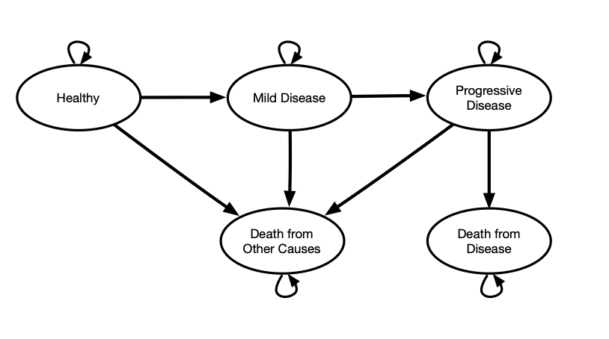
Markov Model
Example:
A good resource to draw these images is http://draw.io

Slide 6
Key Parameters
Examples
Parameter Table
param | Base_case | description | notes | distribution | source
n_age_init | 25.00 | Age at baseline |  |  | Modeling parameter
n_age_max | 100.00 | Maximum age of followup |  |  | Modeling parameter
c_S | 1000.00 | Annual cost of sick(S) |  | gamma (shape=44.4, scale=22.5) | Graves et al. (2022)
r_mortality | 0.15 | Rate of mortality |  |  | Assumption

