Slide 1
Datasets overview
Study | Subjects | Type | Classification task
Bokulich 2016 | Gut microbiomes of infants sampled over the first two years of life | 16S | Diet (breast fed vs formula) Mode of birth (vaginal or c-section)
Brooks 2017 | Gut microbiomes of 30 infants sampled over 75 days |  | Mode of birth (vaginal versus C-section)
David 2014 | Microbiomes of 20 healthy adults receiving dietary interventions | 16S | Diet (plant based vs animal)
DiGiulio 2015 | Vaginal microbiomes of 37 pregnant women | 16S | Delivery time (at term vs pre-term)
Kostic 2015 | Gut microbiomes of 17 infants sampled over the first 3 years of life | MAG | Normal vs development of type 1 diabetes
Shao 2019 | Gut microbiomes of 282 infants (after filtering for subjects with fewer than three timepoints) sampled over 424 days |  | Mode of birth (vaginal versus C-section)
Vatanen 2016 | Gut microbiomes of 117 children sampled over the first three years of life |  | Nationality (Russian versus Estonian/Finnish)

Slide 2
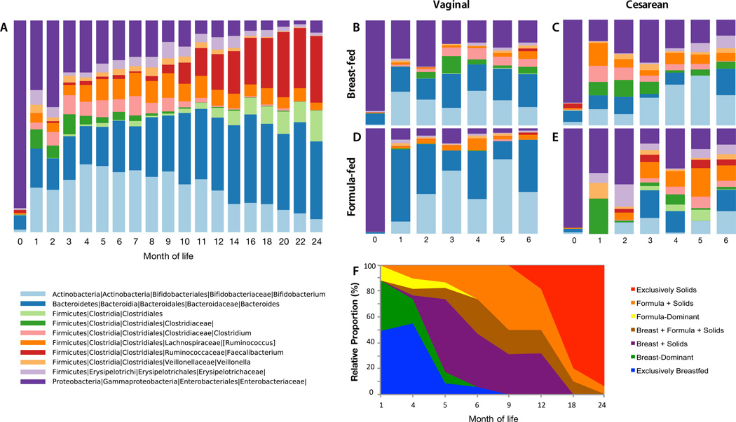
Bokulich 2016
Lower Bacteroidetes population may predict Cesarean section mode of birth
Both MITRE and MDITRE models predicted higher abundance of groups of Firmicutes leading to higher probability of being formula fed; these species more representative of mature adult microbiomes
Notes:
Studied effects of mode of birth, antibiotic exposure, and diet on early life microbiome development

Slide 3
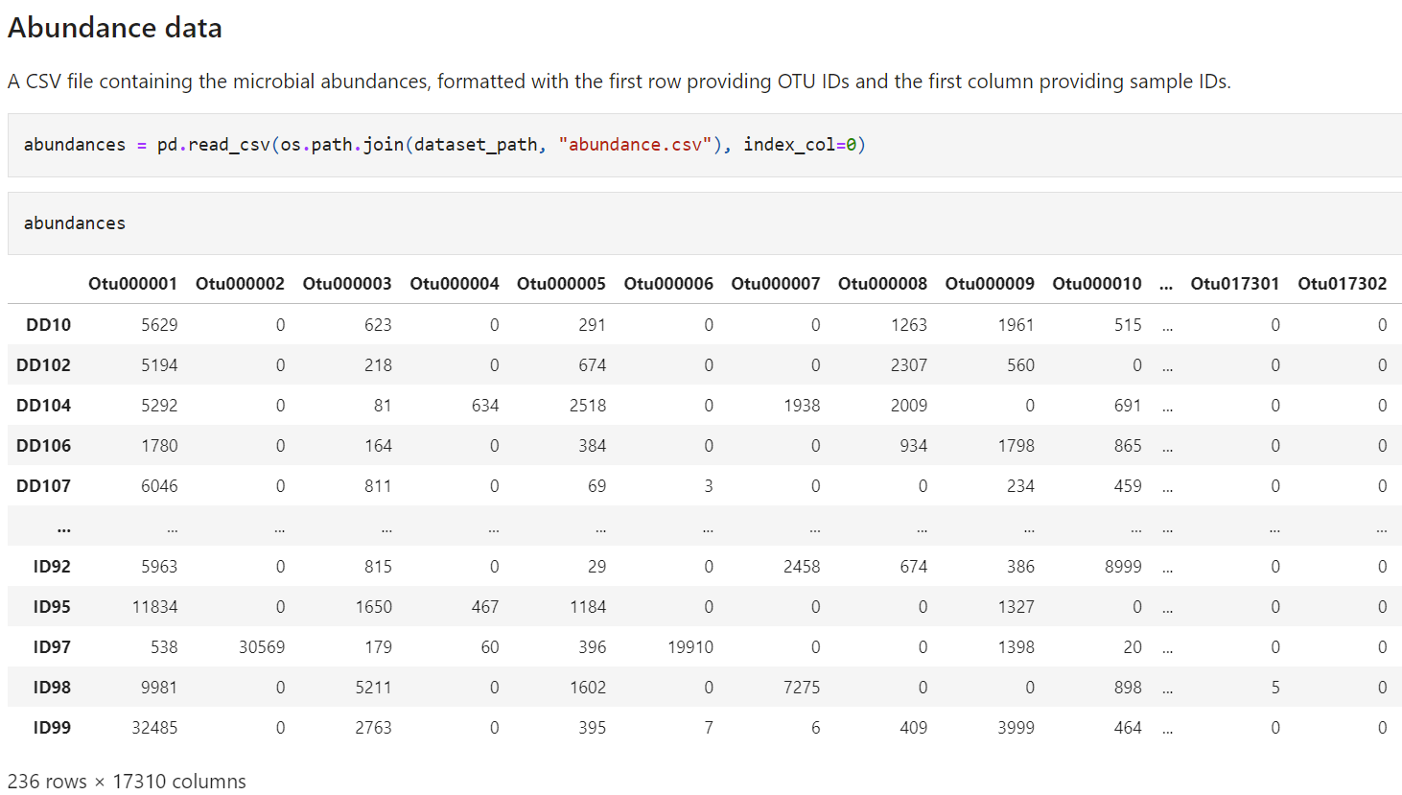
Abundance data (16S amplicon)

Slide 4
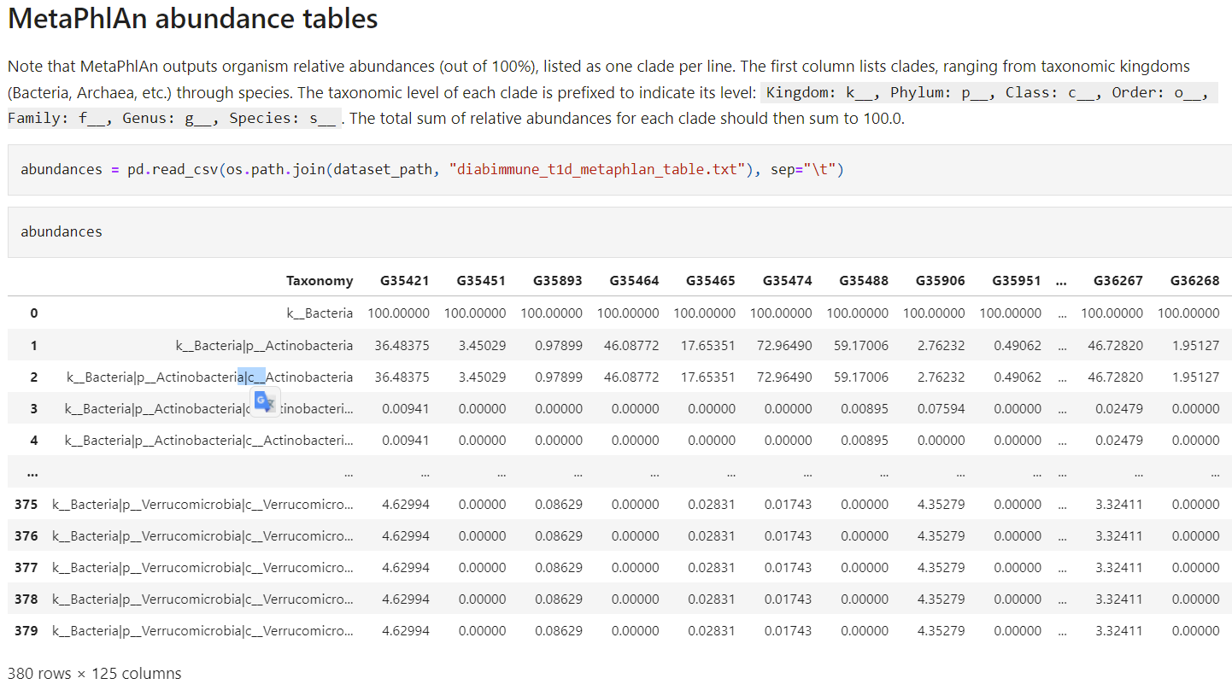
Abundance (shotgun metagenomics)

Slide 5
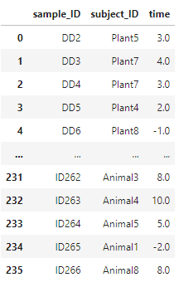
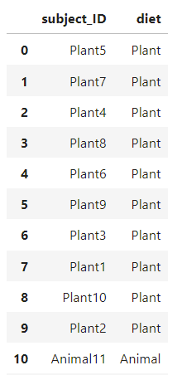
Metadata
Sample metadata
Subject metadata
A CSV file that specifies an associated subject ID and timepoint for each sample ID.
A CSV file that gives information about each subject, (including the value of whatever variable will be used as the host outcome for prediction (e.g., Plant-diet or Animal-diet in the David et al).

