Slide 1
Outline
Interpretable machine learning
Overview of the Bokulich 2016 study
Selecting interpretable features
MDITRE model as an example
Example MDITRE results for Bokulich 2016 study
General overview of the datasets and what the data looks like

Slide 2
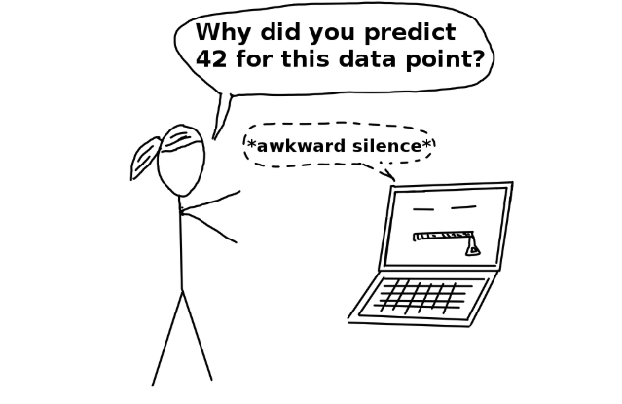
Interpretability
Notion of interpretability difficult to define in general and is domain specific
Non-mathematical definitions:
“Interpretability is the degree to which a human can understand the cause of a decision” (Miller 2017)
“Interpretability is the degree to which a human can consistently predict the model’s result” (Kim et al 2016)
https://christophm.github.io/interpretable-ml-book/terminology.html
Miller, Tim. “Explanation in artificial intelligence: Insights from the social sciences.” arXiv (2017)
Kim, Been, Rajiv Khanna, and Oluwasanmi O. Koyejo. “Examples are not enough, learn to criticize! Criticism for interpretability.” Advances in Neural Information Processing Systems (2016)

Slide 3
Importance of interpretability
Why not just trust the model predictions?
Ok for low stakes situations (e.g. recommending a movie to watch)
Model trust and safety: can better trust the model if we understand why a decision was made
Interpretability makes it possible to extract knowledge from the learned model
For many microbiome applications, the critical tasks are discovering relationships between the microbiome and the host or finding clinically useful biomarkers
Want to know why a prediction was made more so than just what the prediction is
Want to validate predictions, need to be able to generate specific testable hypotheses and clinical tests
Favor specificity over sensitivity
Ok taking a hit on predictability; want to pick out few interactions we can understand clearly

Slide 4
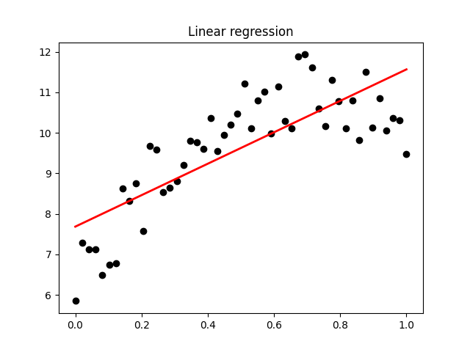
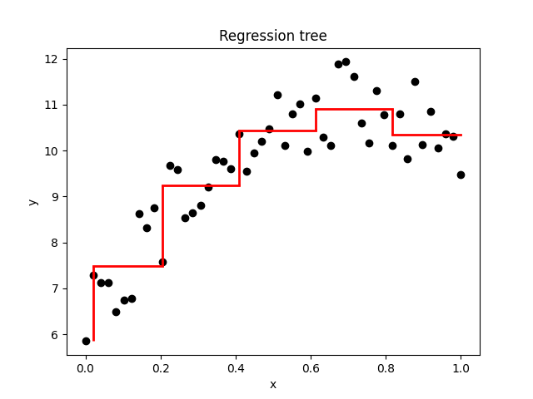

Intrinsically interpretable models
Regression models:
Linear
Can interpret learned weights
Generalized Linear Models
E.g. logistic regression
Generalized Additive Models
Interpret from plots
Decision trees
Capture feature interactions, nonlinearities
Regression or classification
Rule lists/sets
IF-THEN statements
Features combined with AND’s
can be as expressive as decision trees, while being more compact

Slide 5
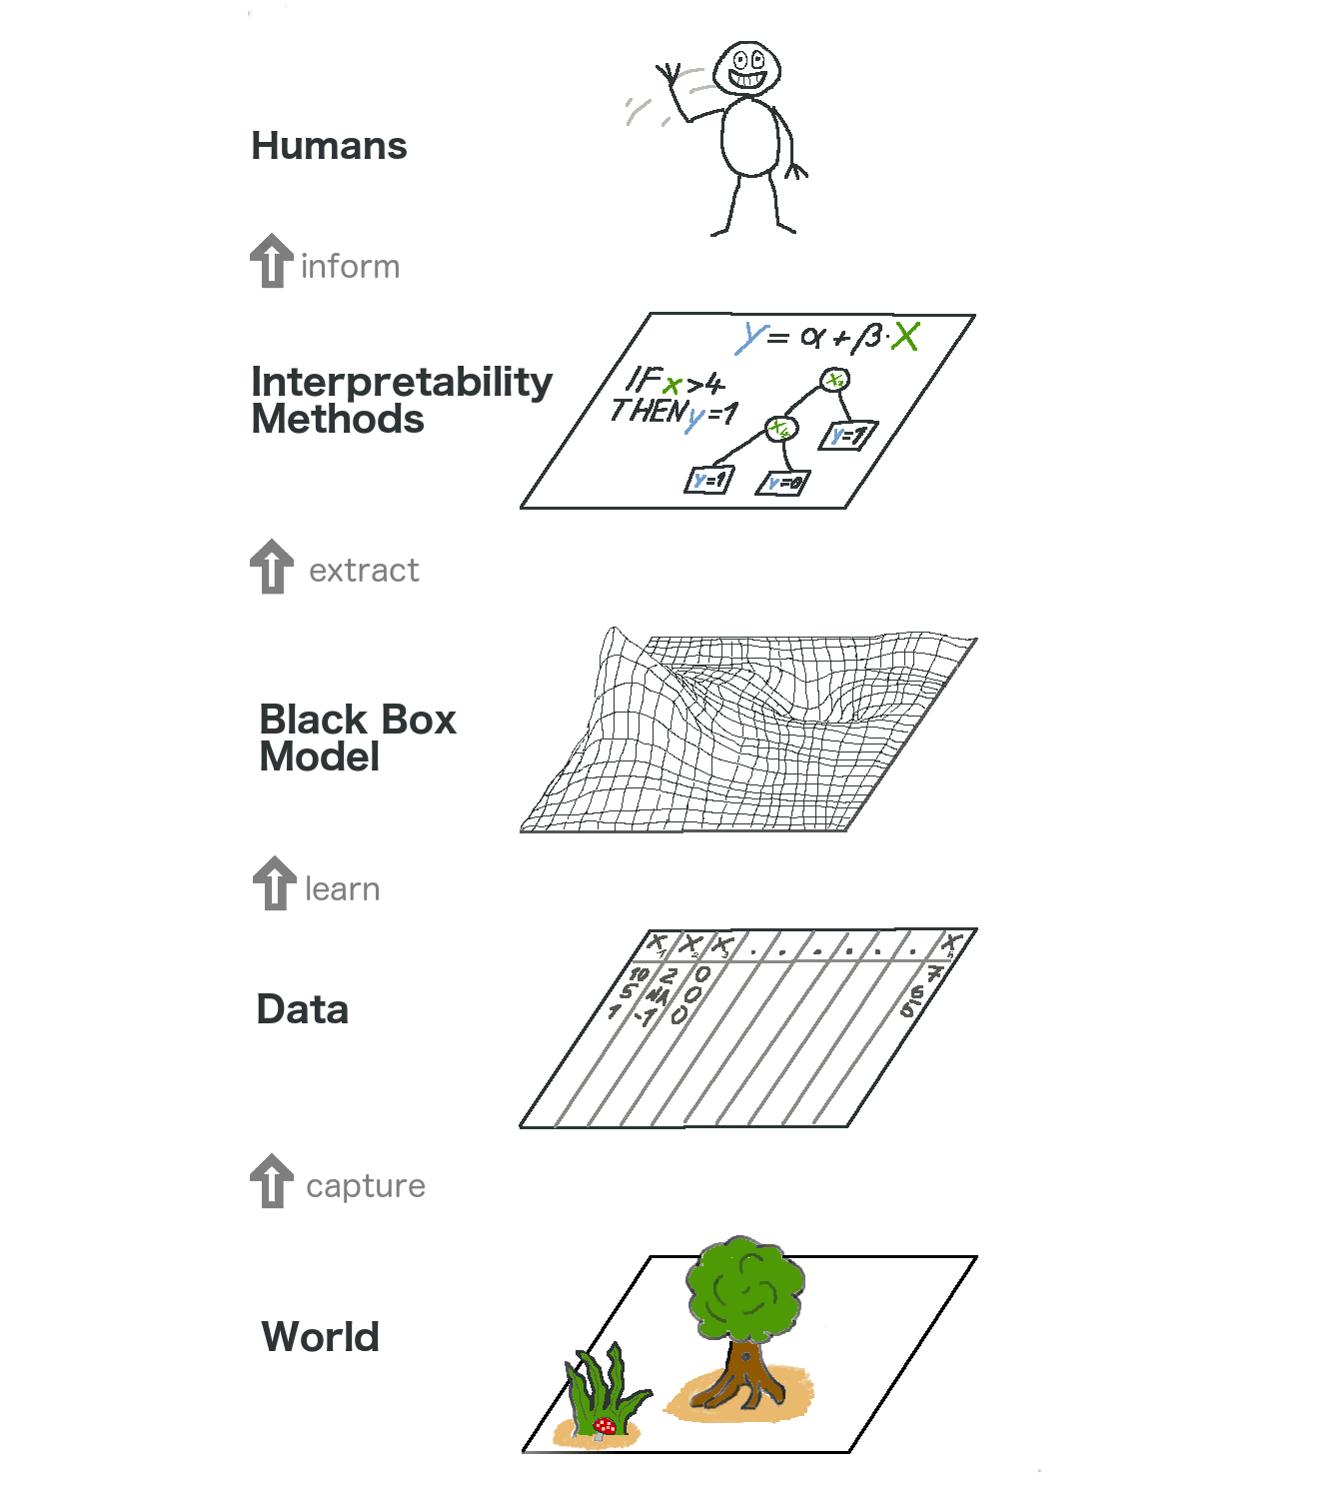
Post-hoc interpretation
Model agnostic
Can work with any black box model
Usually work by analyzing feature input and output pairs
Cannot have access to model internals such as weights or structural information
Global methods explain the entire model behavior
Partial dependence plot (PDP)
Permutation feature importance
Global surrogate models
Local methods seek to explain individual predictions
Local surrogate models (LIME)
Individual conditional expectation (ICE)
Shapely values
https://christophm.github.io/interpretable-ml-book/terminology.html

Slide 6
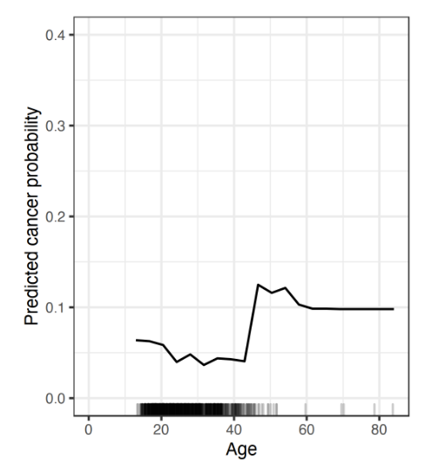
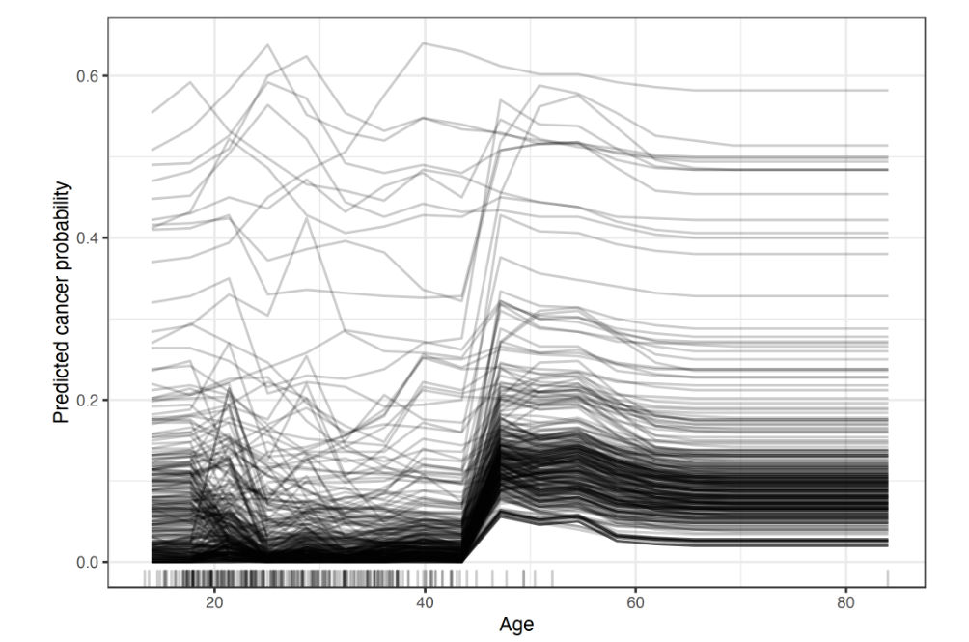
Global vs local methods
Partial dependence plots (PDP)
Individual conditional expectation (ICE)
GLOBAL: PDP shows the marginal effect one or two features have on the predicted outcome of a machine learning model
LOCAL: ICE plots display one line per instance, showing how each instance’s prediction changes when a feature changes

Slide 7
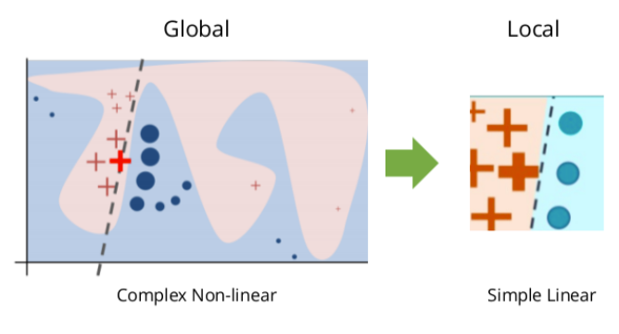
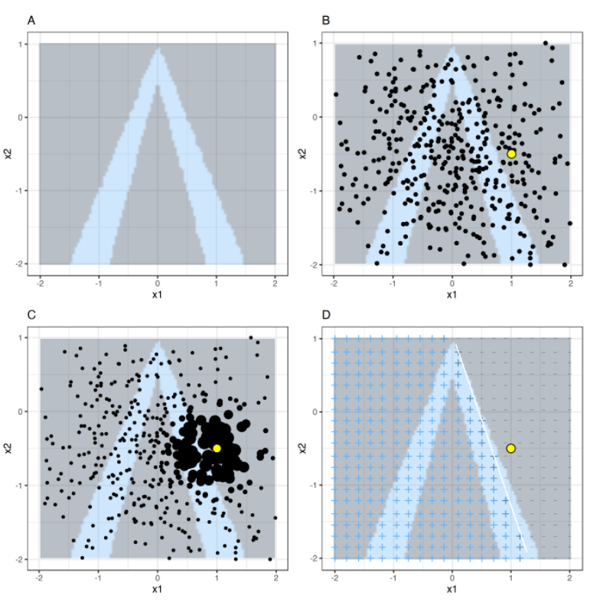
Local surrogate models (LIME)
LIME generates a new dataset consisting of perturbed samples around an instance of interest and the corresponding predictions of the black box model
Train a weighted, interpretable model on the generated dataset
Can then explain the prediction by interpreting the local model
https://christophm.github.io/interpretable-ml-book/lime.html

Slide 8
LIME advantages and disadvantages
Advantages:
Black box models might perform better for prediction; can maybe pick out weaker signals
Model agnostic, can be applied to any model in general, even on already interpretable models
Explanations created with local surrogate models can use other (interpretable) features than the original model was trained on
E.g. regression model could be trained on components of a principal component analysis (PCA) of answers to a survey, but LIME might be trained on the original survey questions
Disadvantages:
Might pick out more false positives, may not be as sparse
For LIME, complexity of the explanation model has to be defined in advance
Explanations can be unstable, explanations of close points can potentially vary greatly

Slide 9

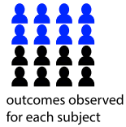
Bokulich 2016 study
Infant fecal samples during first two years
Year 0
Year 2
Total of 43 infants were enrolled for follow-up for up to the age of 2 years
Stool samples collected and sequenced; 151-bp paired end sequencing on the Illumina MiSeq platform
Original study operational taxonomic units (OTUs) were assigned using QIIME’s uclust; data you have has been reprocessed with dada2 and pplacer to obtain tables of OTU abundances and phylogenetic placements for each OTU on a reference tree
Host labels for antibiotic exposer, mode of birth, and diet
Antibiotic exposure
Could be at any point over the 2 years
Mode of birth
Diet (Breast fed vs formula)
during the first 3 months of life

Slide 10
Bokulich 2016 study
Motivation:
Disruptions to microbiome development has been associated with conditions emerging later in life, including obesity, diabetes, and allergies
Microbial taxa that best define “microbial age” can be used as biomarkers to track infant microbiota progress, paralleling how weight-for-height tracks child development, both affected by disruptions to health
Aimed to characterize early-life microbial development in the context of antibiotic use, cesarean section, and formula feeding
Example research question:
Can we predict which subjects were breast fed or formula fed from the microbial time series data?
From our model, can we interpret why the prediction was made?
E.g.: What are the relevant microbes and time windows?

Slide 11
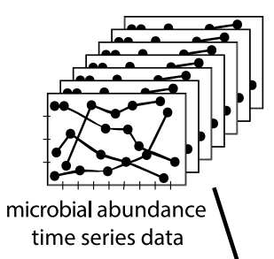
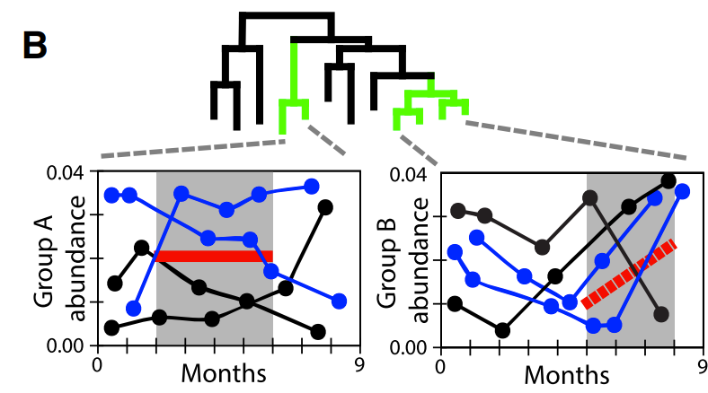
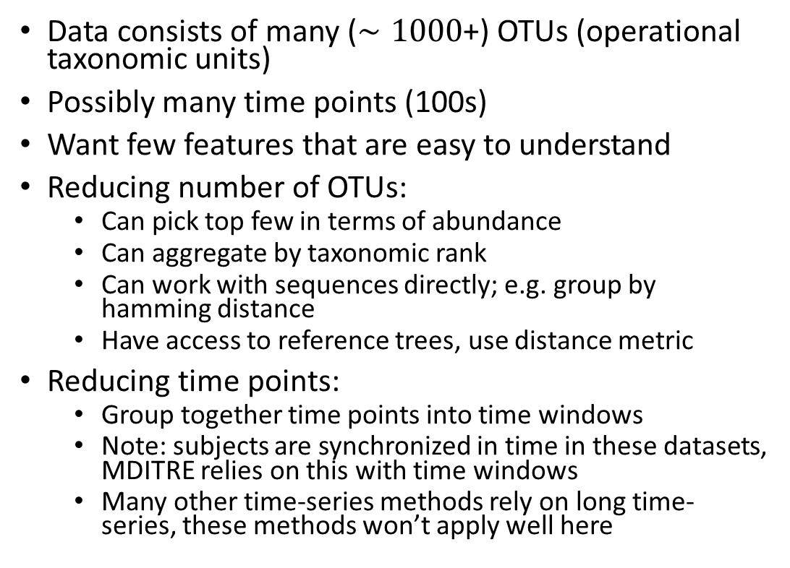
Selecting relevant features
Data consists of many ($∼1000$+) OTUs (operational taxonomic units)
Possibly many time points (100s)
Want few features that are easy to understand
Reducing number of OTUs:
Can pick top few in terms of abundance
Can aggregate by taxonomic rank
Can work with sequences directly; e.g. group by hamming distance
Have access to reference trees, use distance metric
Reducing time points:
Group together time points into time windows
Note: subjects are synchronized in time in these datasets, MDITRE relies on this with time windows
Many other time-series methods rely on long time-series, these methods won’t apply well here

Slide 12
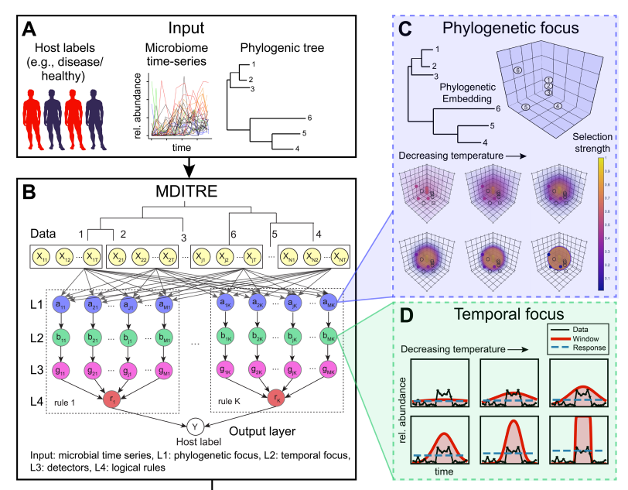
MDITRE model overview
Phylogenetic focus layer:
Model takes phylogenetic reference tree and computes distances between OTUs
Embed distance matrix into latent space of reduced dimensionality via PCoA
Learn groups of closely related taxa with phylogenetic window
Aggregating microbes over time windows
Learns relevant time windows
Computes average abundances and rates of change of abundances of phylogenetically focused groups of microbes
Possible features missed by MDITRE model:
Time lags and features such as “IF A increases X days after B THEN, …”
Periodic time features

Slide 13
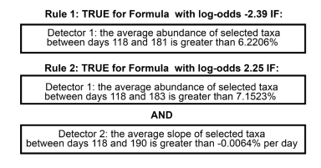
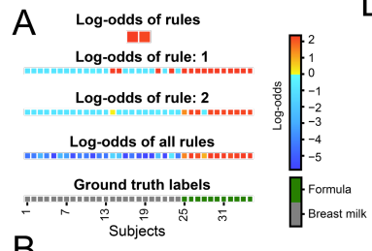
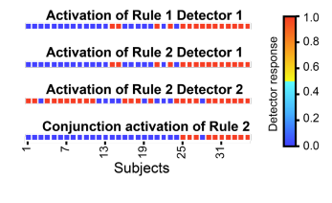
Example MDITRE prediction for Bokulich study
Combining both rules together gives clear separation of both groups with high odds

Slide 14
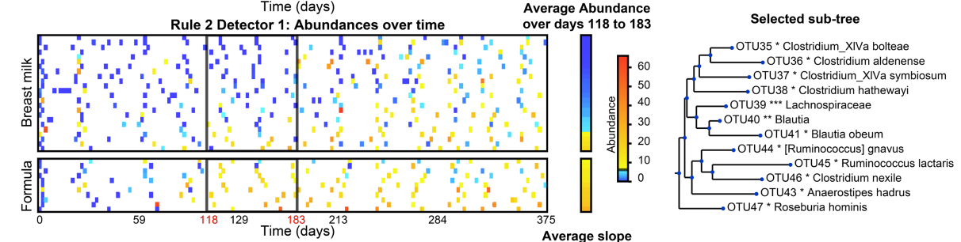
Second rule, first detector
Both detectors focus on same time window,
Around when most infants are introduced to solid foods, which may occur earlier for formula-fed infants
From visual of rules, can see that after the window, abundances become more difficult to distinguish; may suggest similar diets post-liquid foods in both groups
First detector selected selected twelve taxa in the Order Clostridiales
Detects all the formula-fed infants and four of the breast-fed infants
Many of the selected taxa are strict anaerobes that metabolize more complex nutrient sources, including starches and lipids which may be present in formula

Slide 15
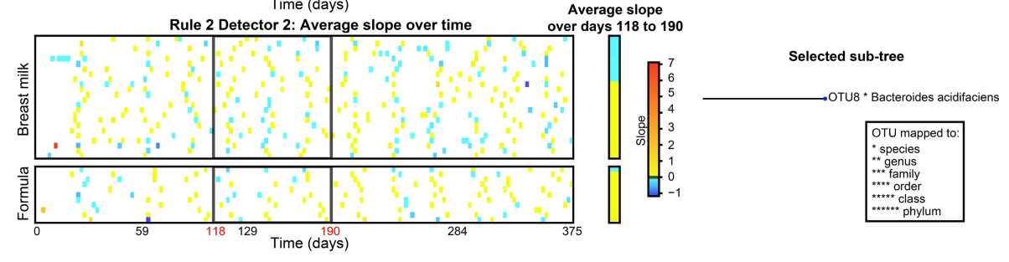
Second rule, second detector
Second detector focuses on the rate of increase of a single taxon, Bacteroides acidifaciens; TRUE if this taxon is increasing
Bacteroides acidifaciens has been shown to increase with higher fiber diets
Detector picks out all but one formula-fed infant but also many breast-fed infants; but is false for the four breastfed infants identified by the first detector

Slide 16
Datasets overview
Study | Subjects | Type | Classification tasks
Bokulich 2016 | Gut microbiomes of infants sampled over the first two years of life | 16S | Diet (breast fed vs formula) Mode of birth (vaginal or c-section)
Brooks 2017 | Gut microbiomes of 30 infants sampled over 75 days | MAG | Mode of birth (vaginal versus C-section)
David 2014 | Microbiomes of 20 healthy adults receiving dietary interventions | 16S | Diet (plant based vs animal)
DiGiulio 2015 | Vaginal microbiomes of 37 pregnant women | 16S | Delivery time (at term vs pre-term)
Kostic 2015 | Gut microbiomes of 17 infants sampled over the first 3 years of life | MAG | Normal vs development of type 1 diabetes
Shao 2019* | Gut microbiomes of 282 infants (after filtering for subjects with fewer than three timepoints) sampled over 424 days | MAG | Mode of birth (vaginal versus C-section)
Vatanen 2016 | Gut microbiomes of 117 children sampled over the first three years of life | 16S | Nationality (Russian versus Estonian/Finnish)
*Shao dataset has very little time-series, may not want to use

Slide 17
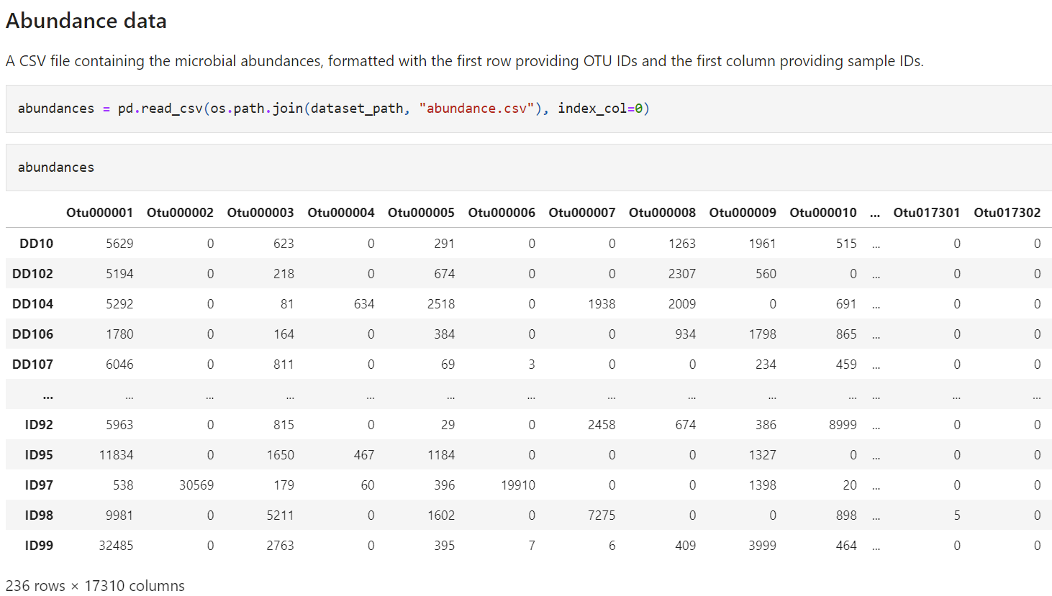
Abundance data (16S amplicon)
Note: Will probably want to do some data preprocessing
Remove OTUs with low counts or that are only present in a few samples/time points
Discard subjects with too few samples
Discard time points with only few subjects
Can look to MITRE and MDITRE papers for some guidelines

Slide 18
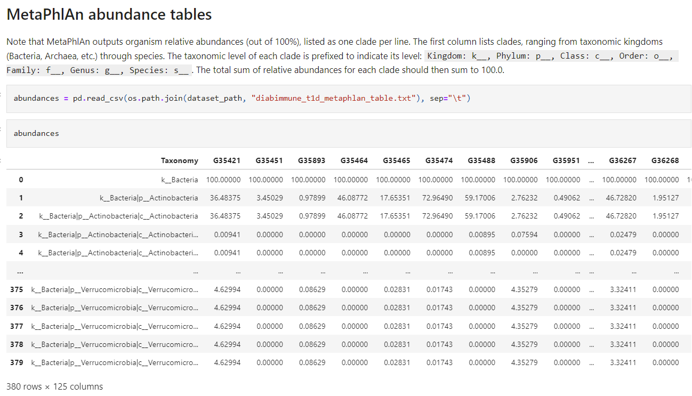
Abundance (shotgun metagenomics)
To filter at the species level, for example, can search for the pattern ‘s__’

Slide 19
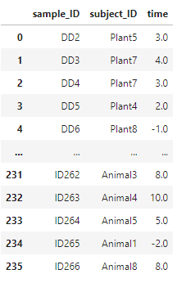
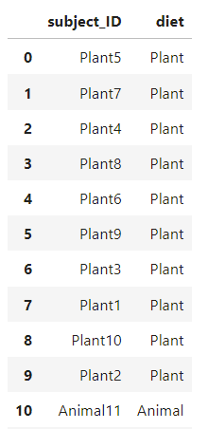
Metadata
Sample metadata
Subject metadata
A CSV file that specifies an associated subject ID and timepoint for each sample ID
A CSV file that gives information about each subject, (including the value of whatever variable will be used as the host outcome for prediction (e.g., Plant-diet or Animal-diet in the David et al)

