Slide 1
Outline
Interpretable models in general
Pros/cons of models with built in interpretability vs post-hoc methods
What the data looks like
Overview of the datasets
In depth overview of the Bokulich 2016 study
Selecting interpretable features
MDITRE model as an example
Example MDITRE results for Bokulich 2016 study

Slide 2
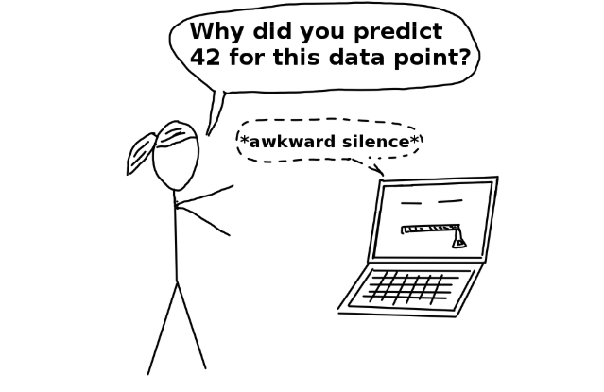
Interpretability in general
Notion of interpretability difficult to define in general, is domain specific
Qualitative metrics: can a human understand why prediction was made?...
Why it’s important
https://christophm.github.io/interpretable-ml-book/terminology.html

Slide 3
Interpretability in time-series microbiome data
High stakes medical applications
Specificity over sensitivity
For many microbiome applications, the critical tasks are discovering relationships between the microbiome and the host or finding clinically useful biomarkers, rather than pure prediction, care more about model interpretability than predictive power

Slide 4
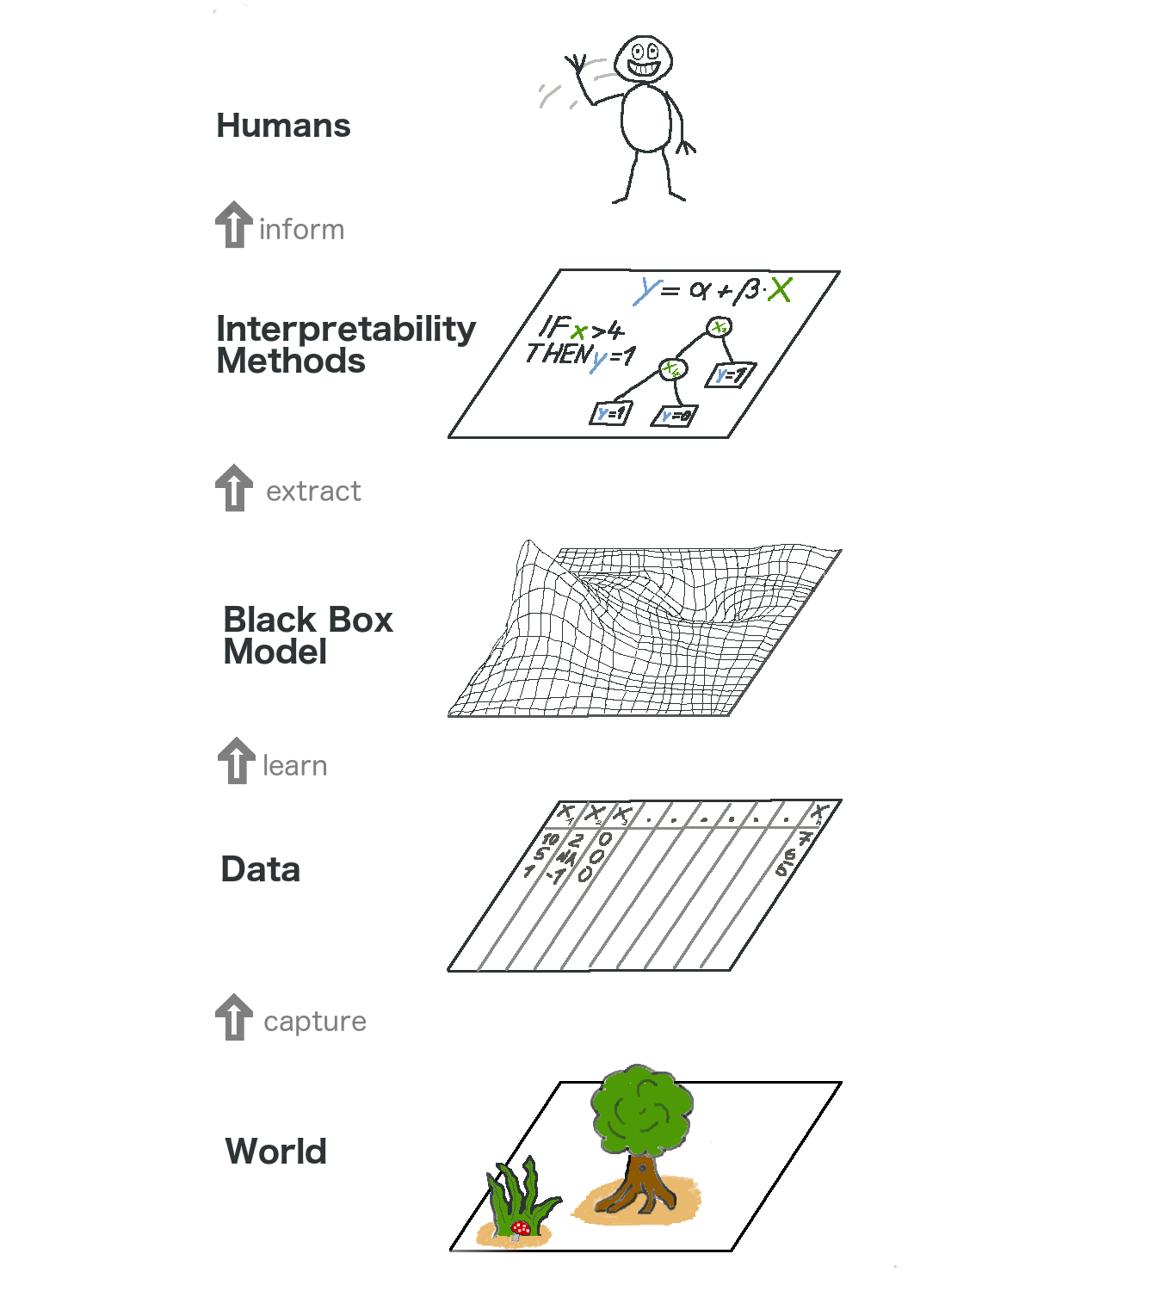
interpretability in models
Want features that are easier to understand/use:
Grouping together relevant sets of taxa
Focusing on relevant time windows
Human interpretable model output…
Models with interpretability baked-in
Regression models: linear, logistic, GLM, GAM
Decision trees
Rule lists/sets
Model agnostic post-hoc methods
LIME
https://christophm.github.io/interpretable-ml-book/terminology.html

Slide 5
Interpretable models vs post-hoc interpretability
Pros and cons of each
Post-hoc pro, more general model can maybe pick out weaker signals, con, might be false positive, or not sure why its being picked out

Slide 6
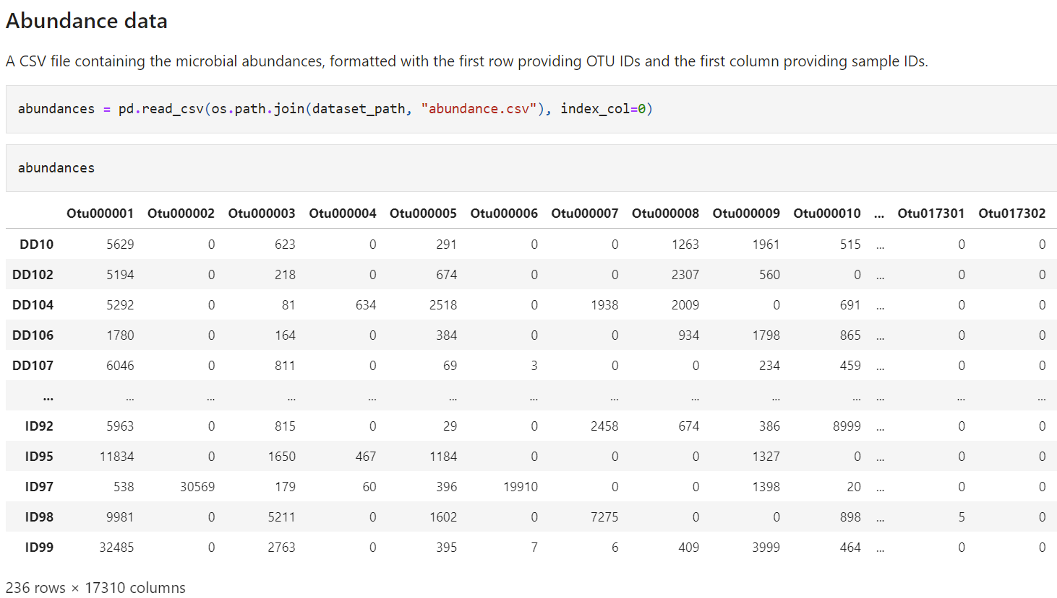
Abundance data (16S amplicon)
Will probably want to do some data cleaning before hand; remove otus with low counts or that are only present in a few samples/time points;
might want to only focus on some time periods (e.g. if most subjects do not have samples outside of a given time window)
Discard subjects with too few samples, etc…

Slide 7
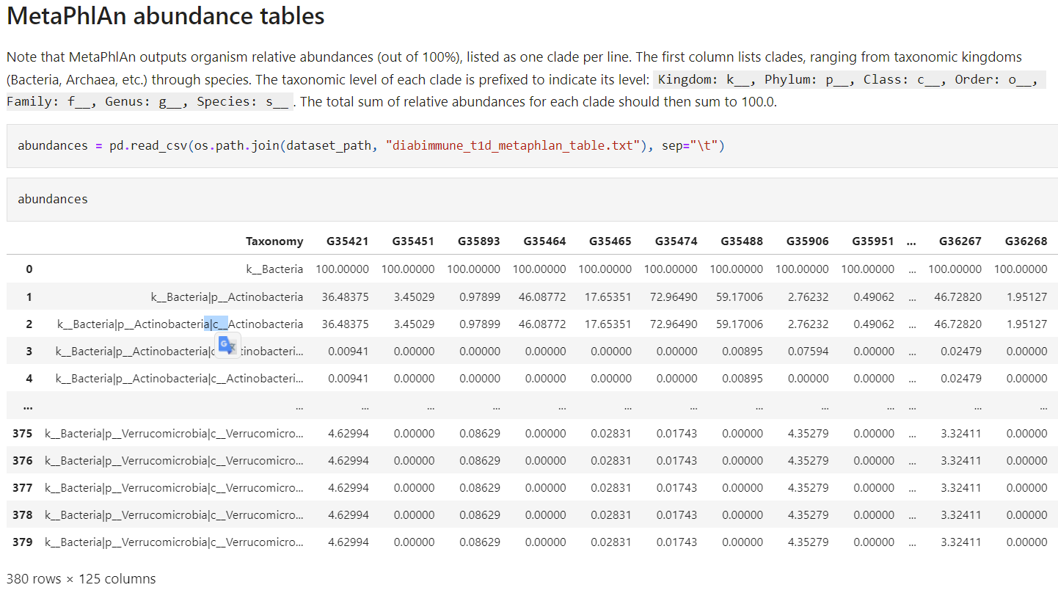
Abundance (shotgun metagenomics)

Slide 8
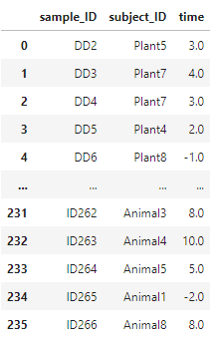
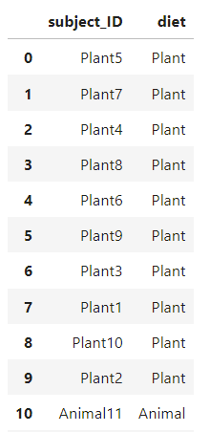
Metadata
Sample metadata
Subject metadata
A CSV file that specifies an associated subject ID and timepoint for each sample ID.
A CSV file that gives information about each subject, (including the value of whatever variable will be used as the host outcome for prediction (e.g., Plant-diet or Animal-diet in the David et al).

Slide 9
Datasets overview
Study | Subjects | Type | Classification tasks
Bokulich 2016 | Gut microbiomes of infants sampled over the first two years of life | 16S | Diet (breast fed vs formula) Mode of birth (vaginal or c-section)
Brooks 2017 | Gut microbiomes of 30 infants sampled over 75 days | MAG? | Mode of birth (vaginal versus C-section)
David 2014 | Microbiomes of 20 healthy adults receiving dietary interventions | 16S | Diet (plant based vs animal)
DiGiulio 2015 | Vaginal microbiomes of 37 pregnant women | 16S | Delivery time (at term vs pre-term)
Kostic 2015 | Gut microbiomes of 17 infants sampled over the first 3 years of life | MAG | Normal vs development of type 1 diabetes
Shao 2019 | Gut microbiomes of 282 infants (after filtering for subjects with fewer than three timepoints) sampled over 424 days | MAG | Mode of birth (vaginal versus C-section)
Vatanen 2016 | Gut microbiomes of 117 children sampled over the first three years of life | 16S | Nationality (Russian versus Estonian/Finnish)
*Shao dataset has very little time-series, may not want to use

Slide 10

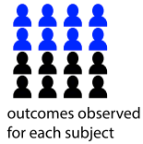
Bokulich 2016 study
Infant fecal samples during first two years
Year 0
Year 2
Aimed to characterize early-life microbial development in the context of antibiotic use, cesarean section, and formula feeding
total of 43 infants were enrolled for follow-up for up to the age of 2 years
Stool samples collected and sequenced; 151-bp paired end sequencing on the Illumina MiSeq platform
Original study: Operational taxonomic units (OTUs) were assigned using QIIME’s uclust; data you have has been reprocessed with dada2 to obtain tables of OTU abundances and phylogenetic placements for each OTU on a reference tree
Antibiotic exposure
Could be at any point over the 2 years
Mode of birth
Diet (Breast fed vs formula)
during the first 3 months of life

Slide 11
Example research question
Can we predict which subjects were breast fed or formula fed from the microbial time series data?
What features would be relevant predictors?
Groups of taxa with expected similar functions [phylogeny]
Relevant time windows
Want to focus on finding only the essential features (in this case, microbial clades and relevant time windows), for better interpretability and possibly better model performance

Slide 12
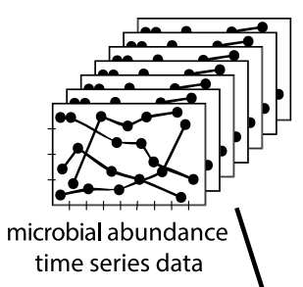
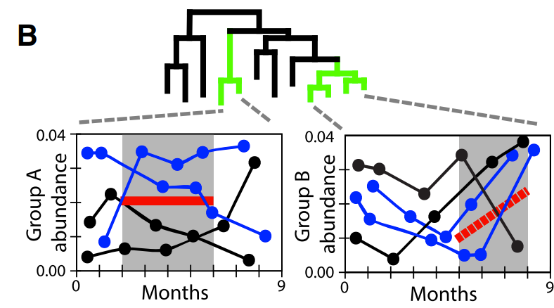
Selecting relevant features
Can aggregate by taxonomic rank for example
Can pick top abundance bugs to start; will want to do some sort of filtering in general
Might be better to work with sequences directly
Have access to reference trees, use distance metric
generating time windows

Slide 13
MDITRE model overview
Aggregating phylogenetically similar microbes
Aggregating microbes over time windows
Possible features missed by mditre model

Slide 14
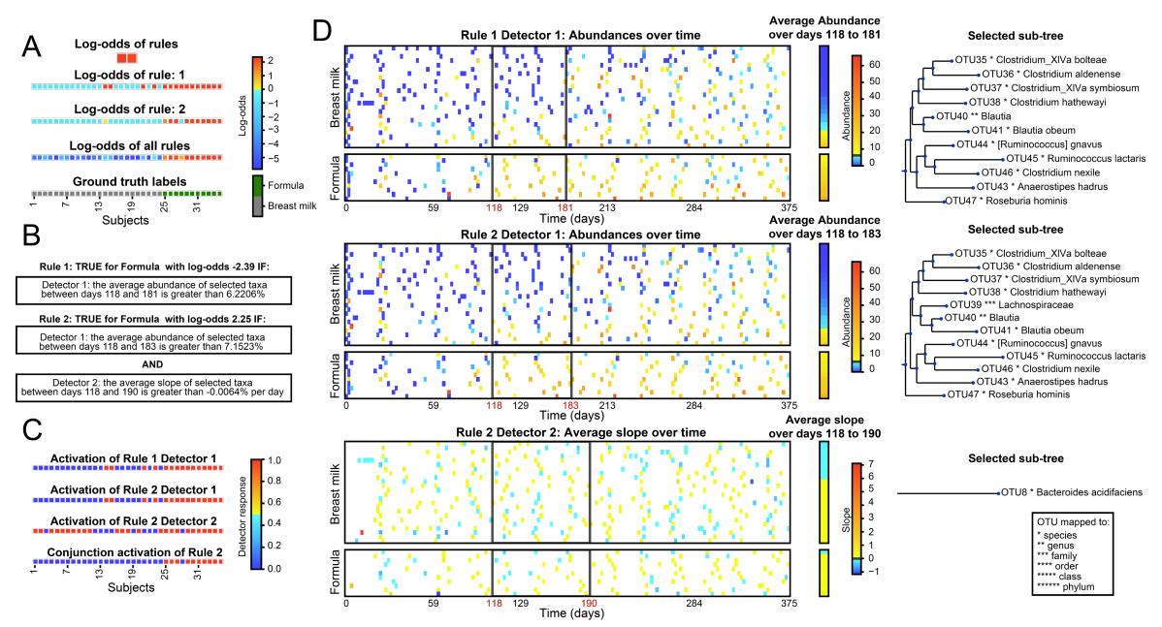
Example MDITRE prediction for Bokulich study

