Slide 2
About a girl -Nirvana-
David Ott

Slide 3
Content
Nirvana in general
Nirvanas cast
„About a girl“ in general
About „Bleach“
Why did i choose this song?
Message
Lyrics
Analysis of the lyrics

Slide 4
About Nirvana (1)
Grunge band
Found in 1987 by Kurt Cobain and Krist Novoselic
First album „Bleach“ released in 1989
Big mainstream sucess with „Smells like teen spirit“ (Nevermind, 1991)
Nirvana was one of the best selling bands of all time with 75 million sold records
They broke up after the suicide of Kurt Cobain in April 1994
In and after their mainstream time they received an American Music Award, Brit Award, and Grammy Award, as well as seven MTV Video Music Awards and two NME Awards

Slide 5
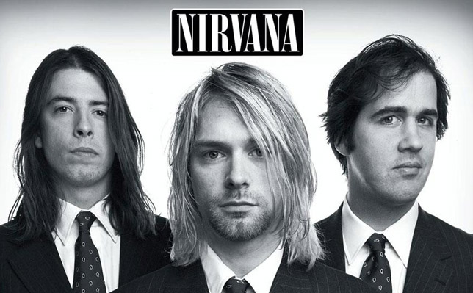
About Nirvana (2)
Drummer Singer/Guitarist Bassist
Dave Grohl(1990-1994) Kurt Cobain Kris Novoselic
Chad Channing(1998-1990) (1987-1994) (1987-1994)

Slide 6

About „Bleach“
Nirvana‘s debut album
Released on June 15 in 1989
Recorded in Seattle, Washington
More than 4.25 million copies sold
4x gold and 4x platinum

Slide 7
About „About a girl“
The third song on the 1989 published album „Bleach“
Was recorded 1998 in Seattle
Was sold of 550,000 times and received 3x gold and 1x platin
The song is about Cobain‘s then girlfriend Tracy Marander
He wrote it, because she complained, that he didn‘t wrote a song for her
The title is „About a girl“, because that was the first thing said by Kurt Cobain about the song

Slide 8
Why did i choose this song?
It is a beautiful song with deep and emotional lyrics

Slide 9
Message
It‘s about the complicated relationship between Kurt Cobain and his girlfriend Tracy Marander
She wants him to get a job, or otherwise he wouldn‘t see her anymore and she would kick him out

Slide 10
Lyrics
But, I can't see you every night
Free
I do
I need an easy friend
I do with an ear to lend
I do think you fit this shoe
I do but you have a clue
I′ll take advantage while
You hang me out to dry
But I can′t see you every night
No, I can't see you every night
Free
I do
I do
I do
I do
I need an easy friend I do with an ear to lend I do think you fit this shoe I do but you have a clue I′ll take advantage while You hang me out to dry But, I can't see you every night Free I do I′m standing in your line I do hope you have the time I do pick a number too I do keep a date with you
I'll take advantage while
You hang me out to dry

Slide 11
I need an easy friend I do with an ear to lend I do think you fit this shoe
He just wants someone, who he can talk to easily and thinks she‘s the right one for this

Slide 12
But, I can't see you every night free
His girlfriend threathend to kick him out, if he wouldn‘t get a job, because at the time she supported both of them financially

Slide 13
I′ll take advantage while You hang me out to dry
He exploited her financially, but felt at the same time, that she let him down

Slide 14
Thank you for listening

