Slide 1
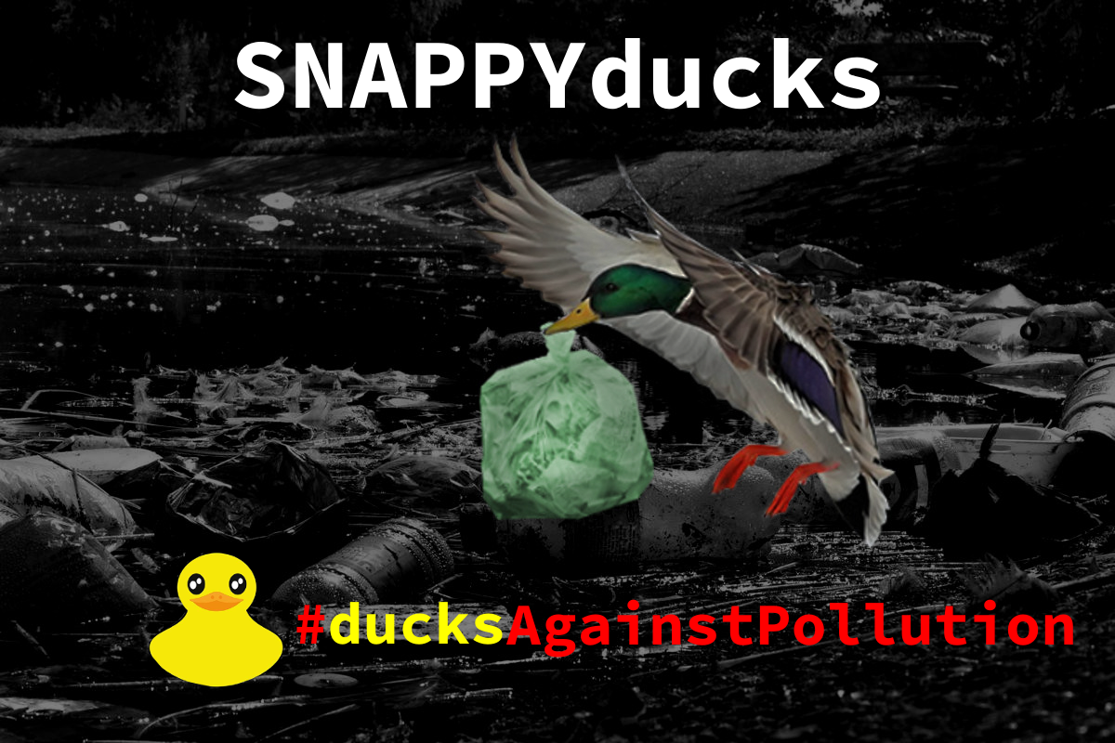

Slide 2

Story behind
Our hero, duck Beacky, comes back to her home pond and meets her old friend Quilly. They both notice that the problem of pollution is even worse than the year before.

Slide 3
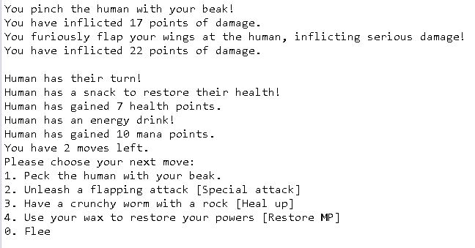
Thus, they decide to fight back against the main cause of the pollution - humans.

Slide 4
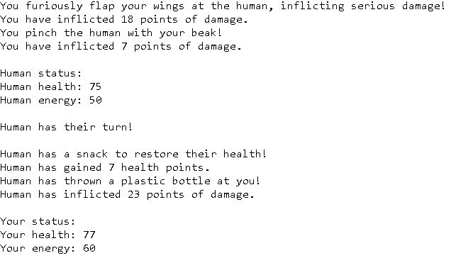
Use special attack of flapping wings to scare. This would require energy.

Slide 5
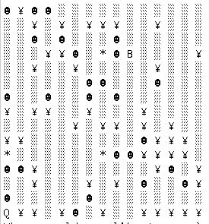
You have limited resources to fight humans. You must keep an eye on your health bar and your energy at all times.
If a tourist overpowers you, you will lose your consciousness and float to the shore.
After some time, Beacky will need a rest, and Quilly can take over.
Together you will be able to clear the pond of the litter and those who leave it.

Slide 6
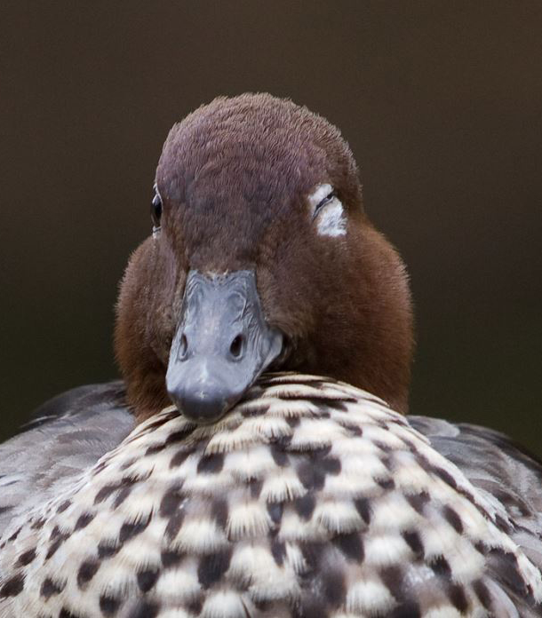
Thanks for attention!
Completed by 1st year students

