Slide 1
Theoretical Grounds and Market Adaptations of Financial Fx and Interest Rate Options
Gerardo Durán Martín

Slide 2
Objective
To put in context the mathematical tools required, and the assumptions made in order to derive the Black-Scholes (B.S.) formula for European put and call options.
Set option pricing in the context of FX and interest rate markets.
Show how the B.S. model is adjusted in pursuance of risk management and no-arbitrage under real market conditions.

Slide 3
Theoretical Grounds
The Black-Scholes PDE (1973)
European Call Option

Slide 4
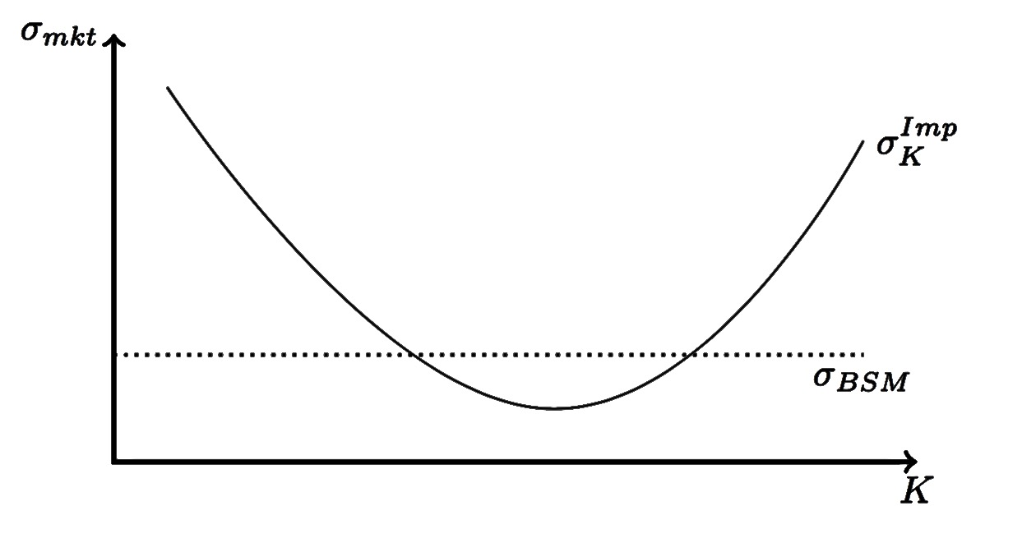
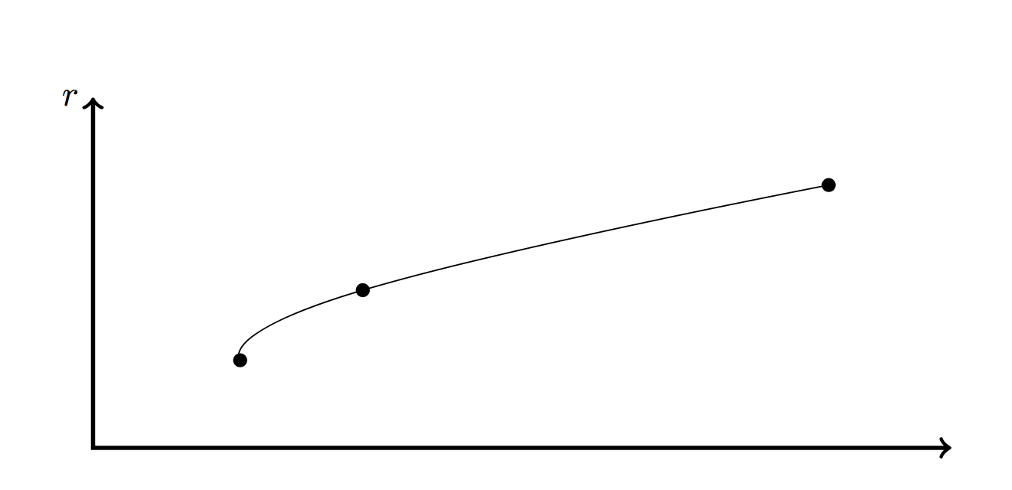
Market Adaptations
Volatility Smile
Rate Curves

Slide 5
Motivation
The desire to understand the machinery behind vanilla option pricing.
Have a rigorous treatment of the B.S. model , yet at the same time accessible to any newcomer in the field with sufficient mathematical background (me).
Merge the theory and the practice of option pricing: models are complex, market conventions are complicated.

Slide 6
The Content
Financial Market
Probability Theory
Random Walks and Brownian Motion
A Primer to Option Pricing
Stochastic Calculus
The Black-Scholes-Merton Formula
Pricing Under Real Market Conditions
Volatility & Interest Rates

