Slide 1
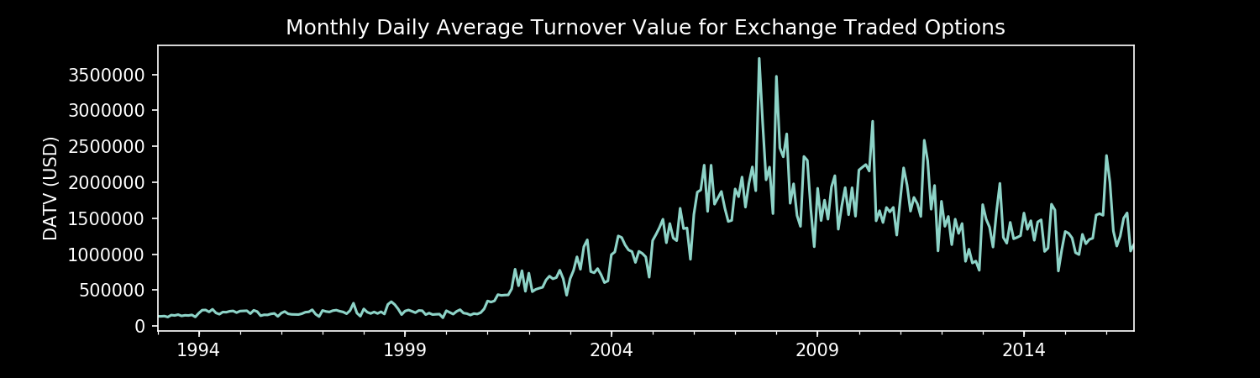
Theoretical Grounds and Market Adaptations of Financial Fx and Interest Rate Options
Gerardo Durán Martín

Slide 2
Theoretical Grounds
The Black-Scholes PDE (1973)
European Call Option

Slide 3
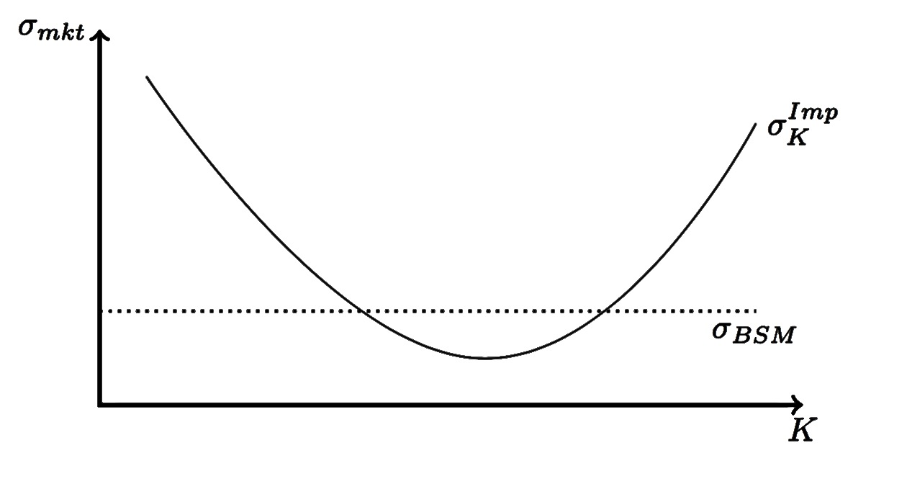
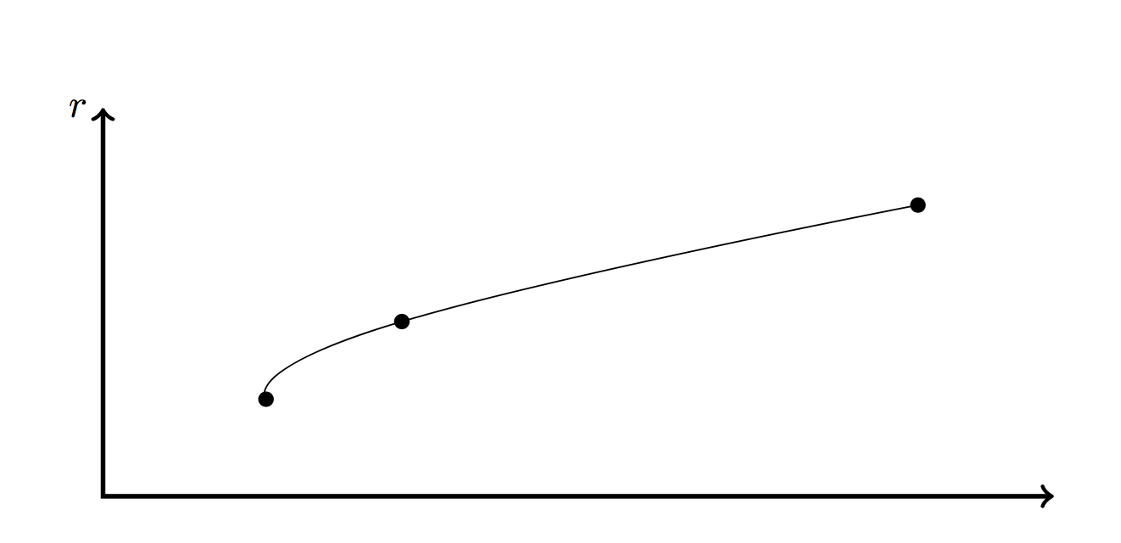
Market Adaptations
Volatility Smile
Rate Curves

