Slide 1
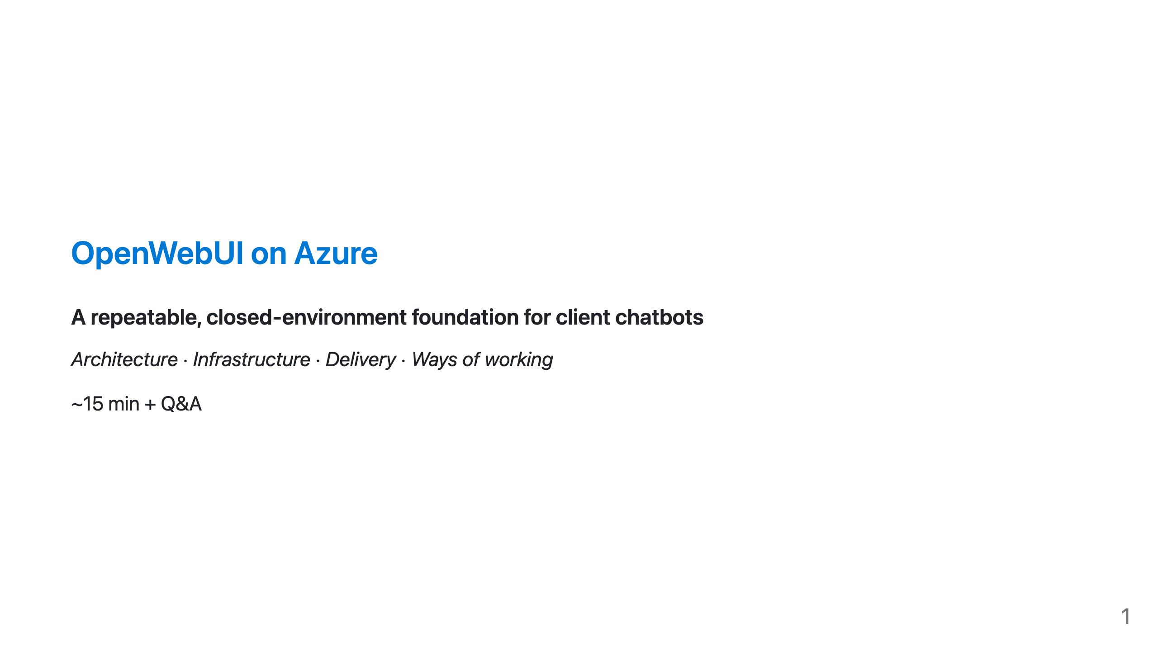

Slide 2
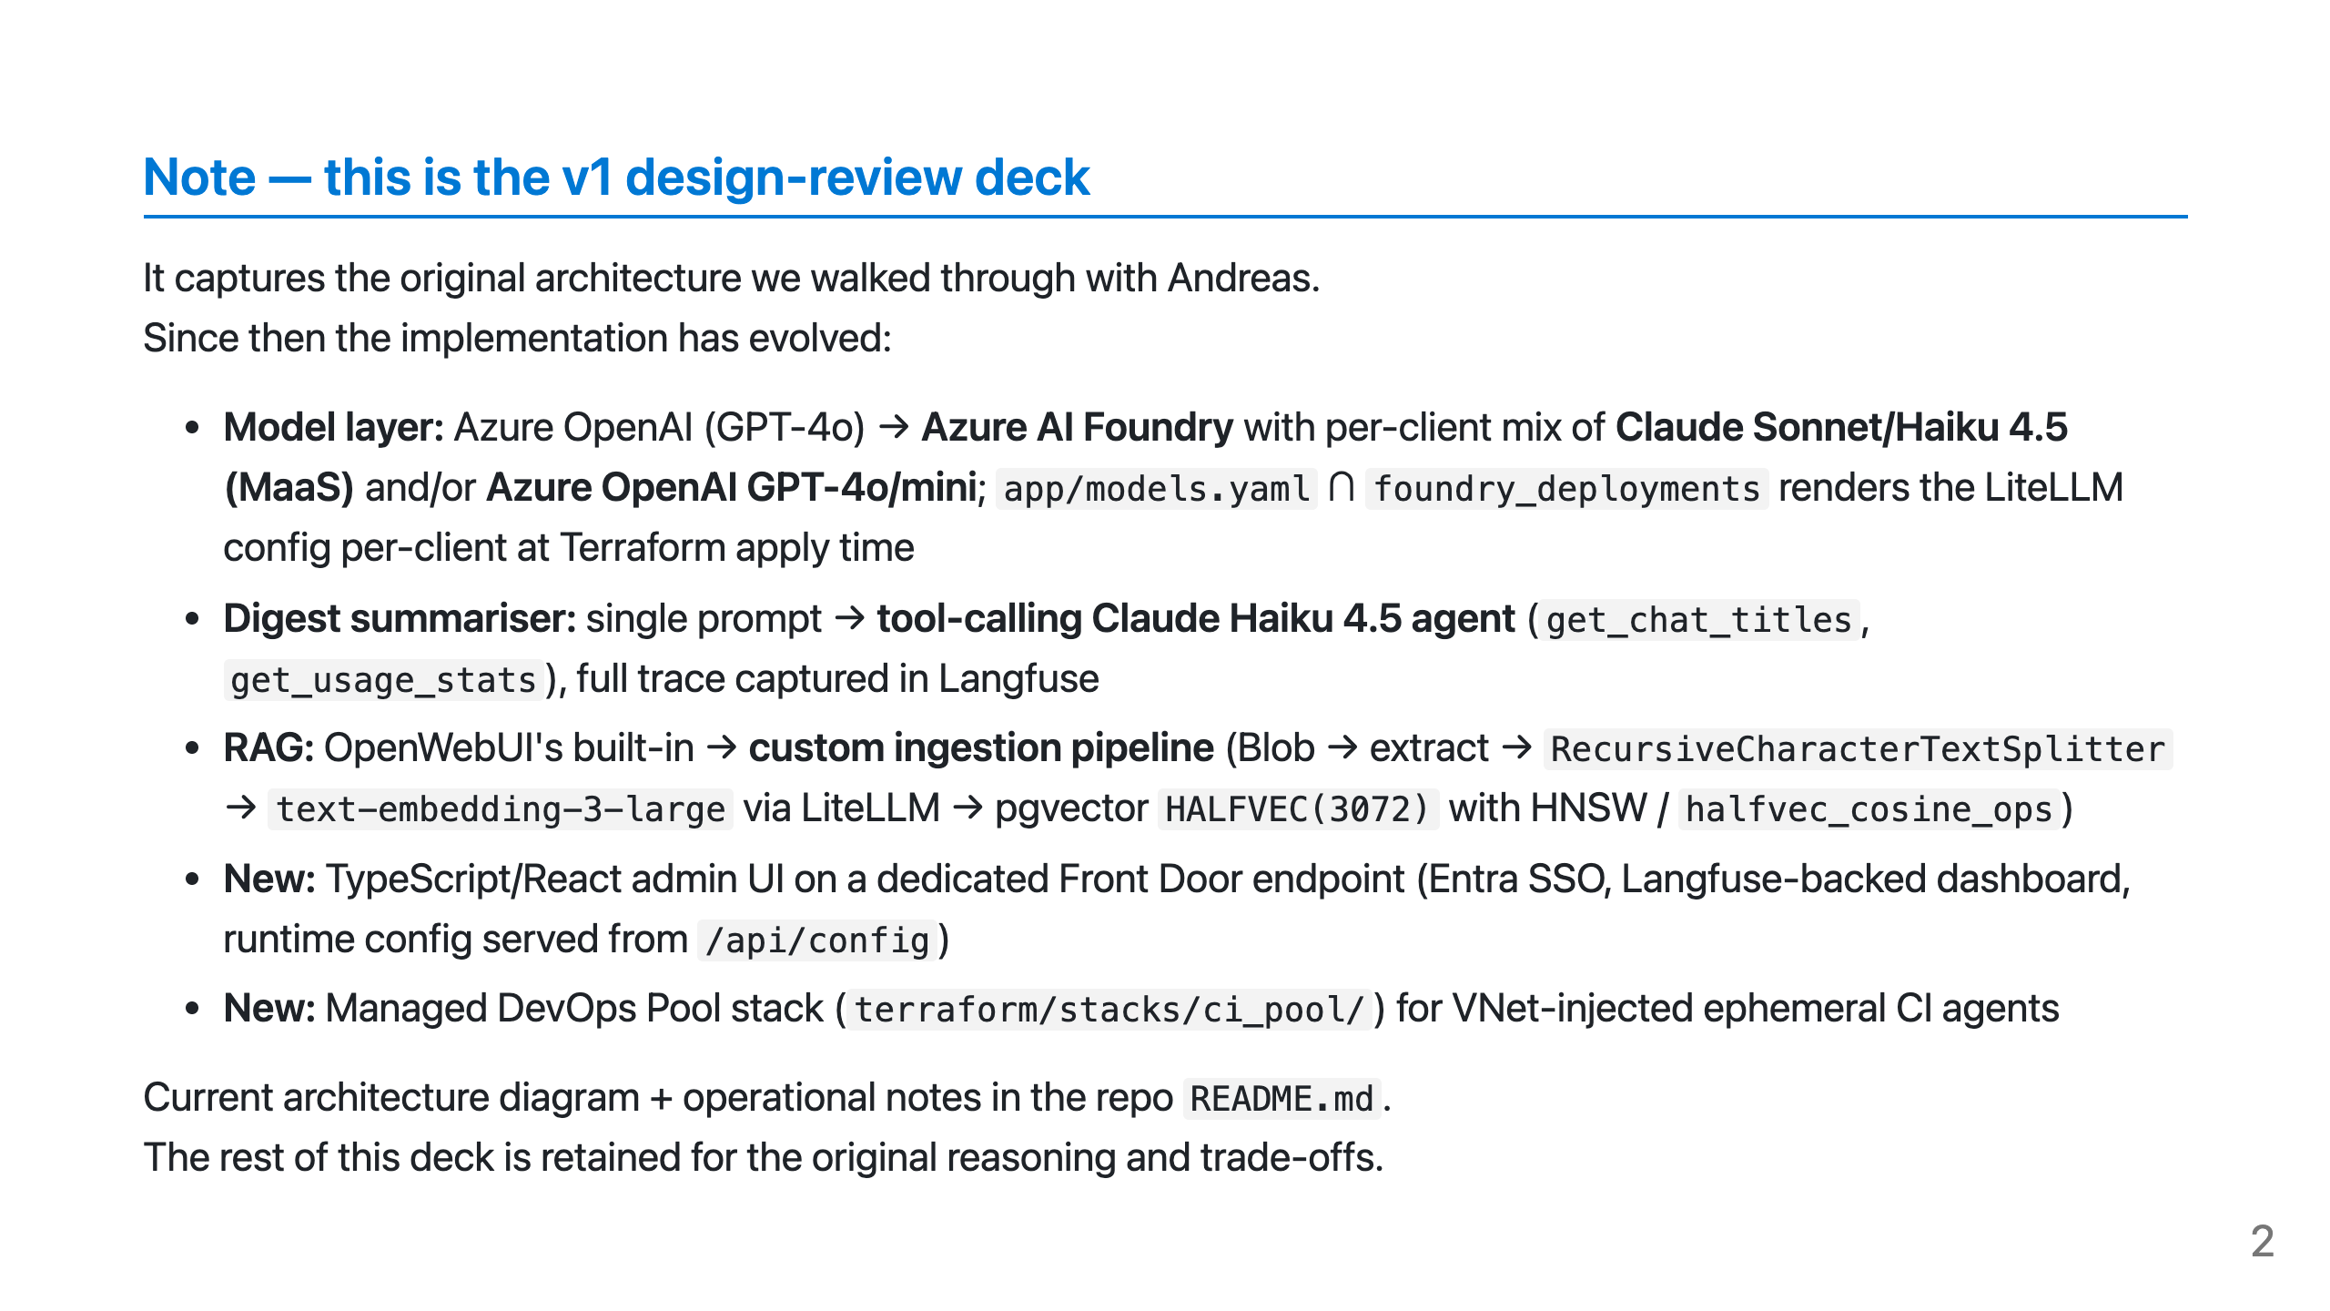

Slide 3
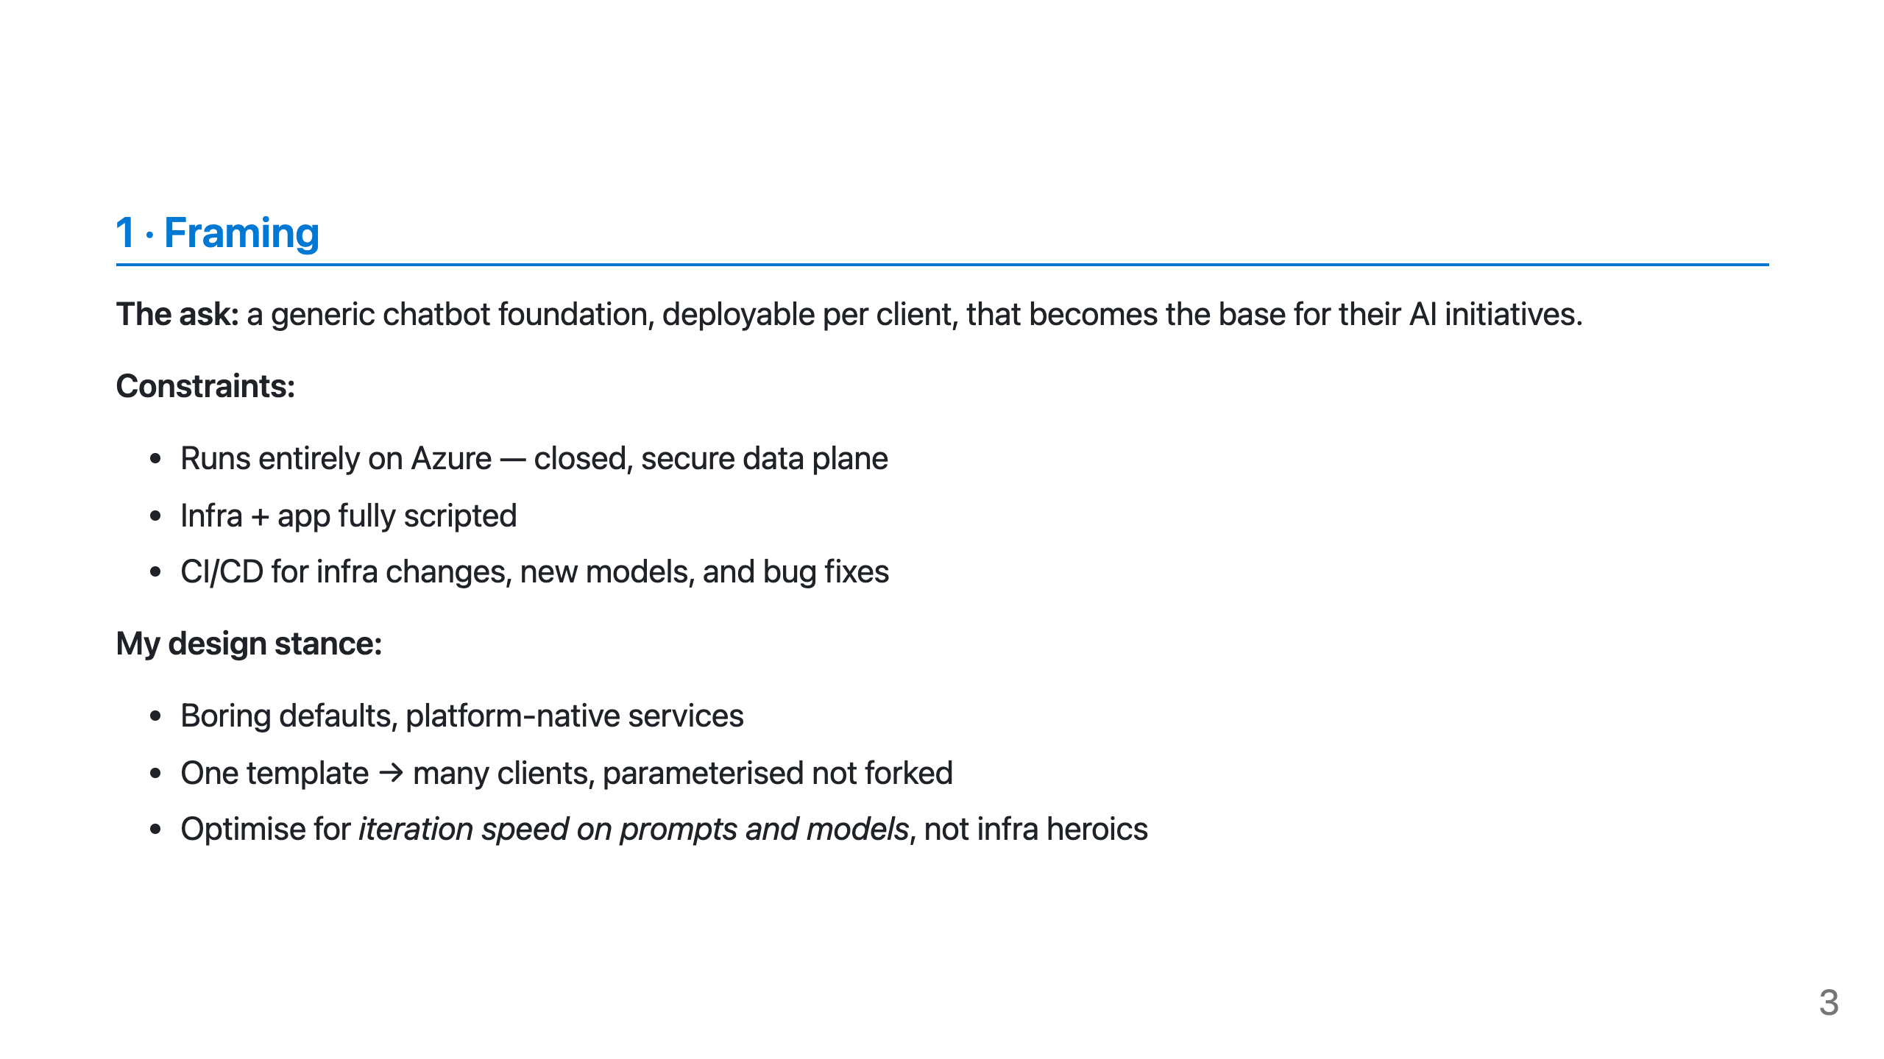

Slide 4
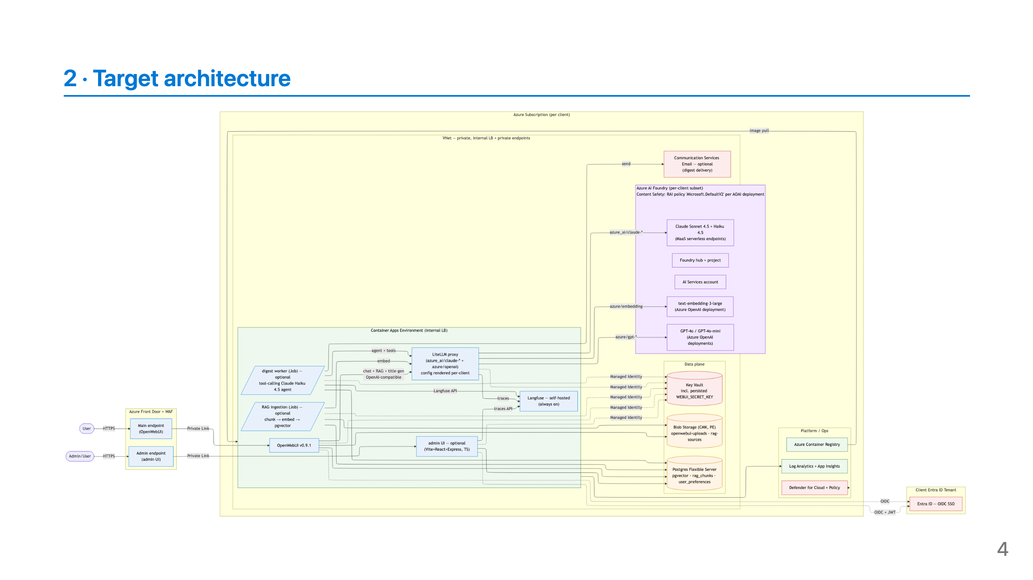
Notes:
Speaker notes: - Everything behind Front Door + WAF; origin is private. - OpenWebUI runs as a stateless container; Postgres holds state + vectors. - LiteLLM is the single OpenAI-compatible endpoint OpenWebUI talks to — lets us swap/route models without touching the app. - Langfuse is the LLM observability plane — self-hosted so traces never leave the tenant.

Slide 5
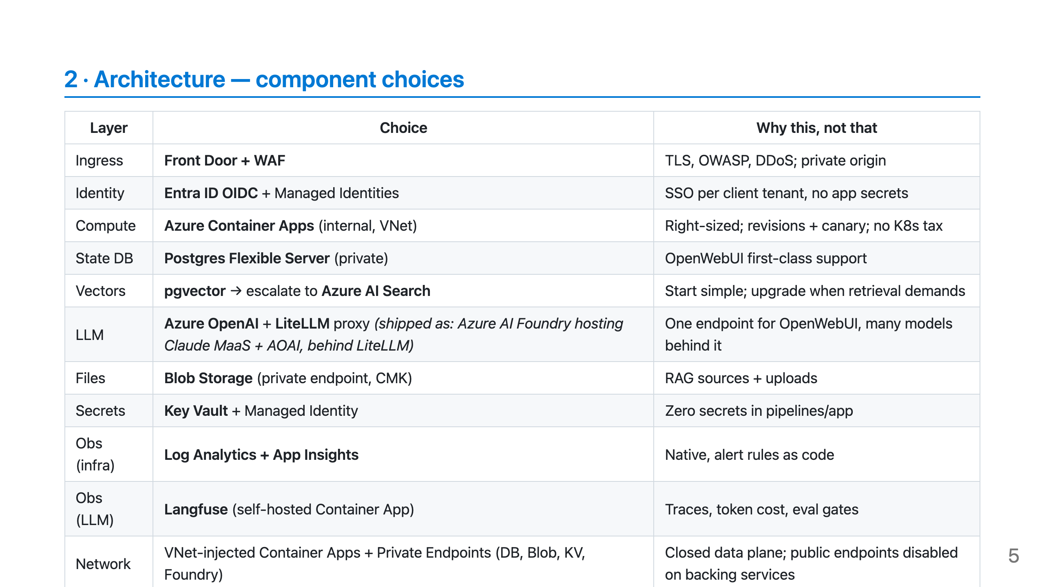

Slide 6
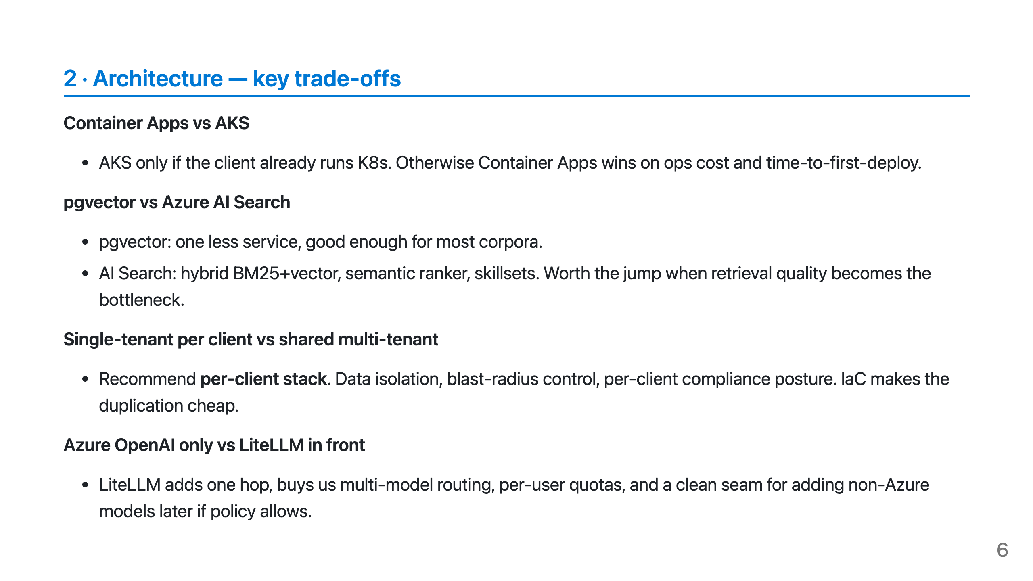

Slide 7
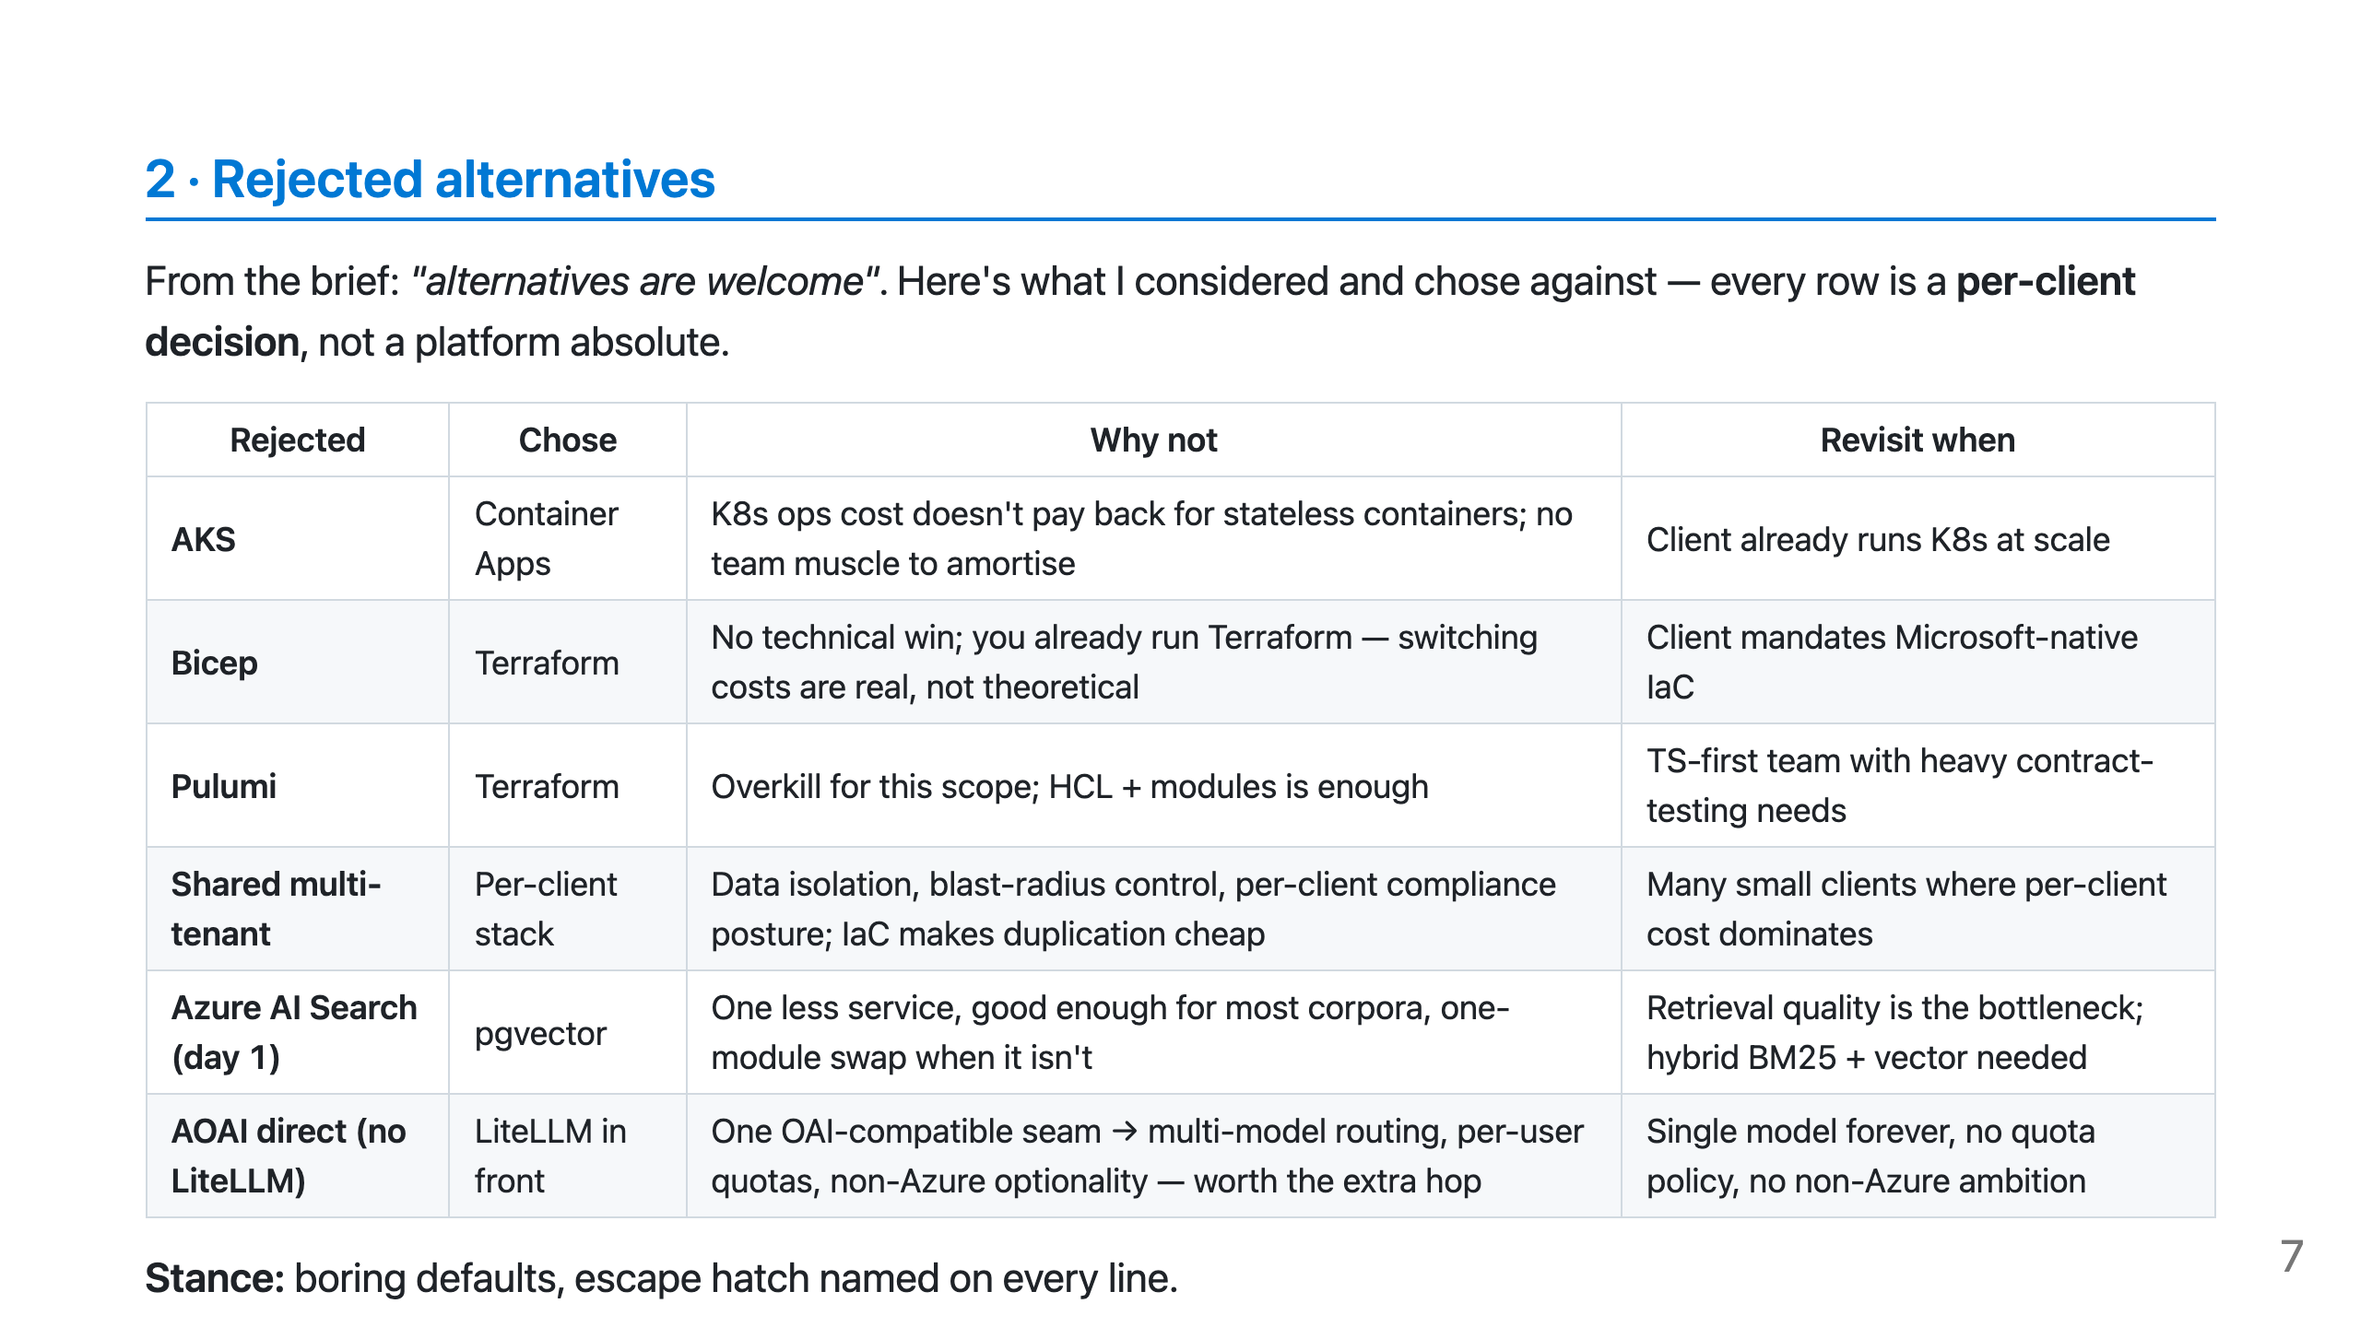

Slide 8
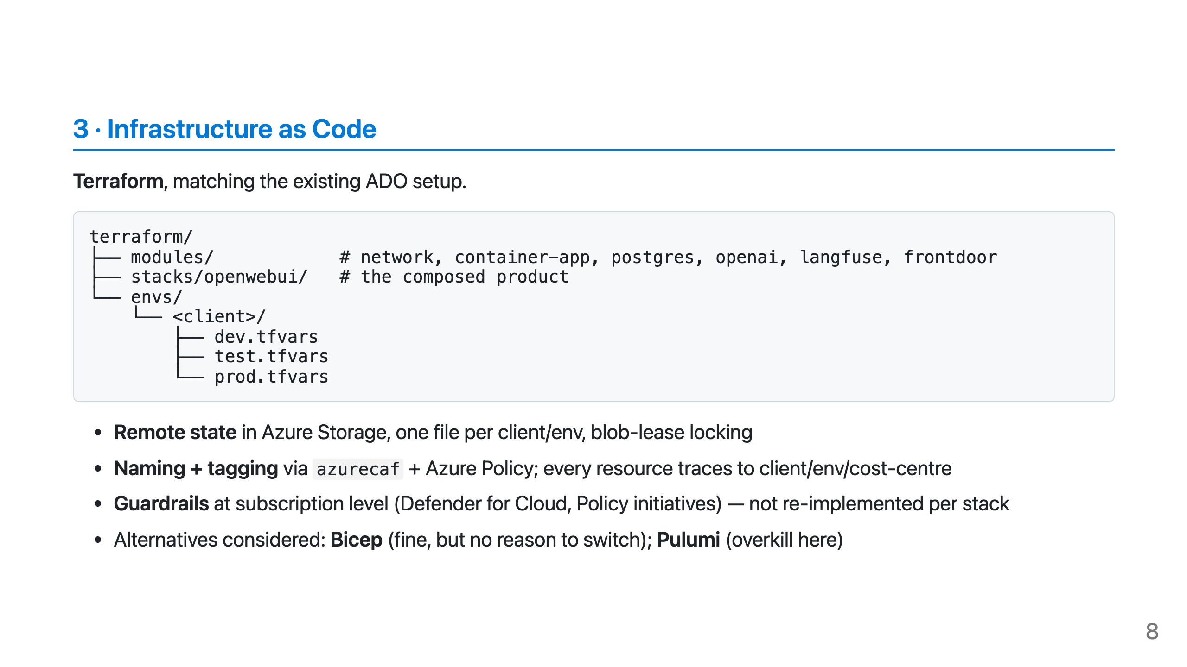

Slide 9
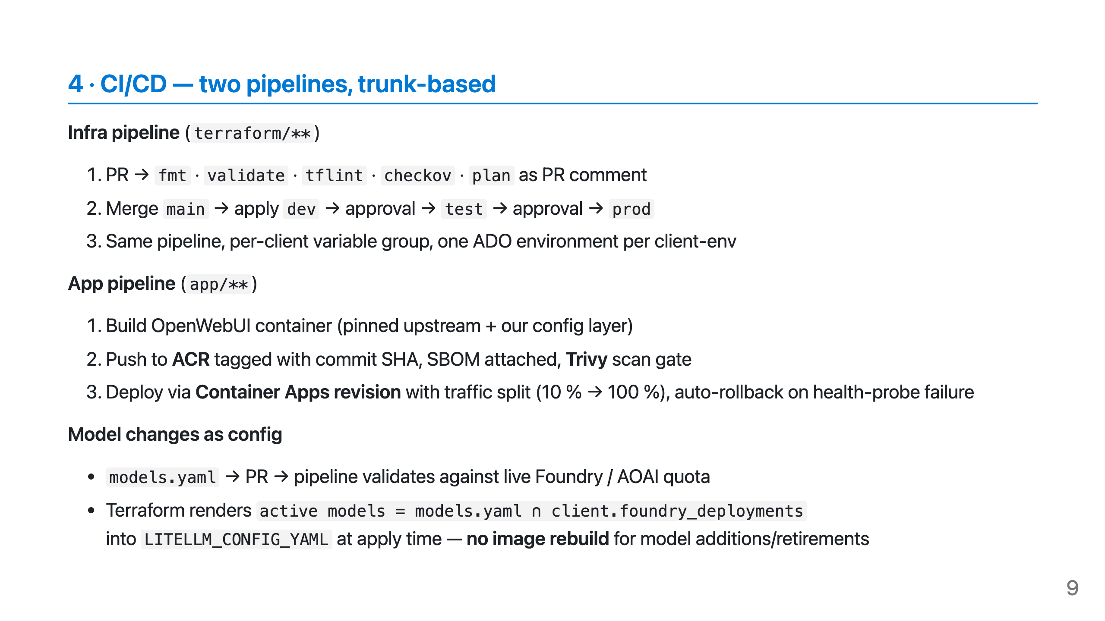

Slide 10
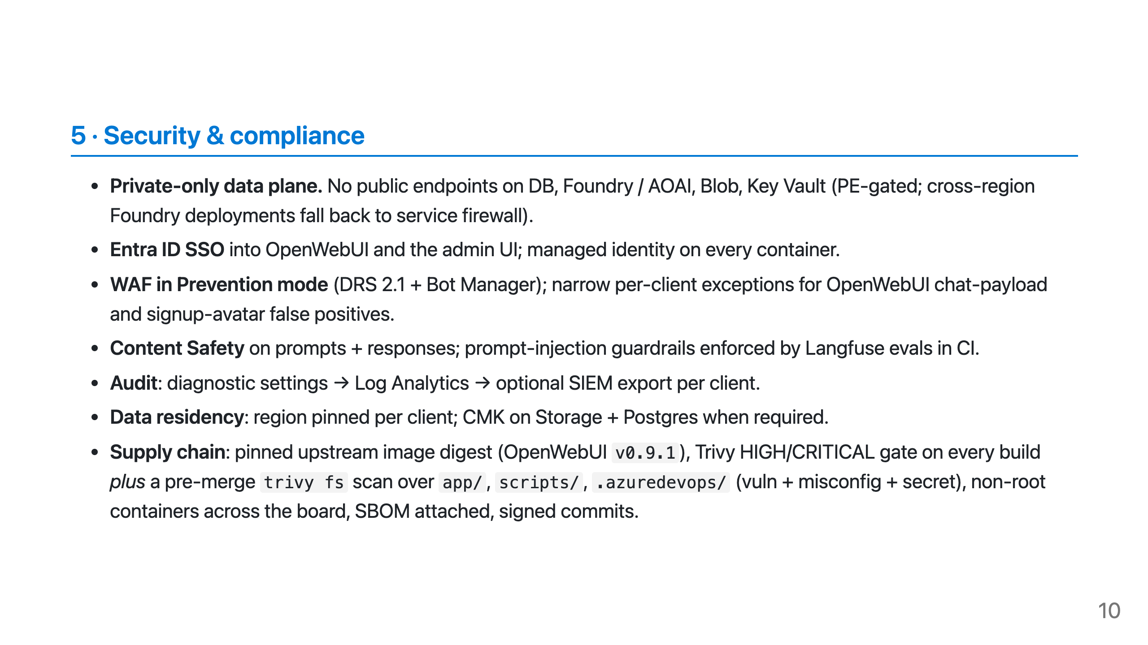

Slide 11
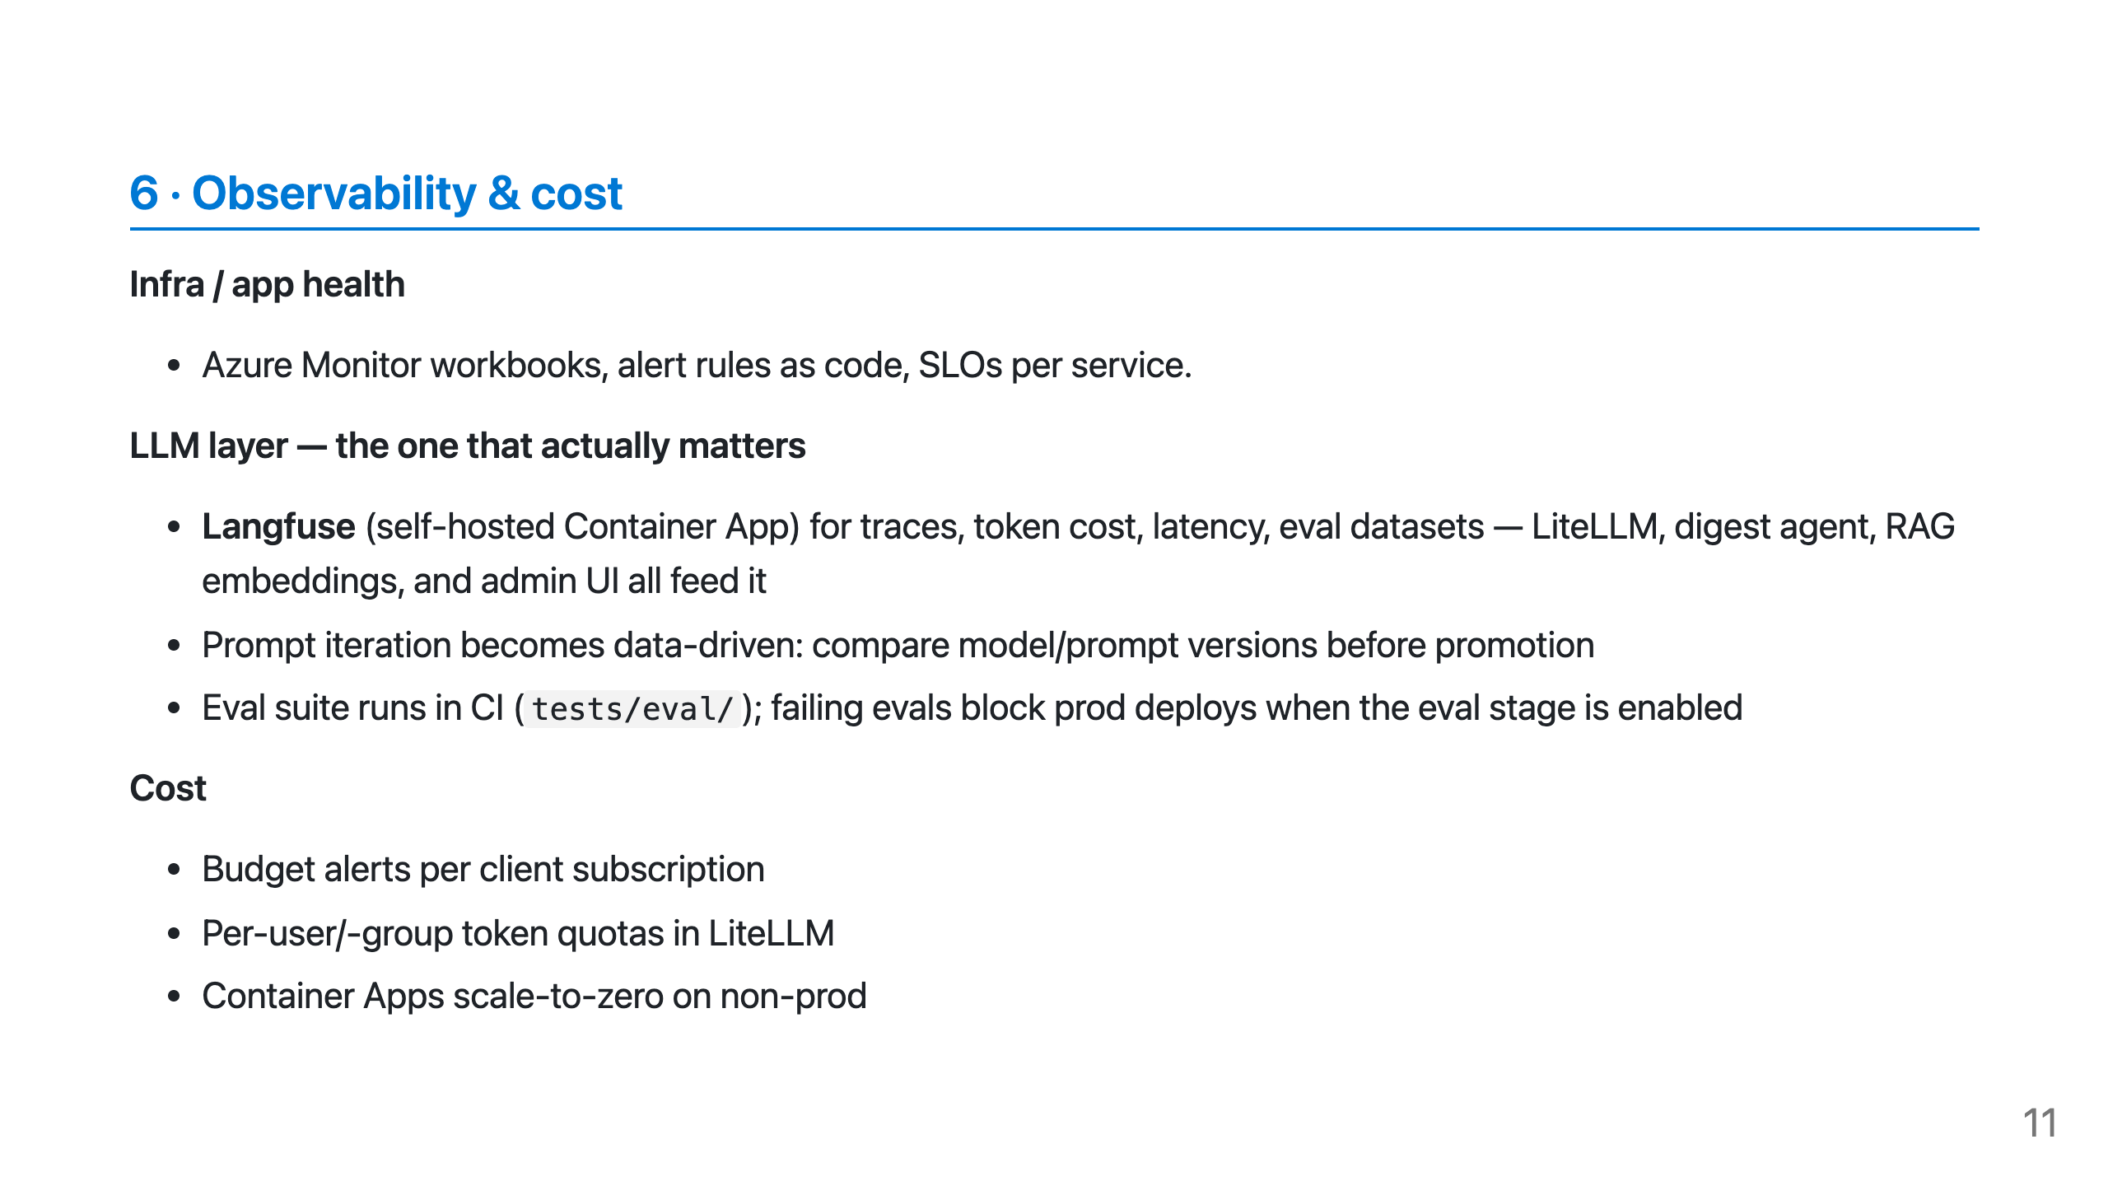

Slide 12
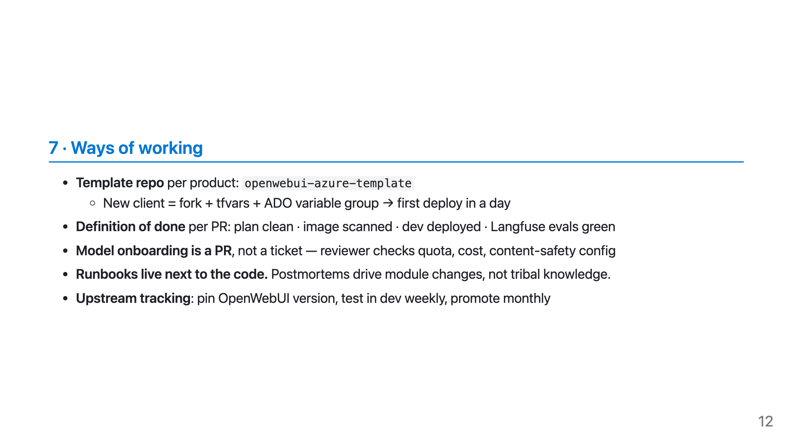

Slide 13
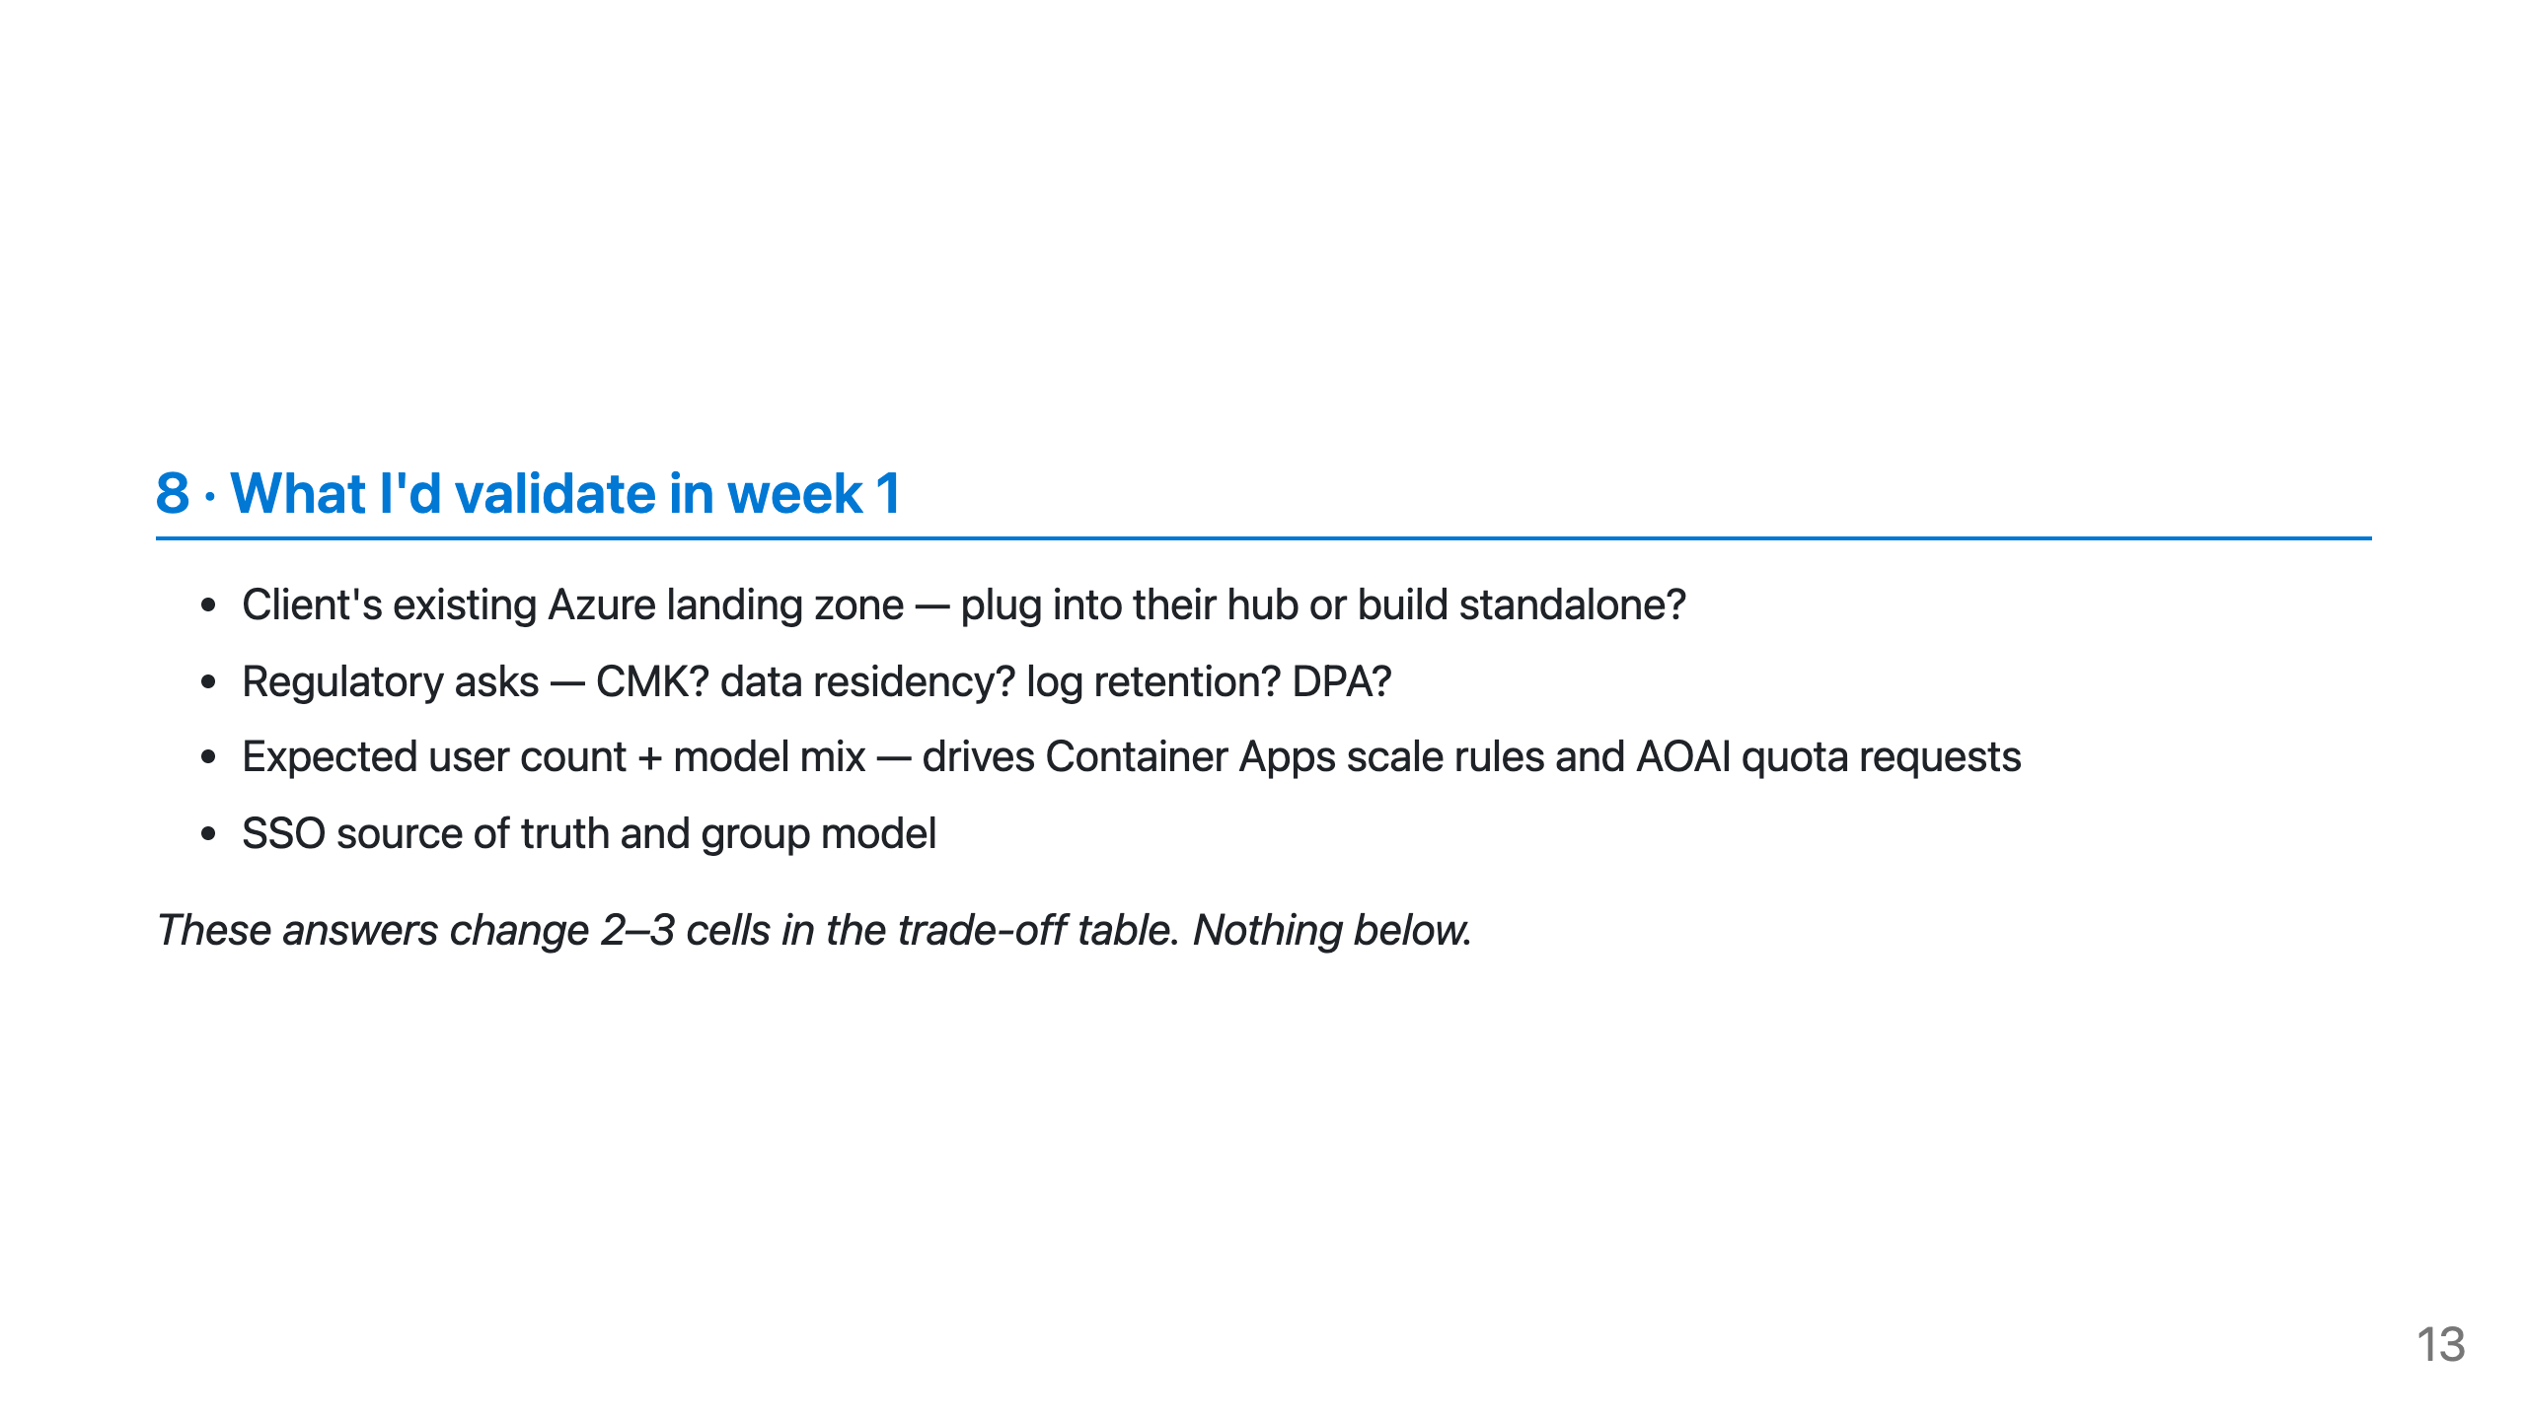

Slide 14
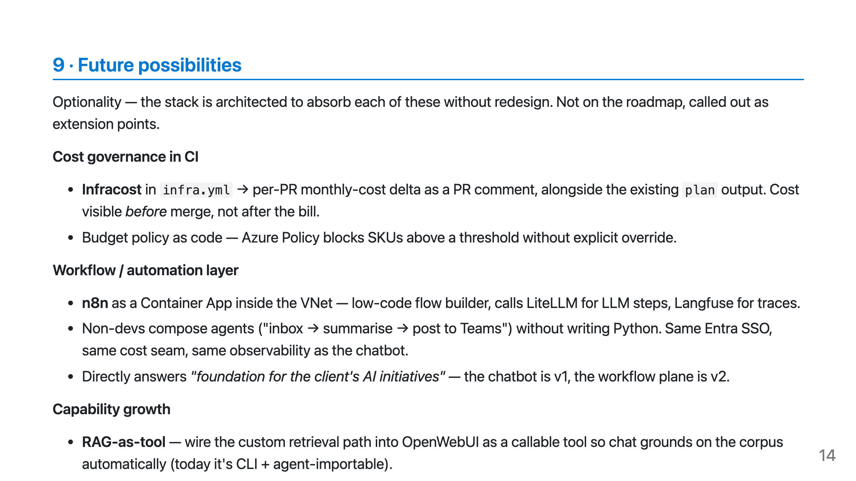

Slide 15
