Slide 1
DartsDetector
C++ OpenCV application for a Dart Board
Gergő Papp-Szentannai

Slide 2
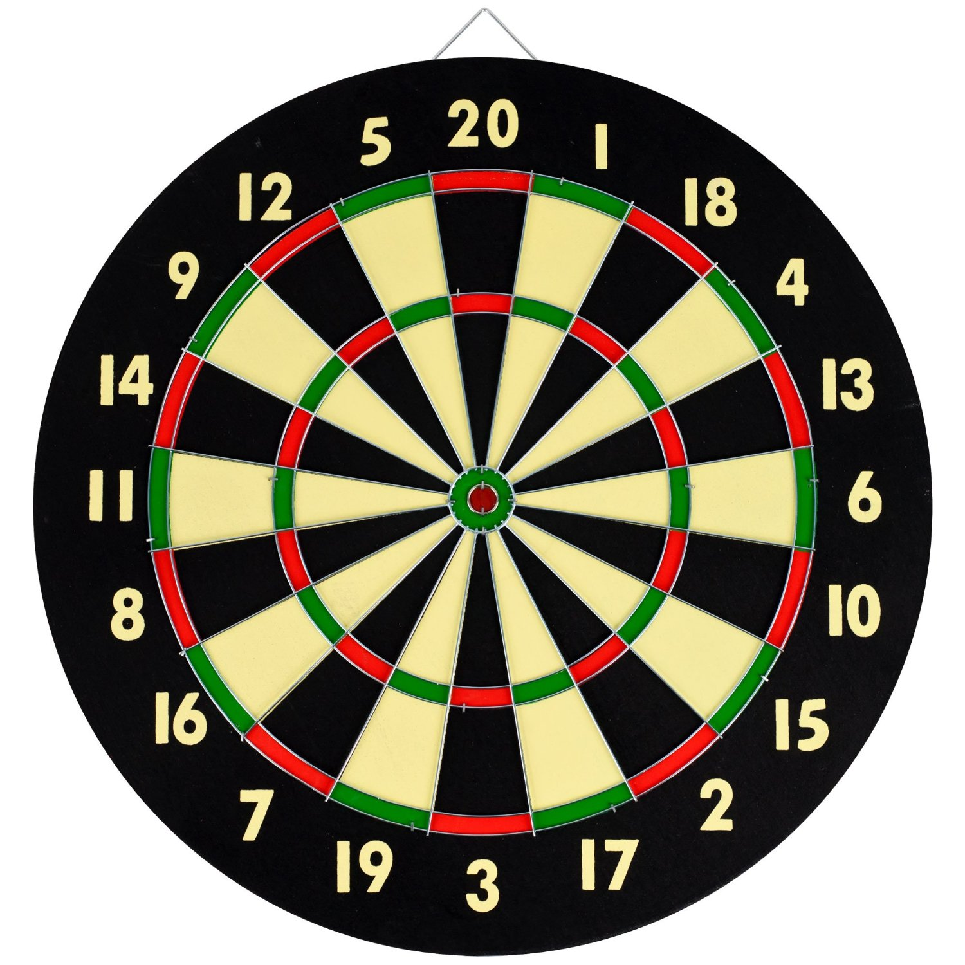
Dart Board
Slices: 1 – 20
Multipliers:
Single
Double (Outer ring)
Triple (Inner Ring)
“Bull’s eye”

Slide 3
Implementation
Preprocessing
Create Mask
Label Slice
Assign a specific value to each pixel

Slide 4
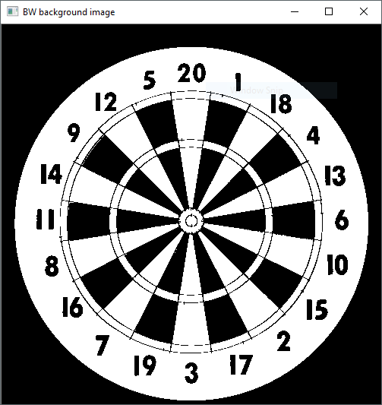
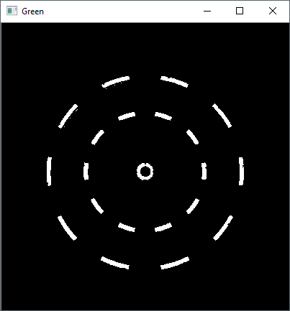
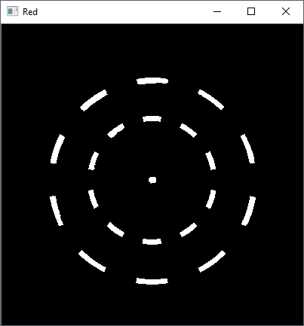
Preprocessing
Thresholding the color image to create B&W image
Splitting the colors (green & red)

Slide 5
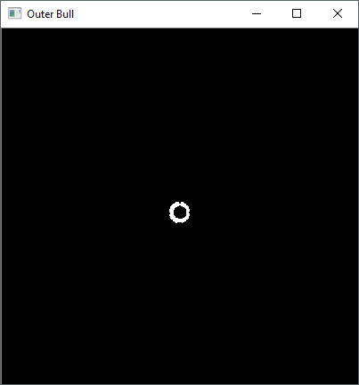
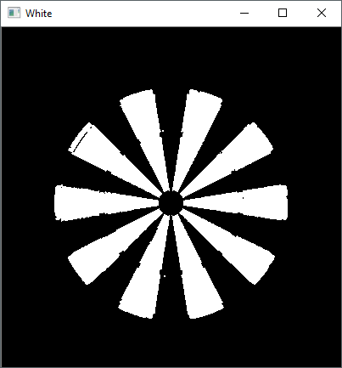
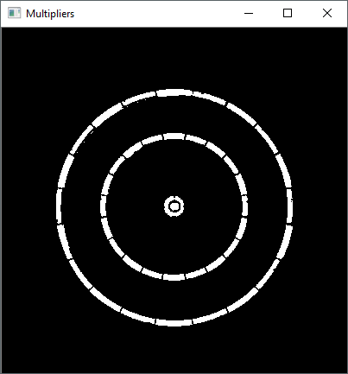
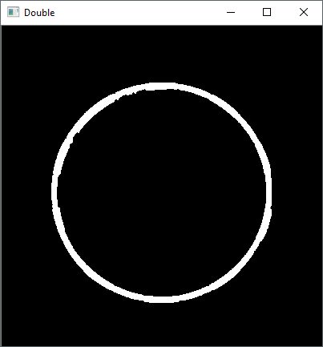
Create Mask
Contents of the Mask:
White
Black
Multipliers
Multiplier rings
Board
Miss
Single
Double
Triple
Outer bull
Inner bull

Slide 6
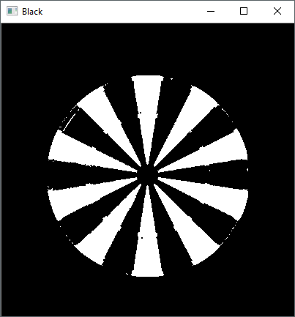
Label slices: (source image)

Slide 7
Assign a specific value to each pixel
Apply morphological operations to make sure regions do not intersect
Apply image labeling to the images
Detect the center of each slice and compute the angle
Assign the real dart value to the region

Slide 8
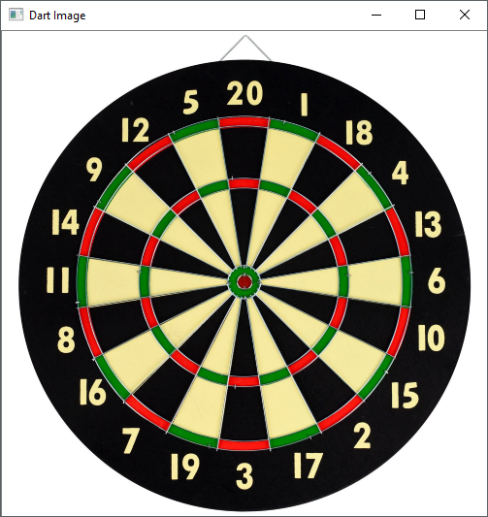
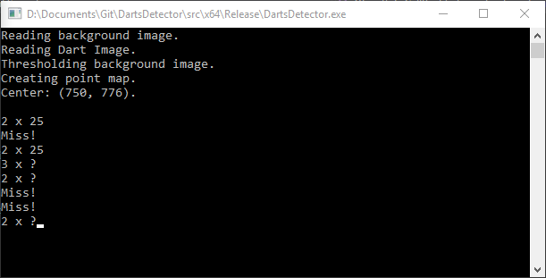
Demo and Usage
User selects a pixel
Check if pixel in board
Check region
Single
Double
Triple
Bull’s eye
Check slice
Values: 1 – 20
If a pixel is not covered by a labeled slice we approximate the closest slice and assign it

