Slide 1
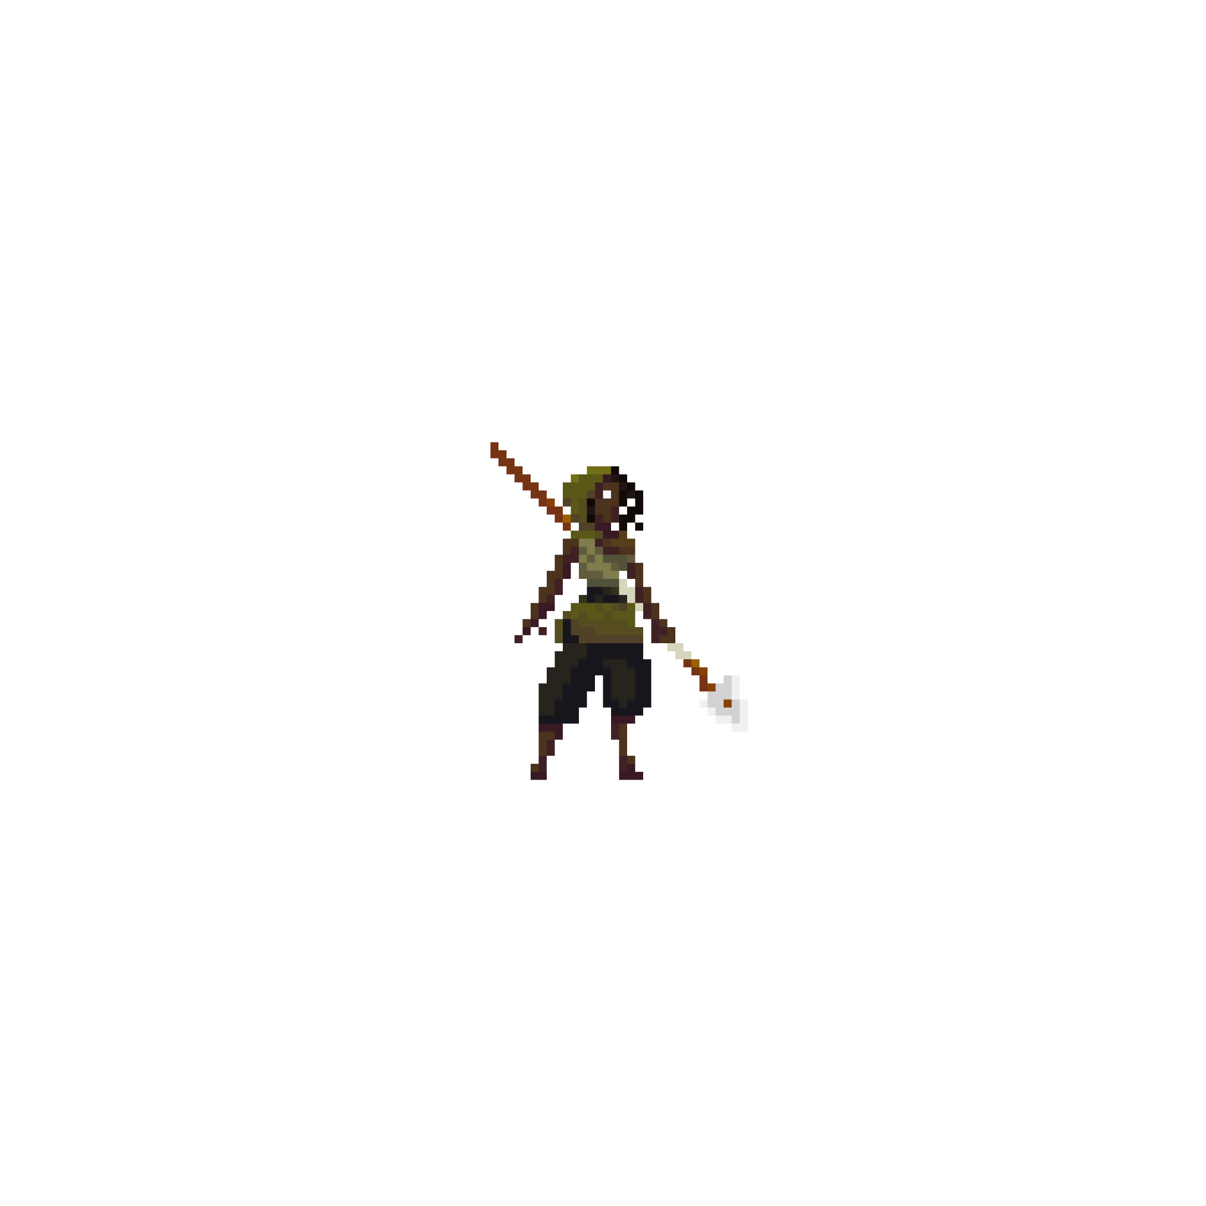
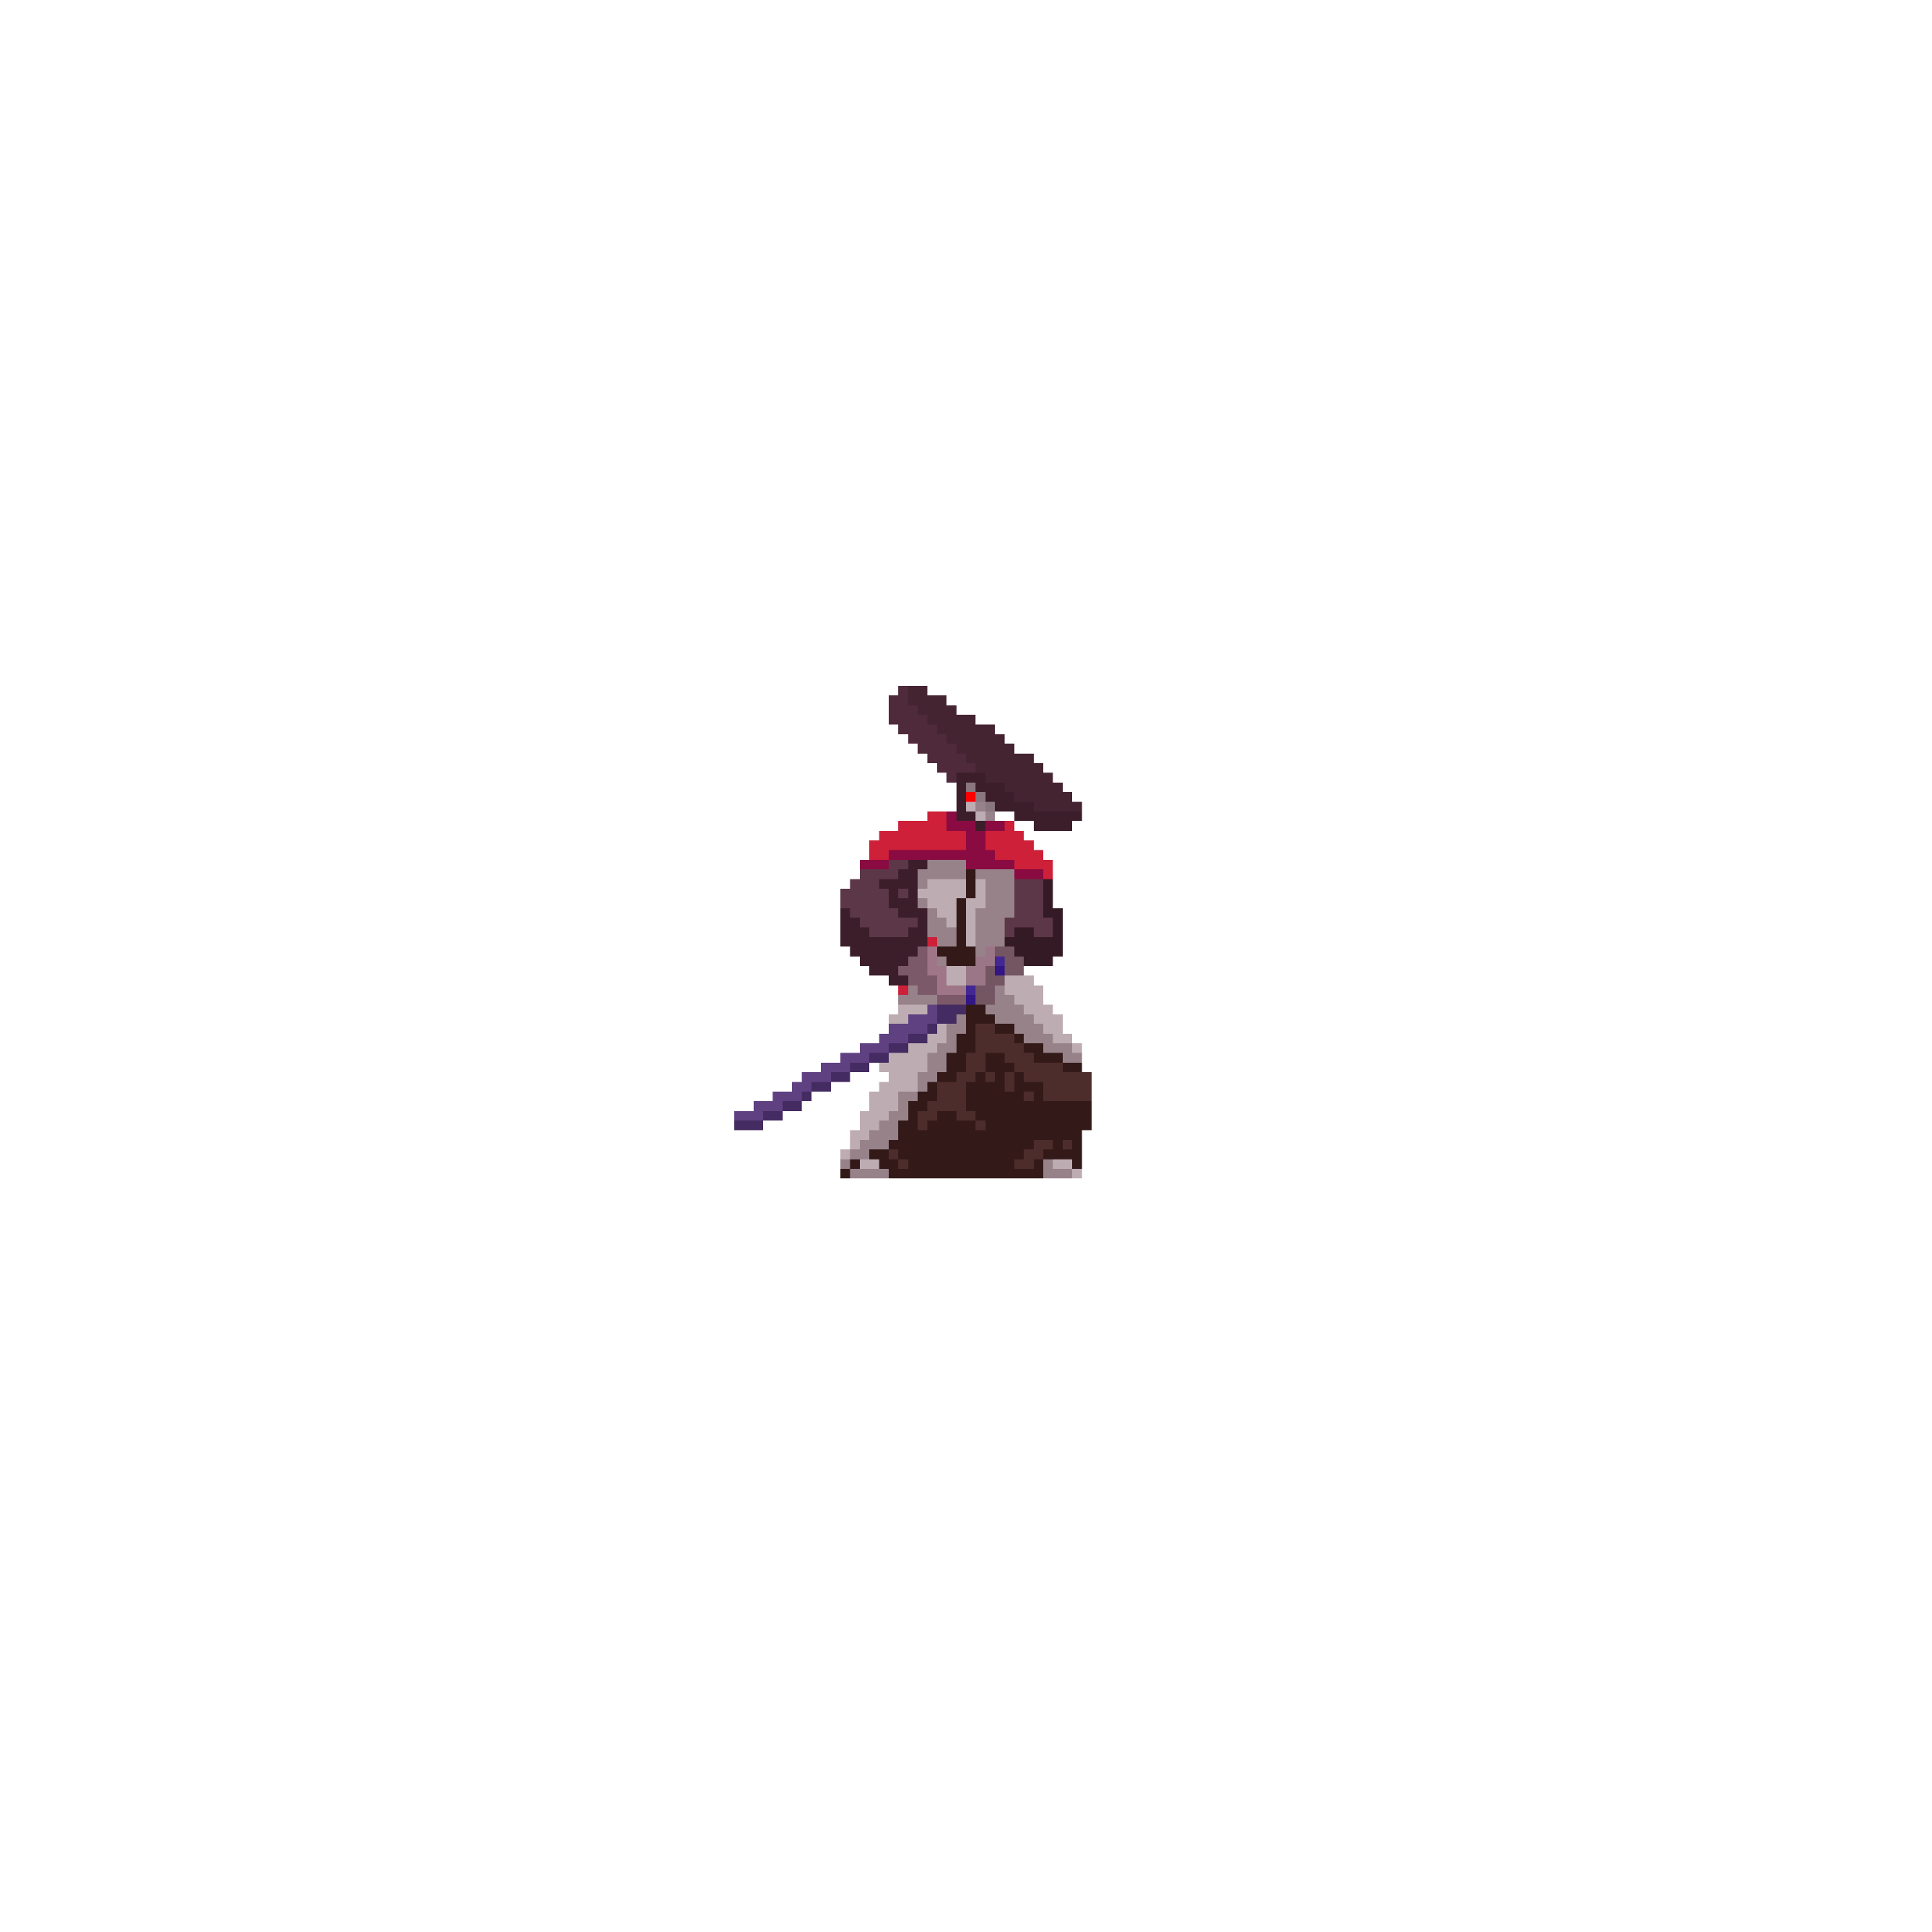
Blades of Destiny

Slide 2
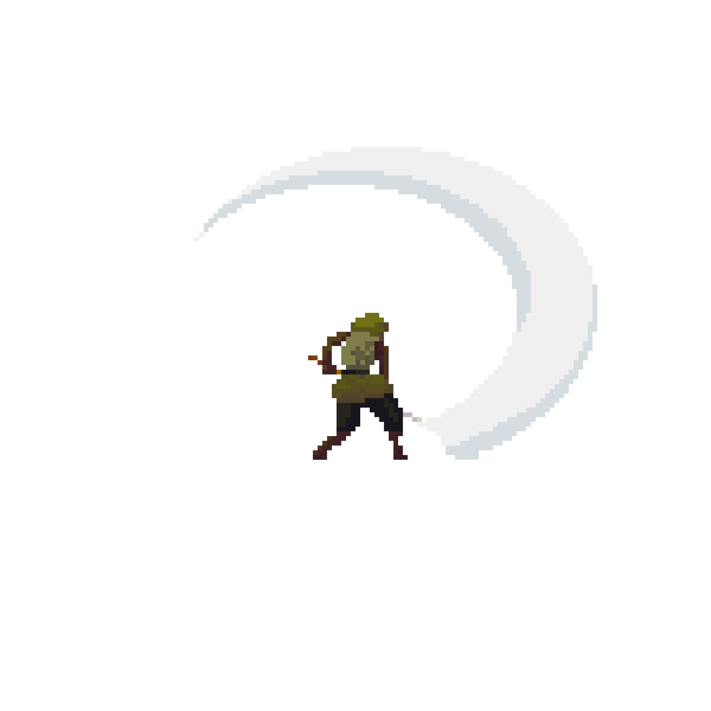
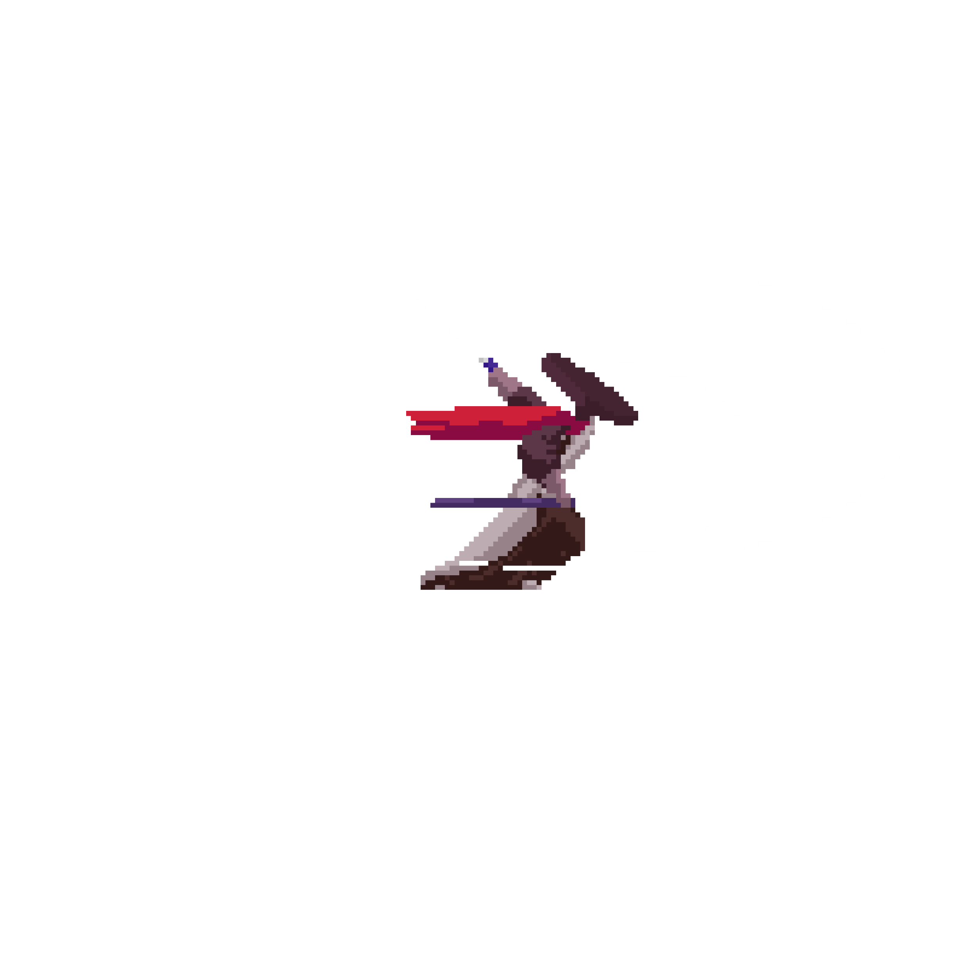
Alap elképzelés
VS

Slide 3
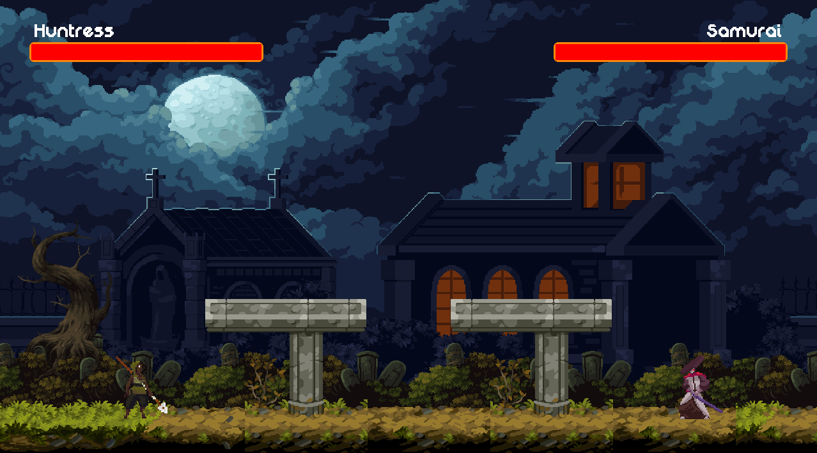


Hogyan is néz ki a játék
Miből épül fel:
-háttér
-csempék
-élet csík
-platformok
-karakterek
Élet
Platform
Huntress
Samurai
Csempe

Slide 4
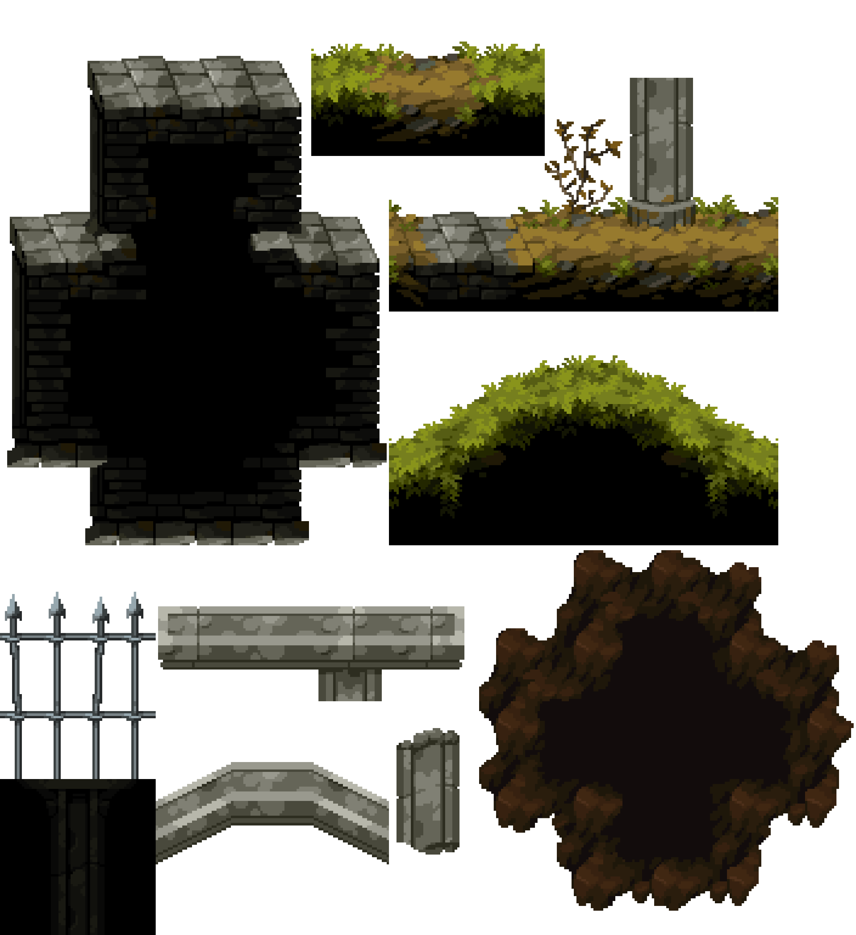
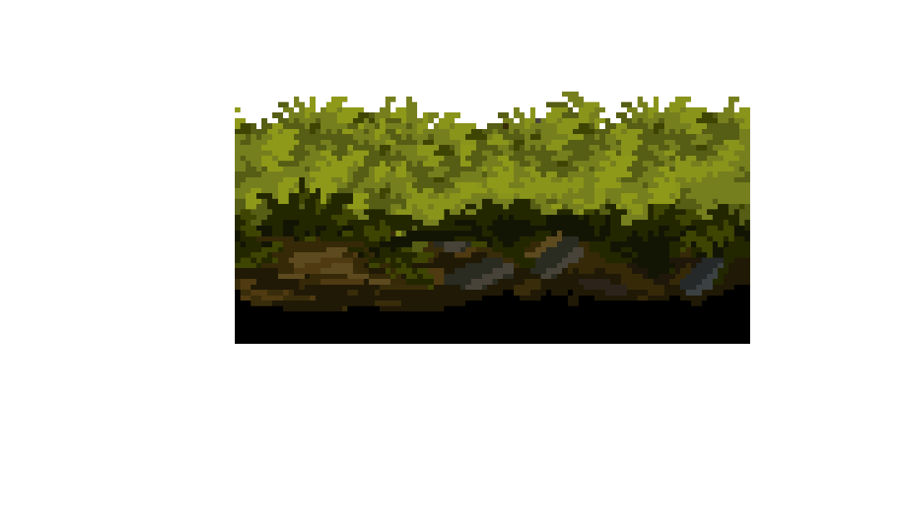
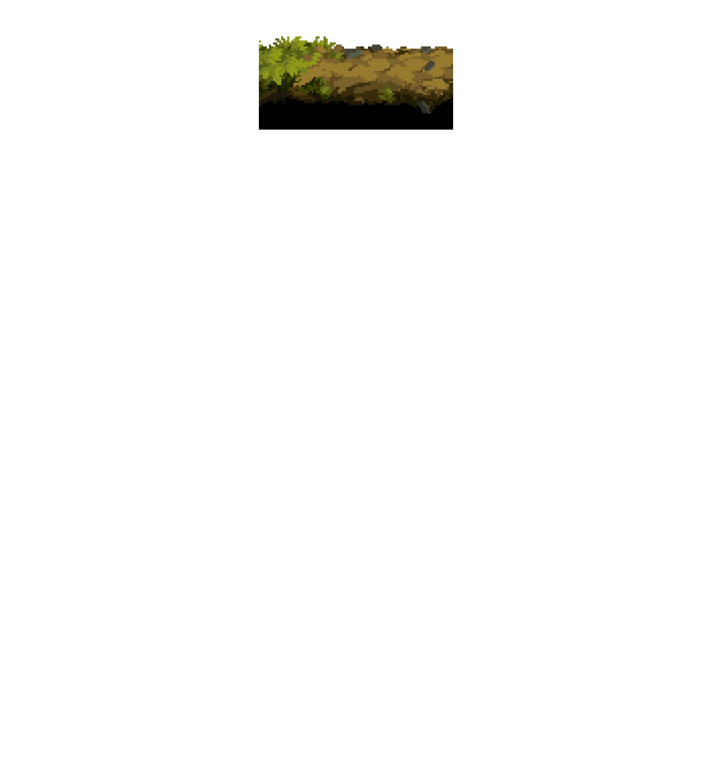
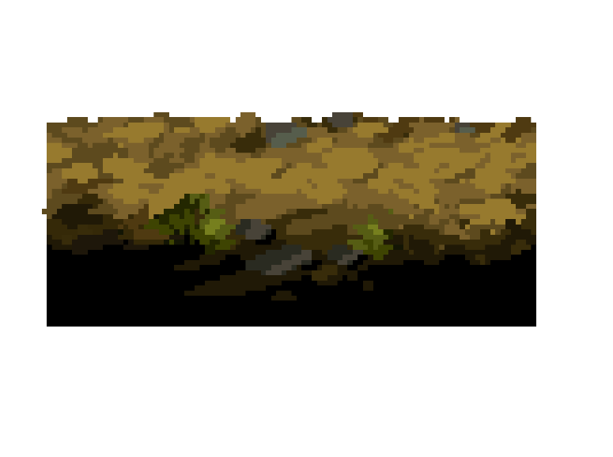
Csempék
LEVEL_MAP_STR: list[str] = [
" ",
" ",
" ",
" P P ",
" ",
"xXfzfzXx"
]

Slide 5
Csempék
LEVEL_MAP_STR: list[str] = [
" ",
" ",
" ",
" P P ",
" ",
"xXfzfzXx"
]
P
z
f
X
x
P
x
X
f
z

Slide 6
Csempék
LEVEL_MAP_STR: list[str] = [
" ",
" ",
" ",
" P P ",
" ",
"xXfzfzXx"
]
P
P
x
X
f
z
f
z
X
x

Slide 7
Csempék
LEVEL_MAP_STR: list[str] = [
" ",
" ",
" ",
" P P ",
" ",
"xXfzfzXx"
]

Slide 8
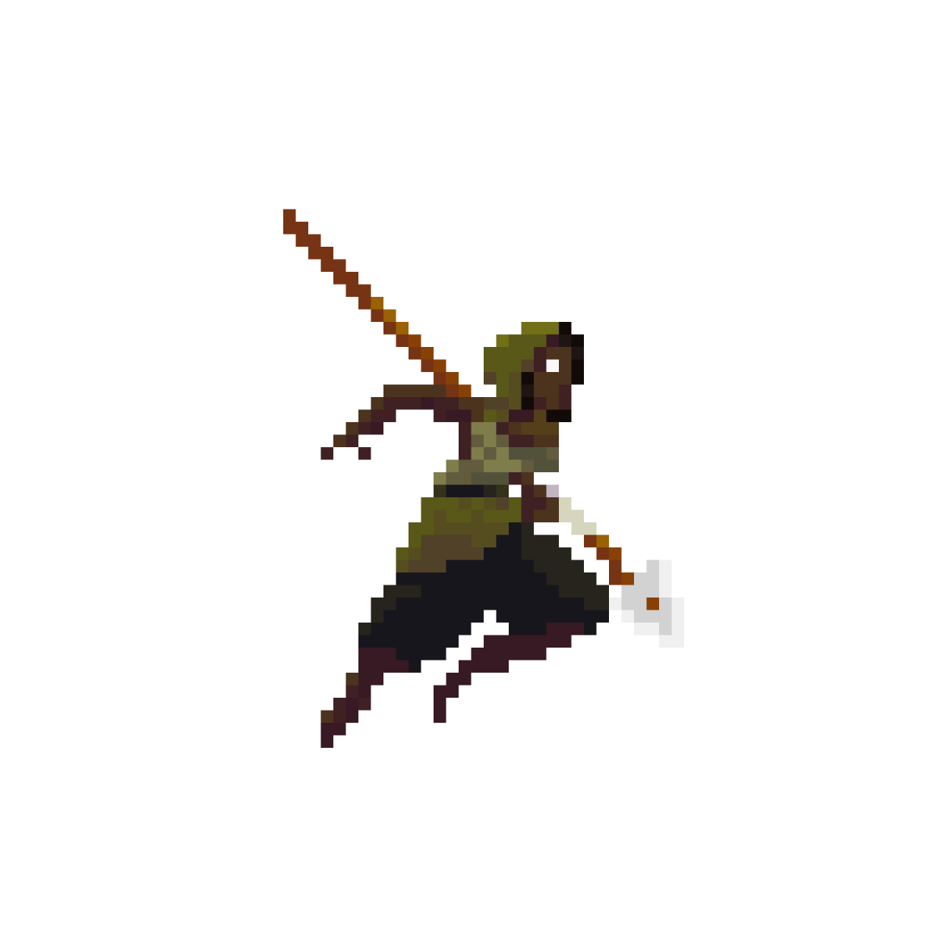
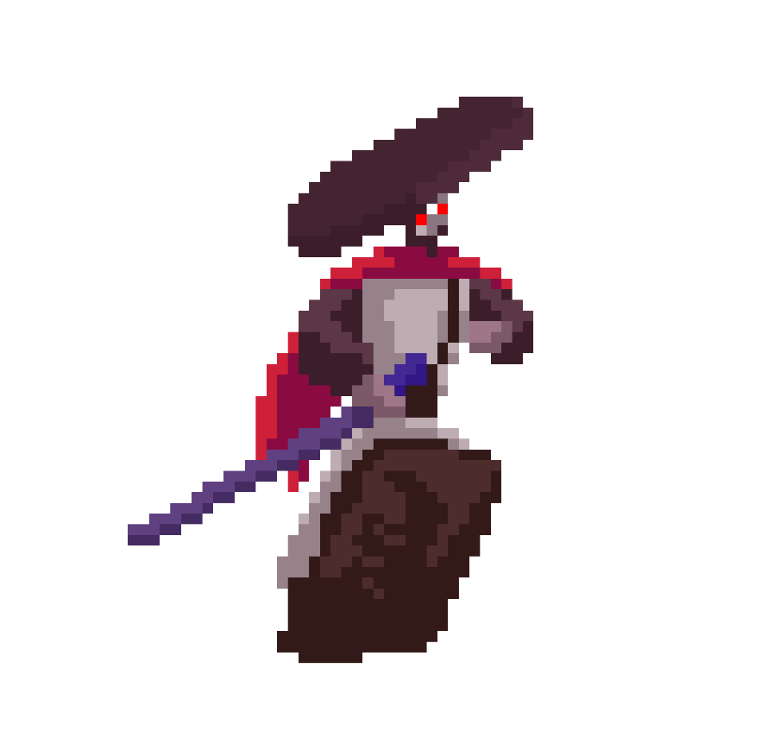
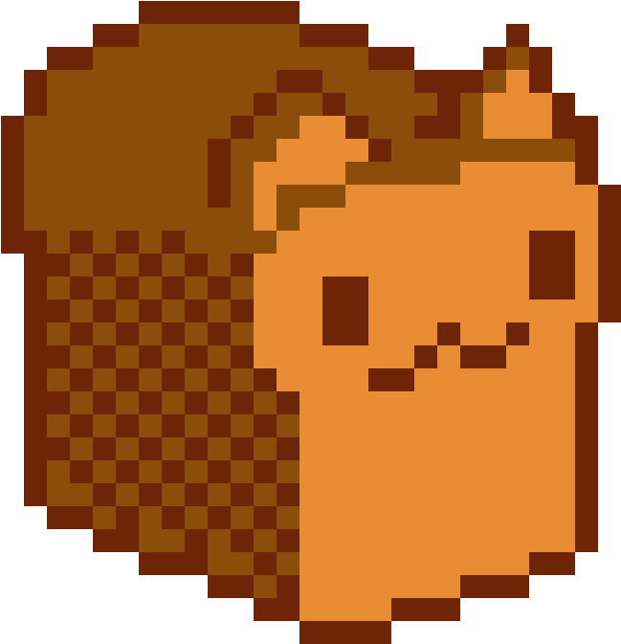
Osztályok
Player
Display_Name
Samurai
Huntress
Bredket
Healthbar

Slide 9
Sebzés
def knockback(self, enemy_dir: None|str = None) -> None:
self.P_knockback = True
if enemy_dir:
self.enemy_dir_const = enemy_dir
if self.knockback_force > 0:
if self.enemy_dir_const == "left":
self.move_left(self.knockback_force)
else:
self.move_right(self.knockback_force)
self.knockback_force -= sett.PLAYER_VEL_1//2
else:
self.P_knockback = False
self.knockback_force = sett.PLAYER_VEL_1 * 5
def make_hit(self, damage: int):
if self.hit_count == 0:
self.hp -= damage
self.hit_count = 0
self.hit = True
Knockback

Slide 10
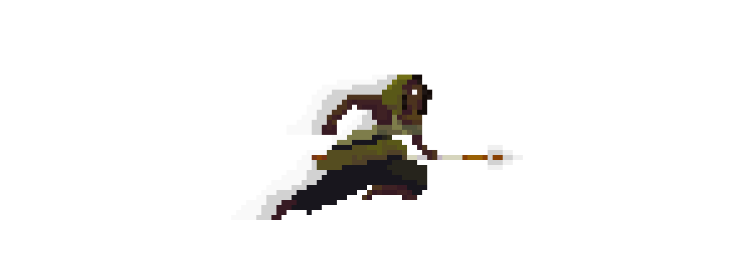
def dash(self):
if self.dash_count > 0:
self.P_dash = True
self.jump_force = 0
self.fall_count = 0
if self.direction == "left":
if self.name == "Huntress":
self.move_left(sett.PLAYER_VEL_1*1.7)
else:
self.move_left(sett.PLAYER_VEL_2*2.4)
else:
if self.name == "Huntress":
self.move_right(sett.PLAYER_VEL_1*1.7)
else:
self.move_right(sett.PLAYER_VEL_2*2.4)
self.dash_count -= 1
else:
self.P_dash = False
self.dash_cd = 90
self.dash_count = 5 * self.ANIMATION_DELAY
self.jump_force = -self.GRAV * 22
Dashelés
Dash
Kód

Slide 11
Easter egg

Slide 12
Köszönjük a figyelmet

