Slide 1
Futóbolondok
2nd TW
Ask máté
project

Slide 2
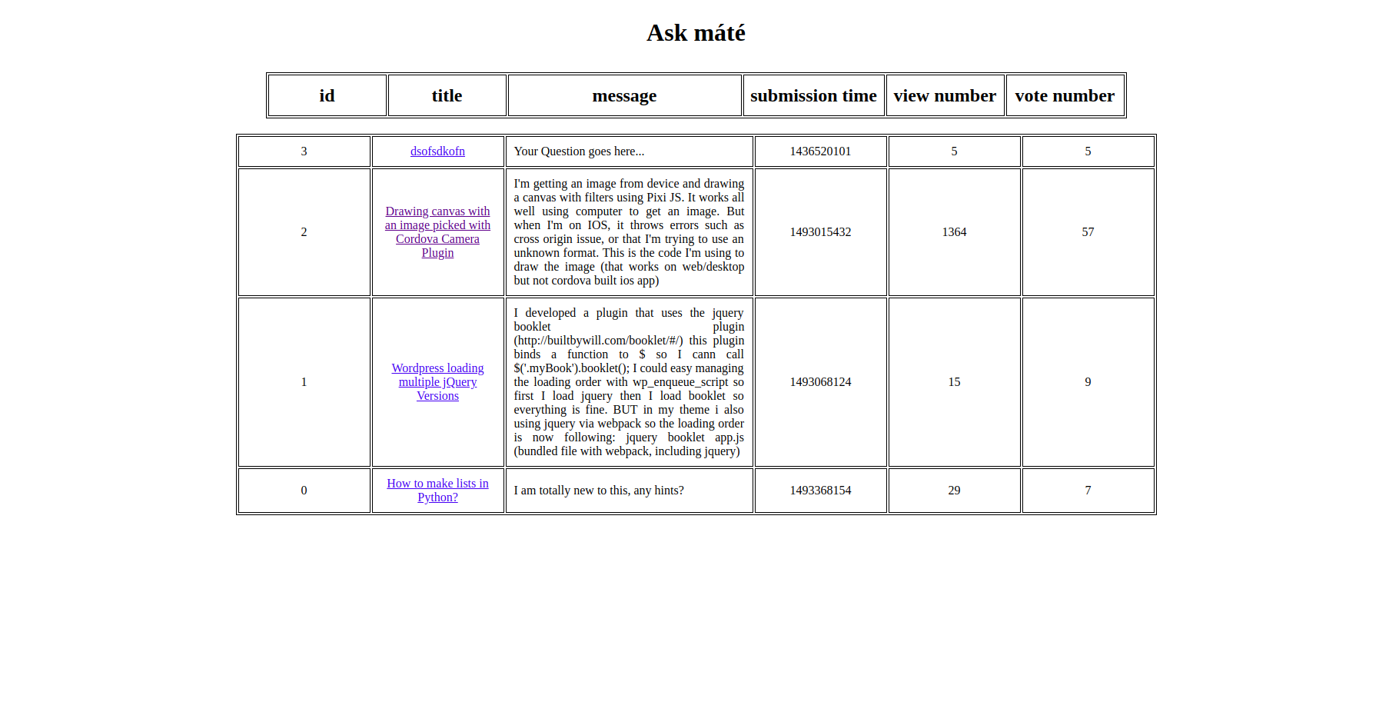
Previous version

Slide 3
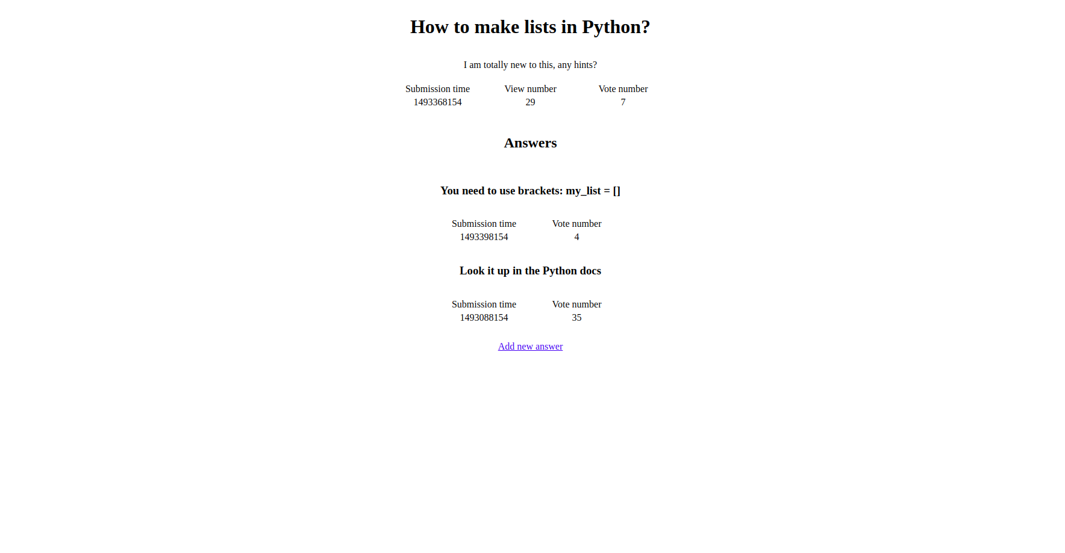
Previous version

Slide 4
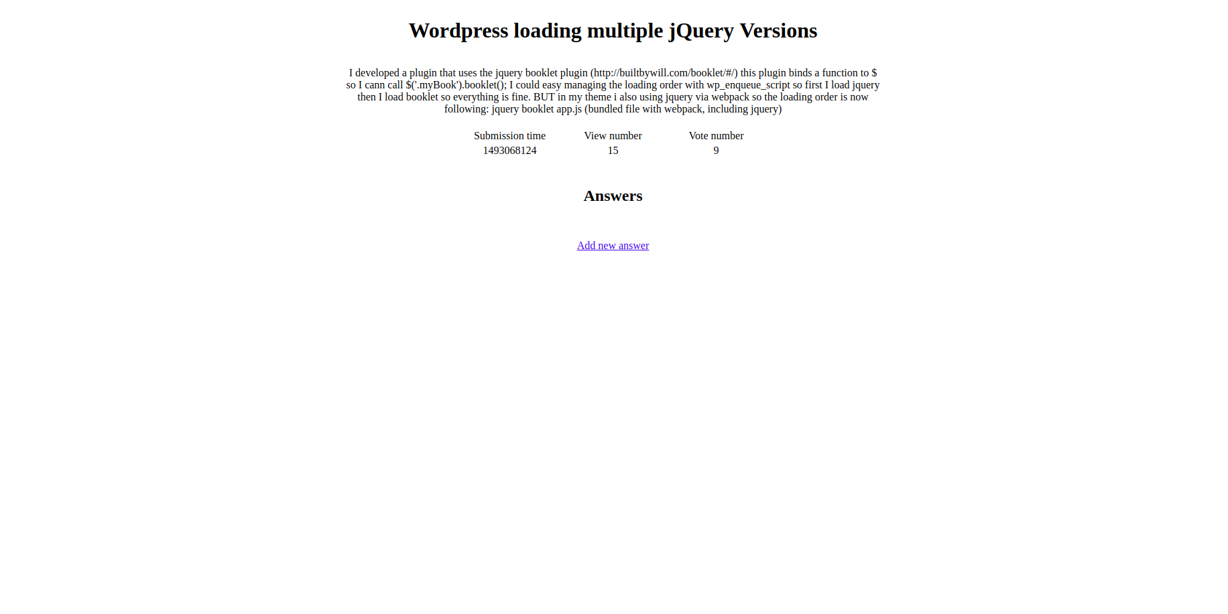
Previous version

Slide 5
Previous version
Only a few features (ask questions, answer questions, delete questions and answers)
CSV files
No CSS

Slide 6
New version
Previous features improved
SQL
Add comments to answers and questions
Sort questions
Search in questions
Edit answers
Display latest questions
CSS

Slide 7
Business value
Previous version: 5000
New version: 7800

