Slide 1
Futóbolondok
Ask máté project

Slide 2
Ask Máté
Questions can be asked
Answers can be posted
Questions and answers can be deleted
And many more!

Slide 3
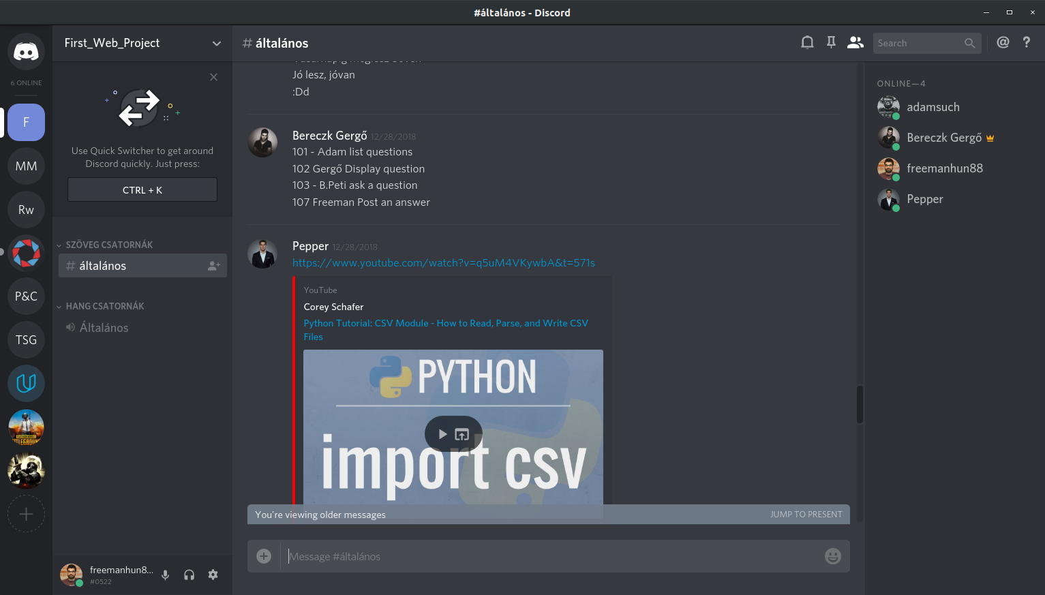
What we planned

Slide 4
What we achieved
List questions – 1000
Display a question – 1000
Ask a question – 1000
Post an answer – 1000
Delete an answer – 400
Delete question - 600

Slide 5




Technologies we used

Slide 6
Let’s jump into it!
http://0.0.0.0:8000

