Slide 1

An Introduction to
RoboCup
and
Soccer Simulation 2D
February 28, 2009
Danial Khashabi
Amirkabir University of Technolgy

Slide 2

Overview of lecture
Overview of RoboCup
Necessity of Simulation Leagues
Overview of 3D Simulation
Simulator Mechanics
Simulator Communications Protocol
Some Existing Clients
Other Developments/Tools

Slide 3
What is RoboCup?!
The Robot World Cup Initiative
Started in 1992 as the Robot J-League (Japan)
First games and conferences in 1997
Workshops, conferences and yearly competitions
Slogan of games:
  “By the year 2050, develop a team of fully autonomous humanoid robots that can win against the human world soccer champion team.”

Slide 4
The Goal of Robocup?
RoboCup envisions a set of longer range challenges over next few decades
A standard problem for research in:
  Artificial Intelligence and Machine Learning
  Machine Vision and Image Processing
  Natural Language Processing
  Multi-Agent Team Planning
  And different challenges in Control and Electronics and Computer Science…

Slide 5
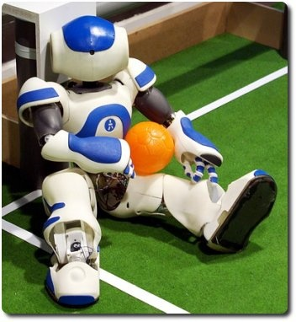
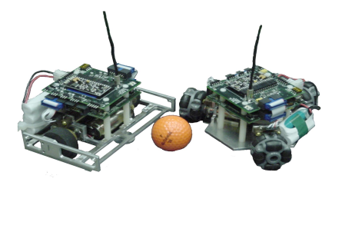
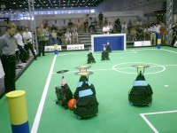
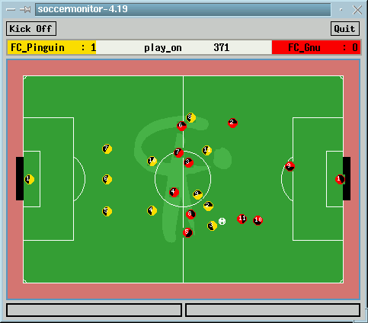
RoboCup Soccer Leagues
Standard Platform
Small Size
Middle Size
Simulation

Slide 6
Why Simulation?!
Since it is not likely that the ultimate RoboCup goal will be met in the near future, it is important to also look for short-term objectives.
The fact that no expensive hardware is needed to build the team.
It provides a standard problem for the evaluation of various theories, algorithms and architectures.
It abstracts from hardware issues and focuses on subjects such as skill learning, coordination techniques, and opponent modeling.
It is much easier (and cheaper) to test a simulation team against different opponents.

Slide 7
Why Soccer?!
    The most popular sport in the world
    Two teams Antagonism
    11 players each Distributed
    Complexity having a lot of conditions
    Uncertainty Result of chaotic behaviour
RoboCup Soccer Simulation
    A research and educational project for multi-agent systems and artificial intelligence.
    The attempt to model a real-life situation on a computer so that it can be studied to see how the system works.

Slide 8
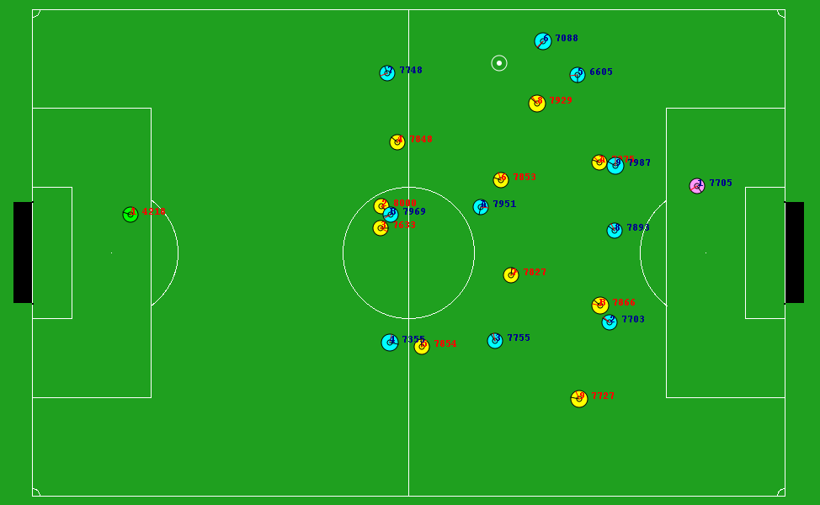
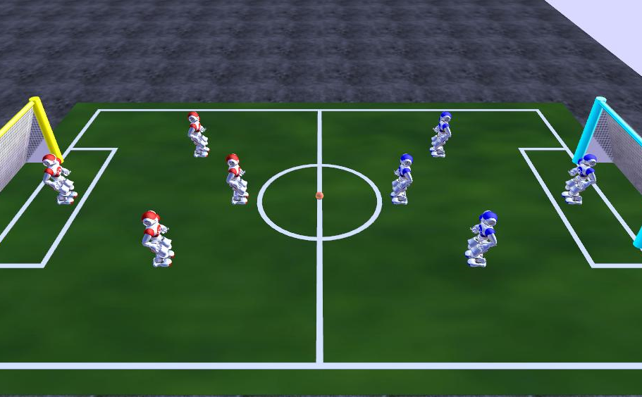
RoboCup Football Simulation Leagues
 | 2D Simulation
 | 3D Simulation

Slide 9
RoboCup Simulation
Consists of:
Server
Monitor clients
Player clients (i.e. agents!)
Coach clients for each team

Slide 10
2D Soccer Simulation
Two teams of 11 virtual agents each play with each other.
based on a computer simulator (i.e. Soccer Server or RCSSServer) that provides a realistic simulation of soccer robot
One demonstrator software to show processes in graphical interface(i.e. Soccer Monitor or RCSSMonitor )
Each agent is a separate process that sends the simulation server.
Environmental information are send to each agent, after actions’ occurrence based on noise values.
Why noise?
  Realistic
  Uncertainty
  Partially
  ….

Slide 11
What is different from computer games?!
Goals
entertainment! Vs. research and education
Differences in characteristics:
  Reality
  None-deterministic
  Noisy
  Partially observation
  Continuous
  Real time
  Distributed
  Practical

Slide 12


Client
Client
Client
Server
Client
Client
Client
Client
Client
Client
Client
Client
Client
Coach
Soccer Monitor
Coach
Monitor(s) used to visualize the action and/or interrupt the game
Coaches (optional) to give guidance to teams
One server
Up to 11 clients per team (plus one coach)
Clients/server communicate via UDP/IP
  TCP/IP support will be added soon!

Slide 13
Soccer Agents
Surrounding Information
Client
Parsing new information and sending new command
Server
Updating environment based on new commands
New Commands
A cycle between server and clients :
Sensory information received from server, decision made, action command sent back to server
Clients may talk only to the server... not to each other!
Clients’ connection is just possible by restricted use of “Say Command”
Clients; Autonomous agents
One client represents one player, goalie 0r coach
Clients can be written in any language (C++, Java, Smalltalk, ...)
Clients can be run on same machine or a network

Slide 14
Clients
An agent is anything that can be viewed as perceiving its environment through sensors and acting upon that environment through effectors.
  The outcome of actions is non-deterministic, consequently the agent has to learn a model for their prediction.
  Observations are noisy and ambiguous, consequently the agent has to build an internal representation of the world, known as a “world model”.
  The environment is dynamic, consequently the agent has to interact in real time.
  The environment contains more than one agent, consequently the agent has to compete or cooperate with other agents.

Slide 15

RoboCup Clients
T(n)
T(n+1)
Surrounding Info:
time
play mode
my body
landmarks
other players
(Say)speech
coach instructions
Player Agent
Actions:
dash
turn
turn head
kick
catch
speak
Parsing new info
And
decision-making
Input from server
Output to server

Slide 16
RoboCup Soccer Server
Keeps time (typically 6000 simulator cycles, 10 cycles per second)
Sends new status information
Receives client messages and updates “world model”
“Automated Referee” tracks current play mode

Slide 17
Coach Agent
Privileged clients used to provide assistance
Receives noise-free view of the whole field
Used for opponent modeling, game analysis, giving strategic tips to teammates
1- Online Coach: Used to advise players during game
2- Offline Coach(Trainer): Used to train agent’s in out of game time. This is an important tool for implement AI algorithms on one team.

Slide 18
Some RoboCup Source Codes
Mersad(Iran)
WrightEagle_BASE(China)
UvA Trilearn (Amsterdam) (2003 champion)
HELIOS (Japan)
Agent2D (HELIOS_BASE)(Japan)

Slide 19
Typical Approaches
Hard-coding (i.e. trial and error !)
Layered Learning
Reinforcement Learning
Artificial Neural Networks
Markov Decision Process
Fuzzy methods
…
and combination of items above with together .
Focus of implementations are also different :
  Decision Making problem. (Cooperative, MAS)
  Skill modeling ( Individual or dual )
  Opponent Modeling(e.g. about specific skill, cooperative task or positioning )
  ….

Slide 20
Example: Krislet
Only one strategy: run to the ball and try to kick it!
Surprisingly effective: Some times it a good challenge for trained teams to test their algorithm’s effectiveness versus a stupid team!
Written in Java, easy to extend

Slide 21
Example: Stripslet
STRIPS style linear planning
Written by Aloke Wiki
Based off of Krislet
A Stripslet implementation is made up of four main concepts: Actors, Sensors, Actions, and a GoalList

Slide 22
Example: UvA Trilearn
Coordination Graphs for cooperative tasks e.g. passing, anticipating passing points
Layered skills hierarchy (e.g. pass and intercept)

Slide 23
Example: FC Portugal
Strategic, ball possession, ball recovery behaviours
“Situation Based Strategic Positioning”
Given game situation, calculated best position and go there

Slide 24
Example: Brainstormers
Scientific research Vs. competitions
Neural Modeling; Most off skills are written based on MLP.
MDP-based decision making
The best team in history of 2d league

Slide 25
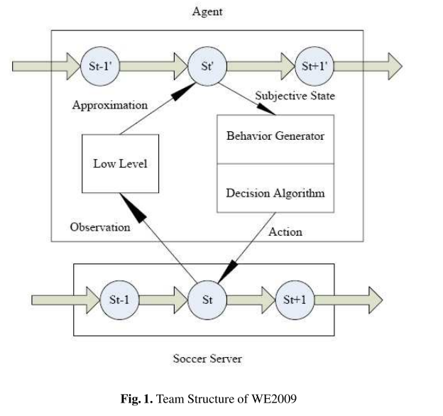
Example: WrightEagle
Neural Modeling
Probabilistic approach to decision making
Great offline noise modeling

Slide 26
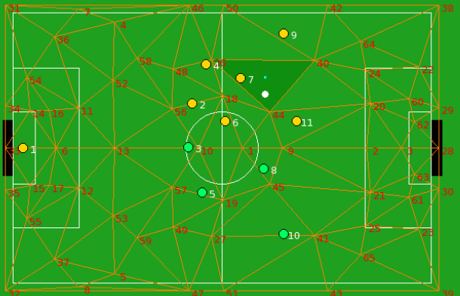
Example: HELIOS
Most of team is hard coded and is result of experimental tests.
The most heuristic part of this team is its semi-dynamic base positioning, based on Delaunay Triangulation. A local and fast function approximation.

Slide 27
Research On Soccer Simulation?!
Try to construct agents that are both autonomous and rational.
Autonomous implies that the agent makes its decisions without the guidance of a user.
Rational means that the agent selects those actions that are expected to achieve the best expected outcome based on the available information.

Slide 28
Research
Opponent Modeling
Modeling and reasoning about other agent’s goals, plans, knowledge,
capabilities, or emotions — is a key issue in multi-agent interaction.
On-line tracking Involves individual players’ real-time, dynamic tracking of opponents’ goals and intentions based on observations of
actions.
On-line strategy recognition ”Coach” agents for teams may observe a
game from the sidelines, and understand the high-level
strategies employed by the opposing team.
Off-line review ”Expert” agents may observe the teams playing in an
after-action review, to recognize the strenghts and
weaknesses of the teams, and provide an expert commentary.

Slide 29
How do I join RoboCup?!
Knowledge
    Programming Language: C++(STL, boost), Script(bash, MATLAB, python...)
    Linux Operation
    Computer Algorithms, Artificial intelligence, ...
    Software Engineering

Slide 30
Starting a Game
Download and install applications:
RCSSServer : Main game running program. Teams connect to this module.
RCSSMonitor : Visuliser of game.
RCSSLogplayer: A tool for reviewing post game.
(running the configure and make scripts for the Unix / Linux systems)
Run the Server (default host is localhost and default port is 6000)
Run the Monitor, connecting to the host and port of the Server
Connect the players to the Server host and port
Start the kick-off!

Slide 31
Read More?!
About RoboCup: www.robocup.org
Soccer Server Manual
Robosina from scratch(Bachelor Thesis)
Articles and TDPs of world cup teams

Slide 32
How To Start?!
Start with UvA-Trilearn-Base:
  Download: http://staff.science.uva.nl/~jellekok/robocup/2003/
Compile it with configure; make;
We will analyze different aspects of UvA-Trilearn-Base code next section

Slide 33
References
Most of the information about RoboCup itself was taken using from the RoboCup Soccer Server manual.
For the latest manuals and server versions, visit the RoboCup project website at: http://sourceforge.net/projects/sserver

