Slide 1
Geodetic Station Information System (GSIS)
Operating System-MS-DOS 3.3 or higher
Software - DBase IV Ver. 1.0
Created/Built in 1989

Slide 2
Geodetic Station Information System (GSIS)
BASIC FEATURES
  Data entry
  Search
  Modify
  Reports
  Maintenance
  Statistics
  Backup & security

Slide 3
Geodetic Station Information System (GSIS)
Data entry
  Collation & coding of data
  Procedure for data entry & validation
    Summarize information
      Filling of data entry form
    Validate immediately after data entry
    Encode (type) station description
  Sketches (diagram of physical location of station)
The MAIN MENU
Search
  Province menu
  Search menu
    by station no.
    by old station no.
    by station name

Slide 4
Geodetic Station Information System (GSIS)
Search (cont’d)
  Search menu
    a window search (latitude, longitude)
      by horizontal order
      by elevation order
    print certificates
      print certificates with the search window
    selective searching (for the current province)
      all stations
      horizontal/elevation order
      horizontal order only
      elevation order only
    province listing
      displays province names and their assigned codes
      allows searching in a different province

Slide 5
Printing of Certificates
Information required
    requesting party
    purpose
    official receipt
    authorized official and title

Slide 6
Geodetic Station Information System (GSIS)
Modify
  Editing, adding and deletion of stations
  Summary/field information and description can be edited
  Options:
    Province menu (select a province)
    Summary Specifications
    Field page specifications
    Add station
    Delete station
    Adding and modifying fields in summary or field page
    History of modifications

Slide 7
Geodetic Station Information System (GSIS)
Reports
  Generate certificates for specific stations
    Supply the needed information
    Service fee of P360.00/sta.
  Statistics on certificates generated
  All stations in a province
  All stations in a municipality
  Window search reports
  History report
  Full report of all barangay names

Slide 8
Geodetic Station Information System (GSIS)
OTHER MINOR FEATURES
  Maintenance
    Repair index files
    Delete or recall marked stations
    Troubleshooting
  Statistics
    Field page numbers
    Total no. of stations
  Backup & Security
    Backup information
      On a magnetic tape (obsolete)
    Restore facility
      All information
      Whole database
    Security of data
      Authorized personnel and trained staff
      Un-erase files accidentally deleted
END

Slide 9
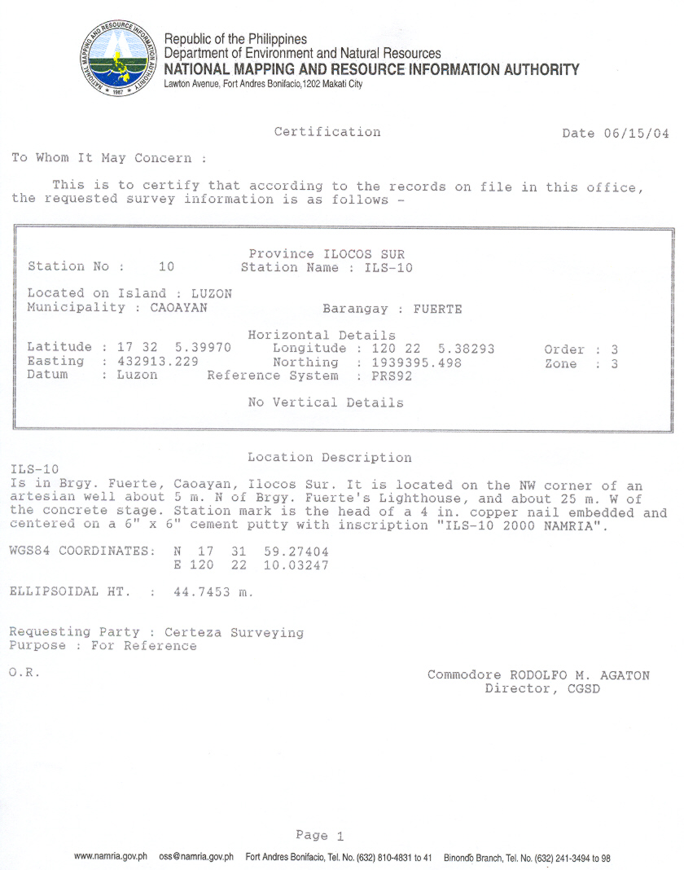
Certification
Certification

Slide 10
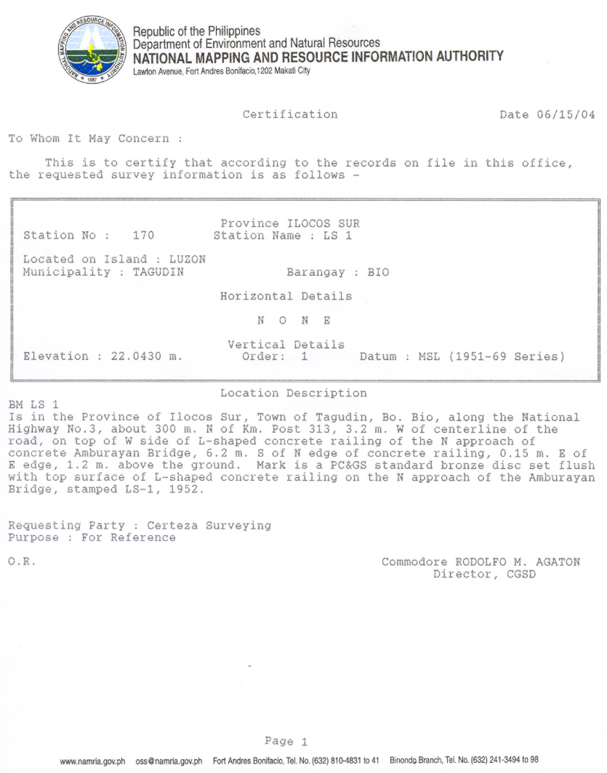
Certification
Certification

Slide 11
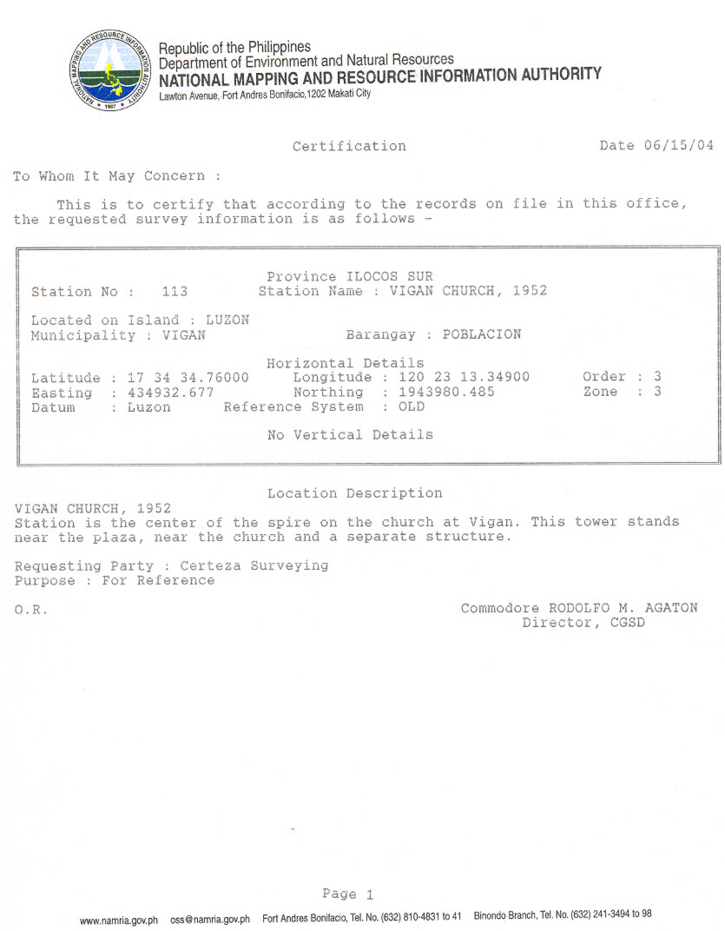
Certification
Certification

Slide 12
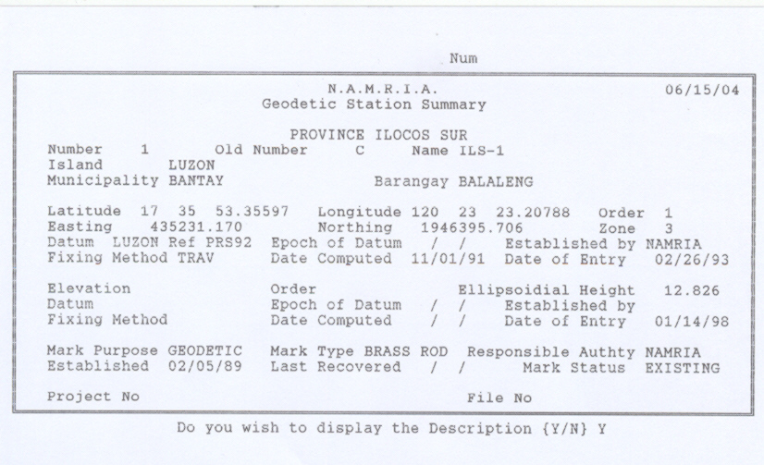
STATION SUMMARY

Slide 13
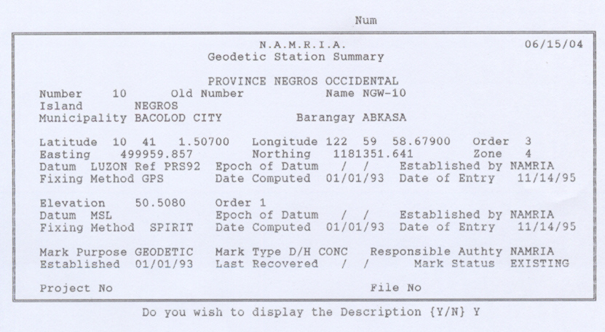
STATION SUMMARY

Slide 14
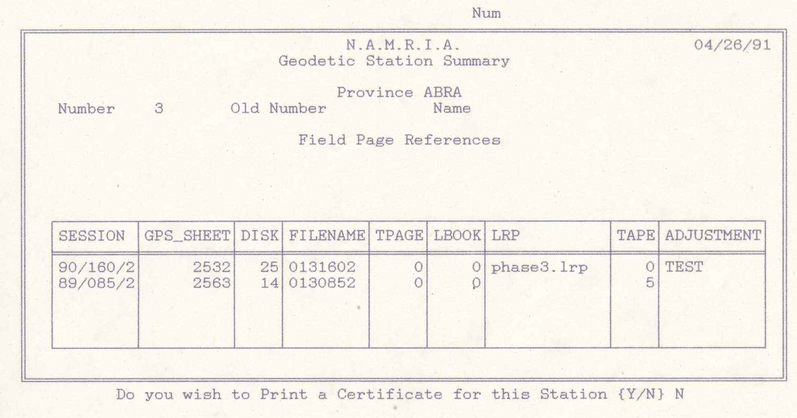
FIELD PAGE

Slide 15
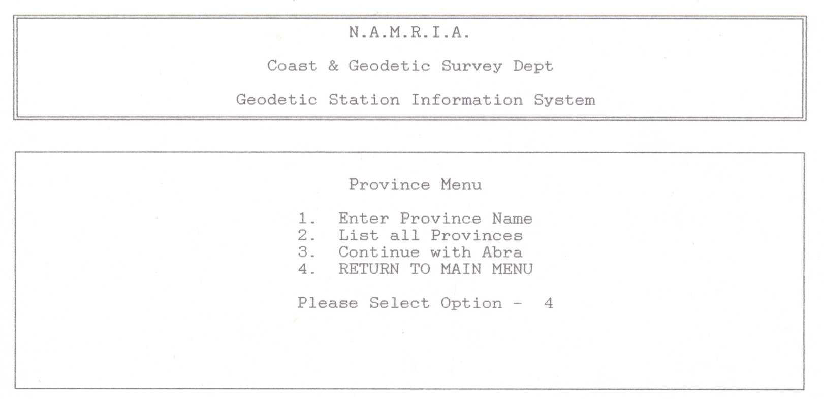
PROVINCE MENU

Slide 16
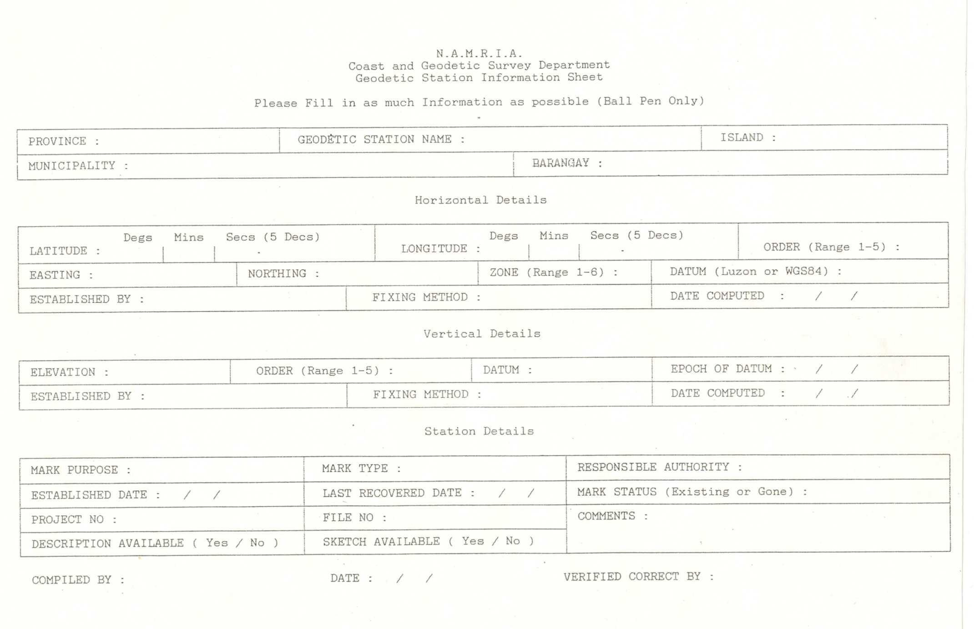
DATA ENTRY FORM

Slide 17
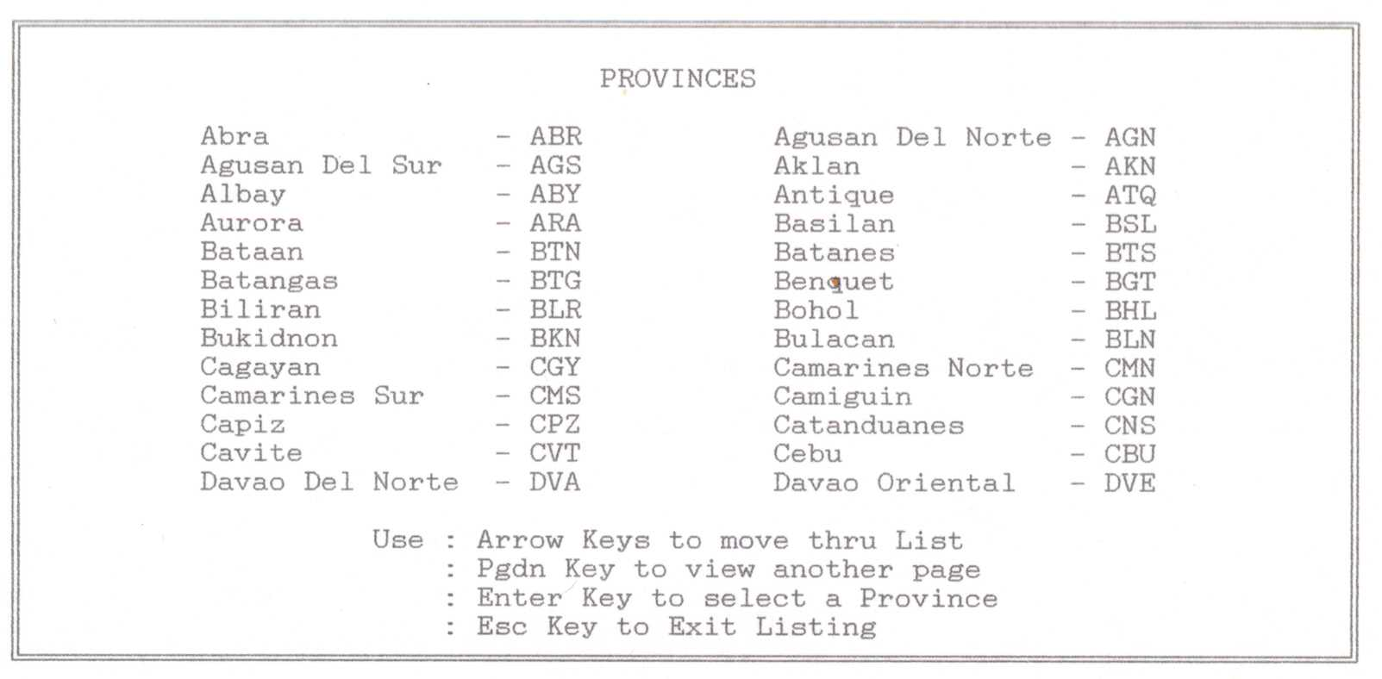
PROVINCE CODES

Slide 18
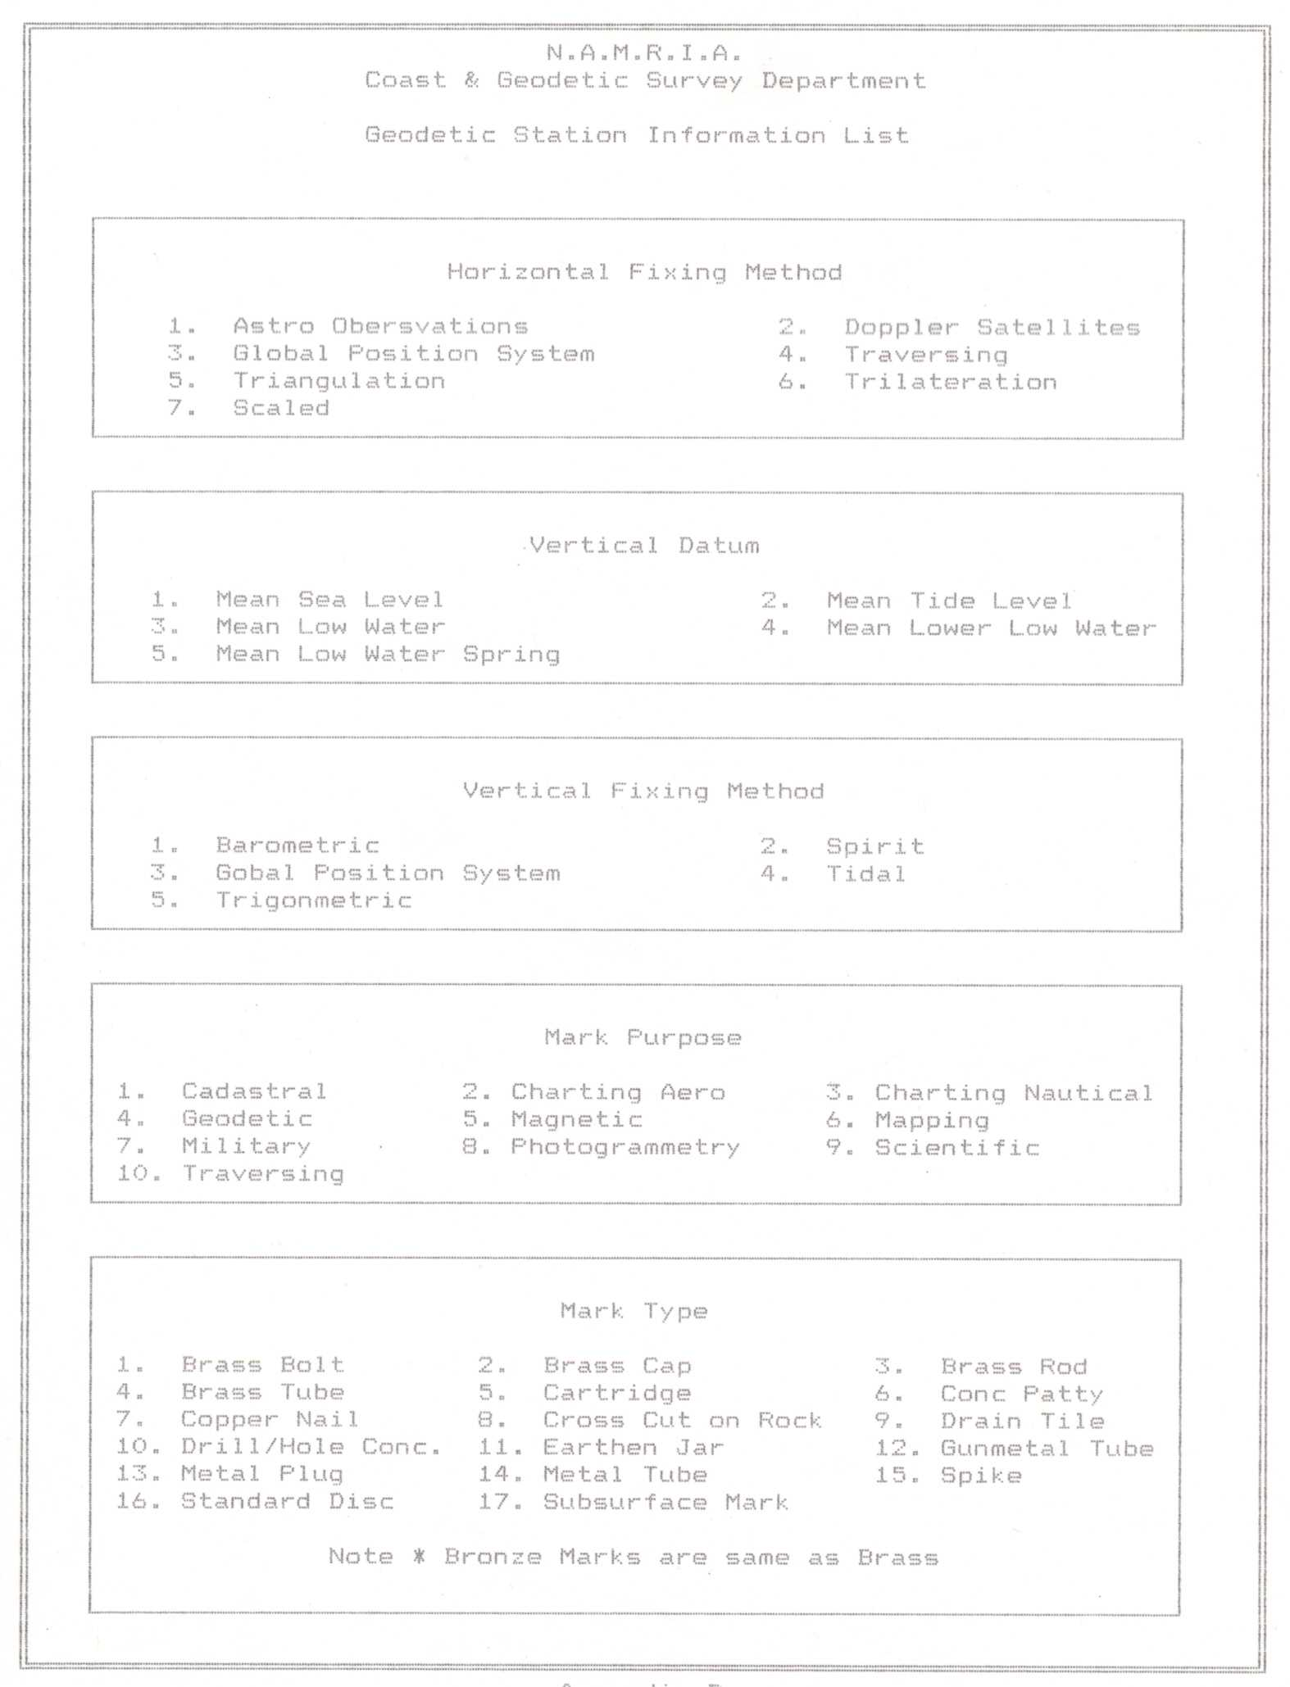
Field Entry
Field Entry

Slide 19
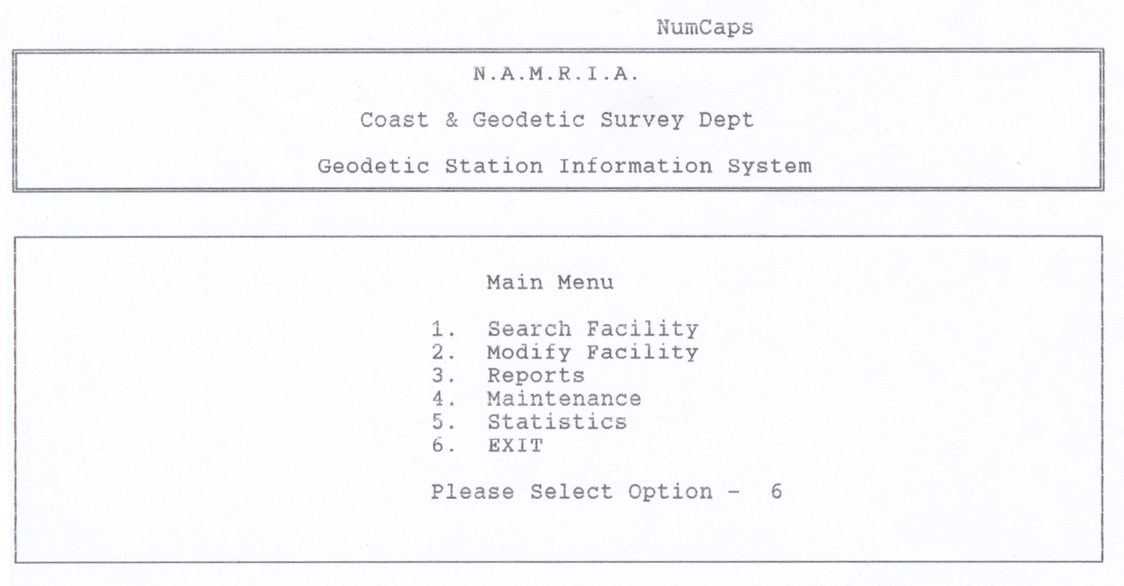
MAIN MENU

Slide 20
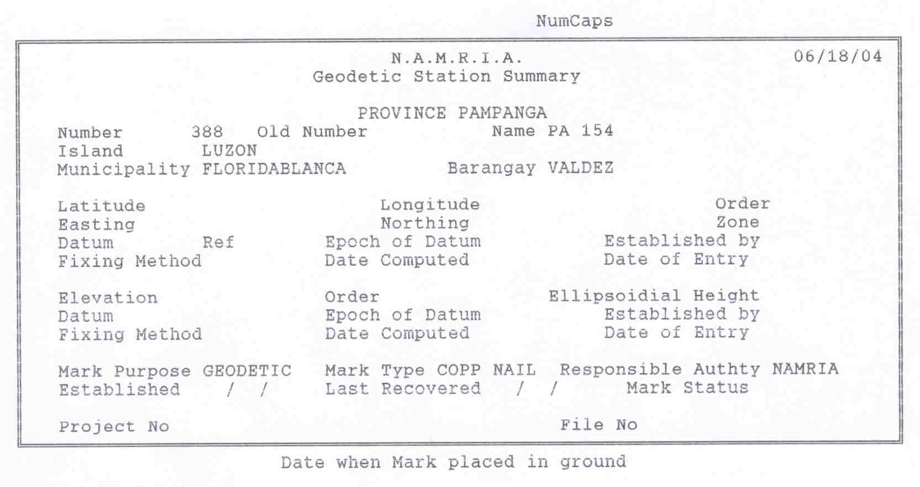
Modify/edit fields

Slide 21
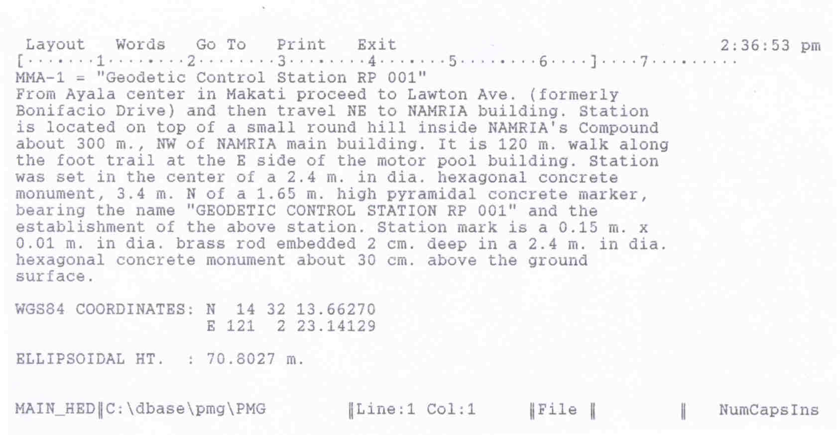
Station Description

Slide 22
Thank you!
Thank you!

Slide 23
PROVINCE CODES

