Slide 1








North Wall
0
1
2
3
$$φ_{i}$$
- +
4
$$T_{0}$$
0
1
2
3
4
$$φ_{0}$$
East Wall
0
1
2
3
$$φ_{i}$$
- +
4
$$T_{0}$$
0
1
2
3
4
$$φ_{0}$$
0
1
2
3
$$φ_{i}$$
South Wall
- +
4
1
$$T_{0}$$
0
1
2
3
4
0
$$φ_{0}$$
2
1
West Wall
0
1
2
3
$$φ_{i}$$
3
- +
4
2
TCd0
$$T_{0}$$
0
1
2
3
4
4
3
0
$$φ_{0}$$
$$φ_{aux}$$
Window
$$φ_{a}$$
5
4
- +
0
1
$$T_{0}$$
0
1
6
5
$$φ_{i}$$
7
TCd7
- +
0
1
6
$$T_{0}$$
0
1
2
2
$$φ_{0}$$
8
7
TCd8
$$φ_{i}$$
- +
0
1
$$T_{0}$$
0
1
2
2
0
- +
+ -
$$φ_{0}$$
$$T_{0}$$
0
1
$$T_{i,sp}$$
TCd9
$$φ_{i}$$
TCd1
- +
0
1
2
3
$$T_{g}$$
0
1
2
3
4
4

Slide 2
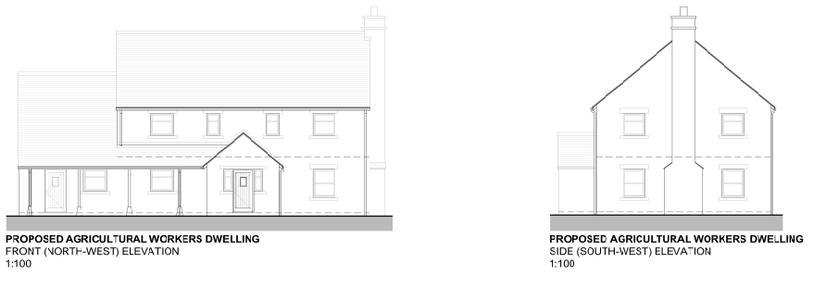
2 m
5 m
14.5 m
7 m

Slide 3
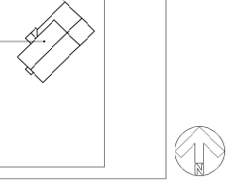
135
-135
W2
W1
R1
R2
W3
W4
G1
45
-45

