Slide 1

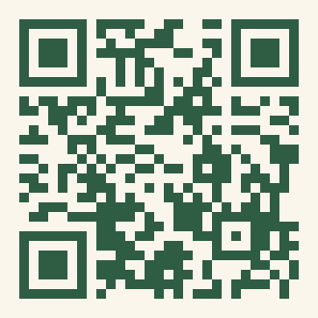
FIRST-GENERATION UNDERREPRESENTED IN RESEARCH & MEDICINE
You Belong Here.
However YOU Define First-Gen Or Underrepresented — Come Find Your People.
This Fall At FURM
• Kickoff Social · Late September — Food, Games & Meeting Your People
• CubCare Mentor / Mentee · October — Get Paired With Someone Who Gets It
• Life @ Med School · November — An Honest Panel With Med Students
• De-Stress Events · Reading Period — Comfort Food & Calm During Finals
• Giveaways · All Semester! — Free Stuff, Thanks To Our Sponsors
Interested In Leadership? Open E-Board Roles — Priority Deadline Sept 18.
Scan To Join
Our Mailing List, Mentorship & E-Board
Brown Bears — Come As You Are.

Slide 2
FURM · Brown PLME
You Belong Here.
First-Gen? Underrepresented In Medicine Or Research? However YOU Define That — There's A Place For You Here.
Community · Mentorship · Belonging
Events All Semester, Plus Our CubCare Mentorship Program.
Scan To Join Our Mailing List & Programs

Slide 3
You Belong Here.
However YOU Define First-Gen Or Underrepresented — Come Find Your People.
First-Generation
Underrepresented
In Research &
Medicine
This Fall
Kickoff Social · Late September
Food, Games & Meeting Your People
CubCare Mentor / Mentee · October
Get Paired With Someone Who Gets It
Life @ Med School · November
An Honest Panel With Med Students
Community
Care
Belonging
De-Stress Events · Reading Period
Comfort Food & Calm During Finals
Giveaways · All Semester!
Free Stuff, Thanks To Our Sponsors
Scan To Join
Mailing List, Mentorship & E-Board
Priority E-Board Deadline: Sept 18
Brown Bears — Come As You Are.

Slide 4
You Belong Here.
First-Gen? Underrepresented In Medicine Or Research? However YOU Define That
Find Your People.
A Home For First-Gen & Underrepresented Students In Medicine
Kickoff Social
Late September
Food, Games & Meeting Your People
CubCare Mentor / Mentee
October
Get Paired With Someone Who Gets It
Life @ Med School
November
An Honest Panel With Med Students
De-Stress Events
Reading Period
Comfort Food & Calm During Finals
Giveaways
All Semester!
Free Stuff, Thanks To Our Sponsors
Join The E-Board
Sept 18
Open Leadership Roles This Fall
Scan To Join
Mailing List, Mentorship & E-Board
Brown Bears — Come As You Are.

