Slide 1

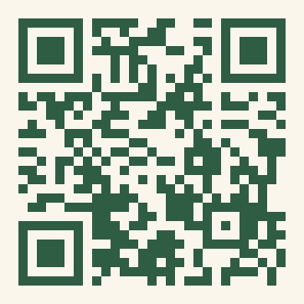
Who we are
A home within Brown PLME for students who care about community, mentorship, and equity in healthcare. We're first-generation and underrepresented in research and medicine — and YOU get to define what that means for YOU.
Whoever you are, if you believe in building more welcoming healthcare spaces, there's a place for you here — we're about belonging and community.
Brown PLME
This fall
First-Generation
Underrepresented in
Research & Medicine
Kickoff Social
Coming late September
CubCare Mentorship
October
Life @ Med School
November
De-Stress Night
Reading Period
Scan to join
mailing list · mentorship · e-board
Community · Care · Belonging
Giveaways · All semester!
Sponsors: AWS, Elks Foundation, Millennium Fellowship

Slide 2
FURM
First-Generation Underrepresented in Research & Medicine · Brown PLME
We're a home within Brown PLME for students who care about community, mentorship, and equity in healthcare. We're first-generation and underrepresented in research and medicine — and YOU define what that means for you.
Whoever you are, there's a place for you here. We're about belonging and community.
Coming late September
October
November
Reading period
Kickoff Social
Food, games & meeting your people
CubCare Mentorship
Get paired with someone who gets it
Life @ Med School
An honest panel with med students
De-Stress Night
Comfort food during finals
Scan the QR to join our mailing list & sign up for mentorship · we do giveaways too!

Slide 3
You belong here.
First-generation? Underrepresented in medicine or research? However YOU define that — come find your people.
KICKOFF SOCIAL · Coming late September
Food · games · community — watch your email for the date
Scan to join our mailing list & mentorship · Brown Bears — come as you are

Slide 4
You belong here.
FURM · First-Gen & Underrepresented in Research & Medicine · Brown PLME
However YOU define first-generation or underrepresented — come find your people. We're about community, care, and belonging.
Fall Events
Interested in leadership?
• Kickoff Social
Coming late September
Open E-Board positions this fall (year-long):
• CubCare Mentor / Mentee Program
October
• Secretary
• Treasurer
• Life @ Med School (honest panel)
November
• Underclassman Liaison (’29 & ’30)
• De-Stress Night
Reading Period
• Upperclassman Liaison (’27 & ’28)
• Giveaways
All semester!
Priority deadline: September 18
Scan to join our mailing list, mentorship & E-Board — all in one place

