Slide 1
University of Eastern Africa, Baraton
INSY 492 · Senior Project Proposal
Vehicle Hire and
Session Tracking System
Gerison Kimathi Muriungi | SMURGE2311
Major: Information Systems & Computing
Supervisor: Omari Dickson Mogaka
1 / 8

Slide 2
Introduction
2 / 8
Industry Context The vehicle hire industry is rapidly growing across East Africa, driven by urbanization, business travel, and tourism. Yet most small and medium-scale agents still rely on phone calls, paper logs, and manual agreements to manage bookings, track vehicles, and compute charges. The Opportunity Advances in web technologies and real-time databases now make it feasible to build affordable, cloud-based platforms that serve both agents and clients simultaneously — automating session management, providing live cost tracking, and capturing approximate vehicle location from the client's device.
East Africa
Rapidly growing hire market
Manual ops
Error-prone, hard to audit
Real-time tech
Enables live tracking & billing
Vehicle Hire and Session Tracking System · INSY 492

Slide 3
Problem Statement
3 / 8
Car hire agents and clients lack a centralized digital platform to manage the full hire lifecycle — from listing and booking through live session tracking to billing and completion.
No real-time visibility
No transparent billing
Agents cannot see which vehicles are in use, by whom, or how long a session has been running.
Clients have no access to live charge accumulation during their hire, leading to disputes.
Poor fleet awareness
Low trust experience
Agents have zero location awareness of vehicles currently out with clients.
Manual processes result in billing disputes, unaccounted usage, and unresolved complaints.
Vehicle Hire and Session Tracking System · INSY 492

Slide 4
Proposed Solution
4 / 8
A web-based platform that digitizes the full car hire workflow through three user roles: Admin, Agent, and Client.
1
Agent Onboarding
2
Client Booking
Agents register and, upon Admin approval, list vehicles with defined hire rates and session charge parameters.
Clients browse approved listings, place hire orders (Pending), and wait for session initiation at vehicle pickup.
3
Live Session Tracking
4
Completion & Billing
On pickup, a real-time timer and charge meter start. The client's device streams approximate GPS coordinates to the agent dashboard.
On return, the session is marked Complete. A final invoice is generated and payment processed via Paystack (M-Pesa, Airtel Money, card).
Vehicle Hire and Session Tracking System · INSY 492

Slide 5
Objectives
5 / 8
01
To develop a web-based platform enabling car hire agents to register, list vehicles, and manage hire operations following administrator approval.
02
To provide real-time session tracking including elapsed duration and live charge accumulation based on agent-defined rates, visible to both client and agent.
03
To capture and display approximate vehicle location from the client's mobile device during active hire, giving agents fleet-wide location awareness.
04
To integrate Paystack payment processing — supporting M-Pesa, Airtel Money, and card — and Nodemailer email notifications for billing and communication.
05
To enable clients to submit reviews and ratings for completed hire sessions, improving agent accountability and service quality.
Vehicle Hire and Session Tracking System · INSY 492

Slide 6
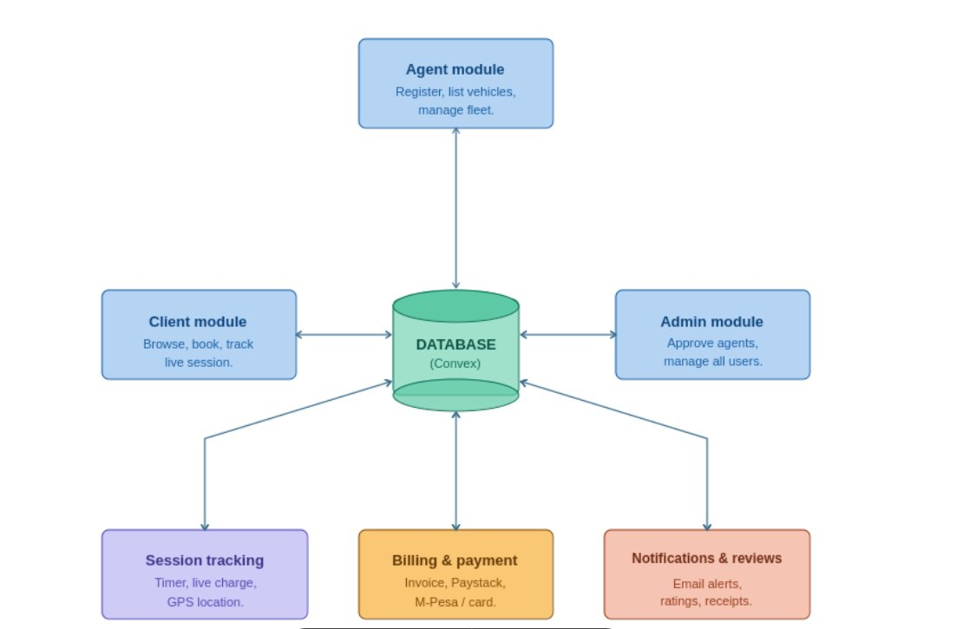
Conceptual Diagram — System Architecture
6 / 8
Vehicle Hire and Session Tracking System · INSY 492

Slide 7
Tools & Technologies
7 / 8
Frontend
Payments
React (TypeScript) · TanStack Router · Tailwind CSS
Paystack — M-Pesa, Airtel Money, card (PCI-DSS Level 1 certified)
Backend & DB
Notifications
Convex — real-time BaaS with reactive database & server functions
Nodemailer — transactional emails for bookings, sessions, receipts
Authentication
Design / Dev
Better Auth with Google OAuth 2.0 (email/password + social sign-in)
Figma (UI prototyping) · Git / GitHub (version control)
Location
Browser Geolocation API — client-side GPS coordinates streamed via Convex
Vehicle Hire and Session Tracking System · INSY 492

Slide 8
System Functionality & Modules
8 / 8
1
Agent Registration & Approval
System Modules
Agent registers → Admin approves → Agent lists vehicles with hire rates.
Agent Module
Client Module
2
Client Browsing & Booking
Registration, vehicles, dashboard
Browse, book, live session, history
Client browses listings → places hire order → booking status: Pending.
3
Session Start (Pending → In Progress)
Admin Module
Session Module
Client picks up vehicle → timer starts → live GPS coordinates stream to agent.
Approval, users, analytics
Lifecycle, timer, GPS streaming
4
Live Monitoring
Client sees elapsed time + accrued charge. Agent sees all active vehicles with live location.
Billing Module
Notifications Module
5
Completion & Billing
Charge calc, invoice, Paystack
Nodemailer for all key events
Vehicle returned → session Completed → invoice generated → Paystack payment → receipt email.
Vehicle Hire and Session Tracking System · INSY 492

