Slide 1
Mr. Racer 2011 - CIG
Mostly described in the Evo* Paper „Driving Faster Than a Human Player“
Joined effort of Jan Quadflieg, Tim Delbruegger and Mike Preuss
24 Variables learned offline with the CMA-ES, now including optimized settings for recovery and the clutch
Two parameter sets learned for a) road and b) dirt tracks, the one performing better is selected during warmup

Slide 2
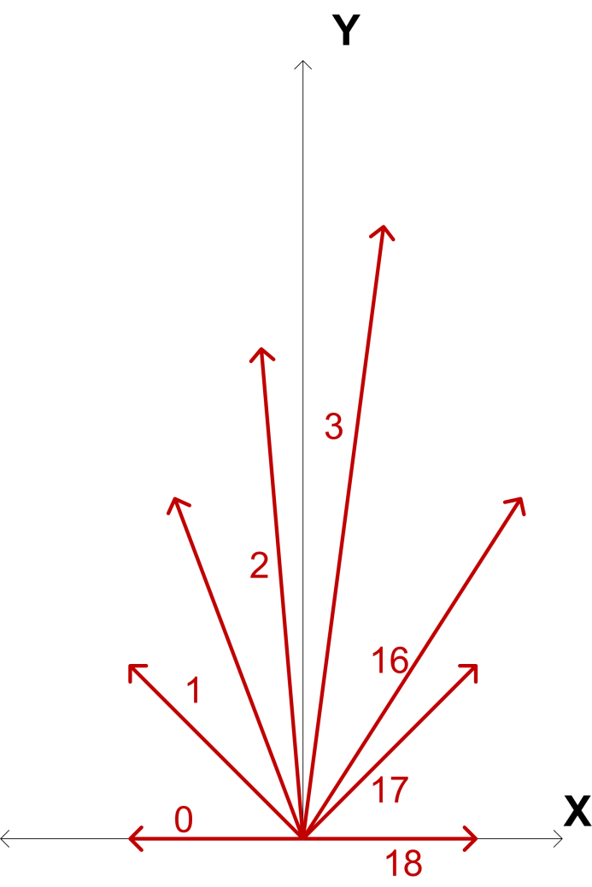
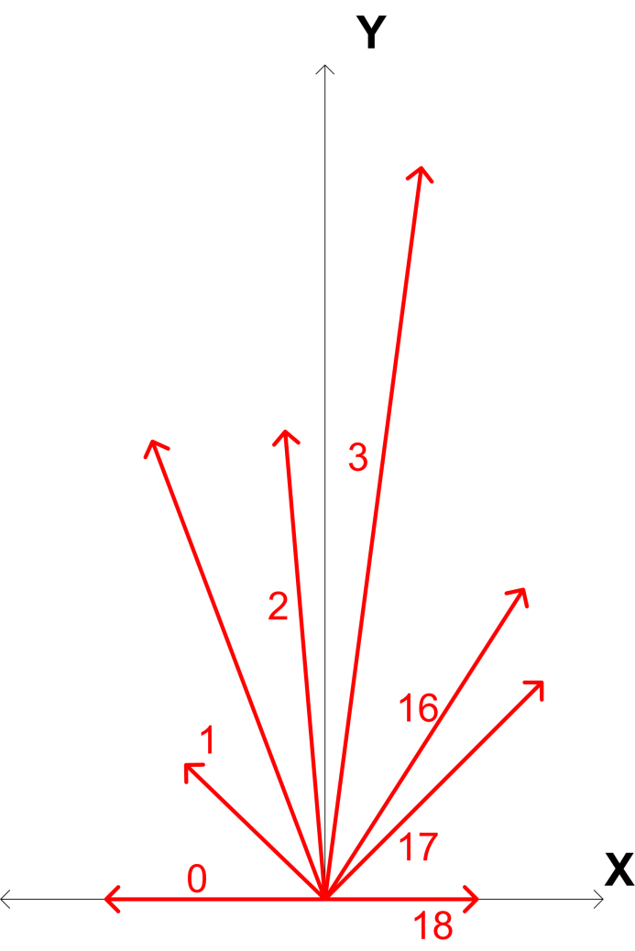
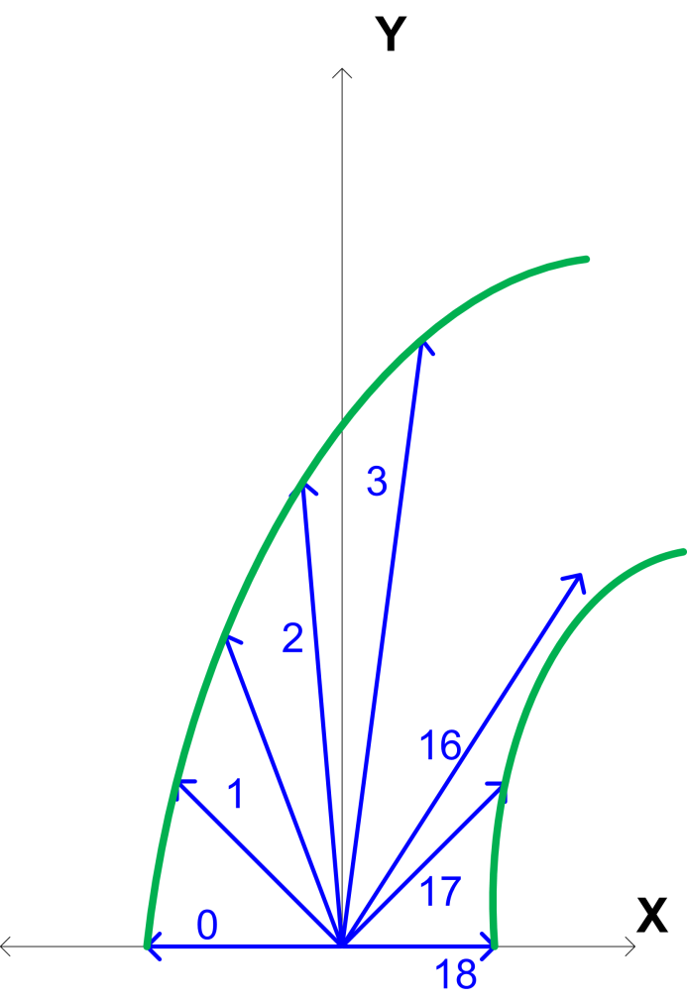
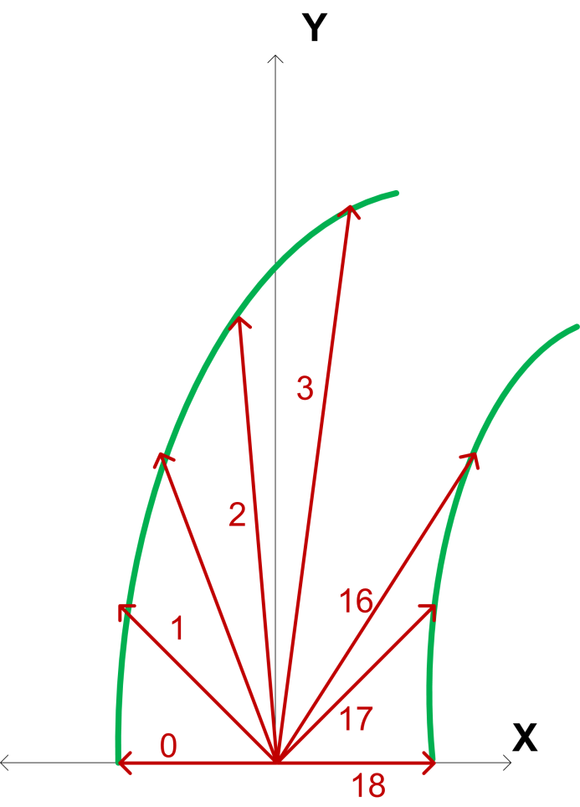
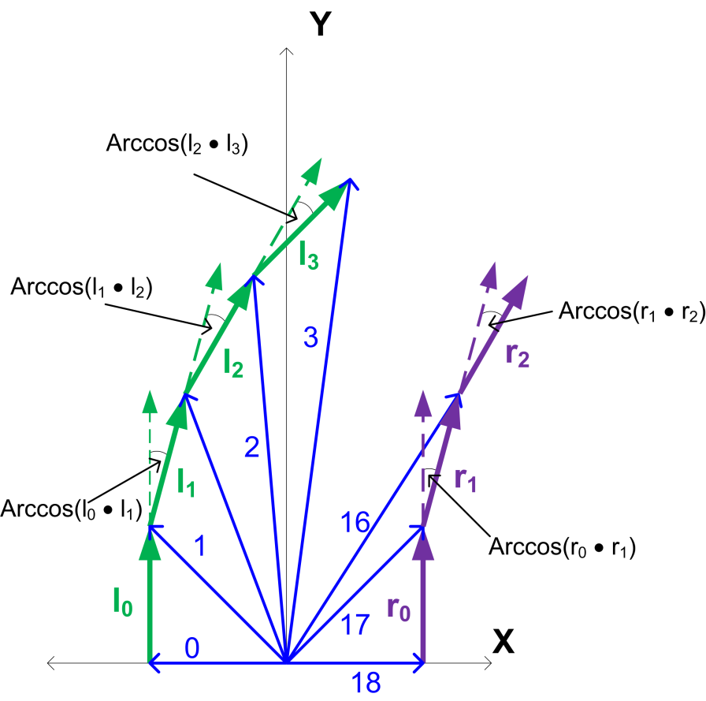
Noise Handling
Low pass filter on sensor values
2 Regression polynoms are fitted to each side
Resample the polygons
Calculate our measure (see CIG paper 2010)
Low pass filter on the last measurements

Slide 3
Online Learning during Warmup
We learn a model of the racetrack
One of two parameter sets is chosen
Target speeds for all corners are then fine tuned
All information is saved at the end of the warmup
And later used during qualifying and the race

Slide 4
Opponent Handling
Noise filtering with a lowpass filter
Observer module interprets filtered sensor readings
This leads to a recommended speed and an overtaking line (created on the fly!)
Planning module incorporates recommended target speed and overtaking line into the plan
Lots of nummerical parameters not yet tuned

