Slide 1
160122
TRANSFER TD DATA INTO POWER

Slide 2
PROCEDURE
Input the Data:
Sample02_A_357kN_132ps_TD.xlsx >> Sample_TD
Sample02_A_357kN_132ps_power.xlsx >> Sample_power
Sample_fft = FFT(Sample_power) >> fft to sample_power
Sample_fft_abs = abs(sample_fft) >> amplitude of sample_fft
Sample_fft_abs_power = sample_fft_abs.^2 >> get power

Slide 3
Procedure
Plot both measured power data and calculated data
Find that they have common shapes but doesn’t match quite well.
Get the ratio of the two data sets by:
Get max point for both measured and calculated data :
x_m, y_m x_c, y_c
x_ratio = x_c/x_m y_ratio = y_c/y_m
Fix calculated data by dividing the ratio.

Slide 4
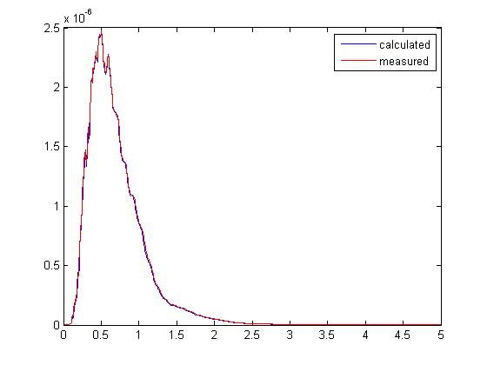
Result
x_ratio = 133.0685
y_ratio = 4.3157e+09

Slide 5
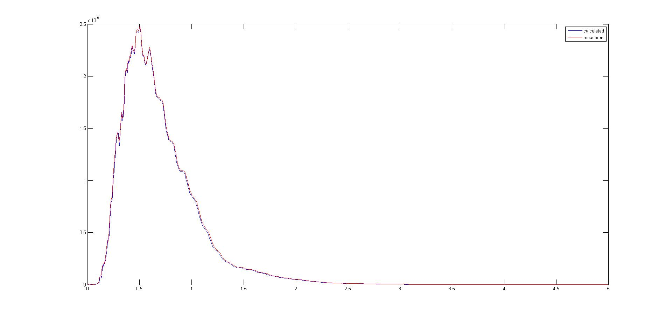

Slide 6
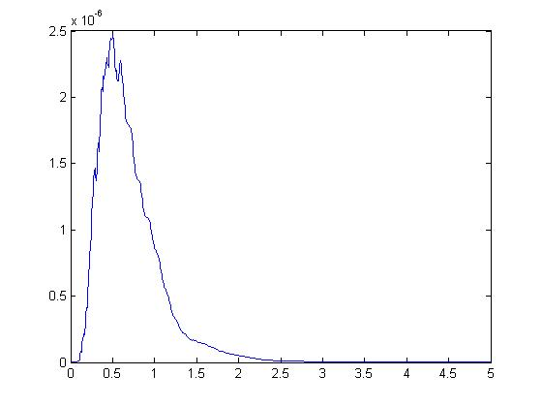
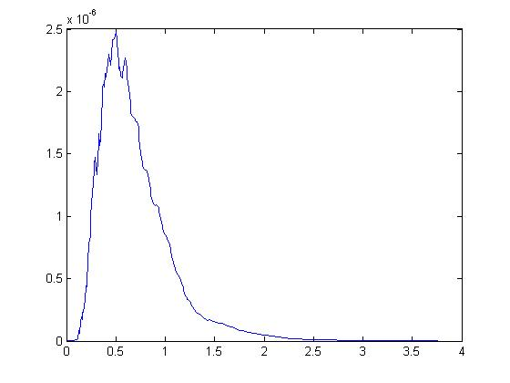
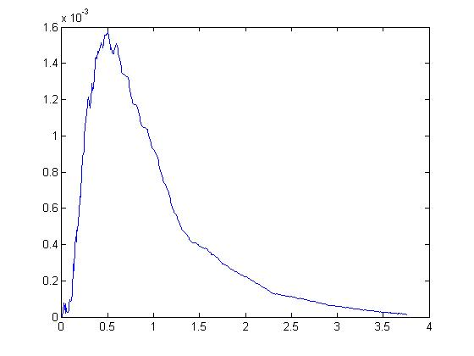
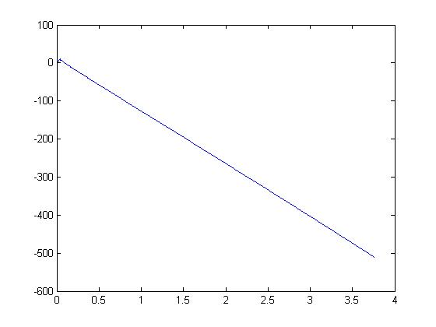
Measured Power
Calculated
Power
Calculated
Amplitude
Calculated
Angle

Slide 7
Questions
In my calculation, I “fixed” the calculated value by dividing certain ratio to both frequency and power. Will this affect angle?
There are still differences between measured data and calculated ones. Which one should I use?
Another possible way of fixing:
Using the same step as the instrument did. That is, change the step of x_axis from 1 to 0.007629, with a ratio of 131.0788.

Slide 8
