Slide 1
160304
TRANSFER TD DATA INTO POWER

Slide 2





Equation to Use/Solve
We are solving for the Top part of the matrix equation.
For convenience, Let’s say the equation is
Left side = Right Side → f(n_2) = r
Block1:
Block2:
Block3:
Block4:

Slide 3
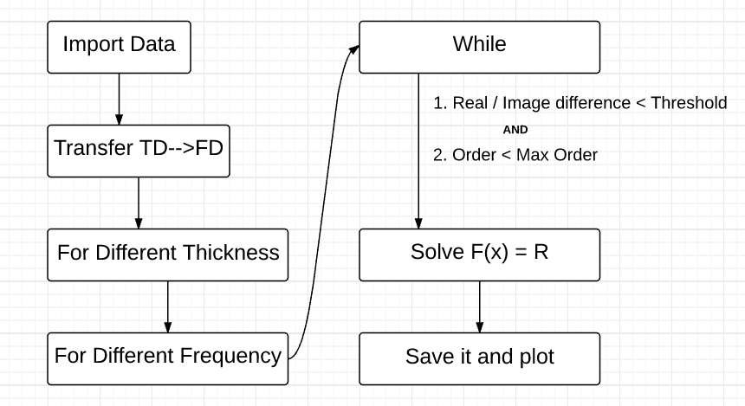
Program Structure

Slide 4


Solve for F(x) = R
We have 2 Solvers – Easy Solver and Newton-Raphson Solver
Easy Solver:
Calculate with all possible answers (real range: 1:0.01：3; img range: 0:0.001:2)
Error Calculate Method:
Total Error:
Compare the error and output the answer with minimum error.
Slow but steady and reliable due to its principle.
Current Parameters:
Real range: 1:0.01:3; Imaginary range : 0:0.001:2

Slide 5

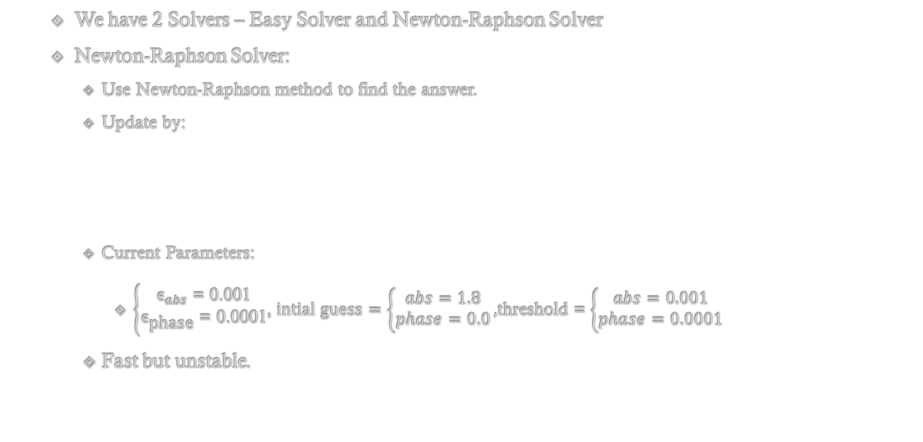
Solve for F(x) = R
We have 2 Solvers – Easy Solver and Newton-Raphson Solver
Newton-Raphson Solver:
Use Newton-Raphson method to find the answer.
Update by:
Current Parameters:
$\left\{\begin{aligned}{\text{ϵ}}_{abs}\text{ = 0.001} \\ {\text{ϵ}}_{\text{phase}}\text{ = 0.0001}\end{aligned}\right.$, $intial guess=\left\{\begin{aligned}abs=1.8 \\ phase=0.0\end{aligned}\right.,$threshold = $\left\{\begin{aligned}abs=0.001 \\ phase=0.0001\end{aligned}\right.$
Fast but unstable.

Slide 6
Easy Solver vs Newton Raphson
I used both solvers to test 50 different frequencies (from 0.7THz to 1THz) with 5 different thickness (from 10 μm to 30 μm in an interval of 5μm)
Real Part:
Average Difference: 0.013169
Imaginary Part:
Average Difference: 0.013383
Notes:
Test1.xlsx

Slide 7
Easy Solver vs Newton Raphson
I used both solvers to test 50 different frequencies (from 0.7THz to 1THz) with 5 different thickness (from 10 μm to 30 μm in an interval of 5μm)
Regardless of the strange behaviors during solving, since the difference is relatively small and the Easy Solver is “reliable but slow”, my Newton Raphson solver is okay to use.
Update 2016/03/04:
I added a limit on iteration times. The higher the order is, the higher the chance that the limit is reached. This means the higher the order is, the less reliable the Newton Raphson method is. This is related to the sudden jumps on the results and act periodically.
Real Part:
Average Difference: 0.013169
Imaginary Part:
Average Difference: 0.013383
Notes:
Test1.xlsx

Slide 8
Test Result
I used both solvers to test 50 different frequencies (from 0.7THz to 1THz) with 5 different thickness (from 10 μm to 30 μm in an interval of 5μm)
· Very thick case (only order 1 is considered, that is, no further reflection inside the material afer the first reflection)
Notes:
Test1.xlsx

Slide 9
Test Result
I used both solvers to test 50 different frequencies (from 0.7THz to 1THz) with 5 different thickness (from 10 μm to 30 μm in an interval of 5μm)
· Order 2
Notes:
Test1.xlsx

Slide 10
Test Result
I used both solvers to test 50 different frequencies (from 0.7THz to 1THz) with 5 different thickness (from 10 μm to 30 μm in an interval of 5μm)
· Order 3
Notes:
Test1.xlsx

Slide 11
Test Result
I used both solvers to test 50 different frequencies (from 0.7THz to 1THz) with 5 different thickness (from 10 μm to 30 μm in an interval of 5μm)
· Order 3 after getting rid of outliers
Notes:
Test1.xlsx

Slide 12
Test Result
I used both solvers to test 50 different frequencies (from 0.7THz to 1THz) with 5 different thickness (from 10 μm to 30 μm in an interval of 5μm)
· Order 3 after getting rid of outliers again
Notes:
Test1.xlsx

Slide 13
Result
Most outputs of Newton-Raphson Solver is reliable, regardless of the strange behaviors during the solving process.
Under very thick case, the real part of the output n2 behaves normal. The imaginary part is way too big than theory.
The answer of higher orders looks strange. However, its “strength” of oscillating may have relationship to the thickness

Slide 14
Guesses
Mis-understand with equation
There might be some mistake during the simplification of the equation, especially for block2.
Parameter Errors:

Slide 15
Possible Solutions
Equation Deduce Error:
Double check parameters
Check with Zac for the equation
Goes back to lower level of the equation and test again.
Data Error:
Use other data to test instead. (Different thickness, different material, etc.)

