Slide 1
160311
TEST AFTER NORMALIZE THE DATA

Slide 2
Normalization
Import refData and testData
Both in Time Domain
Transfer refData and testData → Frequency Domain
Same function
Same length
Normalization:
x_fft = x_fft/x_fftR
x_power = x_power/x_powerR

Slide 3
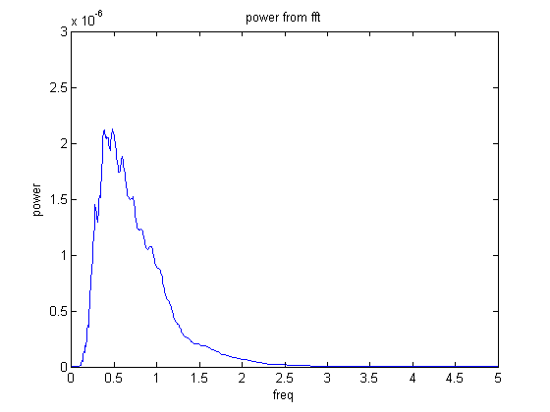
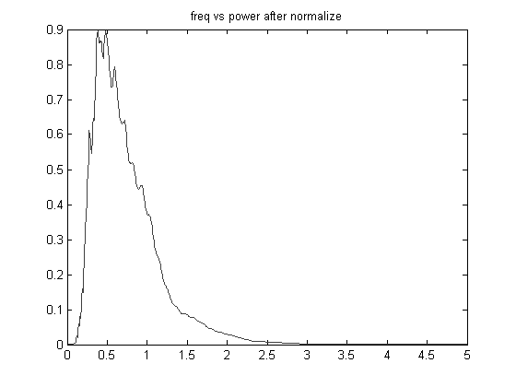
Power after normalize
Test Data
Data after Normalize

Slide 4
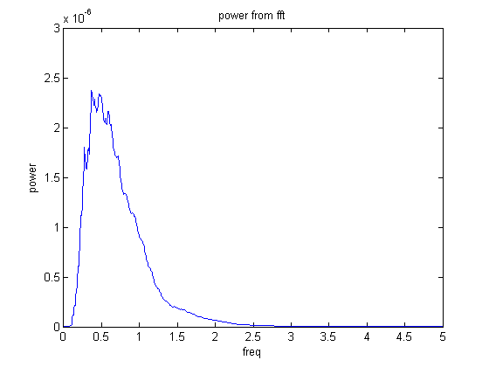
Power after normalize
Test Data
Ref Data
Data after Normalize

Slide 5
Test Result
Still, I used both solvers to test 41 different frequencies (from ~0.7THz to 1THz) with 5 different thickness (from 10 μm to 30 μm in an interval of 5μm)
· Very thick model(only order 1 is considered, that is, no further reflection inside the material afer the first reflection)
Notes:
Test1.xlsx

Slide 6
Test Result (Normalize vs Non-Normal)
· Very thick model(only order 1 is considered, that is, no further reflection inside the material afer the first reflection)
· Quite close in both value and shape
Normalized
Non-Normalized
Notes:
Test1.xlsx

Slide 7
Test Result (Normalize vs Non-Normal)
· Very thick model(only order 1 is considered, that is, no further reflection inside the material afer the first reflection)
· Quite close in both value and shape
Normalized
Non-Normalized
Notes:
Test1.xlsx

Slide 8
Test Result
· Order 2
Notes:
Test1.xlsx

Slide 9
Test Result
· Order 2 (Normalize vs Non-Normalize)
Normalized
Non-Normalized
Notes:
Test1.xlsx

Slide 10
Test Result
· Order 2 (Normalize vs Non-Normalize)
Normalized
Non-Normalized
Notes:
Test1.xlsx

Slide 11
Test Result
· Order 3
Notes:
Test1.xlsx

Slide 12
Result
Mis-understand with equation
There might be some mistake during the simplification of the equation, especially for block2.
Parameter Errors:

Slide 13
Guesses
Fatal error in Normalization
There might be some mistake during the simplification of the equation, especially for block2.

Slide 14
Possible Solutions
Equation Deduce Error:
Goes back to a further lower level of the equation and test again.
Data Error:
Use other data to test files instead. (planning to try it tonight)

