Slide 1
Sum up of PMMA project

Slide 2
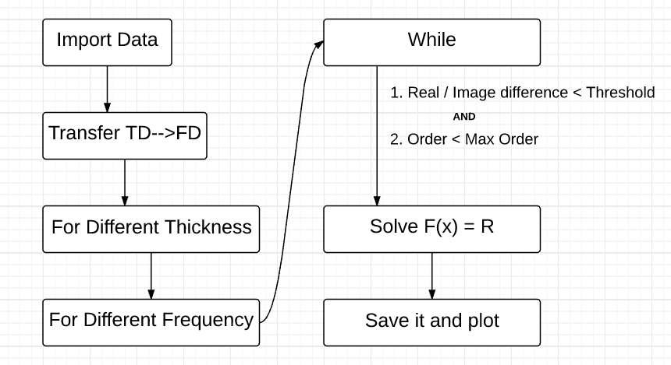
Program Structure

Slide 3





Equation to Use/Solve
We are solving for the Top part of the matrix equation.
For convenience, Let’s say the equation is
Left side = Right Side → f(n_2) = r
Block1:
Block2:
Block3:
Block4:

Slide 4

Equation to Use/Solve
Block2:
$P_{refl2}=r_{refl2}I=\frac{p_{2}−p_{1}}{p_{2}+p_{1}}∗I$ (Zac’s write-up PAGE 5, footnote 3)
$p_{2}=n_{2}\cos{θ_{2} }=n_{2}\sqrt{1−\frac{n_{1}^{2}\sin^{2}{θ_{1}}}{n_{2}^{2}}}$ (Zac’s supplement)
$p_{1}=n_{1}cosθ_{1}$
$I=\begin{matrix}1 & 0 \\ 0 & 1\end{matrix}$

Slide 5

Equation to Use/Solve
Block2:
${G=N}_{2}^{2}={−r_{refl2}\left[\begin{matrix}1 & ik_{0}h_{2}n_{2}^{2} \\ ik_{0}h_{2}\cos^{2}{θ_{2}} & 1\end{matrix}\right]}^{2}$(Zac’s supplement)
$r_{refl2}=\frac{p_{2}−p_{1}}{p_{2}+p_{1}}$ (Zac’s write-up PAGE 5, footnote 3)

Slide 6

Equation to Use/Solve
Block3:
$A_{1}=1$ (normalized)
$R_{1}=A_{1}\frac{p_{1}−p_{2}}{p_{1}+p_{2}}=A_{1}r_{1}$ (Zac’s supplement)

Slide 7

Equation to Use/Solve
Block4:
$R_{1}=A_{1}\frac{p_{1}−p_{2}}{p_{1}+p_{2}}=A_{1}r_{1}\text{ (}\text{Zac}\text{’}\text{s} \text{supplement}\text{)}$
$p_{1}=n_{1}\cos{θ_{1} }$

Slide 8

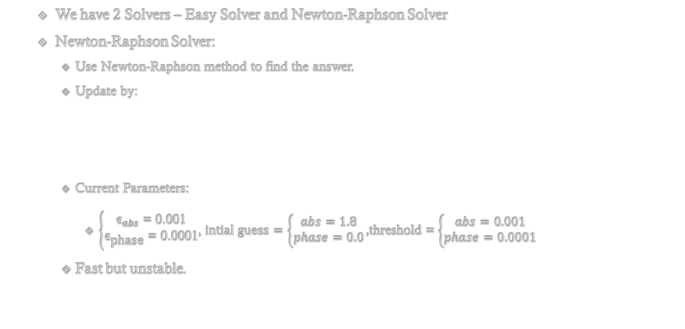
Solve for F(x) = R
We have 2 Solvers – Easy Solver and Newton-Raphson Solver
Newton-Raphson Solver:
Use Newton-Raphson method to find the answer.
Update by:
Current Parameters:
$\left\{\begin{aligned}{\text{ϵ}}_{abs}\text{ = 0.001} \\ {\text{ϵ}}_{\text{phase}}\text{ = 0.0001}\end{aligned}\right.$, $intial guess=\left\{\begin{aligned}abs=1.8 \\ phase=0.0\end{aligned}\right.,$threshold = $\left\{\begin{aligned}abs=0.001 \\ phase=0.0001\end{aligned}\right.$
Fast but unstable.

Slide 9
Easy Solver vs Newton Raphson
I used both solvers to test 50 different frequencies (from 0.7THz to 1THz) with 5 different thickness (from 10 μm to 30 μm in an interval of 5μm)
Real Part:
Average Difference: 0.013169
Imaginary Part:
Average Difference: 0.013383
Notes:
Test1.xlsx

Slide 10
Easy Solver vs Newton Raphson
I used both solvers to test 50 different frequencies (from 0.7THz to 1THz) with 5 different thickness (from 10 μm to 30 μm in an interval of 5μm)
Regardless of the strange behaviors during solving, since the difference is relatively small and the Easy Solver is “reliable but slow”, my Newton Raphson solver is okay to use.
Update 2016/03/04:
I added a limit on iteration times. The higher the order is, the higher the chance that the limit is reached. This means the higher the order is, the less reliable the Newton Raphson method is. This is related to the sudden jumps on the results and act periodically.
Real Part:
Average Difference: 0.013169
Imaginary Part:
Average Difference: 0.013383
Notes:
Test1.xlsx

Slide 11
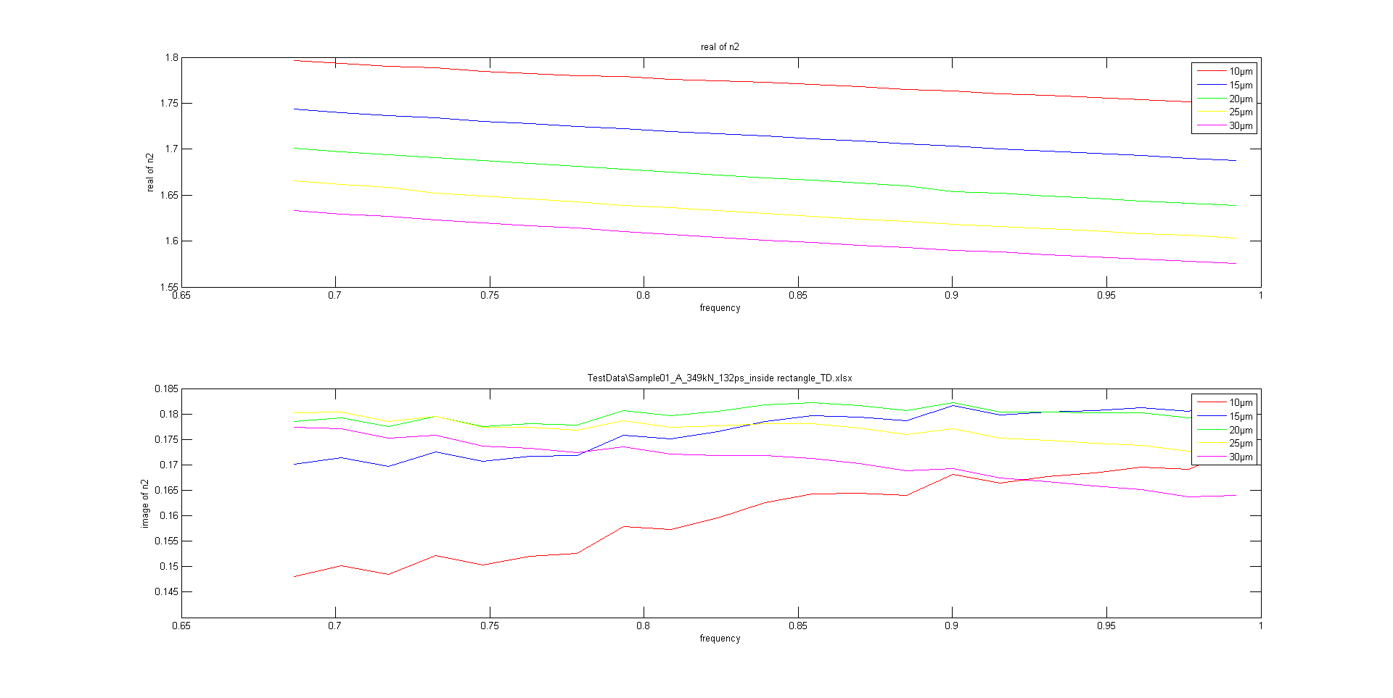
Test Result
Input: Sample01_A_349kN_132ps_inside rectangle_TD.xlsx
Go to .\Outputs\PNG\ for more; The .fig files are in .\Outputs\Figure\
Notes:
Test1.xlsx

