Slide 2
Issues
The difference between both sides of the equation never equals to 0
The smallest difference happens @:
The real part of the N is the smallest in the test values (1 in my test case)
The imaginary part of the N is the largest in the test values (0.5 in my test case)

Slide 3
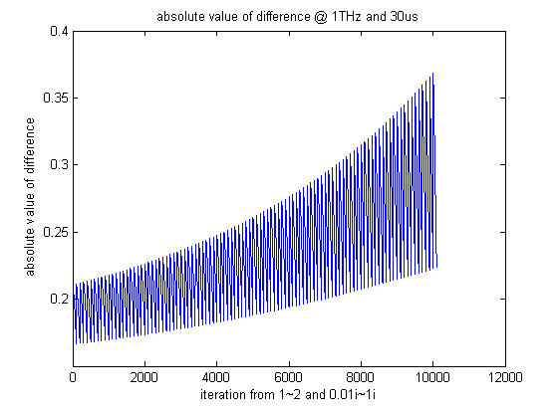
Examples

Slide 4
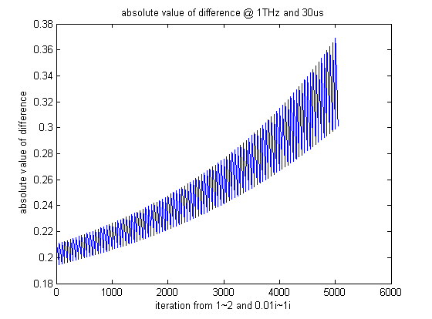
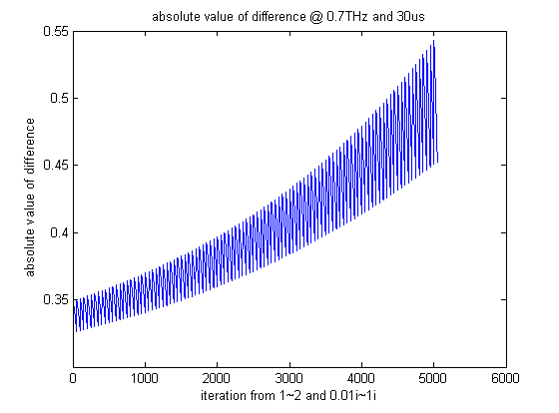
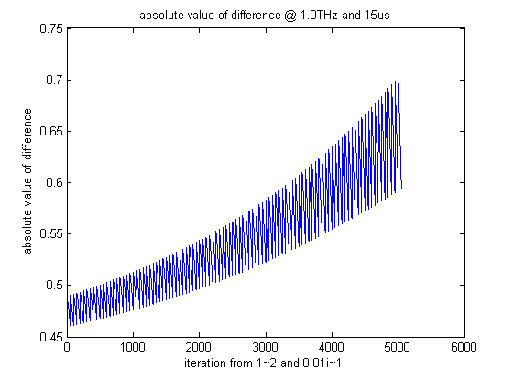
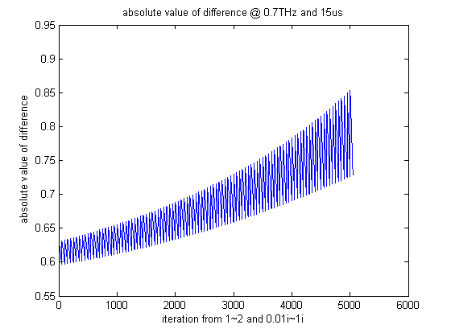
Compare with Different Frequency and Thickness Under TE

Slide 5
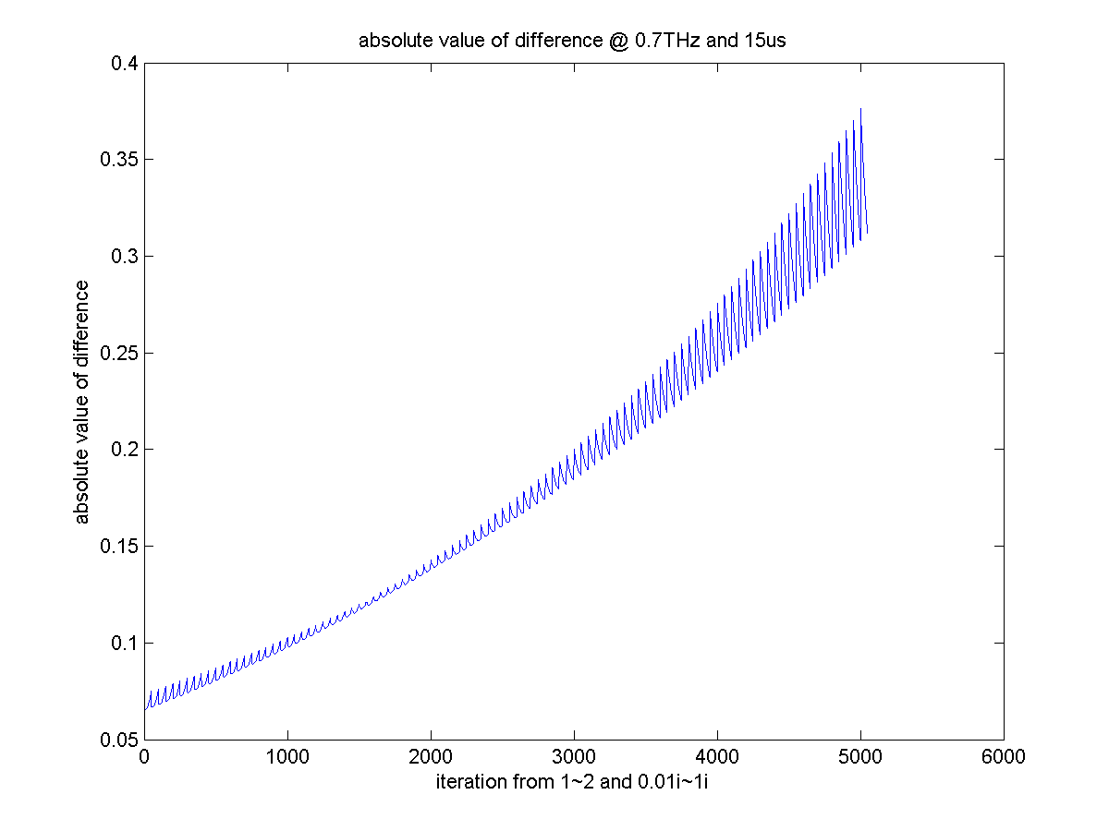
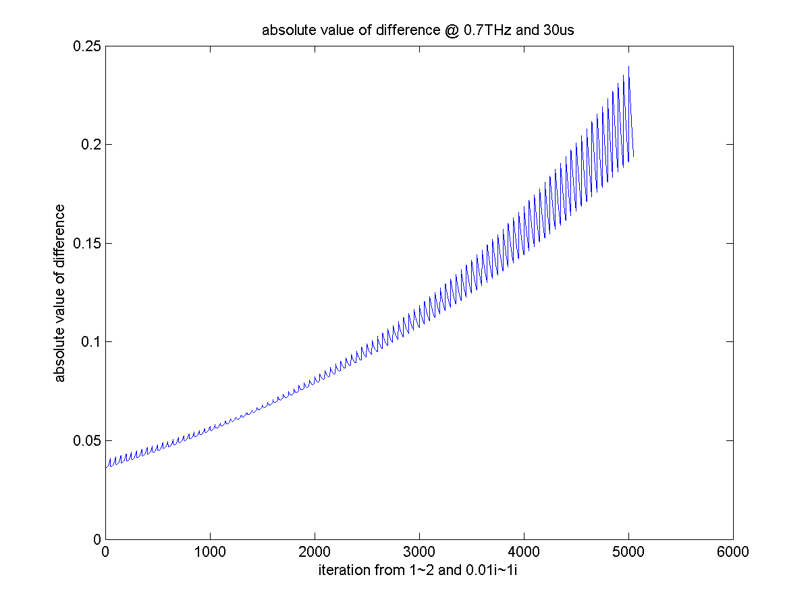
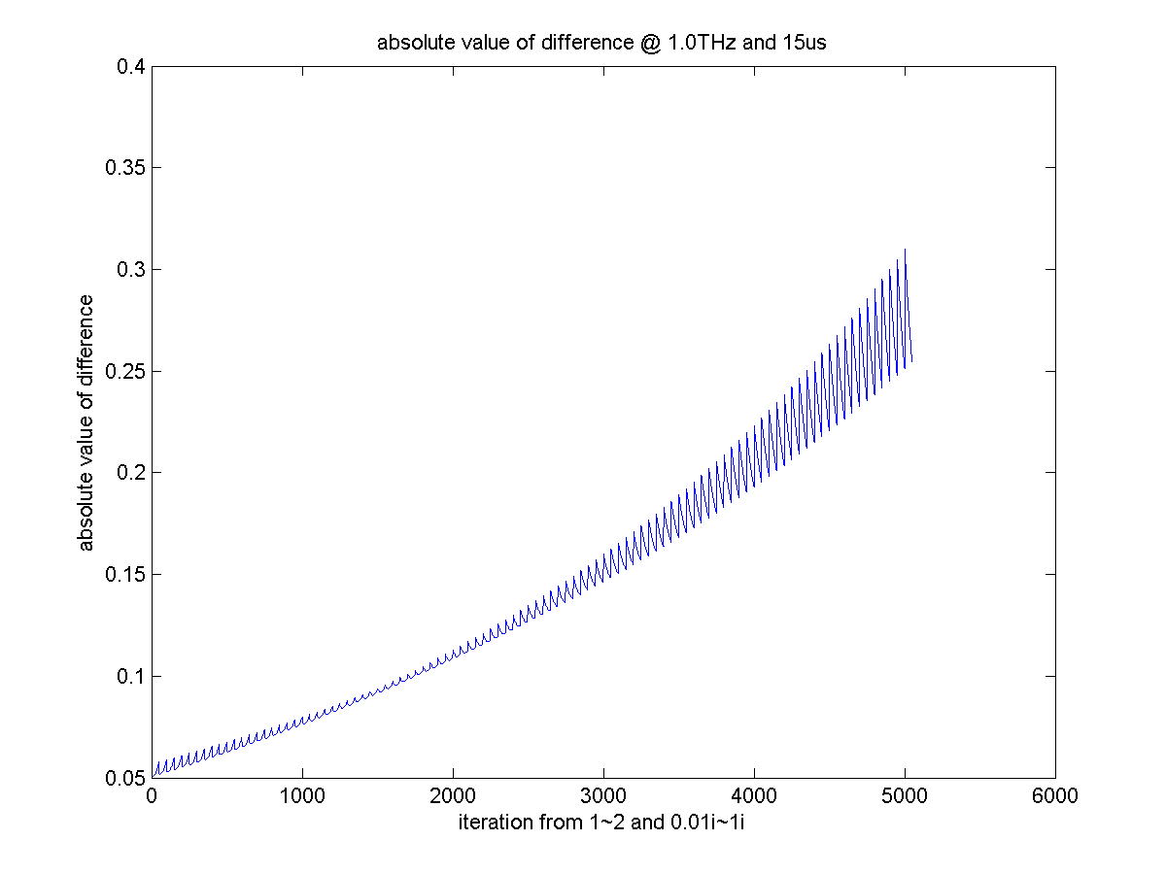
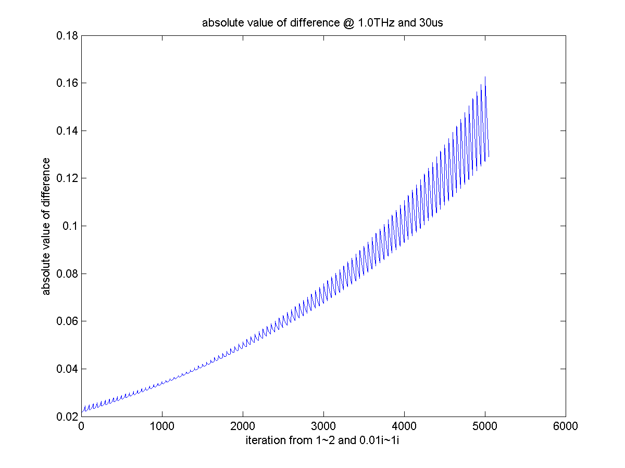
Compare with Different Frequency and Thickness Under TM

