Slide 1
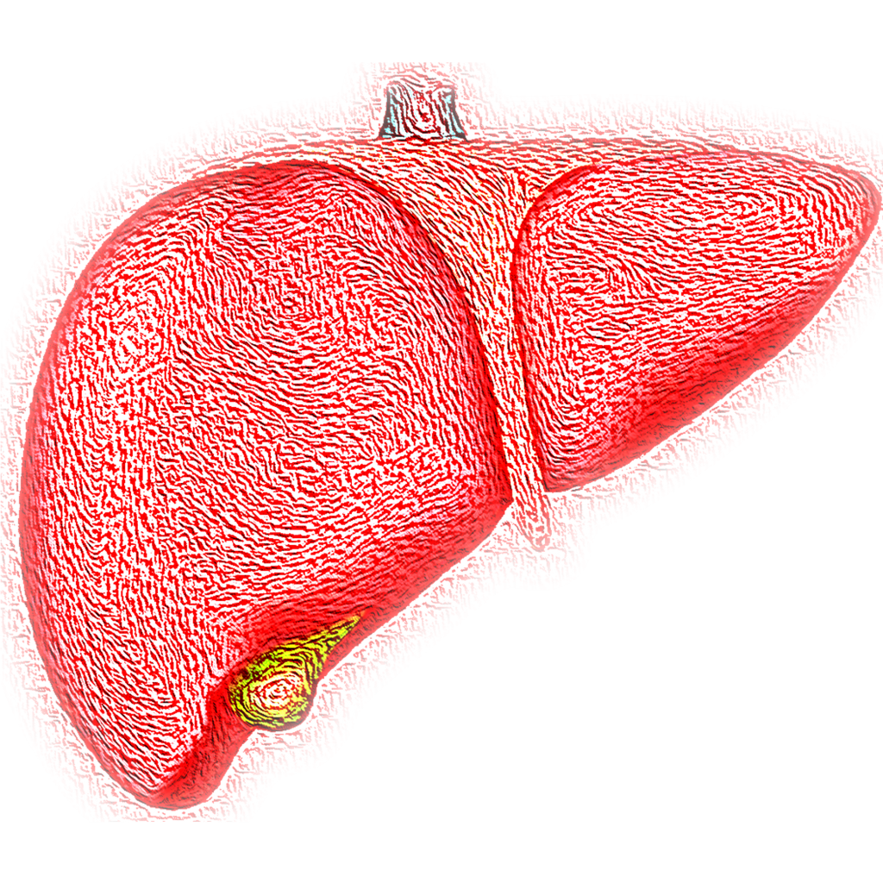
Human liver RNA data analysis
Liron Gershuny
Danny Ben-Zvi Lab

Slide 2
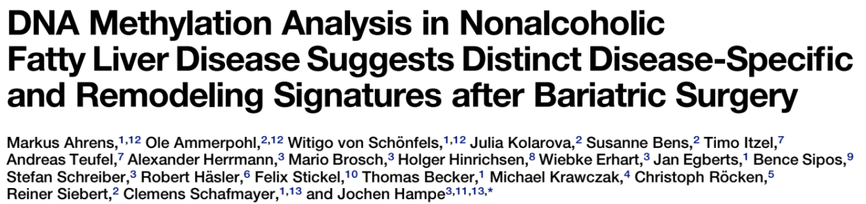
Series GSE48452
Aug 08 ,2013
Human liver biopsy of different phases from control to NASH
73 samples of human liver grouped into:
C (control=14)
H (healthy obese=27)
S (steatosis=14)
N (nash=18)

Slide 3
Filtering the data according to bariatric surgery
liver, C, A1359-05 | liver, N, A1359-06 | liver, H, A1359-07
GSM1178974 | GSM1178975 | GSM1178976
Control | Nash | Healthy obese
Homo sapiens | Homo sapiens | Homo sapiens
tissue type: liver biopsy | tissue type: liver biopsy | tissue type: liver biopsy
group: Control | group: Nash | group: Healthy obese
fat: 2 | fat: 80 | fat: 0
inflammation: 0 | inflammation: 1 | inflammation: 0
Sex: male | Sex: male | Sex: female
age: 80 | age: 49.00555556 | age: 44
bmi: 25.8 | bmi: 25.61728395 | bmi: 36.1
nas: 0 | nas: 4 | nas: 0
fibrosis: 0 | fibrosis: 1 | fibrosis: 1
lar: 0 | lar: 0.159091628 | lar: NA
delta lar: NA | delta lar: NA | delta lar: NA
delta leptin: NA | delta leptin: NA | delta leptin: NA
leptin: 0 | leptin: 0.901124 | leptin: NA
adiponectin: 26.372 | adiponectin: 5.664182401 | adiponectin: NA
delta adipo: NA | delta adipo: NA | delta adipo: NA
Control | 12
Healthy Obese | 16
Steatosis | 9
Nash | 17
Total | 54

Slide 4
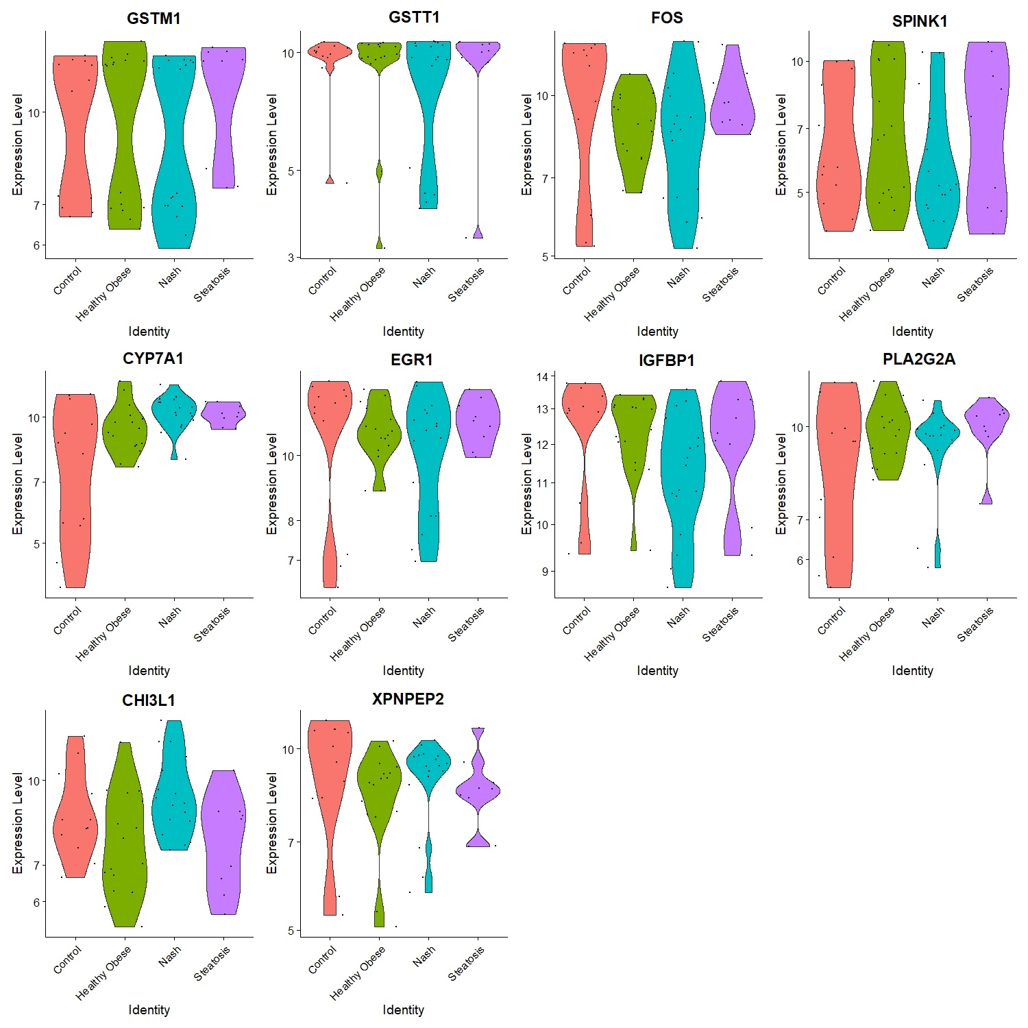
10 most highly variable genes expression levels
GSTM1, GSTT1, FOS, SPINK1, CYP7A1, EGR1, IGFBP1, PLA2G2A, CHI3L1, XPNPEP2

Slide 5
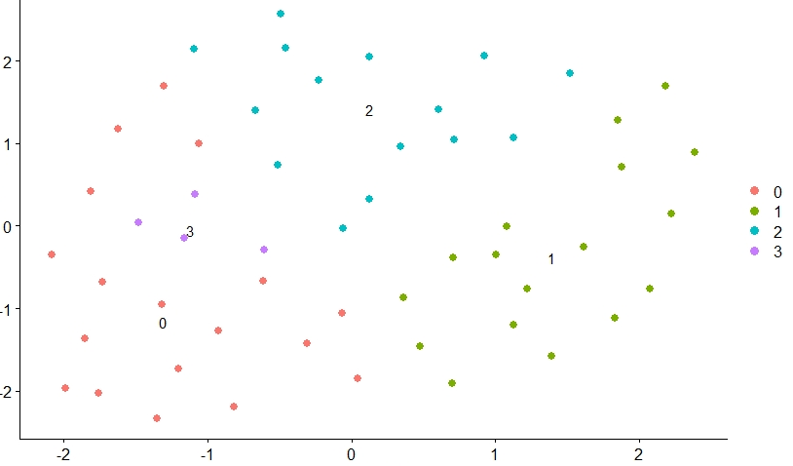
Clustering using k-nearest neighbors algorithm (k=5, 10, 20) into 4 groups

Slide 6
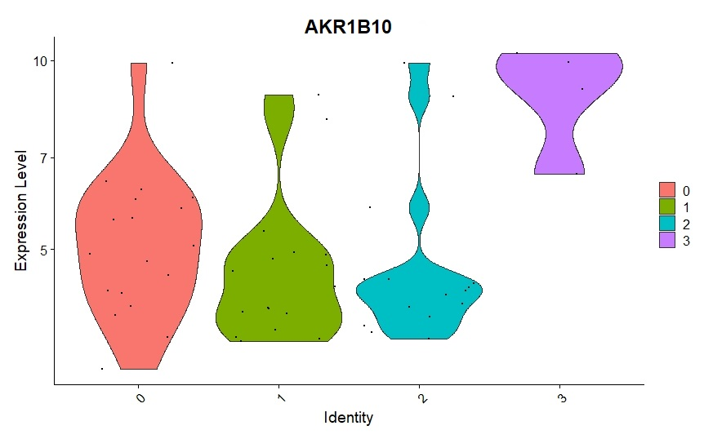
Finding differentially expressed features (cluster biomarkers)

Slide 7
Filtering the data – Control vs Nash (before bariatric surgery only)
liver, C, A1359-05 | liver, N, A1359-06
GSM1178974 | GSM1178975
Control | Nash
Homo sapiens | Homo sapiens
tissue type: liver biopsy | tissue type: liver biopsy
group: Control | group: Nash
fat: 2 | fat: 80
inflammation: 0 | inflammation: 1
Sex: male | Sex: male
age: 80 | age: 49.00555556
bmi: 25.8 | bmi: 25.61728395
nas: 0 | nas: 4
fibrosis: 0 | fibrosis: 1
lar: 0 | lar: 0.159091628
delta lar: NA | delta lar: NA
delta leptin: NA | delta leptin: NA
leptin: 0 | leptin: 0.901124
adiponectin: 26.372 | adiponectin: 5.664182401
delta adipo: NA | delta adipo: NA
Control | 12
Nash | 17
Total | 29

Slide 8
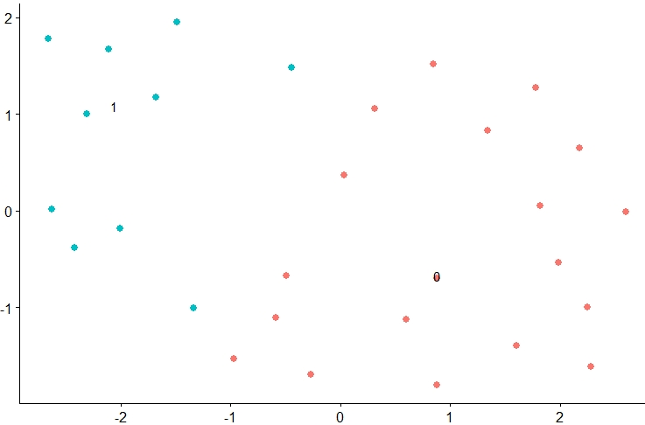
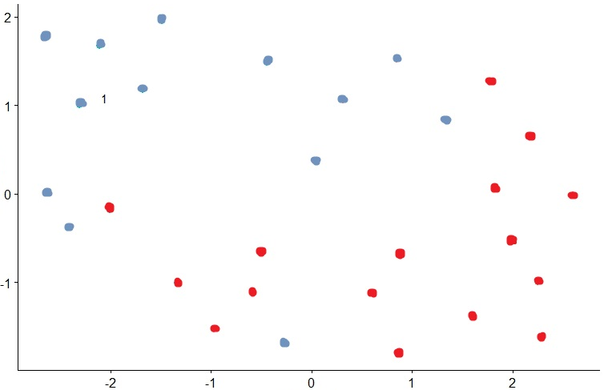
Clustering using k-nearest neighbors algorithm (k=10) into 2 groups
Control | Nash
Original clustering
According to data
10 most highly variable genes expression levels
GSTT1, GSTM1, FOS, CYP7A1, EGR1, PLA2G2A, IGFBP1, XPNPEP2, FOSB, GSTA2

Slide 9
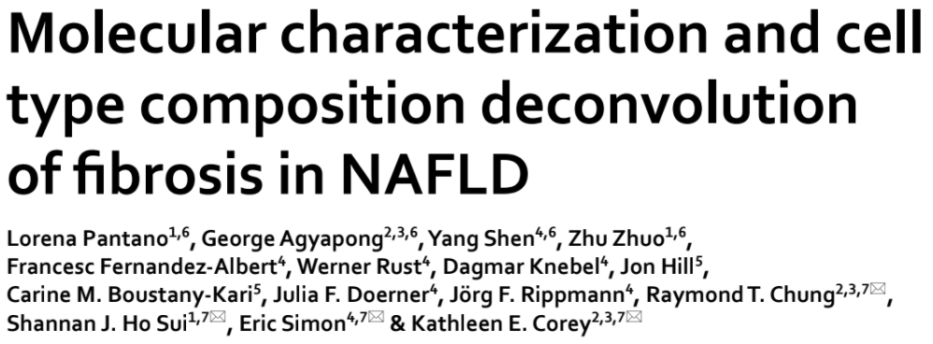
Series GSE162694
Jun 11 ,2021
mRNA-sequencing of 143 NASH patients of various fibrosis stages

Slide 10
A glimpse of the data
Title | nash1_F0 548nash1 | nash10_F1 548nash10 | nash100_N 548nash100 | nash101_F3 548nash101
geo_accession | GSM4957321 | GSM4957322 | GSM4957323 | GSM4957324
source_name_ch1 | Liver biopsy | Liver biopsy | Liver biopsy | Liver biopsy
organism_ch1 | Homo sapiens | Homo sapiens | Homo sapiens | Homo sapiens
Tissue | tissue: Liver | tissue: Liver | tissue: Liver | tissue: Liver
Age | age: 36 | age: 55 | age: 25 | age: 46
Sex | Sex: Male | Sex: Female | Sex: Female | Sex: Female
Fibrosis_stage | fibrosis stage: 0 | fibrosis stage: 1 | fibrosis stage: normal liver histology | fibrosis stage: 3
Nas_score | nas score: 3 | nas score: 3 | nas score: 0 | nas score: 7
143 samples of human liver varied by:
normal liver histology = 31
fibrosis stage: 0 = 35
fibrosis stage: 1 = 30
fibrosis stage: 2 = 27
fibrosis stage: 3 = 8
fibrosis stage: 4 = 12
nas score: 0 = 32
nas score: 1 = 12
nas score: 2 = 9
nas score: 3 = 11
nas score: 4 = 13
nas score: 5 = 19
nas score: 6 = 12
nas score: 7 = 9

Slide 11
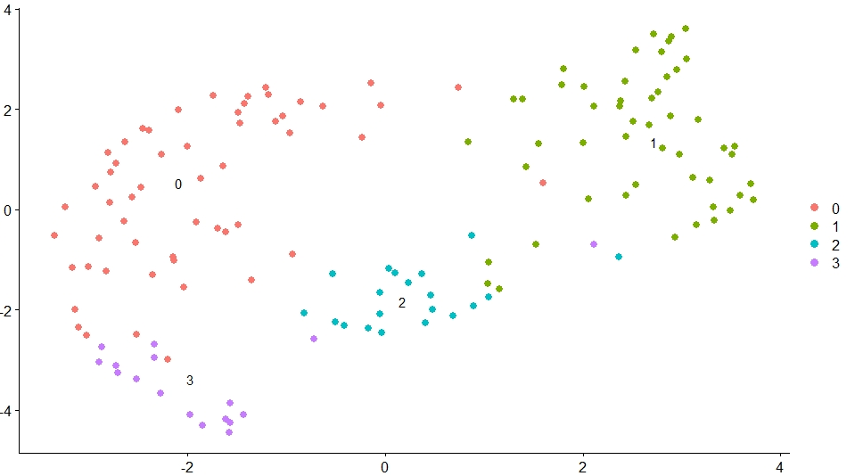
Clustering using k-nearest neighbors algorithm (k=20) into 4 groups

Slide 12
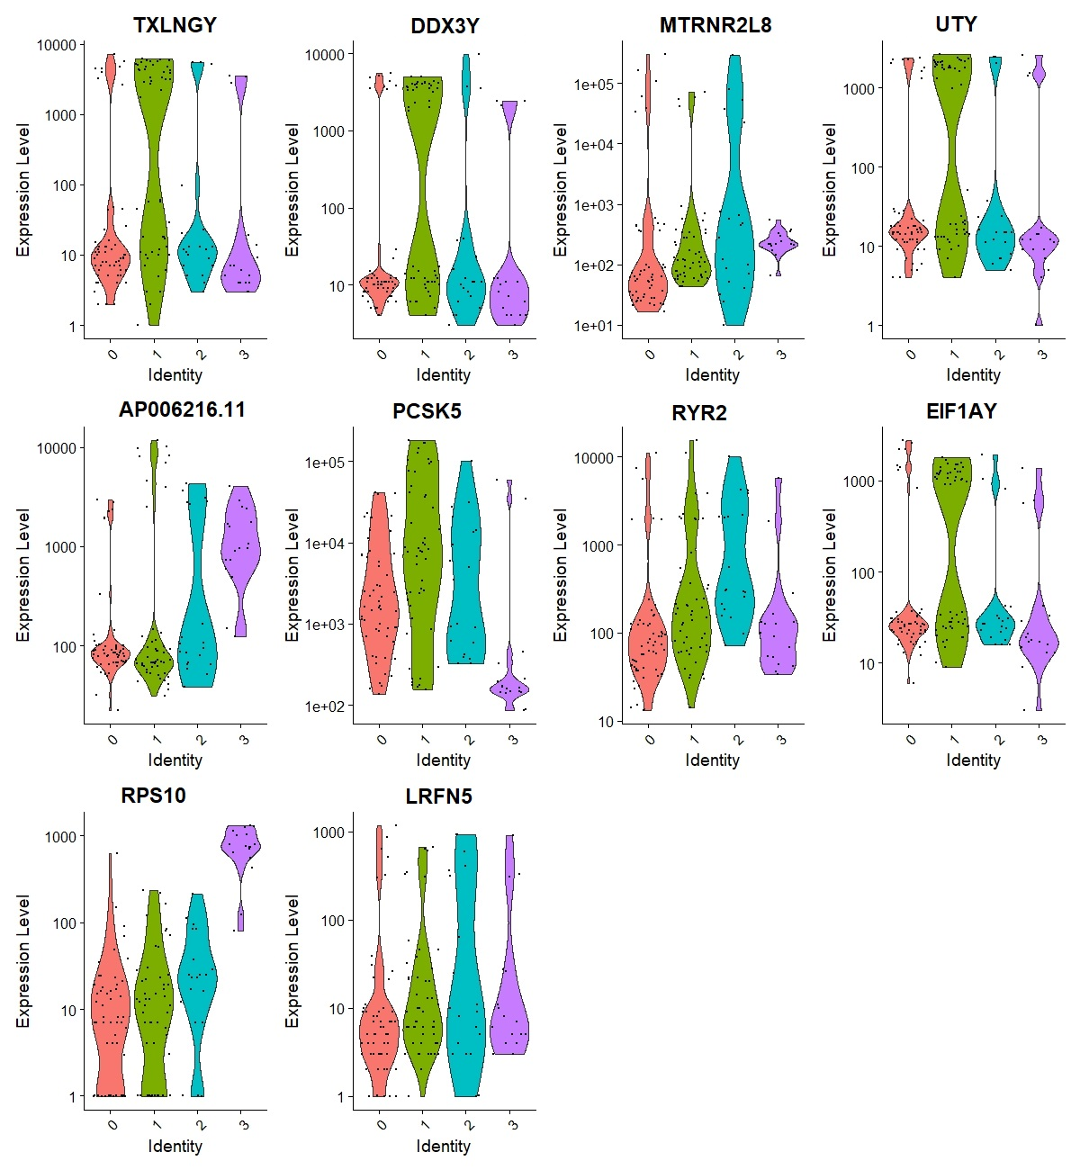
10 most highly variable genes expression levels
TXLNGY, DDX3Y, MTRNR2L8, UTY, AP006216.11, PCSK5, RYR2, EIF1AY, RPS10, LRFN5

Slide 13
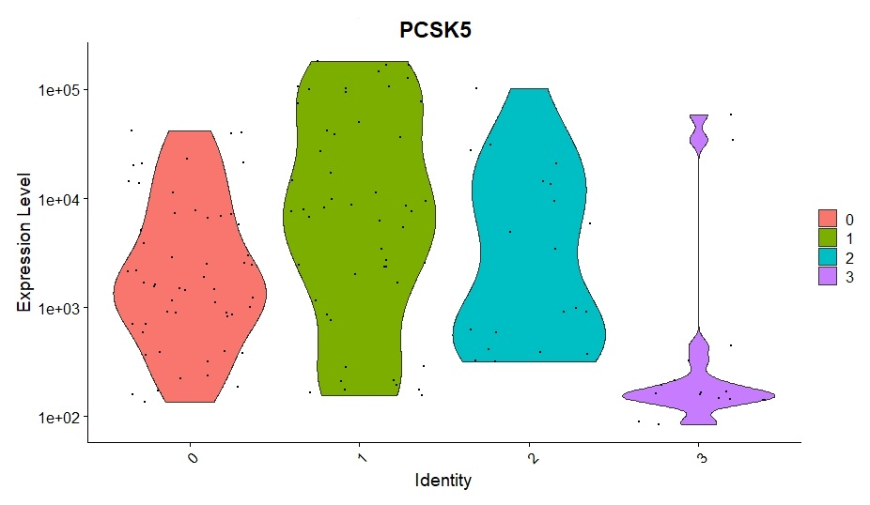
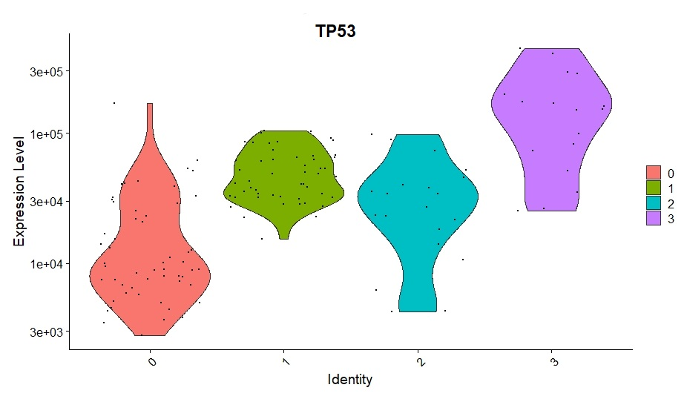
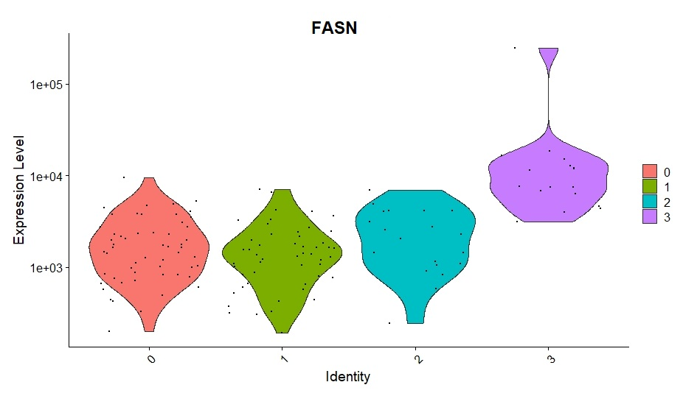
Finding differentially expressed features (cluster biomarkers)
p_val cluster gene
9.98e-13 0 RNU1-1
3.12e-15 0 RNU1
7.51e- 5 1 PCSK5
1.30e-14 1 MT-ND5
2.86e-10 2 C7
1.02e- 7 2 THBS1
8.22e-10 3 FASN
9.92e- 7 3 TP53

Slide 14
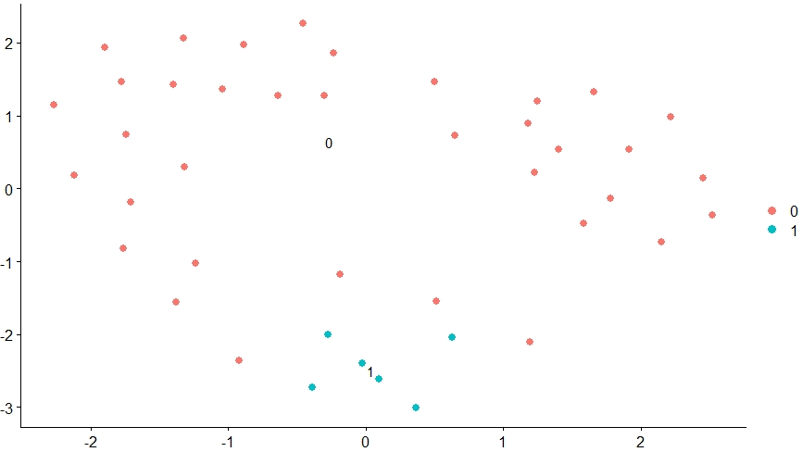
Filtering the data according to fibrosis stage –
normal liver histology vs fibrosis stage: 4
normal liver histology = 31
fibrosis stage: 4 = 12
Clustering using k-nearest neighbors algorithm (k=20) into 2 groups

Slide 15
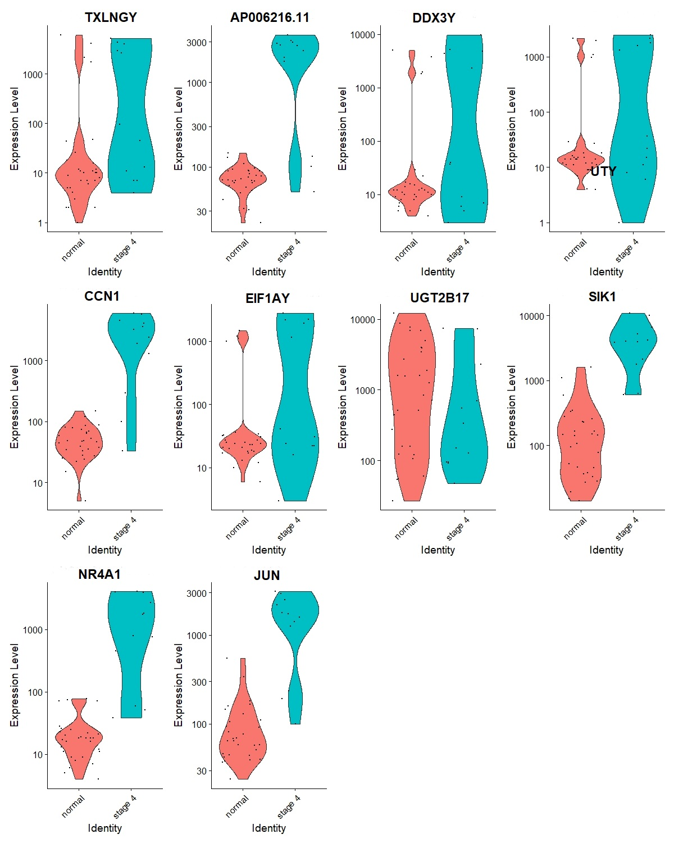
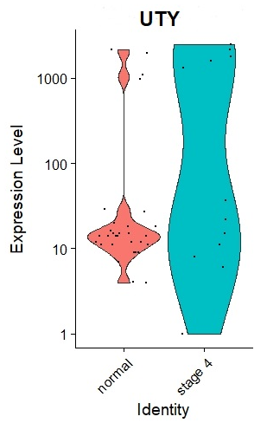
10 most highly variable genes expression levels
TXLNGY, AP006216.11, DDX3Y, UTY, CCN1, EIF1AY, UGT2B17, SIK1, NR4A1, JUN

Slide 16
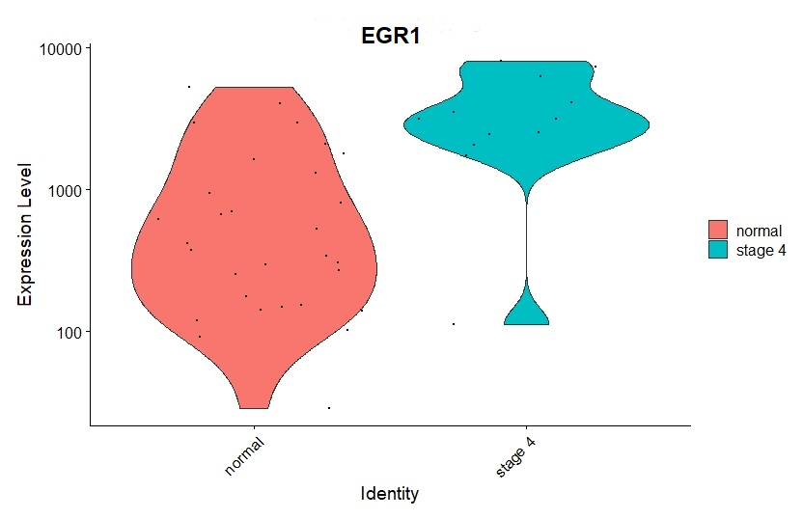
EGR1 expression levels according to fibrosis stage

Slide 17
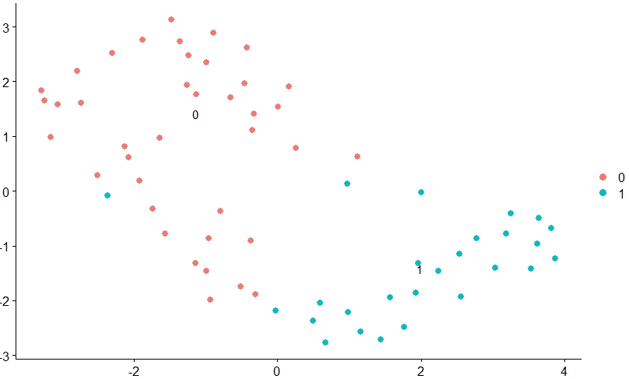
Filtering the data according to Nas score–
0, 1 score vs 6, 7 score
nas score: 0 = 32
nas score: 1 = 12
nas score: 6 = 12
nas score: 7 = 9
Clustering using k-nearest neighbors algorithm (k=10) into 2 groups

Slide 18
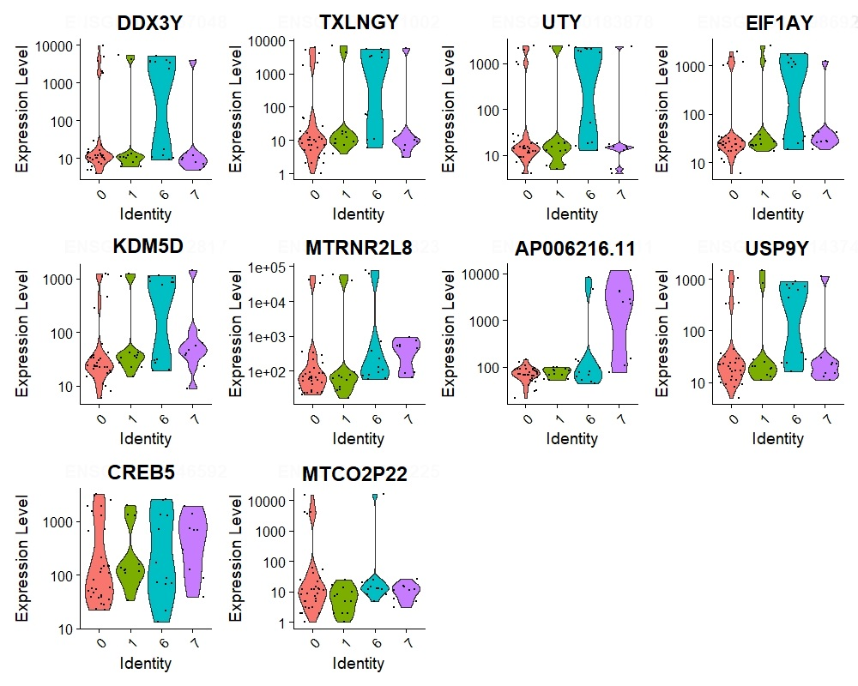
10 most highly variable genes expression levels
DDX3Y, TXLNGY, UTY, EIF1AY, KDM5D, MTRNR2L8, AP006216.11, USP9Y, CREB5, MTCO2P22

Slide 19
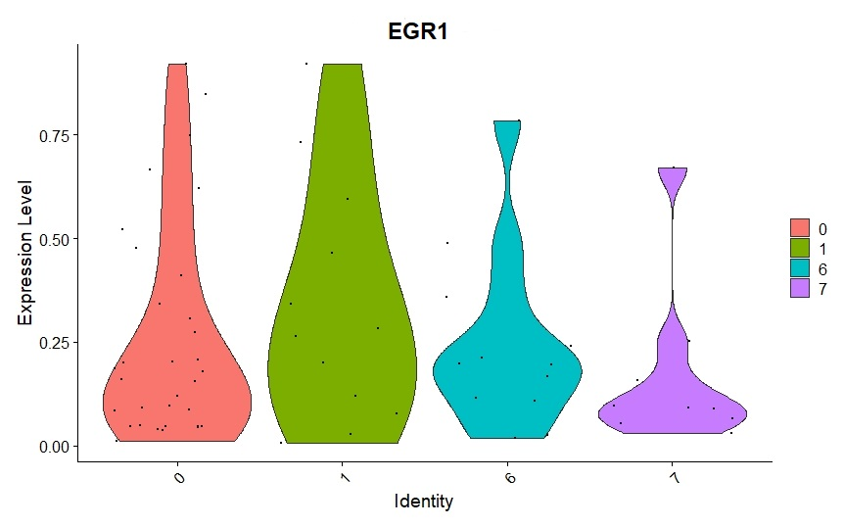
EGR1 expression levels according to Nas score

Slide 20
Conclusions
First dataset grouped according to fatty liver stages
Second dataset grouped according to fibrosis stages
First dataset is a microarray vs RNA-seq at the second dataset
First dataset shows methylation properties other than gene expression
Second dataset use deconvolution other than transcriptome signature
Self-clusterization of the data is different from that of the pathology
EGR1 and FOS found as highly variable for the first dataset
TP53 found as highly variable for the second dataset

