Slide 1

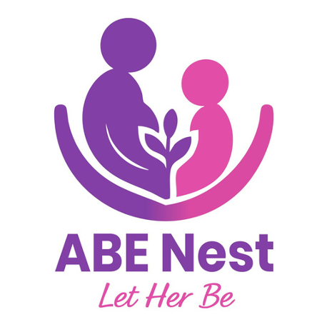
ABE NEST
Empowering Young Mothers
LET HER BE, LET HER GROW, LET HER THRIVE

Slide 2

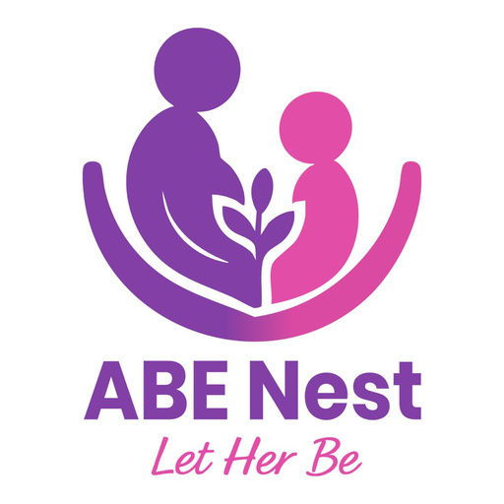
The Rising Crisis in Rwanda
22,454
~70%
Teen Pregnancies (2024)
Maternal Deaths are Avoidable
1 in 20 girls aged 15–19 has already begun childbearing,8% INCREASE in rate in 2025

Slide 3





The Multi-Generational Impact
Economy
Education
Long-term economic disparities for families and communities.
Nutrition
Severe disruption of school cycles, ending futures prematurely.
Increased risks of child stunting and low birth weight.

Slide 4

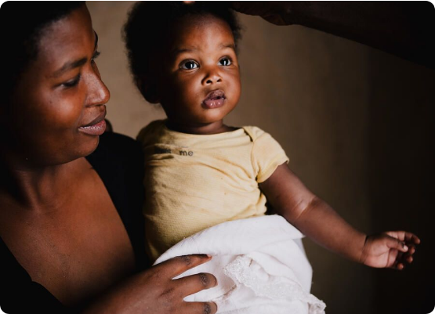
ABE NEST: A Holistic Ecosystem
1,000 Days of Support
We provide a comprehensive Holistic ecosystem supporting young mothers from the start of pregnancy through the first 1,000 days of their child's life.
Bridging the digital-physical gap.
Focused on maternal,nutrition,mental & physical well-being.

Slide 5
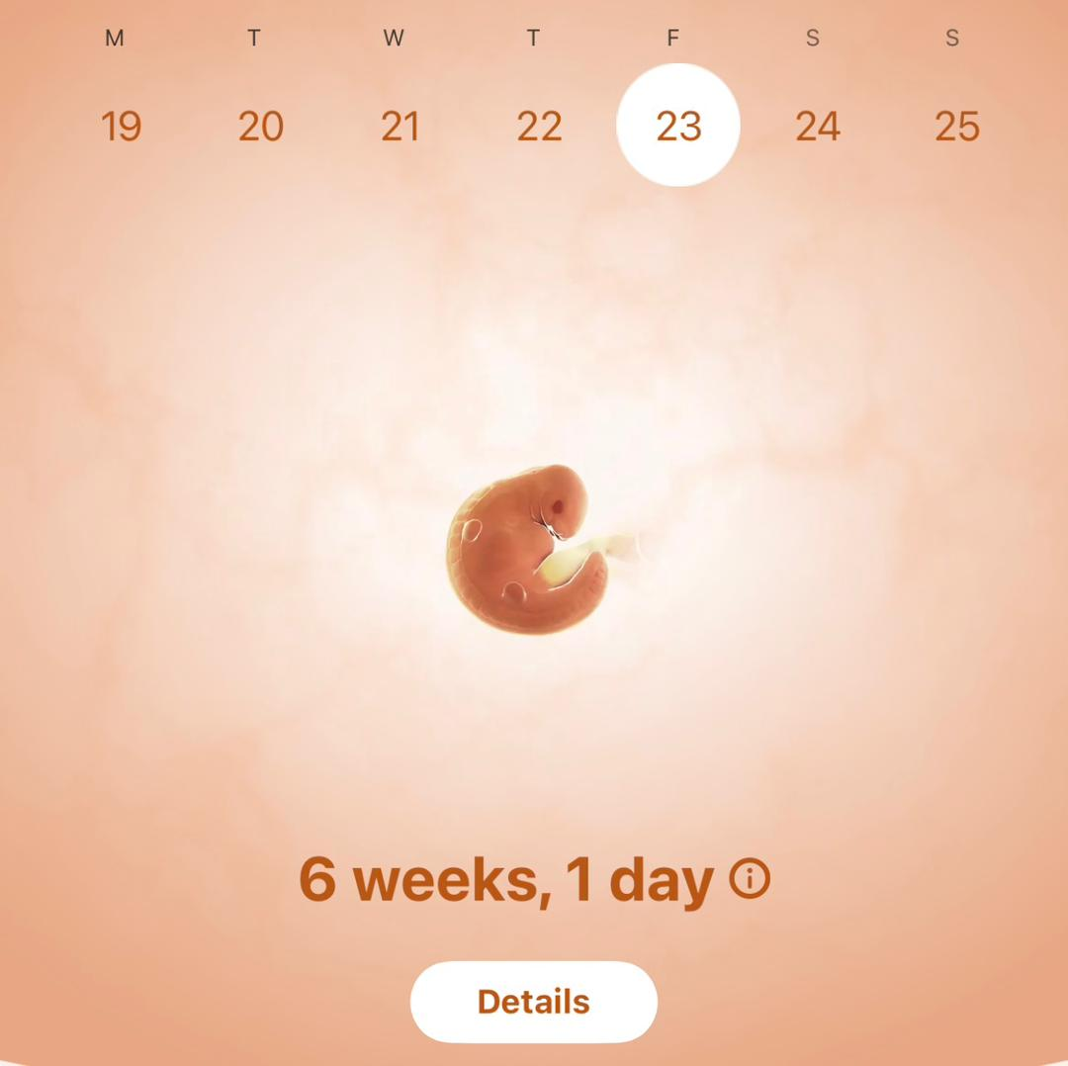
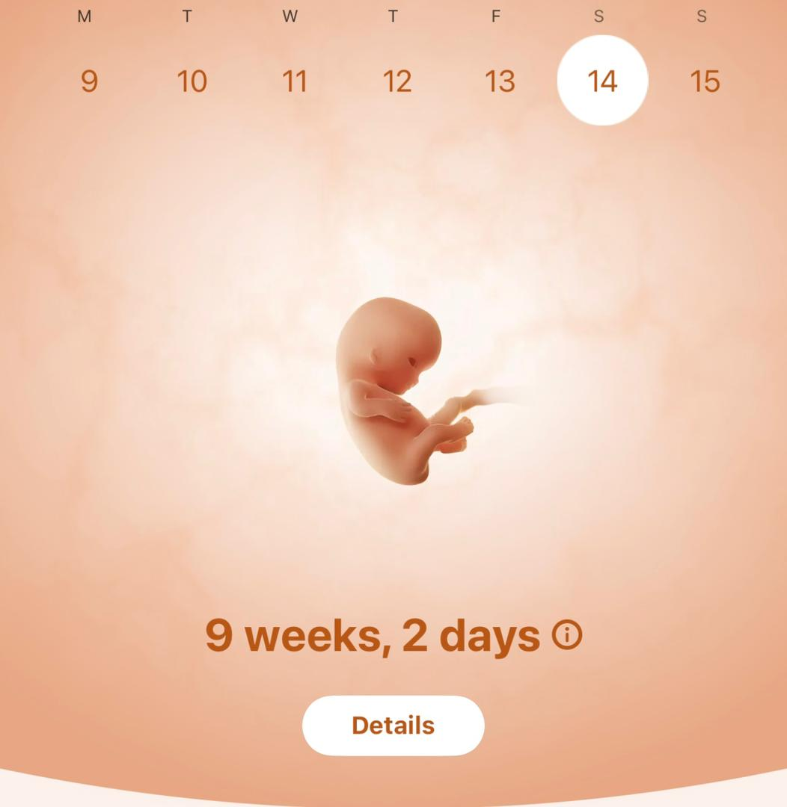
Digital Innovation
Health in Her Hands
#1st Maternal Mobile Application in Rwanda: Menstrual and Pregnancy Cycle trackers and nutrition guides.
AI Chatbot: 24/7 answers for maternal health concerns.
SMS Reminders: Direct notifications for prenatal checkups.

Slide 6






Direct On-The-Ground Support
Toll-Free Support
Talk to a Specialist
Shared Spaces
Round-the-clock emergency guidance and counseling for isolated mothers.
Direct access to healthcare professionals for urgent health concerns.
Community platform for mothers to connect and share experiences.

Slide 7

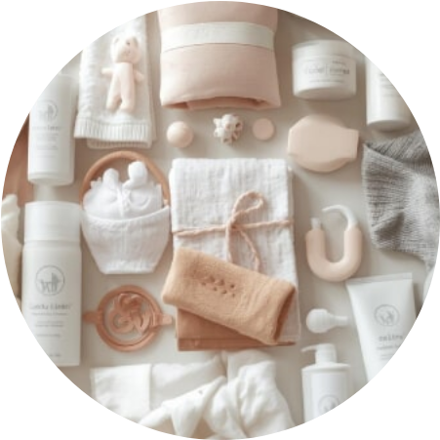


ABE Wellness Center
Essential Motherhood Kits
Generating revenue while providing critical support through curated product lines.
Antenatal Kits: Essentials for a healthy pregnancy.
Postnatal Kits: Recovery and newborn care items
A motherhood guide
Maternal supplementation according to Age
.

Slide 8
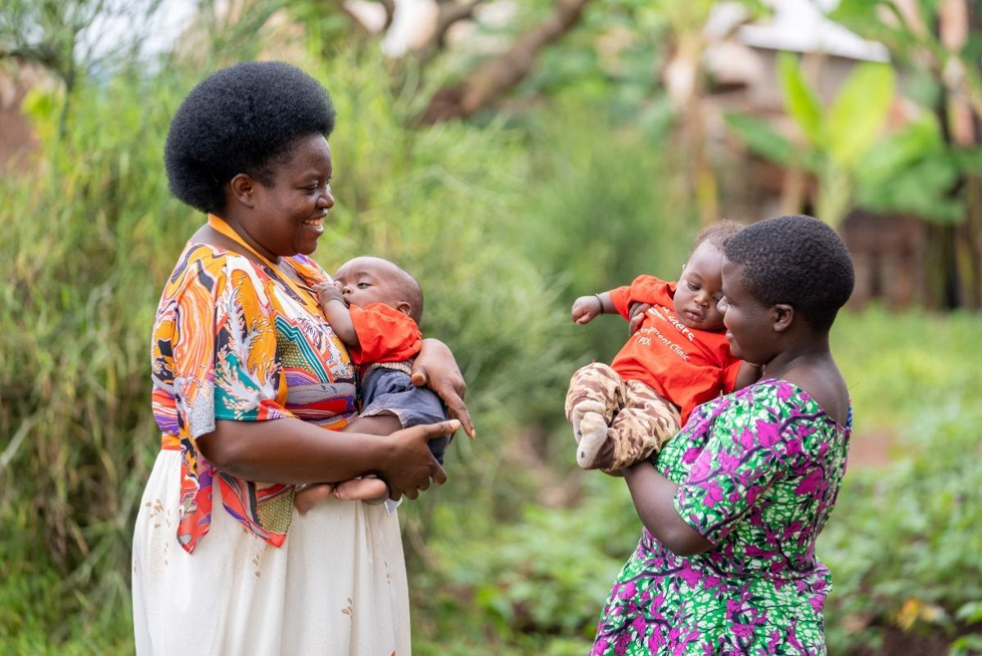
ABE Fitness Center
Health through Connection
Our wellness club encourages physical health through specialized memberships, creating a sustainable funding source for our outreach programs.
Weekly prenatal fitness sessions.
Post-partum recovery classes.
Supportive community environment.

Slide 9


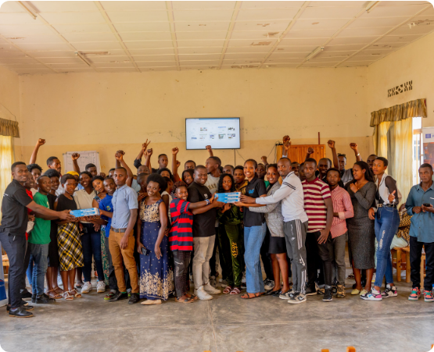
Market Opportunity
A Growing Need
Rwanda's demographic landscape shows a critical need for specialized maternal support.
TAM: 1.2M+
Women of reproductive age in Rwanda.
SAM: 22,454
Annual teen pregnancies requiring urgent care.
SOM: 10,000
Target girls and mothers to be supported by 2028.

Slide 10




ABE NEST
Our Sustainable Business Model
ABE KIT
Fitness Center
Partnerships
Selling specialized Antenatal and Postnatal Motherhood Kits.
Membership-based wellness and fitness programs for young mothers.
Collaborations with NGOs and health institutions for community outreach.
25% of all profits are reinvested directly into our education programs.

Slide 11
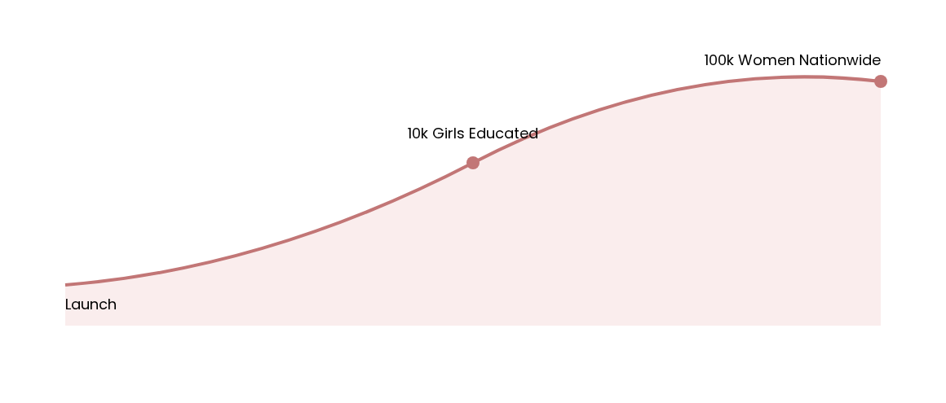
Vision 2028 Roadmap
Scaling services to reduce teen pregnancy, Maternal and neonatal deaths and stunting rates across Rwanda.

Slide 12
Economic Inclusion & Reinvestment
50+
25%
Jobs Created (2 Years)
Profits Reinvested
Focusing on self-reliance and breaking the cycle of poverty through entrepreneurial models.

Slide 13
Competitive Landscape
Feature | Umubyeyi Elevate | ABE NEST
Model | Primarily Digital,no app | Hybrid (Digital + Physical)
Teen Focus | General Maternal | Highly Specialized for Teens,Mothers
Physical Products | No Kits | Antenatal & Postnatal Wellness Kits
Emergency Support | Online Community | 24/7 Toll-Free Support
Inclusivity | Standard | Mothers with Disabilities Focus

Slide 14
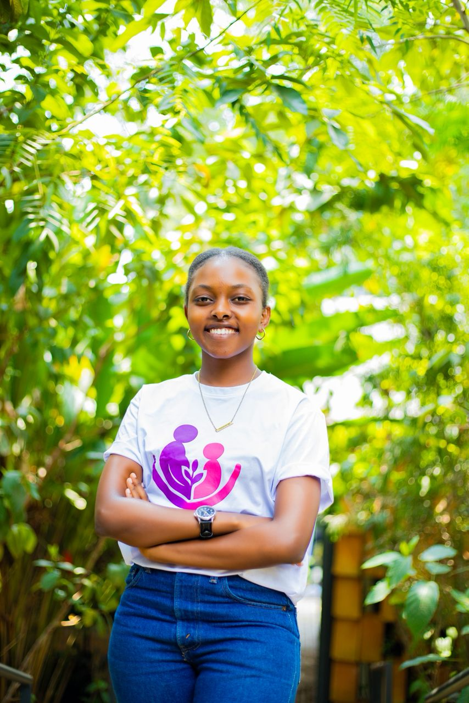
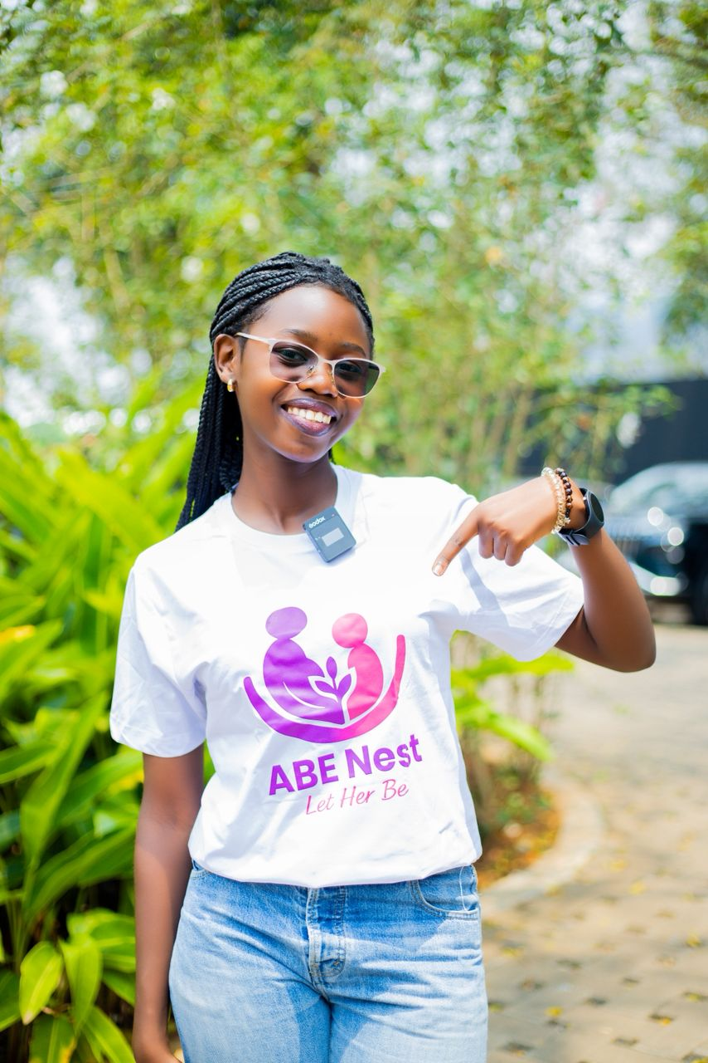
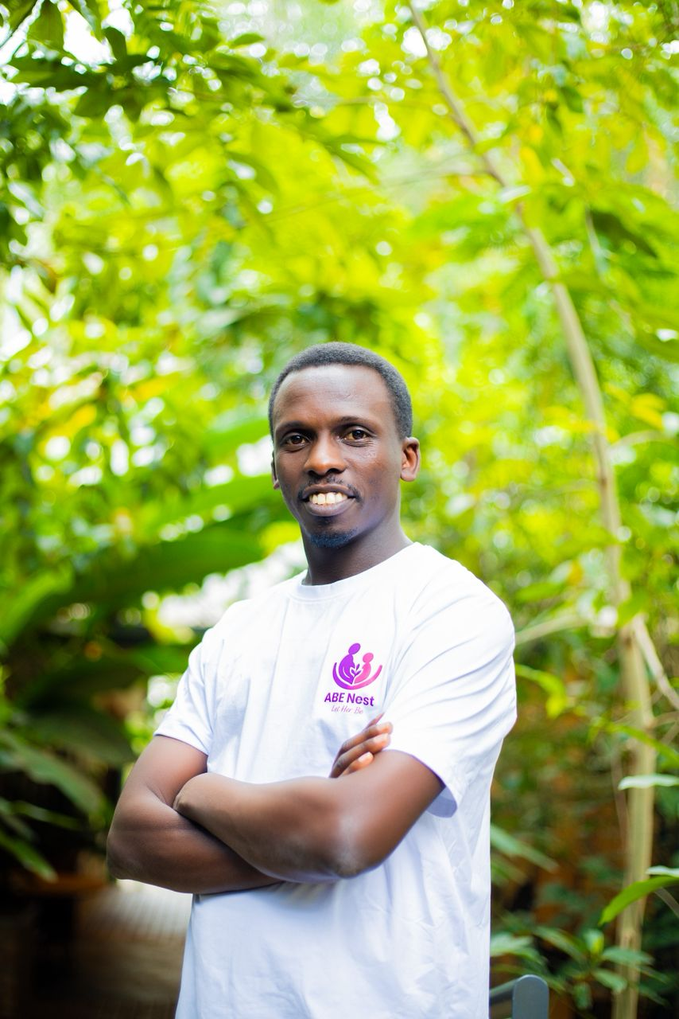
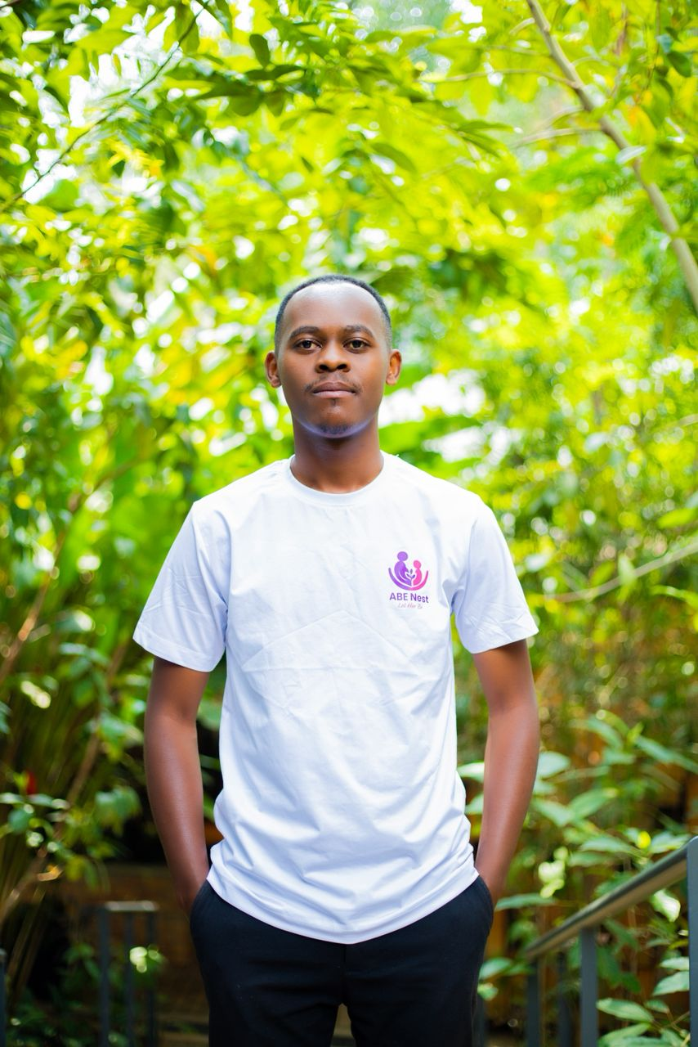
Our Expert Leadership
Sandrine Uwase
Dr. Benjamin Niyishoboyebyose
Germaine Ishimwe Umuhoza
Emmanuel Nsengiyumva

Slide 15
Join Our Journey
abenest250@gmail.com
0787248328 / 0786925625
Empowering the next generation of Rwandan mothers.

