Slide 1


Slide 2
at least 1 million people get killed on roads
EVERY YEAR
70%
of these are from 3rd world countries
this includes
the Philippines
Notes:
Every year atleast 1 million people get killed on roads
70% of these are from 3rd world countries
This includes the philippines

Slide 3
15,064 traffic accidents
41 traffic accidents per day.
Notes:
Reports from pnp shows a total of 15,064 traffic accidents occurs in the country in 2006
That’s an average of 41 traffic accidents per day.

Slide 4
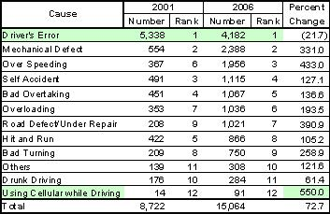
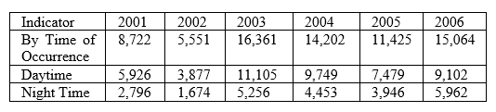

accidents from 2001-2006 were caused mainly by
driver’s errors
4,182 accidents in 2006
This figure, however, was lowered by 21.7%
TABLE 2 TRAFFIC ACCIDENTS: RESULTS AND TIME OCCURANCE 2001-2006
So, what may be causing this?
TABLE 1 NUMBER OF TRAFFIC ACCIDENT BY CAUSE: 2001 AND 2006
References: [1] Philippine Statistic Authority – National Statistical Coordination Board. [2] Transport Accident Commission
Notes:
This was cause mainly by drivers error
It conflicted a total of 4182 accidents in 2006 alone
A number of accidents occur on normal sleeping hours

Slide 5
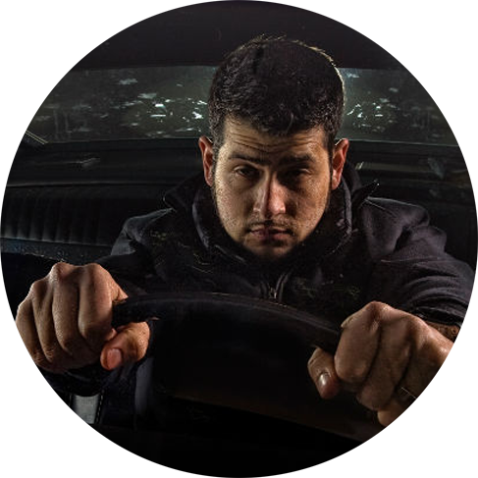
SLEEP DRIVING
Sleep Driving is suspected to be a primary cause in
more than 27.8% of road fatalities

Slide 6



WHO ARE AT RISK?
18-29
MEN
SHIFT WORKERS
References: [3] Philippine Transportation Statistics
Notes:
Adults between 18 and 29 are much more likely to drive drowsy
Men are more likely than women to drive while drowsy
Shift works are more likely than those who work on a normal working hours to drive while drowsy

Slide 7
Road accident statistics in the Philippines by: 2013
4th
leading cause of death
Sleep Driving
Mortality in 2020
79% of road crash fatalities are caused by driver’s error

Slide 8
WAKEAPP
OUR SOLUTION?
DRIVE A MUCH SAFER ROAD EVERY DAY

Slide 9


WHAT IS IT?
WAKEAPP is an integration of smartphones and the latest wearable technology smartwatches
working together to keep car drivers awake and vigilant upon navigating towards their destination.

Slide 10






Problem
Customer Segment
Solution
Unfair Advantage
-Notification
-Real time Drowsiness
-History of past Travel
-Alarm
Unique Value Proposition
Drive a much safer road everyday
Notes:
PROBLEM: Road accident is one of the most fatal cause death here in the philippines more specifically drowsy driving or sleep driving
CUSTOMER: Young Adult between 18 – 29
MEN
Shift workers
SOLUTION: WakeAPP It integrates facial recognition with machine learning to cater real time drowsiness detection
UNIQUE: Drive a much safer road everyday

