Slide 1
INSPIRE Single Monomer Rotation
German Barcenas

Slide 2
Outline
Starting structure
  MD preparation
    Force field generation
  File preparation of DNA + monomer
    Renaming atoms to follow force field conventions
Molecular Dynamics using GROMACS
  Simulation condition setting
    Box setting, solvation choice
    Energy minimization
      Necessary check for steric clashes, conflicting geometries, etc.
    Equilibration steps
      Solvent-system interface needs addressing via NVT equilibrium condition
    Production MD
  Analysis
    Based on E. Stennett paper, a method of demonstration for orientation

Slide 3
Starting Structure
This part of the work is mostly making sure that the atoms in your .pdb file share the same name as specified by your force field. GROMACS will not even allow you to continue if the names do not exist.
Likewise the forcefield parameters must be specified for all atoms. GROMACS will not allow you to continue if this isn’t explicitly listed.

Slide 4
Molecular Dynamics - Preparations
Experimental condition consideration:
  How can we make this simulation mimic some DNA tile constraints?
    Without specifying, GROMACS will have a free floating DNA-monomer system in solvent.
      By adding some position restrains to the terminating oxygen of the DNA used in simulation, the hope is that this is a better representation of any tile-induced torsional effects.
    Position restrains can be edited in the posre_.itp file that is generated when initializing your structure.

Slide 5
Analysis
GROMACS output includes position information from each time step that can help us make a movie of the simulation.
  We also perform some data extraction at each step such as atom1-atom2 distance and atom1-atom3-atom2 angle.
This distance and angle data is how Elana Stennet from Arizona State University dealt with this issue in Photophysical and Dynamical Properties of Doubly Linked Cy3−DNA Constructs (2013).
Before we go and make out own script, what can GROMACS do to help us here?
  It turns out a lot!

Slide 6
Analysis: Theory
We want to create a distance of groups vs angle of groups plot per Stennet et. al.
  Distance is very easy. The angle will require some creativity.
  We can create CoM data for each group
GROMACS can either work with individually named atoms in a list of perform analysis on assigned groups of atoms
  Focusing on groups and defining them by their center of mass allows us to track a group over the simulation
GROMACS can find the distance between atoms or the center of mass of groups of atoms.
  This can be tricky to process data since the file types are in some unique binary types used by GROMACS. Luckily there ae Python libraries that exist that can open these and let us peek inside
  https://www.mdanalysis.org/

Slide 7
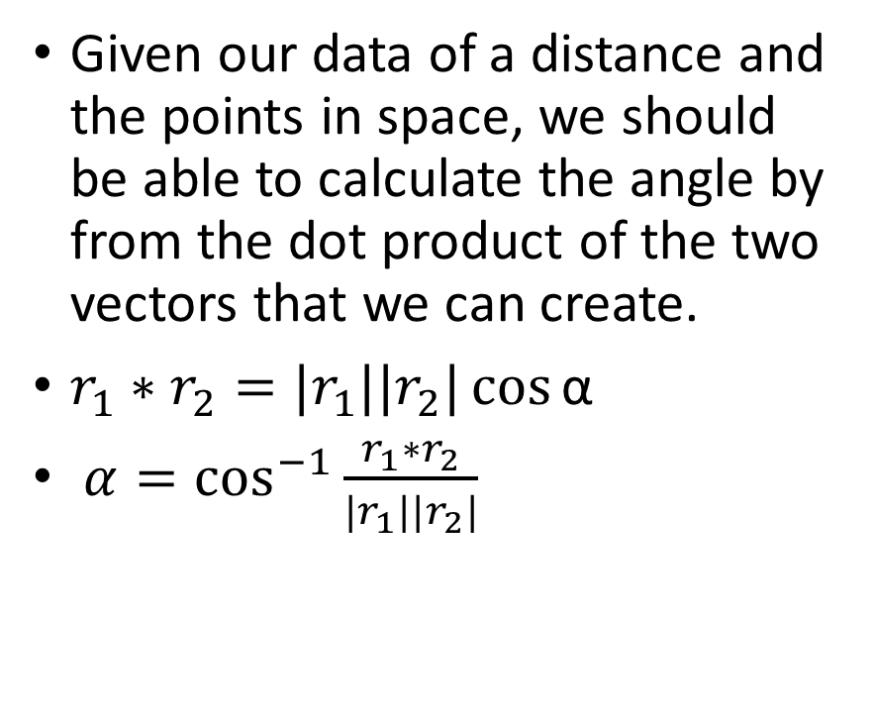
Analysis: Theory cont.
Given our data of a distance and the points in space, we should be able to calculate the angle by from the dot product of the two vectors that we can create.
$r_{1}∗r_{2}=|r_{1}||r_{2}|\cos{\text{α} }$
$α=\cos^{−1}{\frac{r_{1}∗r_{2}}{|r_{1}||r_{2}|}}$
(x,y,z)
R_2
α
(x,y,z)
(x,y,z)
R_1

Slide 8
GROMACS Data Processing
Per the guidance of Stennet, we need to make of plot of the distance of the center of mass of the monomer and the nucleotide N1 across from the monomer.
We also need the angle calculated from the monomer, N1, and the next nucleotide in the sequence on N2.
The goal is to get some distance and angle as a function of time and make a histogram with each bin representing the amount of time a certain orientation is found. This can show whether certain orientations are found more often than not and can be analogous to monomer orientation stability.

Slide 9
GROMACS Specific Instructions
To isolate the monomer, N1, and N2, we need to create specific indexes to only focus on these atoms.
  Identify the atoms that make up the group and write these down
    I find that the interface of UCSF Chimera for this type of work
  gmx make_ndx -f input.gro -o histogram.ndx
    Specify the atoms identified here. You will identify the groups as a #-#,
      DA 16: 538-1569
      DA 15:1506-1537
      CY5 42 509-583
    Check the new group you’ve made with:
      vim histogram.ndx
      If you use this index as is, you will have to remember the atom groups by this GROMACS atom naming, so now DA-16 would be identified as a_1538-1569
      If you have vim’d into the index file, you can find the name in the brackets and replace that string as DA-16

Slide 10
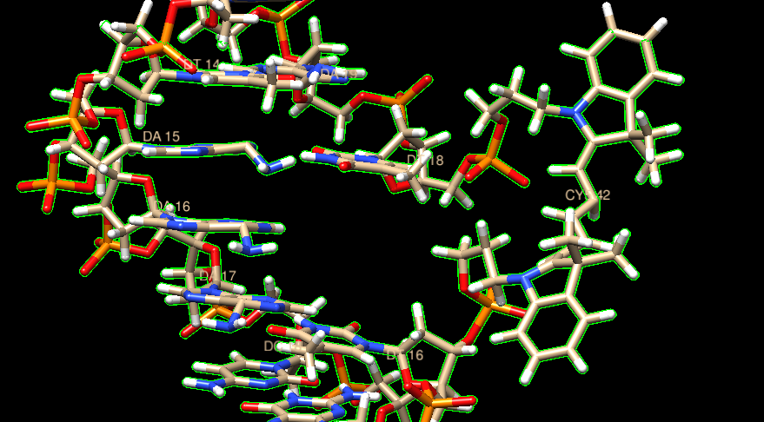
Chimera Example

Slide 11
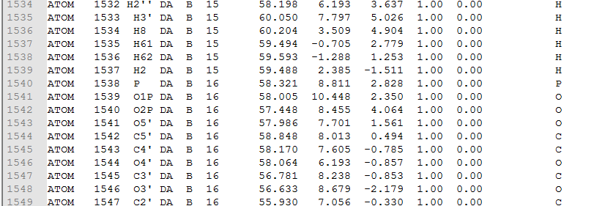
Extracting names of atoms
Chimera helped us identify the residues we care about:
  DA 16, DA 15, and CY5 42
  Open .pdb file and look for those atoms and their atoms numbers ( column 2)
Notes:
DA 16:
1538-1569
DA 15:
1506-1537
CY5 42
509-583

Slide 12
GROMACS Specific Instructions Cont.
With these index files, we can now get the center of mass (-com) as a function of time for all groups.
gmx distance -f input.xtc -s input.gro –n index.ndx – select ‘com of group “CY5” plus com of group “DA-16” –oxyz –oall output
  “CY5” and “DA-16” are only usable here if you have renamed the group names as such. Make sure that you use the group name found in the index file.
Do this again to make the distance of DA16 and 15 so we can make 2 vectors and get angles. GROMACS does not do angles of the COM very well

Slide 14
Plotting
From here you should have the raw data make a histogram like Stennet.
I would use python with matplotlib, but any language that you’re comfortable will do.

