Slide 1
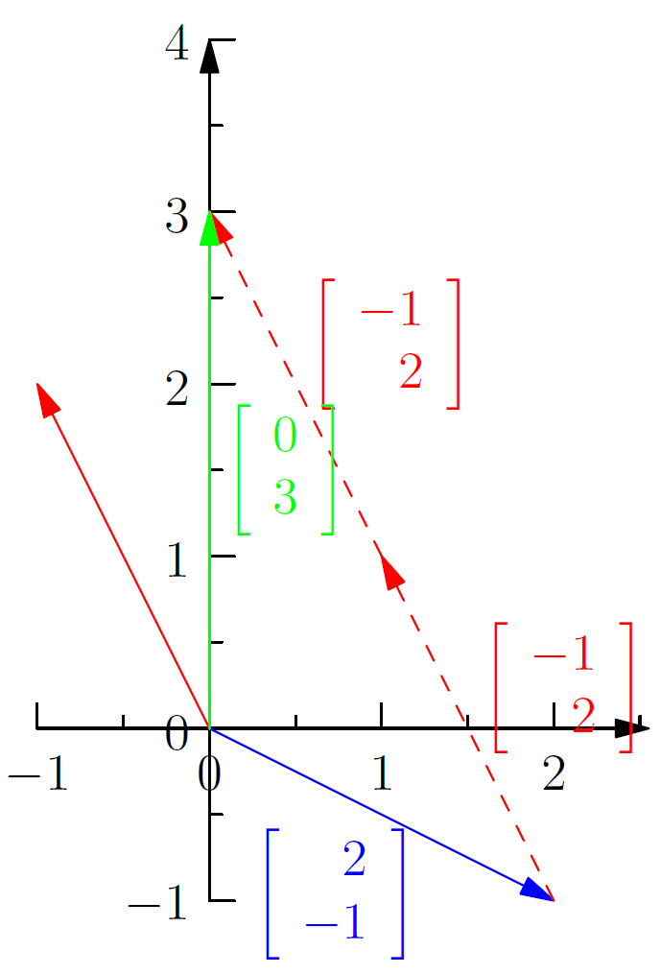
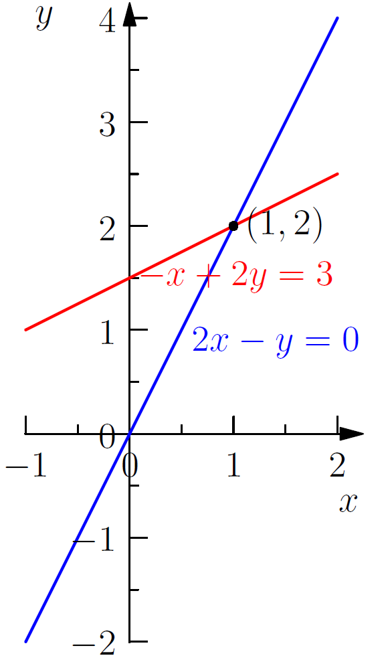

Slide 3
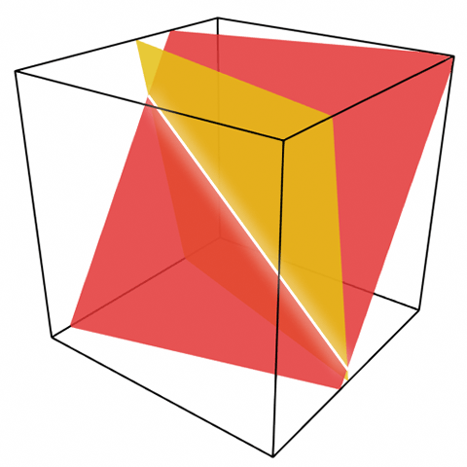

Slide 4
y
b = -1
b = 0
b = 1
x

Slide 5
y
b = -1
b = 0
b = 1
x

Slide 6
y
x + y = 2
2x – y = 0
A
x – 2y = 0
C
B
x

Slide 7
y
x + y = 2
2x – y = 0
A
x – 2y = 0
C
B
x

Slide 8
y
x + y = 2
2x – y = 0
A
x – 2y = 0
C
B
x

Slide 9
y
b = 0
x

Slide 10
y
b = 1
x

Slide 11
y
b = 2
x

Slide 12
y
x

Slide 13
y
x

