Slide 1


Slide 2

Agenda
Introduction to Agents for Amazon Bedrock
Agent orchestration
Agent structure
Demo
Athene’s use of Agents for Amazon Bedrock
Closing

Slide 3





Workflow automation challenges
Knowledge workers stretched, need productivity tools
LLM’s are powerful, but they can’t take actions
Integration of databases and systems is expensive and slow
Building production agents involves complex engineering
Need diverse set of programming languages and interfaces

Slide 4
Agents for Amazon Bedrock
Uses power of LLM’s to prompt and
respond using natural language
Breaks down and orchestrates tasks
Completes tasks by dynamically
invoking APIs
Securely and privately accesses company data
Surfaces chain-of-thought trace and
underlying agent prompts
Enable generative AI applications
to execute multi-step business tasks using natural language

Slide 5
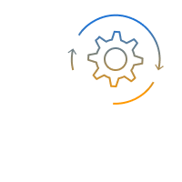



Benefits
Automates orchestration of multi-step tasks
Simplifies building and deploying AI assistants
Provides secure access to enterprise data and APIs
Lets you choose implementation languages
Provides fully managed infrastructure

Slide 6
Understanding agent basics
Agents have instructions, a chosen Bedrock model, and a set of available actions and knowledge bases

Slide 7



Agent basics
Agent
Instructions: “you are an agent that …”
do this
for me…
Done. Here’s
the result…
Actions
Knowledge Bases
Amazon Bedrock

Slide 8
Simplest agent has only a set of instructions
why did the AI
go to school?
to improve its learning Rate
Joke bot
Instructions: “you are a funny agent that can only tell jokes. you refuse to do anything else. you always keep the jokes clean and not offensive. you can tell jokes about any topic.”
write an email
message
I’m sorry, I’m just a
funny bot who tells jokes

Slide 9
Agents use actions to get work done
Meeting assistant
Instructions: “you summarize meetings and send results”
list the action items from my meeting
Meeting Actions Utility Actions
Here are the action
items: 1/ …, 2/ …
List Meetings
In: date range Out: [date, subject, meeting ID]
Send Email
In: subject, recipients, body Out: status
send them to my team
Get Action Items In: meeting ID Out: [action items]
Get Team
Out: list of team member email addresses
Email sent

Slide 10
Agents use Knowledge Bases to find information
HR Policy Assistant
Instructions: “you are an HR agent, helping employees understand HR policies”
If I switch to part- time, will I still get vacation days?
HR Knowledge Base
Vacation Policy Contains the entire vacation policy for the company
Sorry, part-time staff aren’t eligible for vacation days.

Slide 11

Agents can combine Actions and Knowledge Bases
HR Policy Assistant v2
how much vacation do I get per year?
Instructions: “you are an HR agent, helping employees
understand HR policies and manage vacation time”
as a full-timer with 3 years tenure, you get 15 days
HR Knowledge Base HR Actions
Vacation Policy Contains the entire vacation policy for the company
Request Vacation In: start date, end date Out: approval status,
remaining balance
cool. I’d like to take
off December 8 to 15
approved, enjoy. you have 8 more days available

Slide 12


Agents are secure
Agent
Knowledge Base
Action group
Each resource has its own IAM role
Principals can be granted or denied access independently
Builds on Amazon Bedrock model invocation security

Slide 13






Agents build on existing enterprise resources
HR Knowledge Base
Existing resources
HR Policy docs
Vacation Actions
get-Vacation-Balance
HR Time Off Agent
Vacation
microservice
Vacation
database
Leave of absence Actions
Leave of absence (LOA) database

Slide 14
What can I build with Agents for Amazon Bedrock?
Here are a few examples to get you started…

Slide 15





Laptop support assistant
Laptop Laptop common
support wiki problems
Sample requests
My laptop is dead; help me order a new one
I ordered a new laptop, but it
hasn’t arrived
My laptop is making weird noises; should I get a new one?
IT Help desk laptop support assistant
Support history
Laptop replacement

Slide 16
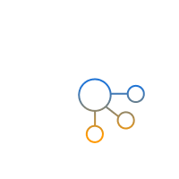
Ticket triage agent
Support policy
Skills profile
Sample requests
Here is the latest request Triage it for me
Take care of the easy ones Route the tough ones to the right person
Ticket triage agent
Ticket routing
Ticket classifier

Slide 17


Product reputation helper
Product brochure
Common complaints
Sample requests
Draft a reply for this product review
Draft a comment for this social media post about the product
Product reputation helper
Reply generator
Comment generator

Slide 18

Tractor maintenance assistant
Operations Troubleshooting
manual guide
Sample requests
My tractor won’t start, what’s the
problem?
I need new lawn cutting blades, what will it cost me?
Can you ship me replacement parts?
How do I change the oil?
Tractor maintenance assistant
Repair history
Repair calculator

Slide 19
Agent orchestration
Orchestrate user requests by breaking them into smaller subtasks

Slide 20
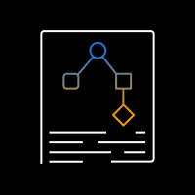


Orchestration – Basic flow
Execute action or search knowledge base
Decompose into steps using available actions and Knowledge Bases
Until final answer
Observe results
Think about next step

Slide 21














Agent orchestration – Detailed flow
PROMPT
Conversation history
Step 1
Step 2
…
Step n
Chain of thought
API call
Results
Actions, KBs
Action
Groups
Instructions
Bedrock model
Task
Task
Bedrock Agent
Results
Search
Results
Knowledge Bases
Task + results
Final
response
Final response
Bedrock model
Agent breaks task into subtasks, determines the right sequence, and executes actions and knowledge searches on the fly

Slide 22
Agent orchestration – An example
Thought: To answer this question, I will:
1. Get open claims
2. Get missing documents for each open claim
3. Get requirements for each missing document
4. Send reminders for each missing claim
Task: Send a reminder to policy holders with missing docs; include doc requirements
GetOpenClaims ₁ <date range, policy type> | CompilePolicyIDsMissingDocs ₂ <list of docs, list of claim IDs> | Search knowledge base 3 <query with docs> | SendReminder 4 <policy ID>
<list of claims> | … | … | <success>
I need the subset of claims with missing docs | … | … | I know the final answer
Action:
Observation:
Thought::
Final Answer: There are currently two open insurance claims with claim IDs claim-006 and claim-857. For claim-006, the pending document required … Reminders have also been sent for both claims

Slide 23
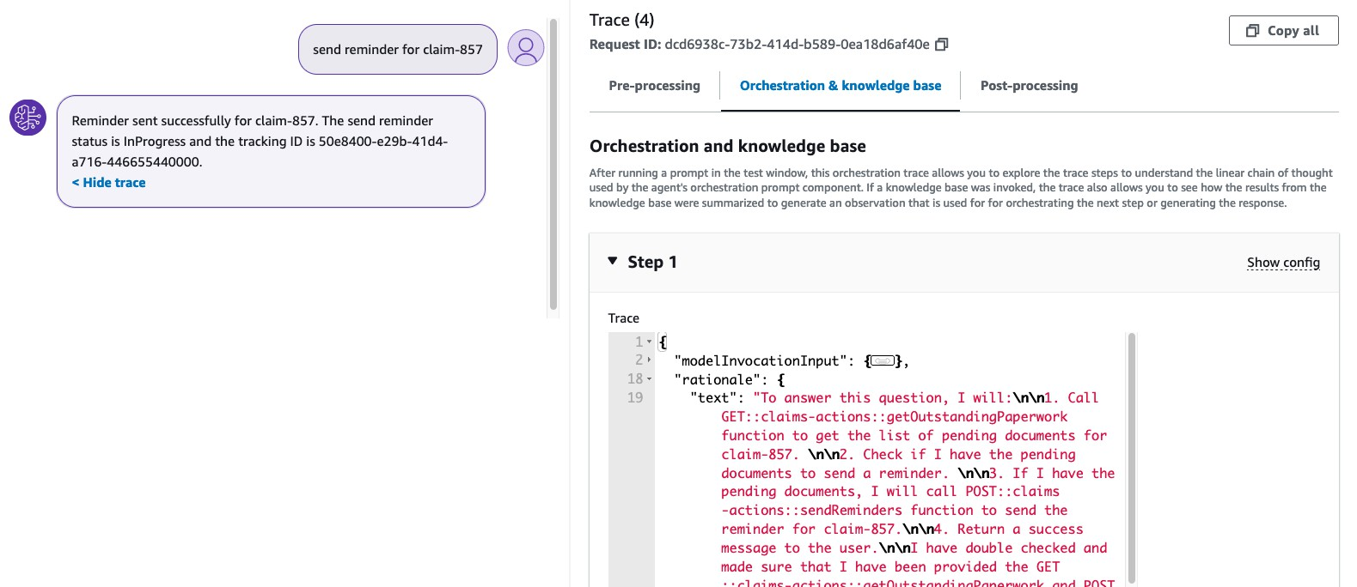
Agent orchestration is transparent – Trace
Detailed orchestration trace in the console and from the SDK

Slide 24
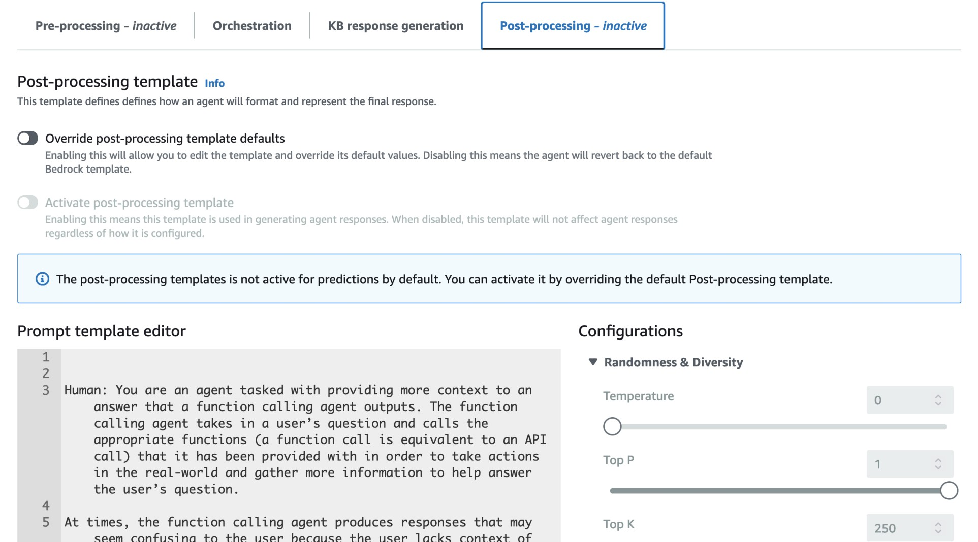
Agent orchestration is transparent – Prompt editing
Detailed orchestration prompt can be updated via console or SDK

Slide 25
Agent instructions help guide an agent
Agent instructions
You're a Bedrock expert. you estimate workload sizes, calculate and compare on-demand and provisioned throughput prices. Requests take input tokens and return output tokens. Workloads have average requests per minute, number of hours per day, specific model, and average request size.
Follow these rules:
1. 1 word = 1.3 tokens
Before calculating, convert time units if needed. Check token and time unit math before calling calculators
Allow users to refer to models using a shorthand name
From available model list, find model name that most closely matches shorthand name from user
Always use exact name of available model, not shorthand model name from the user, when calling calculators
Always use exact name of available model in your final answer
If user hasn't given model name, ask for it, instead of choosing or guessing
Make final answer verbose, including: assumptions, conversions, workload details, exact model name that was sent to the calculator (from the available model list, not the shorthand name)
Never fabricate workload details like workload hours/day. If workload details are missing, ask for them
Let user compare many models for same workload
Amazon Bedrock Pricing Agent

Slide 26
Agent action groups
Sets of actions made available to your agent to get work done

Slide 27


Each Action Group has 3 key elements
Action Group Description
Overview of actions provided – helps agent
know when this action group is relevant
API Schema
Rich definition of each action
Operation name, input parameters, data types, response details
Helps agents know when to use it,
how to call it, and how to use results
Language agnostic API definition using industry-standard schema
Lambda Function
Implementation of each action
Contains either business logic or wraps microservices, databases, or tools
Serverless, scalable, secure
Choice of programming language
(Python, C#, JavaScript, Java, …)

Slide 28
Agent deployment
Deploying and invoking agents

Slide 29

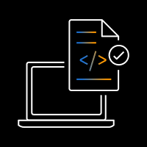
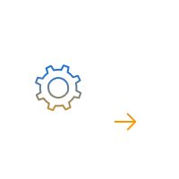


Agents can be deployed and invoked from any app
Building and testing agents Using production agents
Agent builder
Agent user
Agent console or SDK
Customer app
Event
Agent draft
Deployed Agent
To deploy an agent, you create a new Alias,
and optionally a new Version

Slide 30
Demo

Slide 31







Current Process: Mining legacy code takes time
Inputs
Code Documentation Data files
All contain the information for our modernization project
Process
Skilled staff spend weeks extracting logic
and updating documentation
Outputs
Refactored code
A mapping document for the new version

Slide 32



The process today is largely manual and does not scale
Large (150K+ rows) and complicated files with inconsistent formats,
naming, and non-standardized rows/columns across separate carriers
Large data files, no consistency
A large code base with advanced file processing and ETL logic handling multiple file inputs
100k+ lines of legacy code
A very time-consuming process driven by human review and manual
refactoring of the codebase.
Time consuming manual process

Slide 33









Approaching the solution with Amazon Bedrock Agents
Can we use Bedrock Agents to help our Analysts and Engineers save time on the more manual tasks?
”Generate the Mapping
Document”
Determine Fields Determine File Generate Mapping Dependency Document
 | Bedrock Agent Action Groups
2
3
Business Analyst
Amazon Bedrock Data Mapping Agent
4
Mapping File Generated and Placed in S3
Amazon S3
(All relevant data and legacy code files are uploaded)
1
“How is Cash Surrender Value calculated in the code? What files did we use to calculate it?”
“What's it called in the new data
model?”
Load Documents in the KB
5
Amazon Bedrock Knowledge Bases (KB)
Amazon Bedrock Knowledge Base Agent
6
Business Analyst

Slide 34
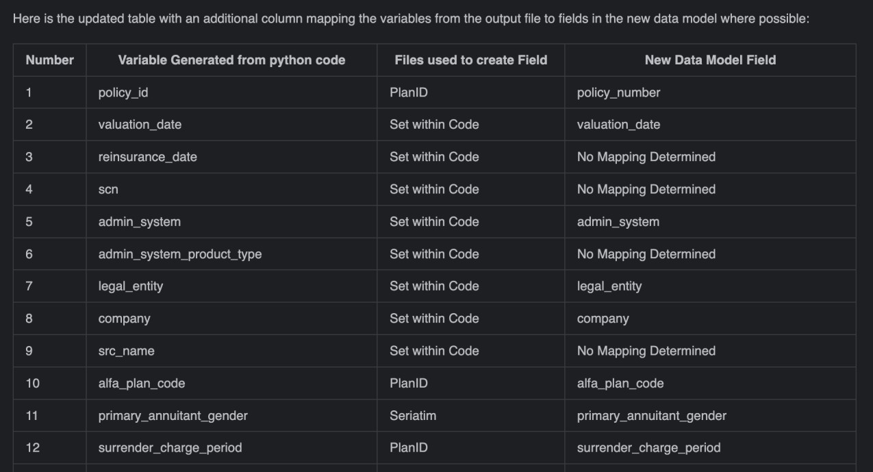
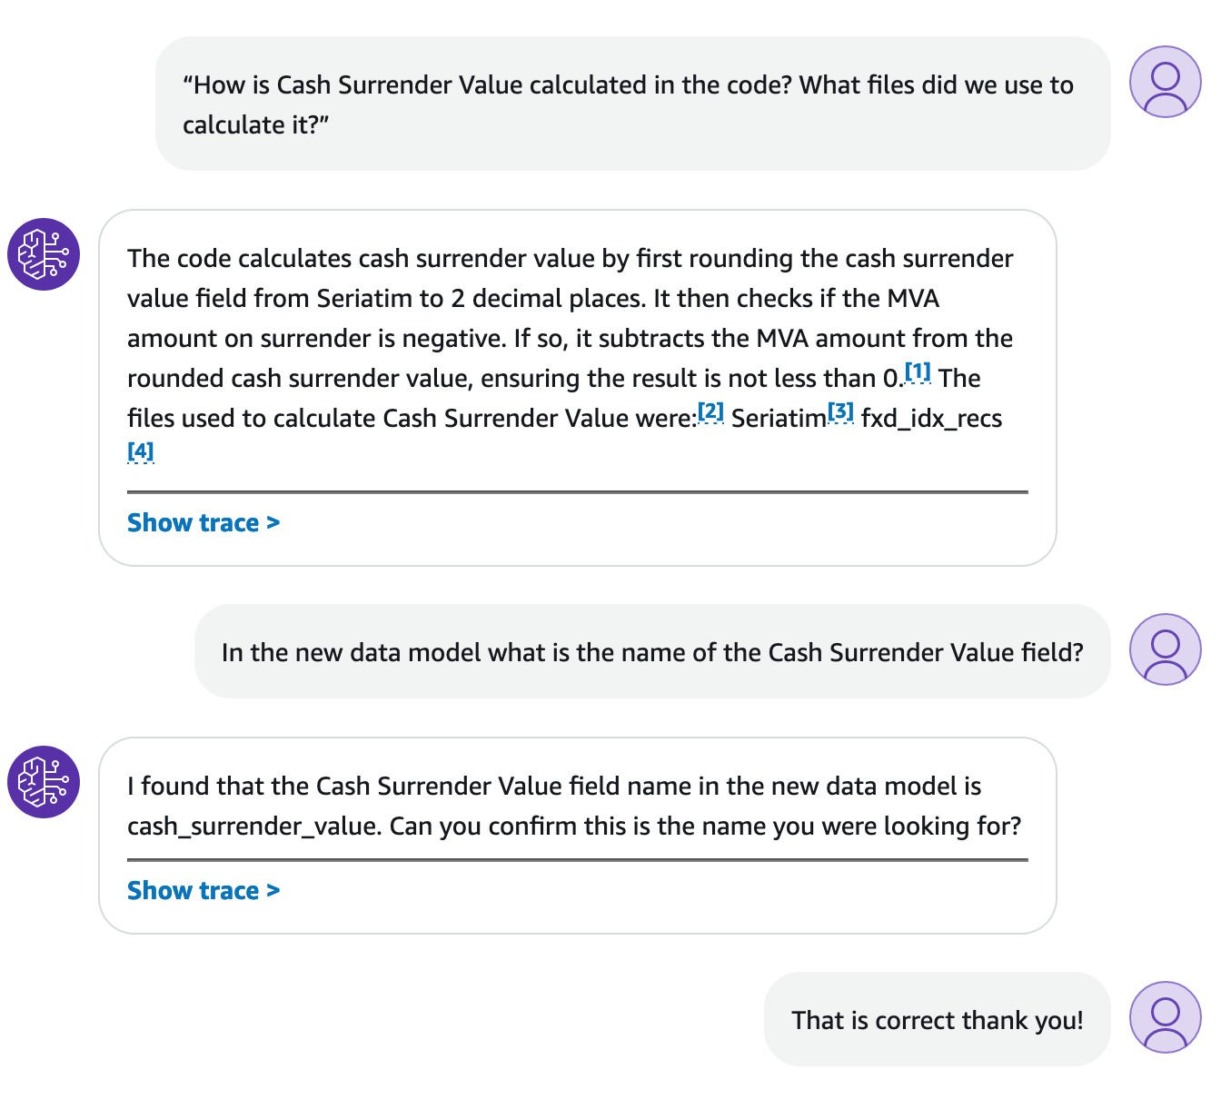
Sample output:
Output Mapping Document
Explainability for Business Analysts

Slide 35



Success! Our pilot produced labor-saving results
The Agent efficiently handled large files and was
able to define an optimal strategy for processing
The Agent accurately mapped the data file to the data map
The Agent produced data mappings, data definitions, calculation logic and documented the original source code

Slide 36



Expanding our usage of Bedrock Agents
Expand to more carriers and use cases
Refine prompts for additional tasks and improved accuracy
Ask the agent to refactor the code

Slide 37
Generate 5 pro tips about agents…
Crawl, walk, run
Prefer many small agents vs a few large ones
Use Agents to build Agents
Test throughly
Stay tuned, this is Day 1 for Agents
Give me 5 pro tips on Agents for Bedrock
“Agents”
Agent

Slide 38
