Slide 1


Slide 2
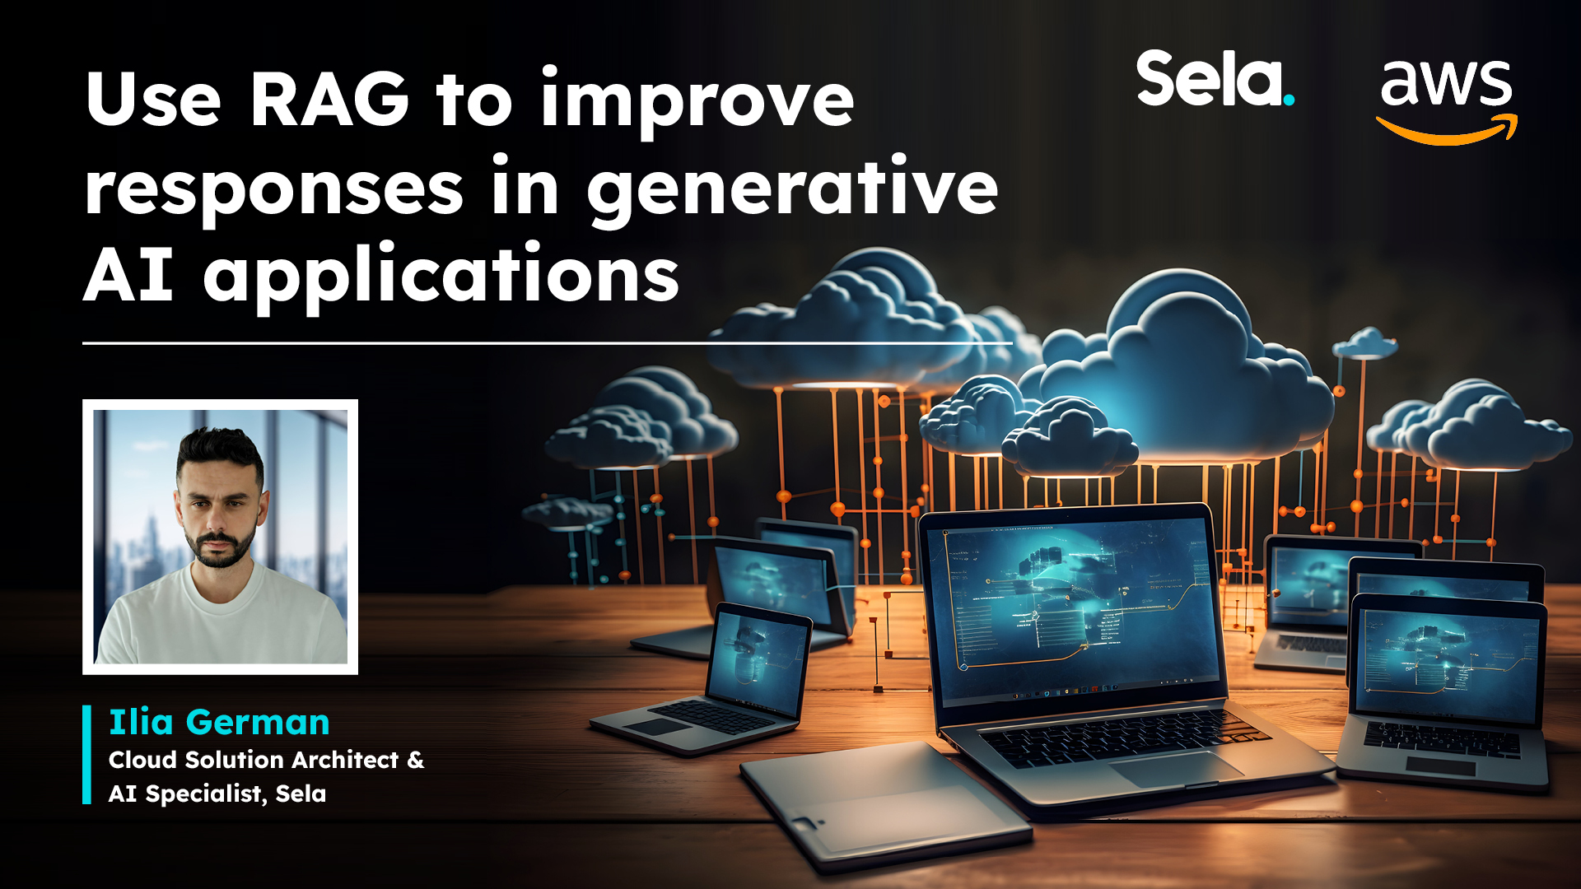

Slide 3

Agenda
Customizing foundation model for your use case
Use cases for retrieval augmented generation (RAG)
What is RAG and how does it work?
Overview and demo Knowledge bases for Amazon Bedrock
Knowledge bases integration with agents
Knowledge bases integration with LangChain

Slide 4



Why customize?
Adapt to domain-specific language
Enhance performance
for specific tasks
Improve
context-awareness
in responses
E.g., Healthcare – Understand medical terminology and provide accurate responses related to patient’s health
E.g., Finance – Teach financial & accounting terms to provide good analysis for earnings reports
E.g., Customer Service – Improve ability to understand and respond to customer’s inquires and complaints

Slide 5




Common approaches for customizing foundation models (FMs)
Complexity, Quality, Cost,
Time
Train FM from scratch
Augment knowledge without changing pre-trained model weights
Fine-tuning
Retrieval Augmented Generation (RAG) for customizing FM responses
Prompt Engineering

Slide 6

Customize vs. augment
External data sources
or up-to-date info
Consolidated or historical info
Task information
Relatively static information (e.g., docs, FAQs)
Dynamic sequence of actions
(e.g., DBs, APIs)
Complex
or specific
Simple
or generic
Real-time
required?
Simple task?
Augment with RAG
Augment with agents and tools
Fine-tuning
Prompt engineering
Knowledge Bases
for Amazon Bedrock
Agents for Amazon Bedrock
Amazon Bedrock -
Custom Models
Amazon Bedrock -
FMs

Slide 7


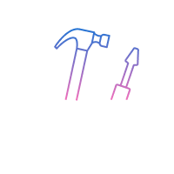


What is Retrieval Augmented Generation?
Retrieval
Fetches the relevant content from the external knowledge base or data sources based on a user query
Augmentation
Generation
Adding the retrieved relevant context to the user prompt, which goes as an input to the foundation model
Response from the foundation model based on the augmented prompt.

Slide 8





RAG use cases
Improved content
quality
Contextual chatbots and question answering
Personalized search
Real-time data
summarization
E.g., helps in reducing hallucinations and connecting with recent knowledge including enterprise data
E.g., enhance chatbot capabilities by integrating with real-time data
E.g., searching based on user previous search history and persona
E.g., retrieving and summarizing transactional data from databases, or API calls

Slide 9




Types of retrieval
0.89 -0.02 -0.53 0.95 0.17 -0.38
Semantic Search
Get relevant documents based on text embeddings
Rule Based
Structured data
Fetches unstructured data like documents
Transactional retrieval from database or API
e.g., Key word searches
e.g., Select customers from All_orders where order == ‘XYZ’
Subway Statue Liberty Tall buildings
New York

Slide 10




What are embeddings?
Numerical representation of text (vectors) that captures semantics and relationships between words.
Embedding models capture features and nuances of the text.
Rich embeddings can be used
to compare text similarity.
Multilingual Text Embeddings can identify meaning in different languages.
New York
0.027 -0.011 … -0.023
Paris
0.025 -0.009
… -0.025
Animal
-0.011 0.021 … 0.013
Horse
-0.009
0.019 …
0.015
Human Text
Vector Embeddings

Slide 11



Why are embeddings important for RAG?
Powers text retrieval based
on semantic meaning.
Used to augment prompts with more accurate context from vector stores using the Retrieval Augmented Generation (RAG).
High-accuracy embeddings leads to improved context and higher quality LLM- generated responses to a user query.

Slide 12

Titan text embeddings model
Amazon Titan Text Embeddings
V2.0
Translates text inputs (words, phrases) into numerical representations (embeddings). Comparing embeddings produces more relevant and contextual responses than word matching.
Highlights
Titan Text Embeddings offers fast, cost effective, high-performance, accurate embeddings in 25 languages.
Optimized for text retrieval tasks, semantic similarity and clustering.
Applications of this model includes
semantic search and personalization.
Max Tokens: 8,000
Output Vectors: 1,536
Language: Multilingual (25 languages)
Model ID: amazon.titan-embed-g1-text-02

Slide 13






RAG in Action
User Input
Text Generation Workflow
User
Prompt
augmentation
Large Language
Model
Response
Embeddings model
Context
Embedding
Data Ingestion Workflow
Semantic search
Vector store
Embeddings model
Document chunks
Data source

Slide 14


However, when it comes to implementing RAG,
there are challenges…
Managing multiple data sources
Creating vector embeddings for large volumes of data
Incremental updates to vector store
Coding effort
Scaling retrieval mechanism
Orchestration

Slide 15





RAG workflow
Fully managed support for end-to-end
Knowledge Bases for Amazon Bedrock
Gives FMs and agents contextual information from your private data sources for Retrieval Augmented Generation (RAG) to deliver more relevant, accurate, and customized responses.
Securely connect FMs and agents to
data sources
Easily retrieve relevant data and augment prompts
Provide source attribution

Slide 16

Data Ingestion Workflow
New data
Data source
Document chunks
Embeddings model
Vector store
Choose your data source (Amazon S3)
Support for incremental updates
Multiple data file formats supported
Choose your chunking strategy
Fixed chunks
No chunking
Default (200 tokens)
Choose your
embedding model
Amazon Titan
Choose your vector
store
Open search serverless
Pinecone
Redis

Slide 17


Retrieval and Generate
User Input
User
Prompt
augmentation
Large Language
Model
Response
Text Generation Workflow
Embeddings model
Context
Embedding
Semantic
search
Knowledge Bases for Amazon Bedrock

Slide 18




RetrieveAndGenerate API
User Input
RetrieveAndGenerate API
Fully manged RAG
User
Response
User query
Generated response
Generate query embedding
Retrieve similar documents from knowledge bases
Augment query with retrieved documents
Generate response from LLM

Slide 19


Customize RAG workflows using Retrieve API
K N O W L E D G E B A S E S F O R A M A Z O N B E D R O C K
User Input
User
Prompt augmentation
Large Language Model
Response
Customized
RAG
workflow
Retrieve API
User query
Retrieved documents
Context
Generate query embedding
Retrieve similar documents from knowledge bases

Slide 20
Demo 1 – RAG DEMO

Slide 21



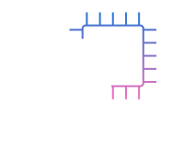



Recap
Data ingestion workflow with Knowledge Bases for Amazon Bedrock
Knowledge Bases for Amazon Bedrock
Integration with Agents for Amazon Bedrock
Customization vs augmentation
RAG concepts

Slide 22
