Slide 1
Ilia German
Introduction to Istio
Email: iliag@sela.co.il
Linkedin: https://www.linkedin.com/in/iliagerman/

Slide 2
What is Istio?
Open source service mesh that layers transparently onto existing distributed applications.
Built for Kubernetes (but also supports Nomad and Consul).
Provides a uniform way to connect, manage, and secure microservices.
It is a platform, including APIs that let it integrate into any logging platform, or telemetry or policy system.

Slide 3
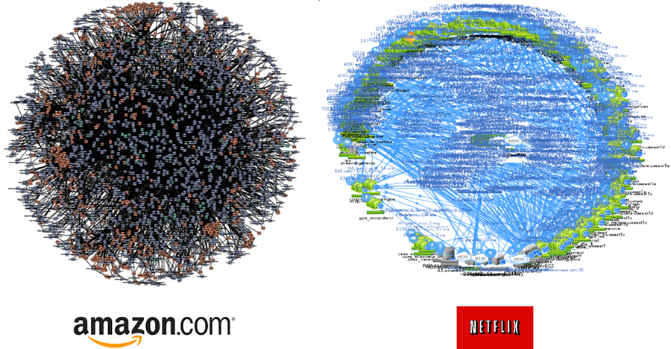
What is a service mesh?
Network of microservices that make up such applications and the interactions between them.
As application grow the communication between services becomes more complex.

Slide 4
Why use Istio?
Istio makes it easy to create a network of deployed services with load balancing, service-to-service authentication, monitoring, and more, with few or no code changes in service code.
Istio support is added by creating a sidecar for each service which serves as a proxy for all inboud & outbound network traffic.

Slide 5
Istio’s control plane
Istio is managed and configurated via control plane :
Automatic load balancing for HTTP, gRPC, WebSocket, and TCP traffic.
Fine-grained control of traffic behavior with rich routing rules, retries, failovers, and fault injection.
A pluggable policy layer and configuration API supporting access controls, rate limits and quotas.
Automatic metrics, logs, and traces for all traffic within a cluster, including cluster ingress and egress.
Secure service-to-service communication in a cluster with strong identity-based authentication and authorization.

Slide 6
Istio’s core features
Traffic management
Security
Policies
Observability
Platform support

Slide 7
Istio’s core features
Traffic management
Security
Policies
Observability
Platform support

Slide 8
Istio’s architecture
The data plane is composed of a set of intelligent proxies (Envoy) deployed as sidecars. These proxies mediate and control all network communication between microservices along with Mixer, a general-purpose policy and telemetry hub.
The control plane manages and configures the proxies to route traffic. Additionally, the control plane configures Mixers to enforce policies and collect telemetry.

Slide 9
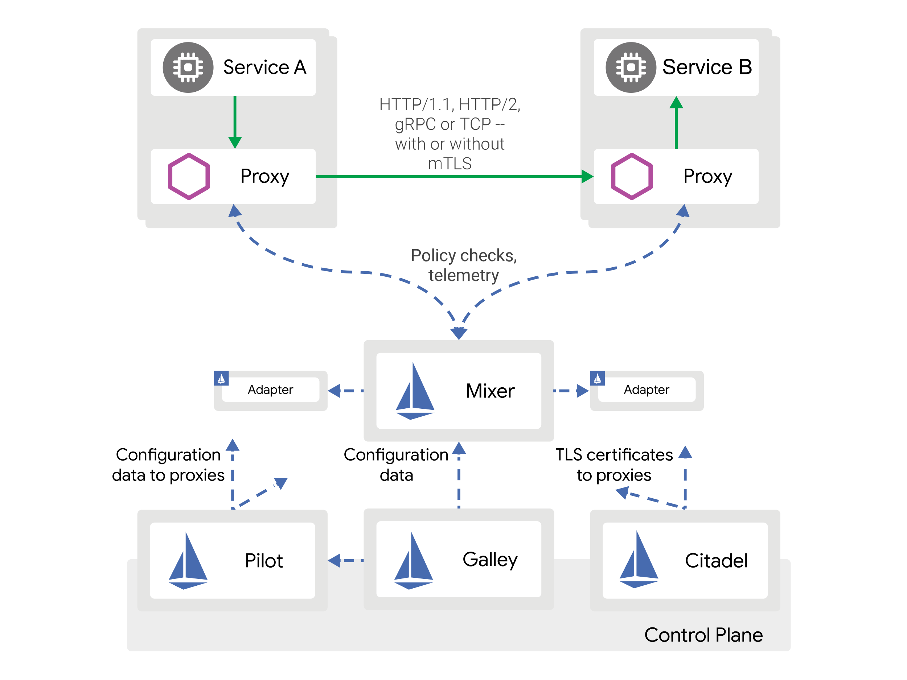
Istio’s architecture

Slide 10
Istio’s architecture - Envoy
Envoy is a high-performance proxy to mediate all inbound and outbound traffic for all services in the service mesh.
Envoy is deployed as a sidecar to all. The sidecar proxy model also allows you to add Istio capabilities to an existing deployment with no need to rearchitect or rewrite code.
Some of the Istio features and tasks enabled by Envoy proxies include:
Network resiliency features
Security and authentication features
Traffic control features
Notes:
Envoy features:
Dynamic service discovery
Load balancing
TLS termination
HTTP/2 and gRPC proxies
Circuit breakers
Health checks
Staged rollouts with %-based traffic split
Fault injection
Rich metrics
Traffic control features: enforce fine-grained traffic control with rich routing rules for HTTP, gRPC, WebSocket, and TCP traffic.
Network resiliency features: setup retries, failovers, circuit breakers, and fault injection.
Security and authentication features: enforce security policies and enforce access control and rate limiting defined through the configuration API.

Slide 11

Architecture (mixer & citadel)
Mixer
Manages Access Control and Policies
Extract request attributes
Collects Telemetry and metrics
Citadel
Service-to-service authentication and Mutual TLS
Supports RBAC (Role-Based Access Control) - like Kubernetes
Automatically manages credentials and certificates
© Copyright SELA Software & Education Labs Ltd. | 14-18 Baruch Hirsch St Bnei Brak, 51202 Israel | www.selagroup.com | Leon Jalfon - Blog: http://blogs.microsoft.co.il/leonj

Slide 12
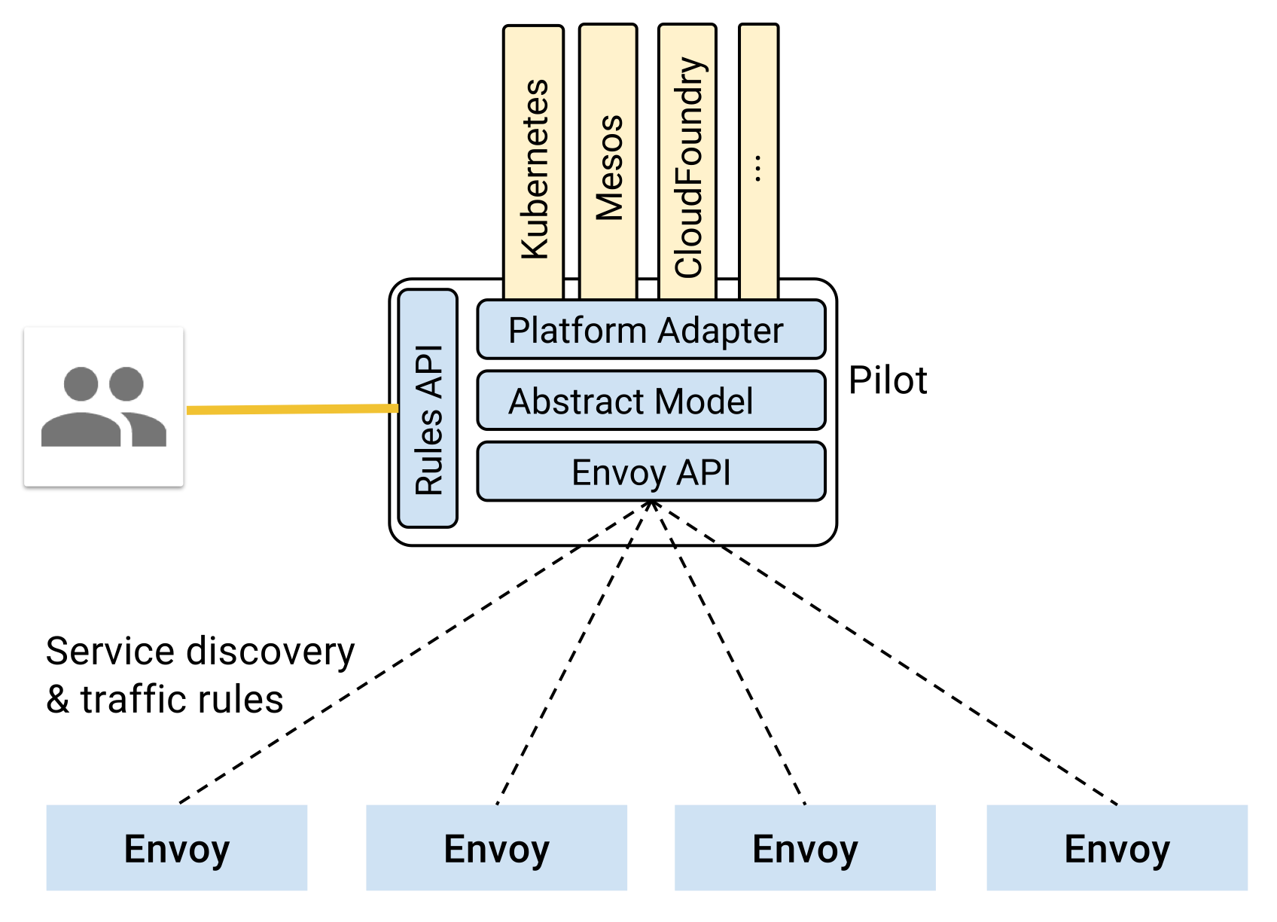
Istio’s architecture - Pilot
Provides traffic management capabilities for intelligent routing
Provides service discovery for Envoy sidecars
A/B tests
canary deployments
Provides resiliency
Timeouts
Retries
circuit breakers

Slide 13
Traffic management
Istio’s traffic routing rules let you easily control the flow of traffic and API calls between services.
Istio’s traffic management model relies on the Envoy proxies that are deployed along with your services.
To populate its own service registry, Istio connects to a service discovery system.

Slide 14
Traffic management – Virtual Services
Virtual services combined with destination rules allows grained control over the cluster internal & external communication.
Each virtual service contains it’s own routing rules
Virtual service allows decoupling where clients send their requests from the destination workloads that actually implement them.

Slide 15
Traffic management – Destination rules
Destination rules used to specify named service subsets, such as grouping all a given service’s instances by version.
Destination rules also let you customize Envoy’s traffic policies when calling the entire destination service or a particular service subset.
Notes:
kubectl get destinationrules -o json | code -

Slide 16
Traffic management
apiVersion: networking.istio.io/v1alpha3
kind: VirtualService
metadata:
name: reviews
spec:
hosts:
- reviews
http:
- match:
- headers:
end-user:
exact: bobo
route:
- destination:
host: reviews
subset: v2
- route:
- destination:
host: reviews
subset: v3

Slide 17
Request Routing

Slide 18
Request Routing
Apply service rules
Display the defined routes:
---
apiVersion: networking.istio.io/v1alpha3
kind: VirtualService
metadata:
name: reviews
...
spec:
hosts:
- reviews
http:
- route:
- destination:
host: reviews
subset: v1
---
Notes:
kubectl get destinationrules -o json | code -

Slide 19
Request Routing - based on user identity
Apply service rules
Display the defined routes:
apiVersion: networking.istio.io/v1alpha3
kind: VirtualService
metadata:
name: reviews
spec:
hosts:
- reviews
http:
- match:
- headers:
end-user:
exact: jason
route:
- destination:
host: reviews
subset: v2
- route:
- destination:
host: reviews
subset: v1
Notes:
kubectl get destinationrules -o json | code -

Slide 20
Fault Injection

Slide 21
Request Routing - Fault Injection
inject a 7s delay between the reviews:v2 and ratings microservices for user bobo
apiVersion: networking.istio.io/v1alpha3
kind: VirtualService
metadata:
name: ratings
spec:
hosts:
- ratings
http:
- fault:
delay:
fixedDelay: 7s
percentage:
value: 100
match:
- headers:
end-user:
exact: jason
route:
- destination:
host: ratings
subset: v1
- route:
- destination:
host: ratings
subset: v1
Notes:
kubectl get destinationrules -o json | code -

Slide 22
Observability
Istio generates detailed telemetry for all service communications within a mesh.
Istio generates the following types of telemetry in order to provide overall service mesh observability:
Metrics - latency, traffic, errors, and saturation.
Distributed Traces
Access Logs

Slide 23
Fault Injection

Slide 24
Observability - metrics
apiVersion: config.istio.io/v1alpha2
kind: instance
metadata:
name: doublerequestcount
spec:
compiledTemplate: metric
params:
value: "2" # count each request twice
dimensions:
reporter: conditional((context.reporter.kind | "inbound") == "outbound", "client", "server")
source: source.workload.name | "unknown"
destination: destination.workload.name | "unknown"
message: '"twice the fun!"'
monitored_resource_type: '"UNSPECIFIED"'
---
# Configuration for a Prometheus handler
apiVersion: config.istio.io/v1alpha2
kind: handler
metadata:
name: doublehandler
namespace: istio-system
spec:
compiledAdapter: prometheus
params:
metrics:
- name: double_request_count # Prometheus metric name
instance_name: doublerequestcount.instance.istio-system # Mixer instance name (fully-qualified)
kind: COUNTER
label_names:
- reporter
- source
- destination
- message
---
# Rule to send metric instances to a Prometheus handler
apiVersion: config.istio.io/v1alpha2
kind: rule
metadata:
name: doubleprom
namespace: istio-system
spec:
actions:
- handler: doublehandler
instances: [ doublerequestcount ]
Notes:
Understanding the metrics configuration
In this task, you added Istio configuration that instructed Mixer to automatically generate and report a new metric for all traffic within the mesh.
The added configuration controlled three pieces of Mixer functionality:
Generation of instances (in this example, metric values) from Istio attributes
Creation of handlers (configured Mixer adapters) capable of processing generated instances
Dispatch of instances to handlers according to a set of rules
The metrics configuration directs Mixer to send metric values to Prometheus. It uses three stanzas (or blocks) of configuration: instance configuration, handler configuration, and rule configuration.
The kind: instance stanza of configuration defines a schema for generated metric values (or instances) for a new metric named doublerequestcount. This instance configuration tells Mixer how to generate metric values for any given request, based on the attributes reported by Envoy (and generated by Mixer itself).
For each instance of doublerequestcount, the configuration directs Mixer to supply a value of 2 for the instance. Because Istio generates an instance for each request, this means that this metric records a value equal to twice the total number of requests received.
A set of dimensions are specified for each doublerequestcount instance. Dimensions provide a way to slice, aggregate, and analyze metric data according to different needs and directions of inquiry. For instance, it may be desirable to only consider requests for a certain destination service when troubleshooting application behavior.
The configuration instructs Mixer to populate values for these dimensions based on attribute values and literal values. For instance, for the source dimension, the new configuration requests that the value be taken from the source.workload.nameattribute. If that attribute value is not populated, the rule instructs Mixer to use a default value of "unknown". For the messagedimension, a literal value of "twice the fun!" will be used for all instances.
The kind: handler stanza of configuration defines a handler named doublehandler. The handler spec configures how the Prometheus adapter code translates received metric instances into Prometheus-formatted values that can be processed by a Prometheus backend. This configuration specified a new Prometheus metric named double_request_count. The Prometheus adapter prepends the istio_ namespace to all metric names, therefore this metric will show up in Prometheus as istio_double_request_count. The metric has three labels matching the dimensions configured for doublerequestcount instances.
Mixer instances are matched to Prometheus metrics via the instance_name parameter. The instance_name values must be the fully-qualified name for Mixer instances (example: doublerequestcount.instance.istio-system).
The kind: rule stanza of configuration defines a new rule named doubleprom. The rule directs Mixer to send all doublerequestcount instances to the doublehandler handler. Because there is no match clause in the rule, and because the rule is in the configured default configuration namespace (istio-system), the rule is executed for all requests in the mesh.

Slide 25
Observability – Grafana Dashboards
Notes:
Istio-mesh-dashboard
Istio-service-dashboard

Slide 26
Observability – Logging with fluentd

Slide 27
Observability - Logging with fluentd
apiVersion: config.istio.io/v1alpha2
kind: instance
metadata:
name: doublerequestcount
spec:
compiledTemplate: metric
params:
value: "2" # count each request twice
dimensions:
reporter: conditional((context.reporter.kind | "inbound") == "outbound", "client", "server")
source: source.workload.name | "unknown"
destination: destination.workload.name | "unknown"
message: '"twice the fun!"'
monitored_resource_type: '"UNSPECIFIED"'
---
# Configuration for a Prometheus handler
apiVersion: config.istio.io/v1alpha2
kind: handler
metadata:
name: doublehandler
namespace: istio-system
spec:
compiledAdapter: prometheus
params:
metrics:
- name: double_request_count # Prometheus metric name
instance_name: doublerequestcount.instance.istio-system # Mixer instance name (fully-qualified)
kind: COUNTER
label_names:
- reporter
- source
- destination
- message
---
# Rule to send metric instances to a Prometheus handler
apiVersion: config.istio.io/v1alpha2
kind: rule
metadata:
name: doubleprom
namespace: istio-system
spec:
actions:
- handler: doublehandler
instances: [ doublerequestcount ]

Slide 28
Observability – Visualizing Your Mesh

