Slide 1



Prompt Engineering for Generative AI Workloads
Shaked Holzman
Technical Account Manager, AWS

Slide 2




Agenda
What is prompt engineering?
Basic techniques
Model specific prompts- Anthropic Claude Prompt Management and Prompt Flows

Slide 3

What is prompt engineering?

Slide 4


What is a prompt?
Prompt
Response

Slide 5
What is Prompt Engineering? – An Example
What is 10 + 10?
10 + 10 = 20
1 + 1 is an addition problem.
1 – 1 is a subtraction problem.
1 x 1 is a multiplication problem. 1 / 1 is a division problem.
What is 10 + 10?
10 + 10 is an addition problem

Slide 6

Prompt engineering philosophy
Systematic design and optimization of prompts to guide the response of LLMs, ensuring accuracy, relevance, and coherence in the generated outputs.
Develop test use cases
Create your prompt
Test against cases
Refine your prompt
Share polished prompt

Slide 7
Instructions matter
Specificity, clarity, and persuasiveness are important!
Compare:
“Tell me a story about cows”
“Tell me a story about cows. It should be roughly 2000 words long and appropriate for American 5th graders. It should be entertaining, but with a moral message about the value of loyalty. Make it amazing and memorable.”
Neither humans nor LLMs can read minds, so you need to be clear and specific if you want something specific.
Many professions are prompt engineering for humans!
Marketing, Education, Tech Writing, Law, Web Design

Slide 8
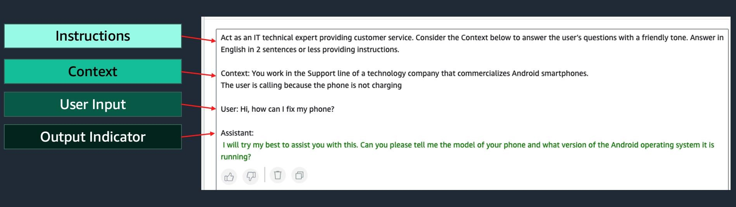
Components of a prompt
A prompt may contain the following elements:
Instruction- Task or instruction for the model (e.g. classify, summarize, …)
Context- Additional information to help the model complete the desired task
User Input- User’s input to which the model is expected to respond
Output indicator- Type or format of the output generated by the model

Slide 9
Basic techniques
© 2024, Amazon Web Services, Inc. or its affiliates. All rights reserved.

Slide 10

Simple techniques
One-shot prompting
Task is to generate airport codes
user: "I want to fly from Los Angeles to Miami”
assistant: Airport codes [LAX, MIA]
user: "I want to fly from Dallas to San Francisco”
assistant: Airport codes [
Few-shot prompting
Classify below tweets as positive, negative or neutral
user: "I hate it when my phone battery dies.” assistant: Sentiment(Negative)
user: "My day has been great”:
assistant: Sentiment(Positive)
user: "This is the link to the article”: assistant: Sentiment(Neutral)
user: {{Tweet}}
assistant: Sentiment(

Slide 11
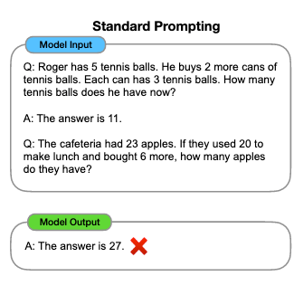
Chain of Thought – CoT
Explore how series of intermediate steps improve ability of LLMs to
perform complex reasoning task
5 tennis balls
1-shot example 2 cans, 3 each. 2 x 3 = 6
5 + 6 = 11 tennis balls
New complex problem
23 apples
20 used, 3 left
Bought 6
3 + 6 = 9
Wrong answer
Source: Chain-of-Thought Prompting Elicits Reasoning in Large Language Models

Slide 12

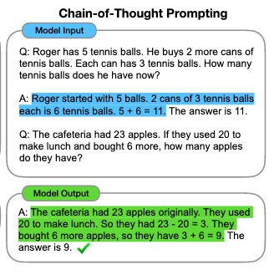
Chain of Thought – CoT
Same 1-shot example
Same new question
Right answer
Source: Chain-of-Thought Prompting Elicits Reasoning in Large Language Models

Slide 13
Model specific prompts- Anthropic Claude

Slide 14
Claude 3 Messages API
Text Completions API
Messages API
Today is December 19, 2023.
Human: What are 3 ways to cook apples? Output your answer in numbered
<method> XML tags.
Assistant: <method 1>
"system": "Today is December 19, 2023.",
"messages": [
{ "role": "user", "content": "What are
3 ways to cook apples? Output your answer in numbered <method> XML tags." },
{ "role": "assistant", "content": "<method 1>" }
]
Notice the technique of prefilling Claude’s
response
https://docs.anthropic.com/claude/reference/migrating-from-text-completions-to-messages

Slide 15
1. Be clear and direct
User | Write a haiku about robots
Claude response | Here is a haiku about robots: Metal bodies move Circuits calculate tasks Machines mimic life
Claude responds best to clear and direct instructions
When in doubt, follow the Golden Rule of Clear Prompting: show your prompt to a friend and ask them if they can follow the instructions themselves and produce the exact result you’re looking for
User | Write a haiku about robots. Skip the preamble; go straight into the poem.
Claude response | Metal bodies move Circuits calculate tasks Machines mimic life

Slide 16
2. Use XML tags to delineate sections
Disorganized prompts are hard for Claude to comprehend
Just like section titles and headers help humans better follow information, using XML tags <></> helps Claude understand the prompt’s structure
User | Hey Claude. Show up at 6AM because I say so. Make this email more polite.
Claude response | Dear Claude, I hope this message finds you well…
User | Hey Claude. <email> Show up at 6AM because I say so.</email> Make this email more polite.
Claude response | Good morning team, I hope you all had a restful weekend…

Slide 17
3. Use examples
User | I will give you some quotes. Please extract the author from the quote block. Here is an example: <example> Quote: “When the reasoning mind is forced to confront the impossible again and again, it has no choice but to adapt.” N.K. Jemisin, The Fifth Season Author: N.K. Jemisin </example> Quote: “Some humans theorize that intelligent species go extinct before they can expand into outer space. If they're correct, then the hush of the night sky is the silence of the graveyard.” Ted Chiang, Exhalation Author:
Claude response | Ted Chiang
Examples are probably the single most effective tool for getting Claude to behave as desired
Make sure to give Claude examples of
common edge cases
Generally more examples = more reliable responses at the cost of latency and tokens

Slide 18
4. Assign roles (aka role prompting)
Claude sometimes needs context about what role it should inhabit
Assigning roles changes Claude’s
response in two ways:
Improved accuracy in certain situations (such as mathematics)
Changed tone and demeanor
to match the specified role
User | Solve this logic puzzle. {{Puzzle}}
Claude response | [Incorrect response]
User | You are a master logic bot designed to answer complex logic problems. Solve this logic puzzle. {{Puzzle}}
Claude response | [Correct response]

Slide 19

5. Format output & speak for Claude
You can get Claude to say exactly
what you want by:
Specifying the exact output format you want
Speaking for Claude by writing the beginning of Claude’s response for it after “assistant:” (Prefill).
User | Please write a haiku about a cat. Use JSON format with the keys as "first_line", "second_line", and "third_line".
Assistant (prefill) | {
Claude response | "first_line": "Sleeping in the sun", "second_line": "Fluffy fur so warm and soft", "third_line": "Lazy cat's day dreams" }

Slide 20
6. Mitigate the risk of hallucinations
Try the following :
Give Claude permission to say “I don’t know” if it doesn’t know
Tell Claude to answer only if it is very confident in its response
Ask Claude to find relevant quotes from long documents then
answer using the quotes

Slide 21
7. Chain prompts
For tasks with many steps, break the task up and chain together responses
User | Find all the names from the below text: "Hey, Jesse. It's me, Erin. I'm calling about the party that Joey is throwing tomorrow. Keisha said she would come and I think Mel will be there too."
Assistant | <names>
User | Here is a list of names: <names>{{NAMES}}</names> Please alphabetize the list.
Assistant | <names>
Claude response | Jesse Erin Joey Keisha Mel </names>
Claude response | Erin Jesse Joey Keisha Mel </names>

Slide 22

Thank you!
© 2024, Amazon Web Services, Inc. or its affiliates. All rights reserved.

