Slide 1





Retrieval Augmented Generation (RAG) and Knowledge bases for Amazon Bedrock
© 2024, Amazon Web Services, Inc. or its affiliates. All rights reserved.
© 2023, Amazon Web Services, Inc. or its affiliates. All rights reserved.

Slide 2

Agenda
What is RAG and how does it work?
Bedrock Knowledge Bases
Demo
2

Slide 3

Common approaches for adapting foundation models (FMs)
Complexity, Quality, Cost,
Time
Prompt Engineering

Slide 4
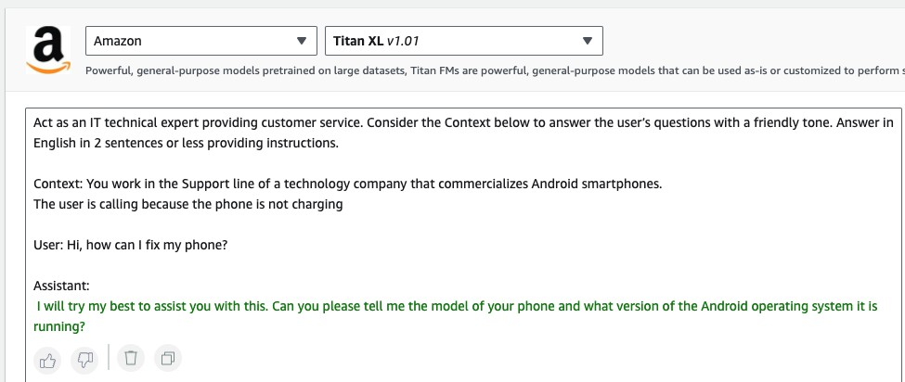
Elements of a Prompt
Instruction
Task description or instruction on how the model should perform
Context
Additional/external information to steer the model performance
Input Data
The input/question that the model needs to provide output for
Output Indicator
The indicator/format the model needs to provide output with
Instructions
Context
User Input
Output Indicator
4

Slide 5



Common approaches for adapting foundation models (FMs)
Complexity, Quality, Cost,
Time
Train FM from scratch
Augment knowledge without changing pre-trained model weights
Fine-tuning
Retrieval Augmented Generation (RAG) for customizing FM responses
Prompt Engineering

Slide 6
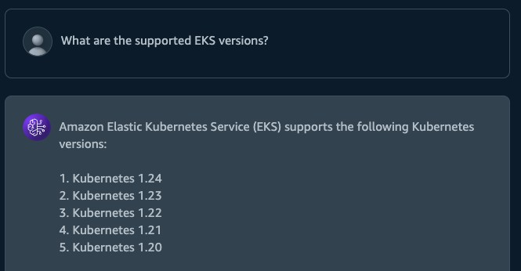
Without RAG

Slide 7
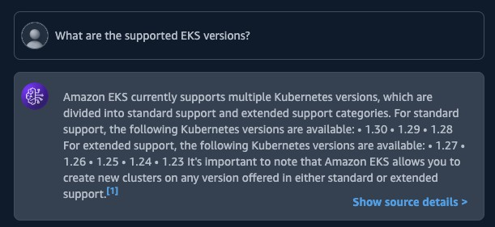
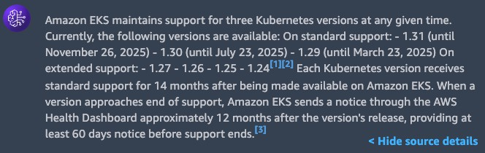
Using RAG

Slide 8








What is Retrieval Augmented Generation?
Retrieval
Fetches the relevant content from the external knowledge base or data sources based on a user query
Augmentation
Generation
Adding the retrieved relevant context to the user prompt, which goes as an input to the foundation model
Response from the foundation model based on the augmented prompt.

Slide 9




Behind the scenes
Quick – find all relevant data around EKS supported versions in our knowledge-base
Query: What are the supported EKS versions?
Okay now rank them based on relevance
Now add this data to context and ask the query
Give this to the
LLM
9

Slide 10






RAG use cases
Improved content
quality
Contextual chatbots and question answering
Personalized search
Real-time data
summarization
E.g., helps in reducing hallucinations and connecting with recent knowledge including enterprise data
E.g., enhance chatbot capabilities by integrating with real-time data
E.g., searching based on user previous search history and persona
E.g., retrieving and summarizing transactional data from databases, or API calls

Slide 11






Types of retrieval
0.89 -0.02 -0.53 0.95 0.17 -0.38
Semantic Search
Get relevant documents based on text embeddings
Rule Based
Structured data
Fetches unstructured data like documents
Transactional retrieval from database or API
e.g., Key word searches
e.g., Select customers from All_orders where order == ‘XYZ’
Subway Statue Liberty Tall buildings
New York

Slide 12




What are embeddings?
Numerical representation of text (vectors) that captures semantics and relationships between words.
Embedding models capture features and nuances of the text.
Rich embeddings can be used
to compare text similarity.
Multilingual Text Embeddings can identify meaning in different languages.
New York
0.027 -0.011 … -0.023
Paris
0.025 -0.009
… -0.025
E M B E D D I N G M O D E L
Animal
-0.011 0.021 … 0.013
Horse
-0.009
0.019 …
0.015
Human Text
Vector Embeddings

Slide 13

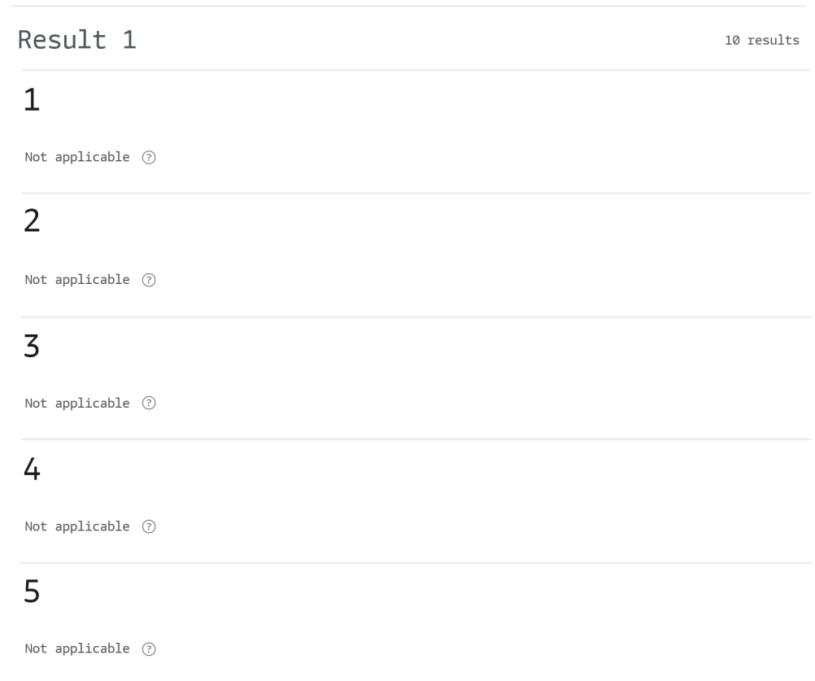



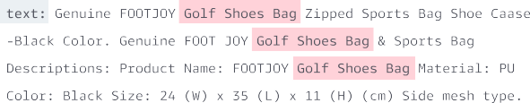



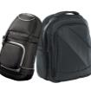




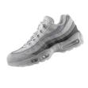







WIT HOUT SE MANT IC SE ARCH
WIT H SE MANT IC SE ARCH
Golf Shoes Bag
Golf Shoes Bag
Golf Shoes
gol f
Golf Shoes Bag
Golf Shoe Case
Golf Shoes
Stretcher for Golf Shoes
Golf Shoes
Golf Shoes
Golf Shoes
Plastic Golf Tees.
Golf Shoes

Slide 14







RAG in Action
User Input
Text Generation Workflow
User
Prompt
augmentation
Large Language
Model
Response
Embeddings model
Context
Embedding
0.89 -0.02 -0.53 0.95 0.17
-0.38
Data Ingestion Workflow
Semantic search
Vector store
Embeddings model
Document chunks
Data source

Slide 15




Knowledge bases for Amazon Bedrock
N A T I V E S U P P O R T F O R R E T R I E V A L A U G M E N T E D G E N E R A T I O N ( R A G )
Securely connect FMs to data sources for RAG to deliver more relevant responses
Fully managed RAG workflow including ingestion, retrieval, and augmentation
Built-in session context management for multi-turn conversations
Automatic citations with retrievals to improve transparency
USER QUERY
AUGMENTED PROMPT
MODEL
ANSWER
1
4
5
AI21 Labs—Jurassic2
6
A M A Z O N
B E D R O C K
Amazon—Titan Text
2
3
Anthropic—Claude
KNOWLEDGE BASES FOR AMAZON BEDROCK
Meta—Llama
Mistral AI - Mistral
Cohere – Command
15

Slide 16
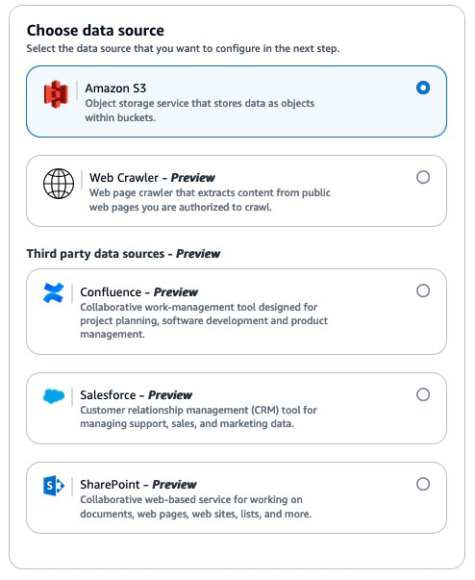

Data Ingestion
K N O W L E D G E B A S E S F O R A M A Z O N B E D R O C K
Fully managed data ingestion workflow
Source data
Choose your data sources (Amazon S3, Web, Salesforce, SharePoint, Confluence)
Support for incremental updates
Support for metadata

Slide 17


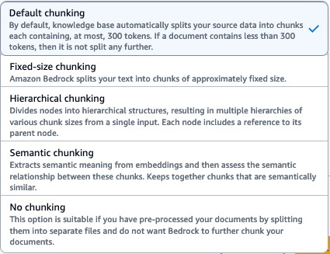
Data Ingestion
K N O W L E D G E B A S E S F O R A M A Z O N B E D R O C K
Fully managed data ingestion workflow
Source data Text extraction
Chunking
Choose your chunking strategy
Default
Fixed-size
No chunking
Hierarchical
Semantic
Custom chunking

Slide 18







Vector databases for Knowledge Bases
K N O W L E D G E B A S E S F O R A M A Z O N B E D R O C K
Vector Engine For Amazon OpenSearch Serverless
Redis Enterprise Cloud
Pinecone
Amazon Aurora
MongoDB

Slide 19




RetrieveAndGenerate API
K N O W L E D G E B A S E S F O R A M A Z O N B E D R O C K
User Input
RetrieveAndGenerate API
Fully managed RAG
User
Response
User query
Generated response
Generate query embedding
Retrieve similar documents from knowledge bases
Augment query with retrieved documents
Generate response from LLM

Slide 20


Customize RAG workflows using Retrieve API
K N O W L E D G E B A S E S F O R A M A Z O N B E D R O C K
User Input
User
Prompt augmentation
Large Language Model
Response
Customized
RAG
workflow
Retrieve API
User query
Retrieved documents
Context
Generate query embedding
Retrieve similar documents from knowledge bases

Slide 21
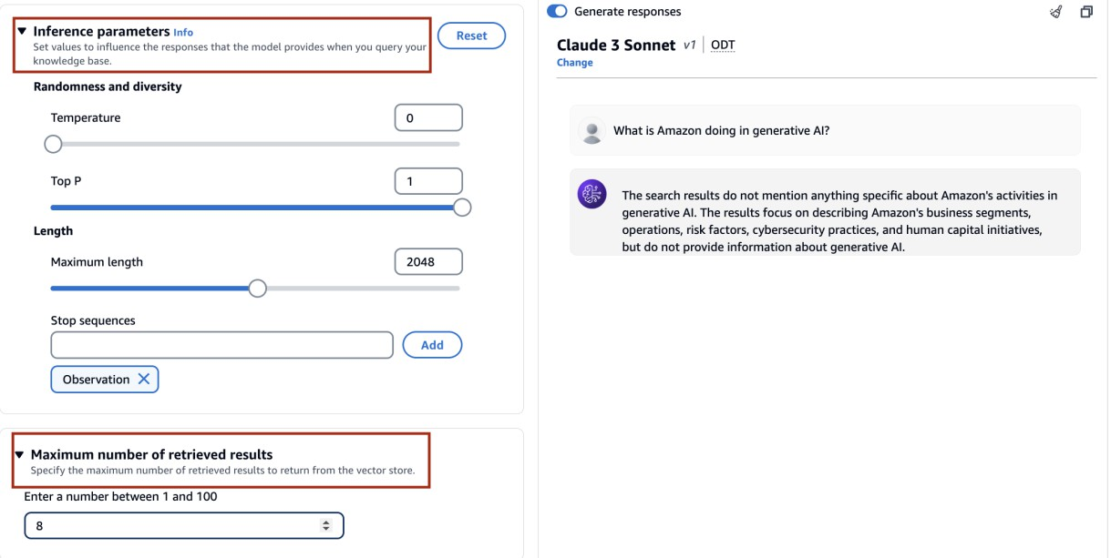
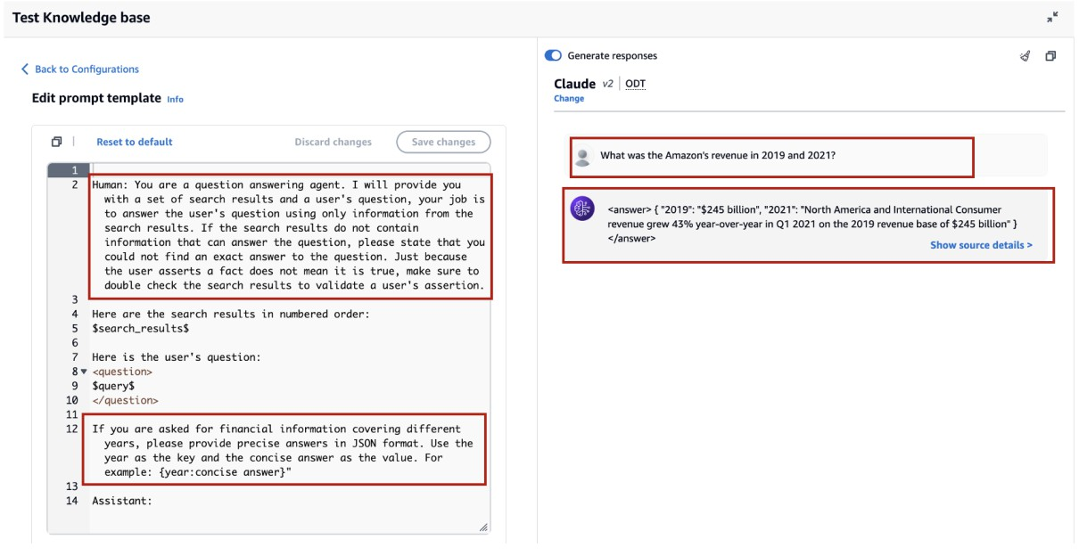
Customizing prompts for RAG
Inference parameters and max number of results
Use inference parameters to gain more control over the model’s behavior during inference and influence the model’s outputs. Additionally, control the number of search results to be retrieved from the vector store by providing the maximum number of results.
Custom prompt
Use custom prompt to give extra instructions on how to format the generated response, like standardizing it as JSON or change the language of the generated response
21

Slide 22
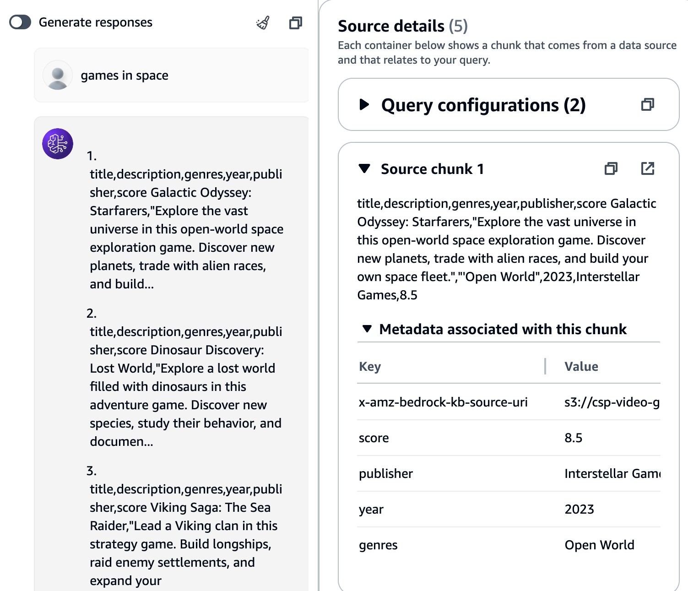
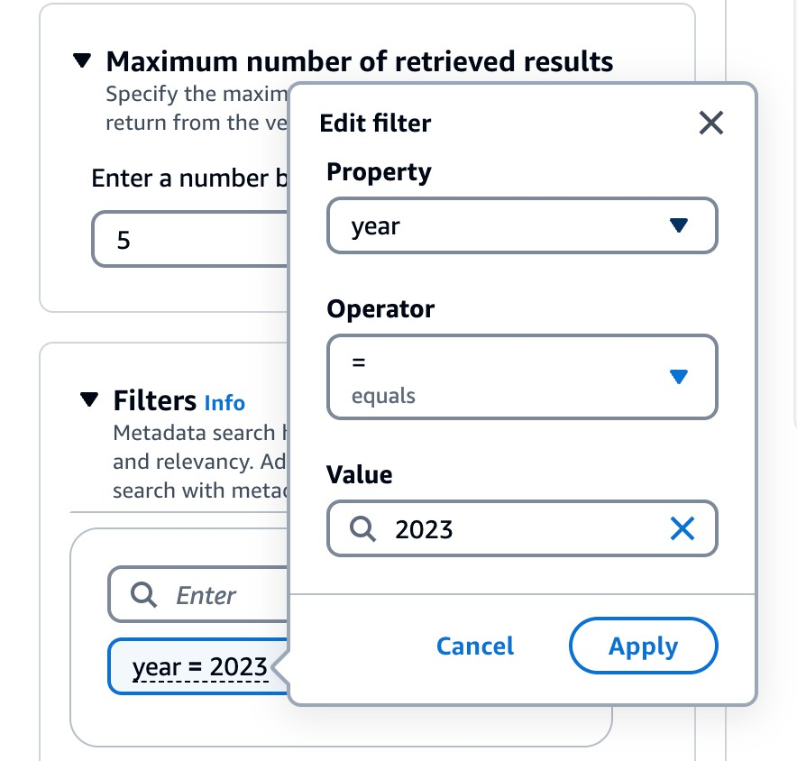
Metadata Filtering
With Metadata Filtering, users can narrow search results by specifying which documents to include or exclude from a query, resulting in more relevant responses generated by the FM. In addition, we can use metadata filters to facilitate person ACL with Knowledge Base content.

Slide 23



Thank you!
_{Thank you!} Please complete the session survey in the mobile app
© 2023, Amazon Web Services, Inc. or its affiliates. All rights reserved.
© 2024, Amazon Web Services, Inc. or its affiliates. All rights reserved.

