Slide 1





Agents for Amazon Bedrock
© 2023, Amazon Web Services, Inc. or its affiliates. All rights reserved.
© 2024, Amazon Web Services, Inc. or its affiliates. All rights reserved.

Slide 2
Agenda
Introduction to Agents for Amazon Bedrock
Agent orchestration
Agent structure
Agents for Amazon Bedrock - Demo
Amazon Bedrock Guardrails for Agents
2

Slide 3

Agents for Amazon Bedrock
Features
Uses power of LLM’s to prompt and
respond using natural language
Breaks down and orchestrates tasks
Completes tasks by dynamically
invoking APIs
Securely and privately accesses company data
Surfaces chain-of-thought trace and
underlying agent prompts
Enable generative AI applications
to execute multi-step business tasks using natural language
3

Slide 4

Understanding agent basics
Agents have instructions, a chosen Bedrock model, and a set of available actions and knowledge bases

Slide 5




Agent basics
Agent
Instructions: “you are an agent that …”
do this
for me…
Done. Here’s
the result…
Actions
Knowledge Bases
Amazon Bedrock

Slide 6

Agents use actions to get work done
Meeting assistant
Instructions: “you summarize meetings and send results”
list the action items from my meeting
Meeting Actions Utility Actions
Here are the action
items: 1/ …, 2/ …
List Meetings
In: date range Out: [date, subject, meeting ID]
Send Email
In: subject, recipients, body Out: status
send them to my team
Get Action Items In: meeting ID Out: [action items]
Get Team
Out: list of team member email addresses
Email sent

Slide 7
Agents use Knowledge Bases to find information
HR Policy Assistant
Instructions: “you are an HR agent, helping employees understand HR policies”
If I switch to part- time, will I still get vacation days?
HR Knowledge Base
Vacation Policy Contains the entire vacation policy for the company
Sorry, part-time staff aren’t eligible for vacation days.

Slide 8

Agents can combine Actions and Knowledge Bases
HR Policy Assistant v2
how much vacation do I get per year?
Instructions: “you are an HR agent, helping employees
understand HR policies and manage vacation time”
as a full-timer with 3 years tenure, you get 15 days
HR Knowledge Base HR Actions
Vacation Policy Contains the entire vacation policy for the company
Request Vacation In: start date, end date Out: approval status,
remaining balance
cool. I’d like to take
off December 8 to 15
approved, enjoy. you have 8 more days available

Slide 9



Agents are secure
Agent
Knowledge Base
Action group
Each resource has its own IAM role
Principals can be granted or denied access independently
Builds on Amazon Bedrock model invocation security

Slide 10






Agents build on existing enterprise resources
HR Knowledge Base
Vacation Actions
get-Vacation-Balance
Leave of absence Actions
Existing resources
HR Policy docs
HR Time Off Agent
Vacation
microservice
Vacation
database
Leave of absence (LOA) database

Slide 11
Agent orchestration
Orchestrate user requests by breaking them into smaller subtasks

Slide 12
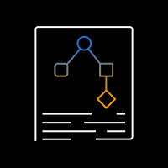


Orchestration – Basic flow
Execute action or search knowledge base
Decompose into steps using available actions and Knowledge Bases
Until final answer
Observe results
Think about next step

Slide 13














Agent orchestration – Detailed flow
PROMPT
Conversation history
Step 1
Step 2
…
Step n
Chain of thought
API call
Results
Actions, KBs
Action Groups
Instructions
Bedrock model
Task
Task
Bedrock Agent
Results
Search
Results
Knowledge Bases
Task + results
Final
response
Final response
Bedrock model
Agent breaks task into subtasks, determines the right sequence, and executes actions and knowledge searches on the fly

Slide 14





Agent orchestration – An example
Thought: To answer this question, I will:
Get open claims
Get missing documents for each open claim
Get requirements for each missing document
Send reminders for each missing claim
Task: Send a reminder to policy holders with missing docs; include doc requirements
GetOpenClaims ₁ <date range, policy type> | CompilePolicyIDsMissingDocs ₂ <list of docs, list of claim IDs> | Search knowledge base 3 <query with docs> | SendReminder 4 <policy ID>
<list of claims> | … | … | <success>
I need the subset of claims with missing docs | … | … | I know the final answer
Action:
Observation: Thought::
Final Answer: There are currently two open insurance claims with claim IDs claim-006 and claim-857. For claim-006, the pending document required … Reminders have also been sent for both claims

Slide 15
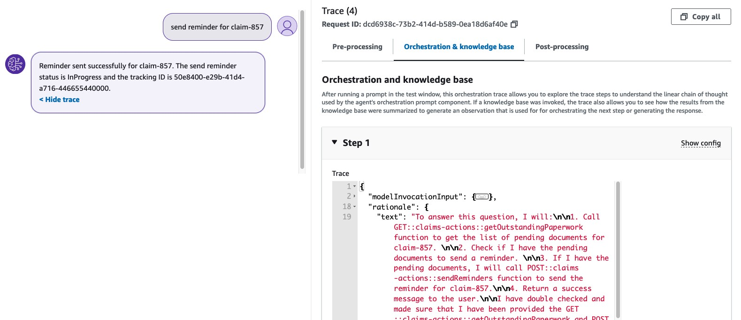
Agent orchestration is transparent – Trace
Detailed orchestration trace in the console and from the SDK

Slide 16
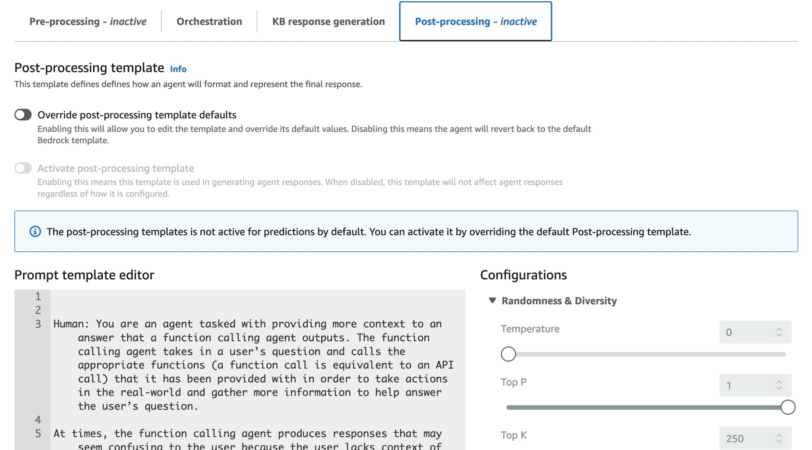
Agent orchestration is transparent – Prompt editing
Detailed orchestration prompt can be updated via console or SDK

Slide 17
Agent action groups
Sets of actions made available to your agent to get work done

Slide 18


Each Action Group has 3 key elements
Action Group Description
Overview of actions provided – helps agent
know when this action group is relevant
API Schema
Rich definition of each action
Operation name, input parameters, data types, response details
Helps agents know when to use it,
how to call it, and how to use results
Language agnostic API definition using industry-standard schema
Lambda Function
Implementation of each action
Contains either business logic or wraps microservices, databases, or tools
Serverless, scalable, secure
Choice of programming language (Python, C#, JavaScript, Java, …)

Slide 19
Action Group example
UtilityActionGroup
Description: “This action group provides a set of commonly used actions. Use these actions for things like sending emails and getting team member lists.”
API Schema Lambda Function
{ ”openapi”: “3.0.0”,
”info”: { “title”: “Utility Actions”,
“description”: “…” },
”paths”: {
“/sendEmail”: {
“post”: {
def lambda_handler(event, context):
if event[‘apiPath’] == ‘/sendEmail’:
result = sendEmail(event)
elif event[‘apiPath’] == ‘/getTeam’:
result = getTeam(event)
def do_action1() response_body = {'applicat_{d}i_{e}o_{f}n/_{d}j_{o}s_o_{a}n_{c}'_{t}:_{ion2()}
{'body': result}}
action_response = { …
‘responseBody’: response_body
return {‘messageVersion’: ‘1.0’, ‘response’: action_response}
”description”: ”operationId”: ”requestBody”: “responses”: {
“200”: {
“This operation …”
“sendEmail”,
{ … },
“text/plain”: {…}
“/getTeam”: { … }
}
}
19

Slide 20
Agent deployment
Deploying and invoking agents

Slide 21


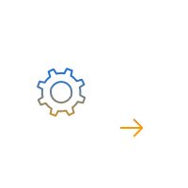


Agents can be deployed and invoked from any app
Building and testing agents Using production agents
Agent builder
Agent user
Agent console or SDK
Customer app
Event
Agent draft
Deployed Agent
To deploy an agent, you create a new Alias,
and optionally a new Version
23

Slide 22
Invoking an Agent via the SDK
Invoke agent
Process the response stream
response = client.invoke_agent( inputText=‘<user request>', agentId=agent_id, agentAliasId=agent_alias_id, sessionId=str(uuid.uuid1()), enableTrace=True )
for event in response['completion']: if 'chunk' in event:
data = event['chunk']['bytes’] answer = data.decode('utf8') print(f”Answer:\n{answer}")
elif 'trace' in event: print(json.dumps(event['trace’],
indent=2))
24

Slide 23
Guardrails for Amazon Bedrock Agents

Slide 24


How to create Agents in Amazon Bedrock
Agents for Amazon Bedrock
Accelerate delivery of generative AI applications
Create an
agent
Use the Amazon Bedrock console or SDK to create an agent and provide a description
You are an office assistant designed to help manage insurance claims
Add action
groups
Upload API schema so the agent can perform actions (call APIs)
GetOpenClaims CompileDocsNotSubmitted SendReminder
Add data
sources
Configure data sources so the agent can look up information
PolicyDetailsDocs ClaimProcessingDocs ClaimHistoryDatabase
Interact with
the agent
Use natural language to tell the agent to perform a task
“Send a reminder to all accounts that have missing documents”

Slide 25

How to create Agents in Amazon Bedrock
Agents for Amazon Bedrock
Accelerate delivery of generative AI applications
Create an
agent
Add action
groups
& data sources
Apply
guardrails
Interact with
the agent
You are an office assistant designed to help manage insurance claims
GetOpenClaims CompileDocsNotSubmitted SendReminder
UndesirableTopic FilterViolence
“Send a reminder to all accounts that have missing documents”

Slide 26
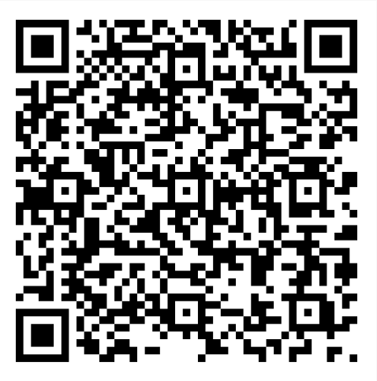
Thank you!
bc02-078149-fb

