Slide 1

How to perform Function calling using Amazon Bedrock with multiple tools

Slide 2

Agenda
LLM Characteristics
Function calling
Function calling and Agents comparison Architecture
Implementation
Demo

Slide 3
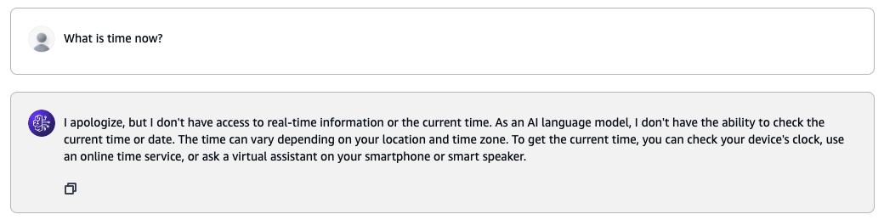
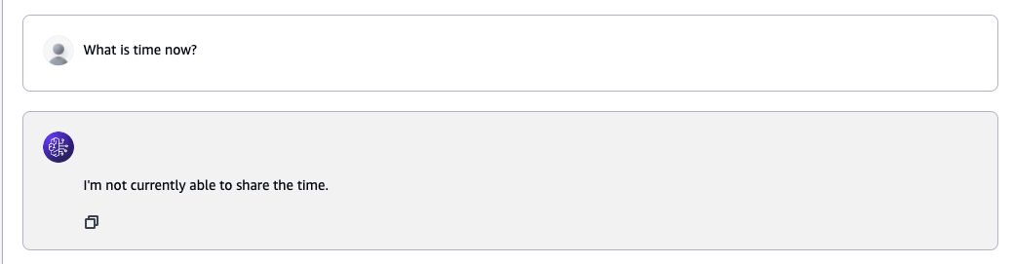
LLM Characteristics
Claude Sonnet 3.5
LLAMA 3.1 70B Instruct

Slide 4
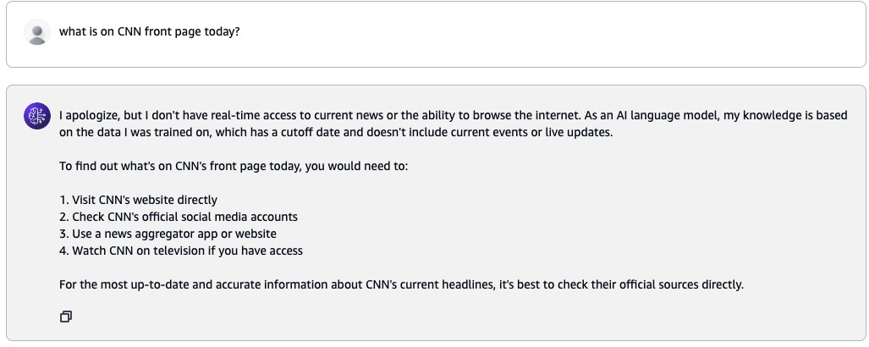
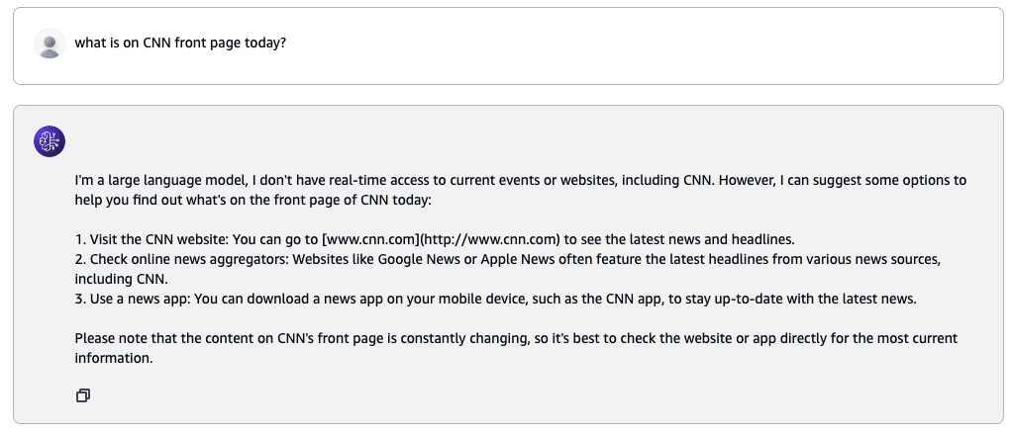
LLM Characteristics
Claude Sonnet 3.5
LLAMA 3.1 70B Instruct

Slide 5
LLM Characteristics
LLM is frozen in time
Isolated environment
No internet access
No way to interact with other resources
No updates
Highly capable to understand and generate human like text

Slide 6
Function calling - Definition
Function calling is a capability that allows large language models to interact with external tools, APIs, or databases by generating structured outputs that can be used to invoke specific functions or services.

Slide 7
Function calling - Features and Implementation
AKA Tools
Extending LLM capabilities
Enables to interact with external APIs
A list of tools may be used
Function execution is NOT by the LLM
Each request use one tool
The return value will need to be appended to the prompt
Not all tools must be used

Slide 8
Function calling – Key Aspects

Slide 9
Function calling – Key Aspects
Structured output
Predefined schema that matches the expected input parameters of a given function.
{ spec:
name: … Description: … Input: …
}

Slide 10

Function calling – Key Aspects
Structured output
Integration
Enables seamless integration to various tools or services.

Slide 11
Function calling – Key Aspects
Structured output Integration Flexibility
Perform actions or access information like retrieving real- time data or executing specific operations.
Currency rates
User ID
Complex
computation/Action

Slide 12
Function calling – Key Aspects
Structured output Integration Flexibility
Enhanced capabilities
Provides a standardized way for developers to define how to interact with external systems.

Slide 13
Function calling – Key Aspects
Structured output Integration Flexibility
Enhanced capabilities
Controlled interactions
Can be used for a wide range of applications, from simple data lookups to complex multi- step processes.

Slide 14
Function calling - Amazon Bedrock
Function calling is native by the model provide Recommended to use Converse/ConverseStream API Supported by Anthropic, Cohere, Mistral, Meta Relativly easy to migrate into Amazon Bedrock
No infrastructure to create

Slide 15
Amazon Bedrock Agents vs. Function calling
Amazon Bedrock Agents
Autonomous
Requires infrastructure
Complex
High learning curve
Granular permissions
”Server side” execution
Deeply integrated
Memory
Function calling
Task specific
No Infrastructure requried
Simple
Low learning curve
Centerlize permission
“Cilent side“ execution
DYI integration
No memroy

Slide 16
Function calling - Pseudocode
Send prompt to LLM with tools description Check if LLM responded end_turn or tool_use While not end_turn:
If tool_use:
Understand which tool, and use the provided input Call the tool with input, and get reponse
Append the response to the prompt send it again to LLM
Provide answer back

Slide 17

Architecture comparison
© 2024, Amazon Web Services, Inc. or its affiliates. All rights reserved. Amazon Confidential and Trademark.

Slide 18
Amazon Bedrock converse
Client
LLM

Slide 19
Amazon Bedrock Agents
Knowledge Base
Amazon OpenSearch Serverless
Amazon S3
Agent
Agent group
You are a bot for …
Agent group

Slide 20
Amazon Bedrock function calling
Client + Tools
LLM
Permssion Network access

Slide 21
Use function calling in Amazon Bedrock
© 2024, Amazon Web Services, Inc. or its affiliates. All rights reserved. Amazon Confidential and Trademark.

Slide 22
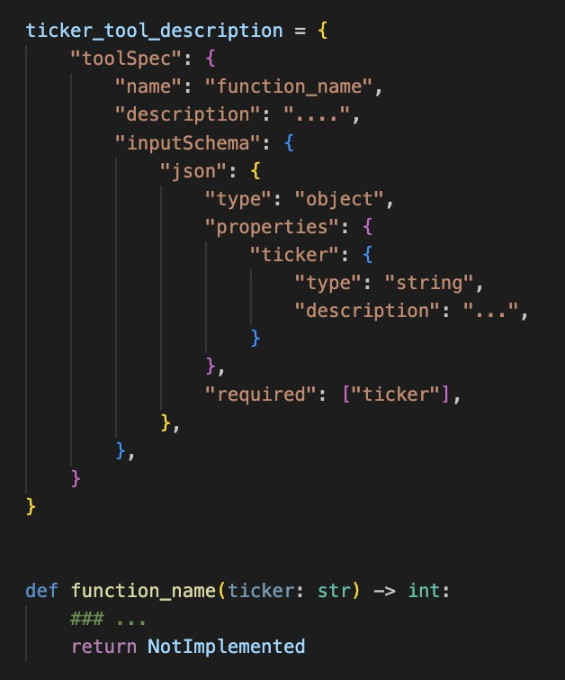
Function calling
Tool Spec definition

Slide 23
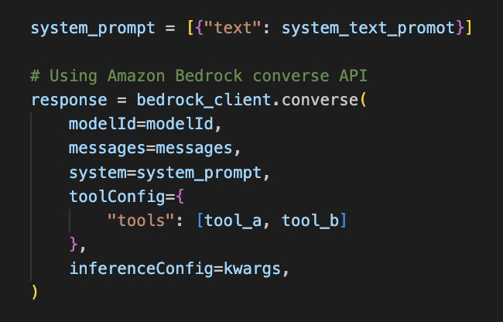
Function calling – pass the tools to tools list

Slide 24
Demo
© 2024, Amazon Web Services, Inc. or its affiliates. All rights reserved. Amazon Confidential and Trademark.

Slide 25
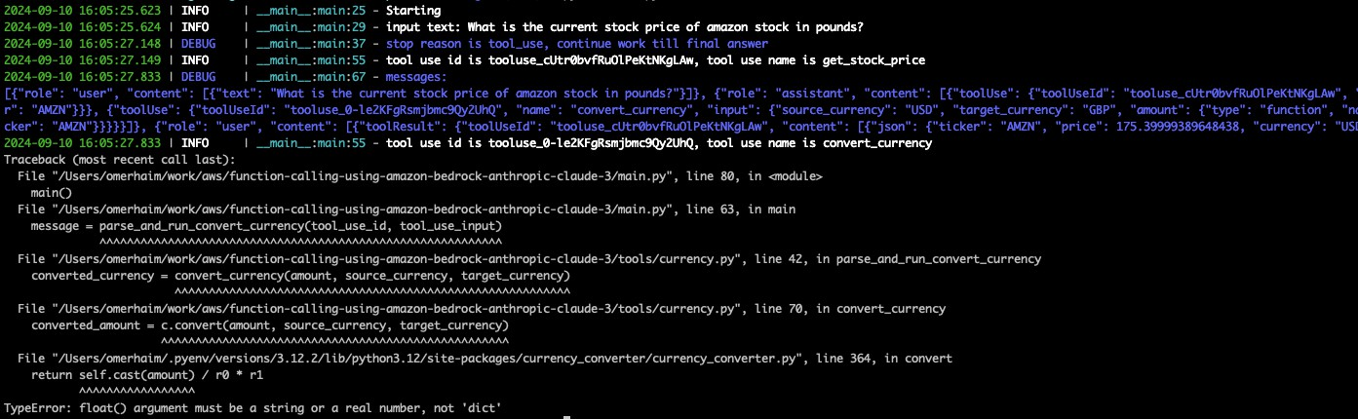
Function calling - pitfalls
Converse unified API doesn’t mean that it will always work
LLAMA 3.1 8B – failed to reason correctly the input schema according to the function description

Slide 26
Function calling - pitfalls
Converse APIs parameters – maxTokens, stopSequesnces, temperature, topP
Some models are more chatty, watch for maxTokens
Not all models support system prompts
Network connectivity
Wide permissions that supports all functions

Slide 27


Thank you!

