Slide 1
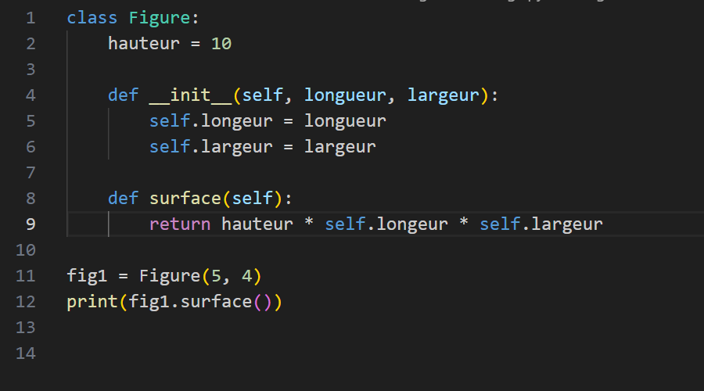

Cycle: conception – debug2 => Corrigez le programme

