Slide 1
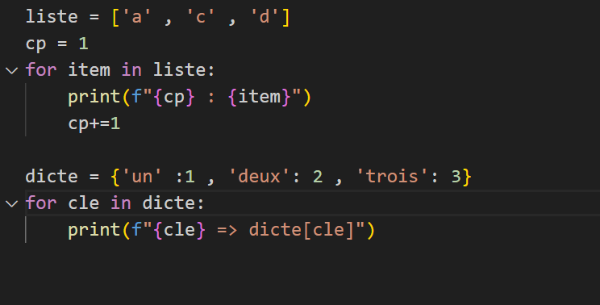
Cycle: env – refact_2 => refactorisez les deux boucles FOR

