Slide 1
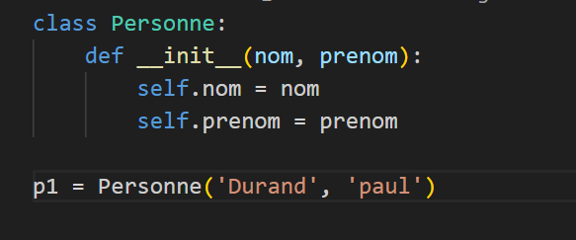
Cycle: env – debug2 => Corrigez le programme

