Slide 1
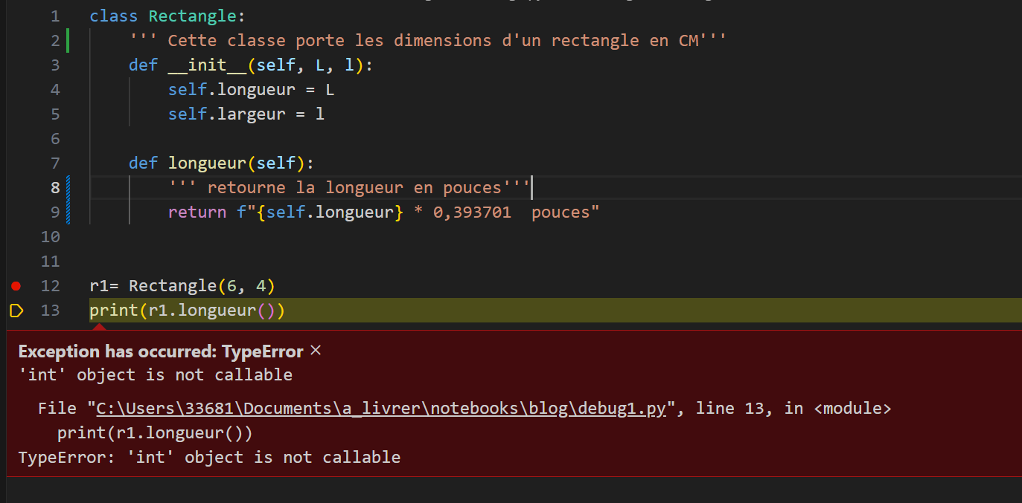
Cycle: conception – debug1 => Corrigez le programme

