Slide 1
GAMS Tutorial
Systems Seminar
Germán Montoya
Ph.D Student

Slide 2
Generalities

Slide 3
What is GAMS?
The General Algebraic Modeling System (GAMS) is a high-level modeling system for mathematical optimization. GAMS is designed for modeling and solving linear, nonlinear, and mixed-integer optimization problems.
GAMS contains an integrated development environment (IDE) and is connected to a group of third-party optimization solvers. Among these solvers are BARON, COIN-OR solvers, CONOPT, CPLEX, DICOPT, GUROBI, MOSEK, SNOPT, SULUM, and XPRESS.

Slide 4
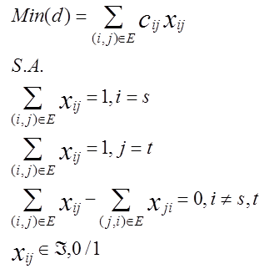
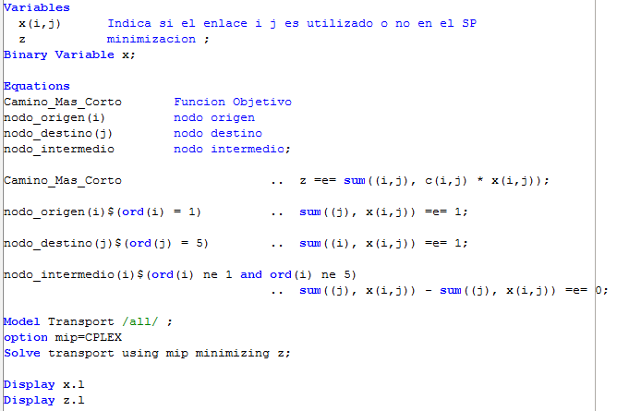
General Purpose
Real-life problem
Mathematical Model
Implementation

Slide 5
Download
http://www.gams.com/
http://www.gams.com/download/

Slide 6
Solution Architecture

Slide 7
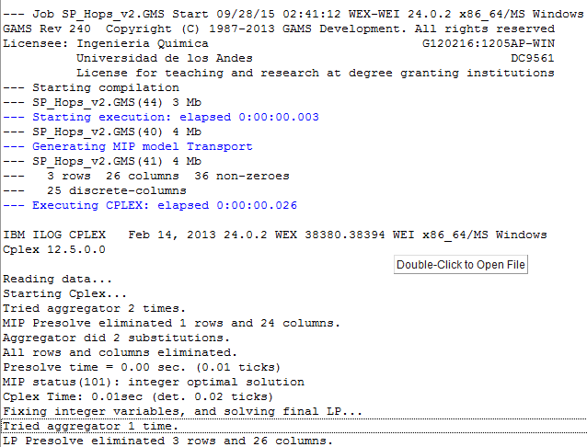
Solution Architecture
File types:
*.gms
*.log

Slide 8
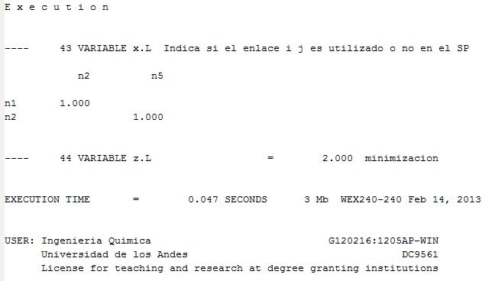
Solution Architecture
File types:
*.lst

Slide 9
Model Components

Slide 10



Example
From 5 saleable goods, buy the ones that incur the minimal possible cost, taking into account our budget, that is, 10 monetary units.
Goods’ values: 12, 5, 9, 6 y 4 respectively.
Mathematical model:

Slide 11


Example
Mathematical model:

Slide 12
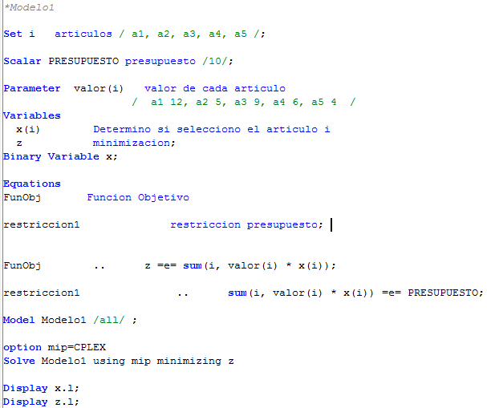
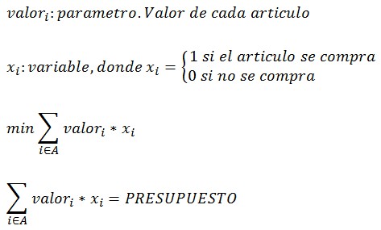
GAMS Implementation
Mathematical model:
GAMS:

Slide 13
Model Components
Sets
Parameters
Variables
Equations declaration
Equations definition
Solver configuration
Results visualization in the *.lst file

Slide 14
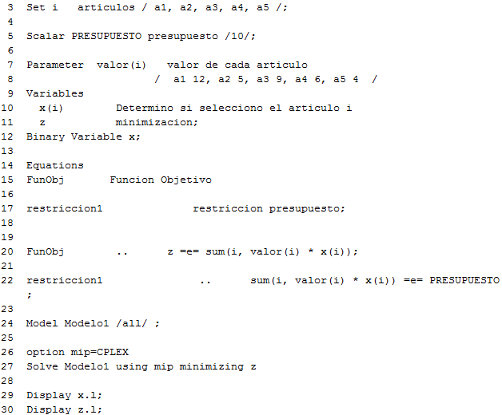
Model Components
*.lst file contents:
A copy of the mathematical model

Slide 15
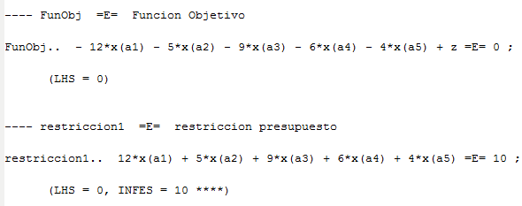
Model Components
*.lst file contents:
Equations

Slide 16
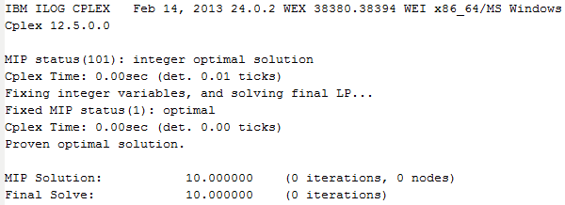
Model Components
*.lst file contents:
Solver

Slide 17
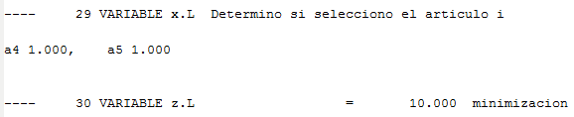
Model Components
*.lst file contents:
Results

Slide 18
Sets

Slide 19


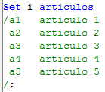
Sets
Five elements:
Create a copy set:
Parameterize the number of elements:
Description of elements:

Slide 20

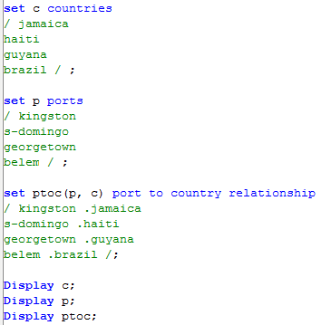
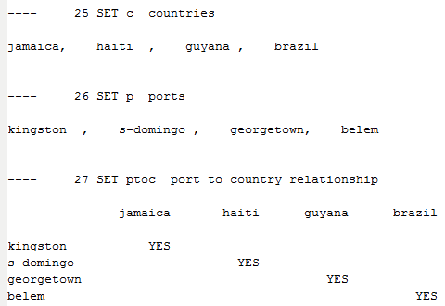
Sets
Subsets:
One-to-one Mapping:

Slide 21
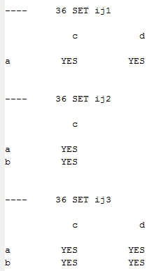
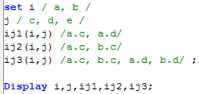

Sets
Many-to-many Mapping:

Slide 22
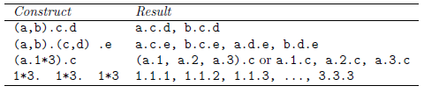
Sets
Many-to-many Mapping:
Exercise:

Slide 23
Sets
Many-to-many Mapping:
Exercise:

Slide 24
Data Entry
Parameters, Scalars &
Tables

Slide 25


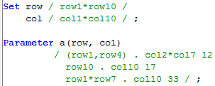
Data Entry
Scalars:
Parameters:
Parameter Data for Higher Dimensions:
Exercise:

Slide 26
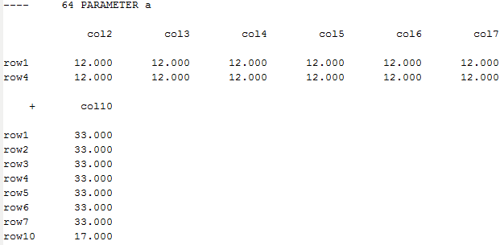
Data Entry
Exercise:

Slide 27
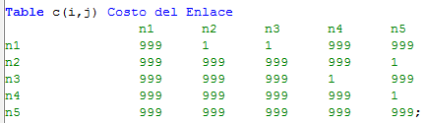
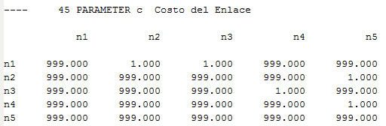


Data Entry
Tables:
$$\sum_{i∈P}{\sum_{j∈B}{C_{ij}X_{ij}}}$$
$C_{ij}$ ?

Slide 28
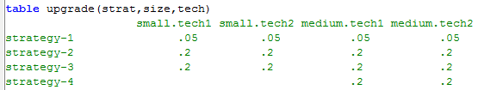

Data Entry
Tables:
More than two dimensions?

Slide 29
Variables

Slide 30

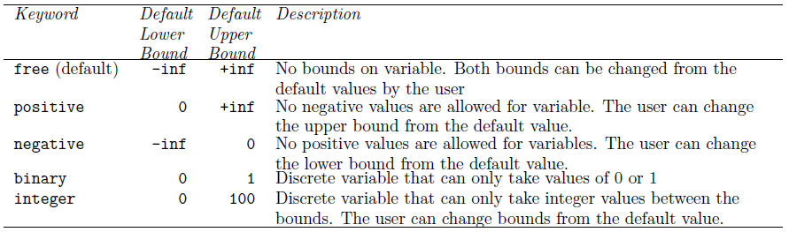
Variables
Declaration:
Variable type:
Variable types:

Slide 31
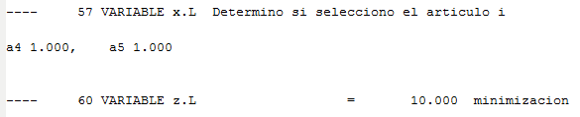
Variables
Displaying the solution of a variable:
.
.
.

Slide 32
Equations

Slide 33
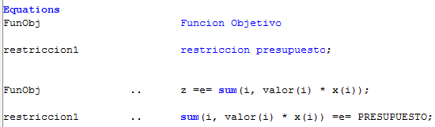

Equations
Declaration and definition:
Relational operators: =e=equal
=g=greater than or equal to
=l=less than or equal to
Declarations
Definitions

Slide 34





Equations
Forall:
$$min\sum_{i∈P}{\sum_{j∈B}{C_{ij}X_{ij}}}$$
$$\sum_{j∈B}{X_{ij}}≤a_{i} ∀i∈P$$
$$\sum_{i∈P}{X_{ij}}≥b_{j} ∀j∈B$$

Slide 35

Model and Solve Statements
Solution for ‘x’ and ‘z’.
‘l’ : level

Slide 36
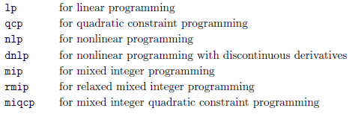
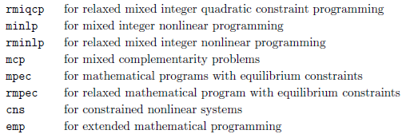
Model and Solve Statements
Problem type:

Slide 37
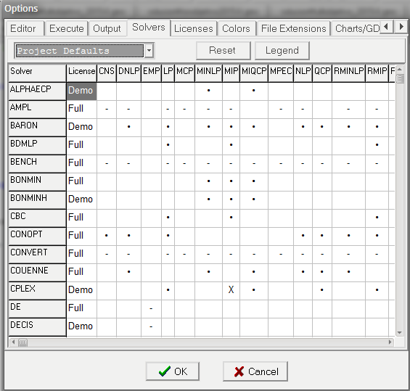
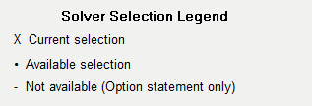
Model and Solve Statements
Problem type:
File>Options>Solvers

Slide 38
Conditionals

Slide 39
Conditionals
a$(b > 1.5) = 2 ;
if (b > 1.5), then a = 2
Relational operators:
le, <= less than or equal to
lt, < strictly less than
eq, = equal to
ne, <> not equal to
ge, >= greater than or equal to
gt, > strictly greater than

Slide 40

Conditionals
$ operator in parameters:
It is equivalent to:
$ operator in constraints:

Slide 41
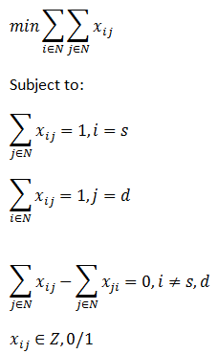
Conditionals
Example:
X₁₂
2
X₂₅
1
1
1
5
1
1
1
X₁₃
3
4
X₄₅

Slide 42
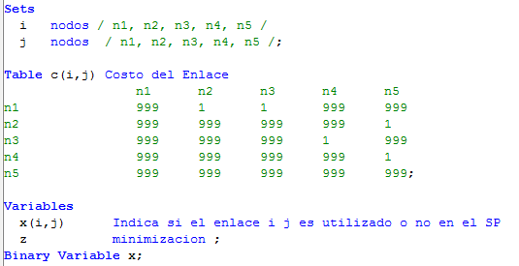
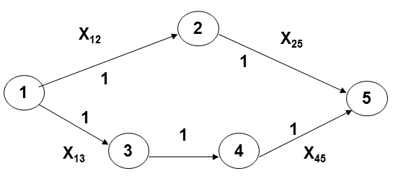
Conditionals
Example:
s=1
d=5

Slide 43
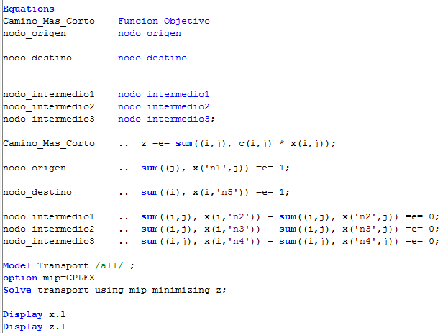
Conditionals
Example:
s=1
d=5

Slide 44
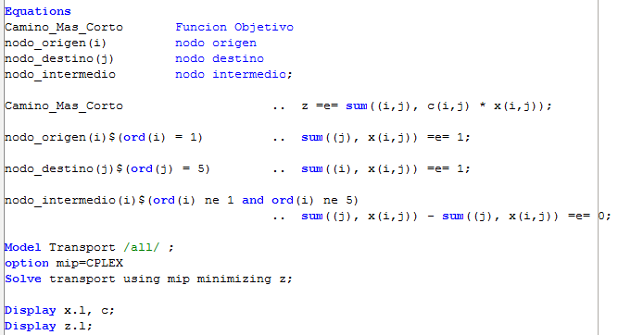
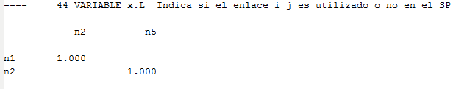
Conditionals
Example: generic version
s=1
d=5

Slide 45
Programming Flow Control Features

Slide 46
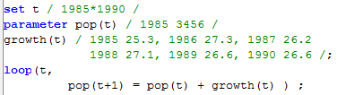

Programming Flow Control Features
Loop:
Conditional loop:
One cannot make declarations or define equations inside a loop statement.
It is illegal to modify any controlling set inside the body of the loop.

Slide 47
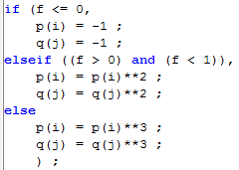
Programming Flow Control Features
If-elseif-else:
One cannot make declarations or define equations inside an if statement.

Slide 48
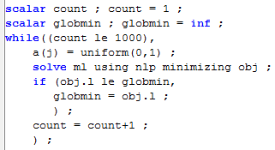
Programming Flow Control Features
while:
One cannot make declarations or define equations inside a while statement.

Slide 49
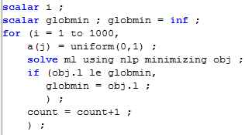
Programming Flow Control Features
for:
One cannot make declarations or define equations inside a for statement.

Slide 50
Programming Flow Control Features
Example: Multiobjective Optimization
Function 1: minimize hops
Function 2: minimize cost
X₁₂
2
X₂₅
10
1
10
5
5
5
5
X₁₃
3
4
X₄₅

Slide 51
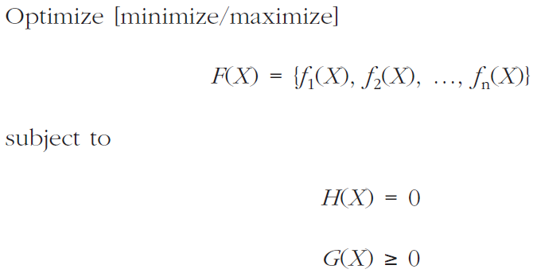
Programming Flow Control Features
Example: Multiobjective Optimization

Slide 52
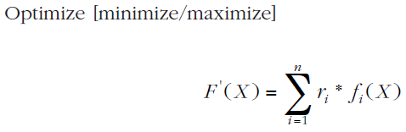
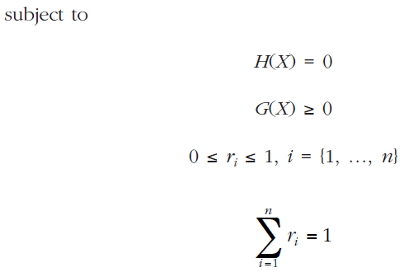
Programming Flow Control Features
Método “Suma Ponderada”:

Slide 53

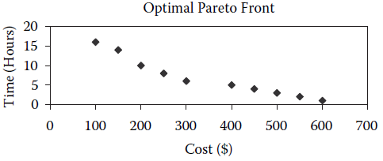
Programming Flow Control Features
“Weighted Sum” Method:
Hops
Cost

Slide 54
Programming Flow Control Features
GAMS
Modelo Matemático:
-Conjuntos
-Parámetros
Pesos: w₁ , w₂
-Función objetivo
k iteraciones
-Variar Pesos
-Solucionar el modelo
-Guardar f₁ y f₂
MATLAB
-Enviar f₁ y f₂
a un archivo de resultados
-Cargar archivo de resultados
-Graficar Frente de Pareto

Slide 55
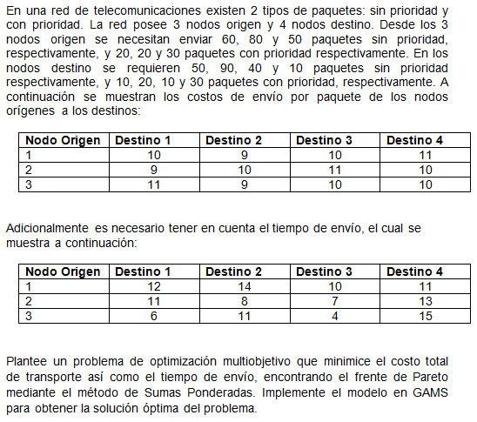
Programming Flow Control Features
Example:

