Slide 1
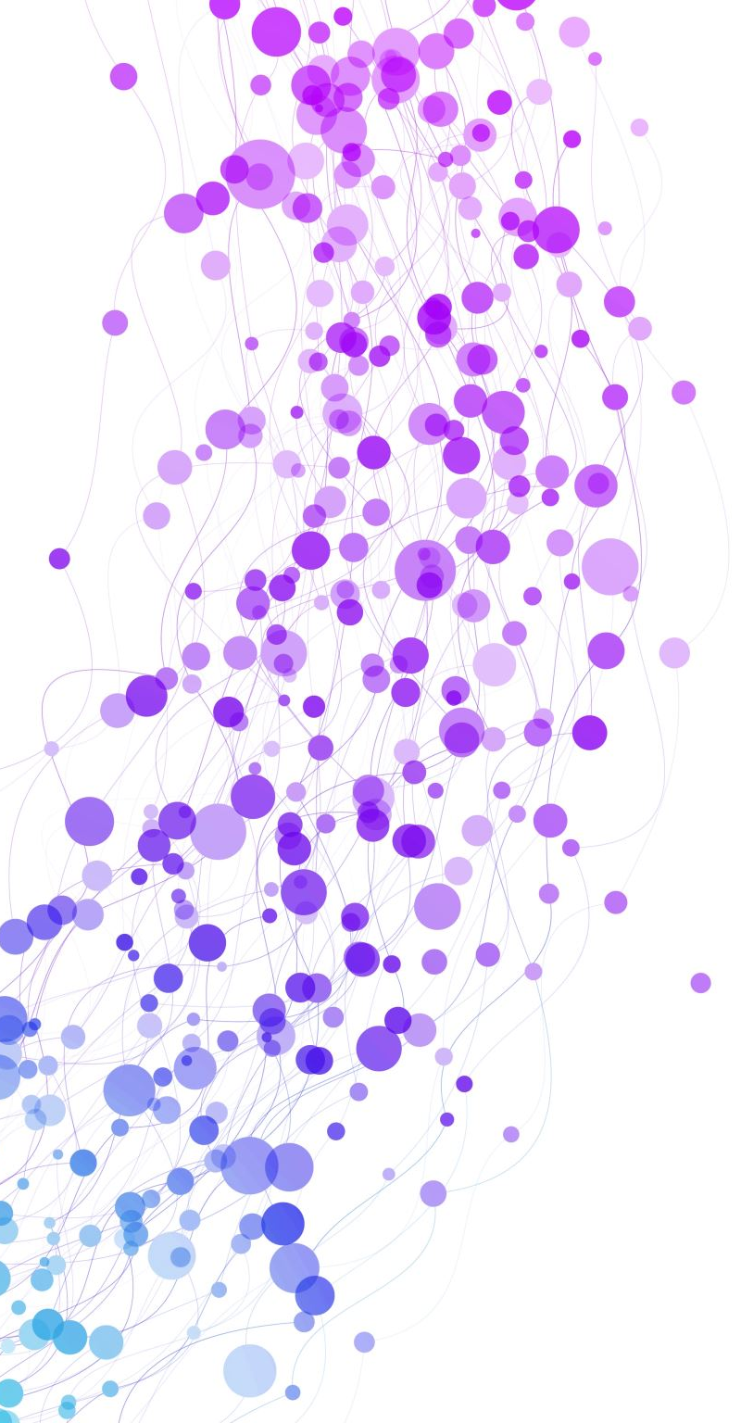
Airbnb in Barcelona
A first Approach for 2022

Slide 2
What was the current situation of Airbnb in Barcelona as for 2022?
What is the price range?
How many locations are in the city?
How are these locations distributed?
What do guests say about Airbnb in Barcelona?
How much of the accommodation offer does Airbnb represent?

Slide 3
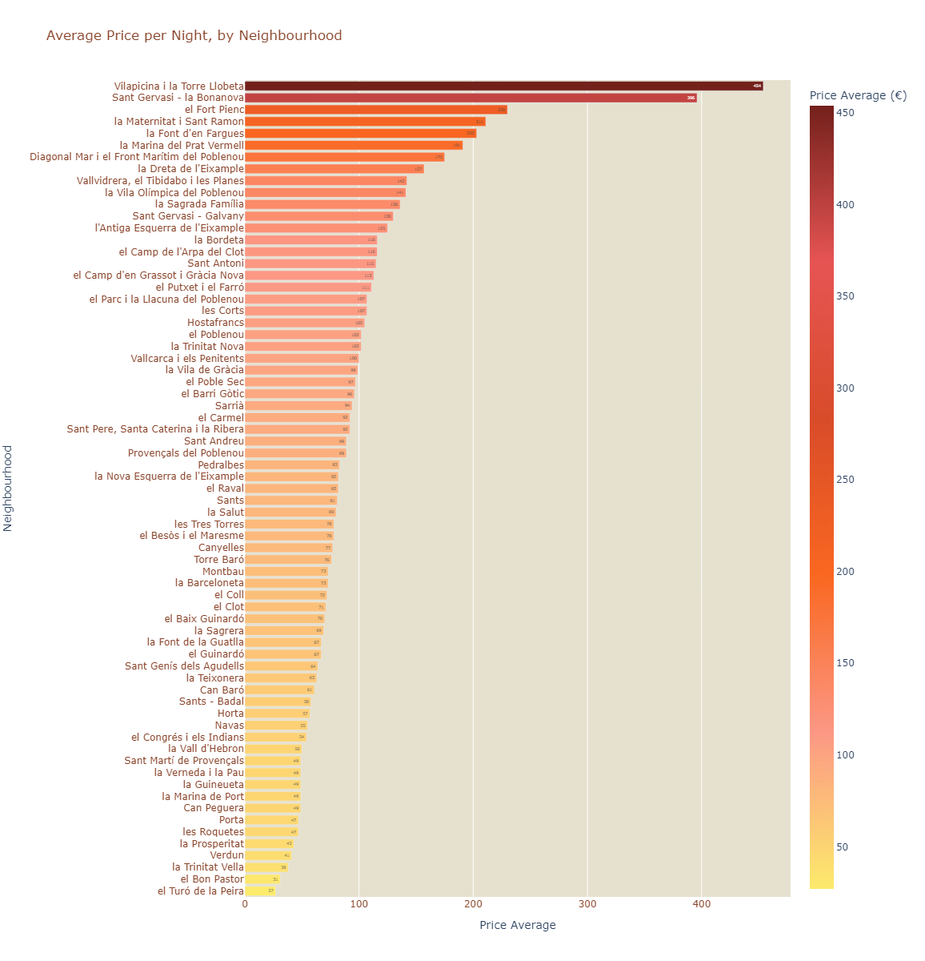
Average Price Range
Most Expensive:
Vilapicina i la Torre Llobeta : 454 €
Cheapest:
el Turó de la Peira : 27 €
AVERAGE: 114 €

Slide 4
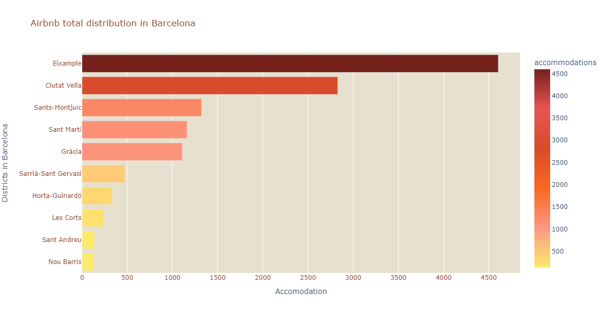
Active accommodations reported by Airbnb in 2022
12338

Slide 5
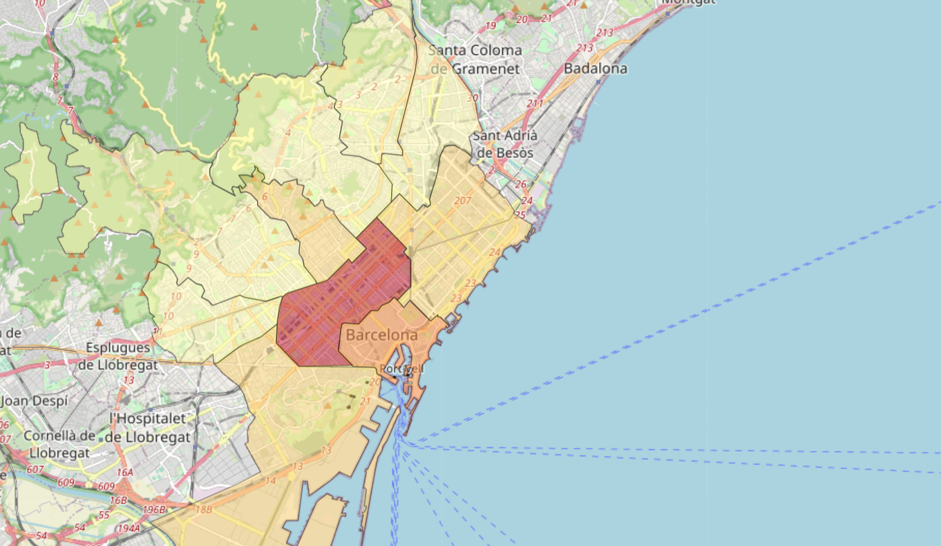
Geographical Density Distribution

Slide 6
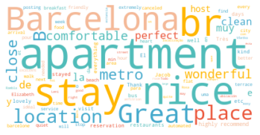
What do satisfied guests say about Airbnb in Barcelona?

Slide 7
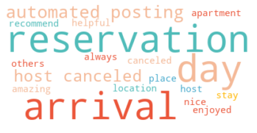
What do unhappy guests say about Airbnb in Barcelona?

Slide 8
How much of the accommodation offer does Airbnb represent?
According to official data from the INE, in 2022, there were a máximum of 3303 tourist apartments available in Barcelona.
This represents 27% of the actual Airbnb offer.
Notes:
https://metropoliabierta.elespanol.com/el-pulso-de-la-ciudad/distritos-inseguros-barcelona_58352_102.html

Slide 9
