Slide 1
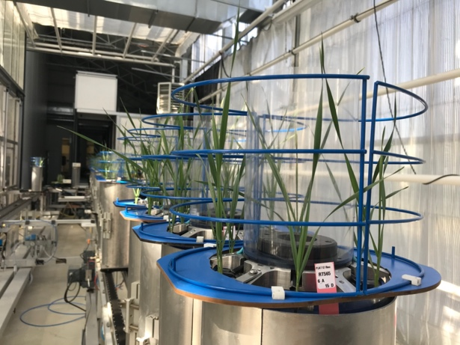
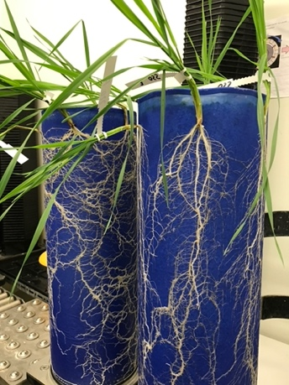
(a)
(b)
(c)
: pure stand
: mixed stand
(d)
R+
R-
Block 1
Block 2
Block 3
Figure 1: Experimental design. (a) and (b) close-up views on RhizoTubes® showing wheat seedlings and their roots. (c) Spatial distribution of the seedlings within the RhizoTubes® in both pure (up) and mixed (bottom) stands. Different colours represent different genotypes. (d) Schematic representation of the experiment, each dark square representing a RhizoTube®. The green squares are the control RhizoTubes® and are all grown with the same wheat variety to check environmental heterogeneity.

