Slide 1
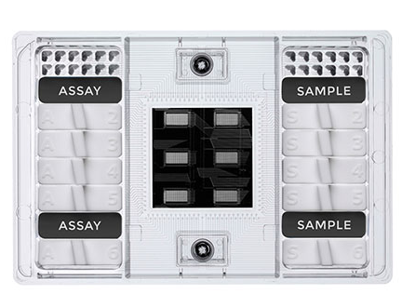
Brief introduction to Flex Six IFC
Basically, Flex Six has 6 Blocks of 12 assays x 12 samples
Each block can be run separately and multiple (or all) blocks can be run together.
Assays (primers) in each block don’t meet with samples in another block.
Thus, the total number of reaction in one Flex Six IFC can be up to 864.
Definitely, we need to make replicates either for assays or samples.
When you have a number of samples to run, the proper number of assays (primer sets) for Flex Six is 4 to 6. (4 is ideal, FYI).
When you try to put more than 6 assays, there would not be enough space for serial dilutions of standard DNAs.
1
2
3
4
5
6

Slide 2
Example of Design
Let’s assume that you are going to run 4 assays for > 100 samples.
First, I will put 4 assays in triplicate for all 6 blocks. (Note that assays of Block X are only mixed with samples of Block X)
Then, I will prepare a serial dilution of standard DNA in 6 concentrations corresponding to the assays. Those will be filled in sample wells of Block 1 and Block 2.
From Block 3 to Block 6, I will put the samples that I want to test, which number will be 48.
If you know the range of detection or if you want to put more samples in one IFC, you can reduce the number of standard DNA dilutions (maybe 3 to 4).
A
B
STD A
C
D
STD B
A
B
STD C
C
D
STD D
A
B
Samples
C
D
A
B
C
D
A
B
C
D
A
B
C
D

