Slide 1
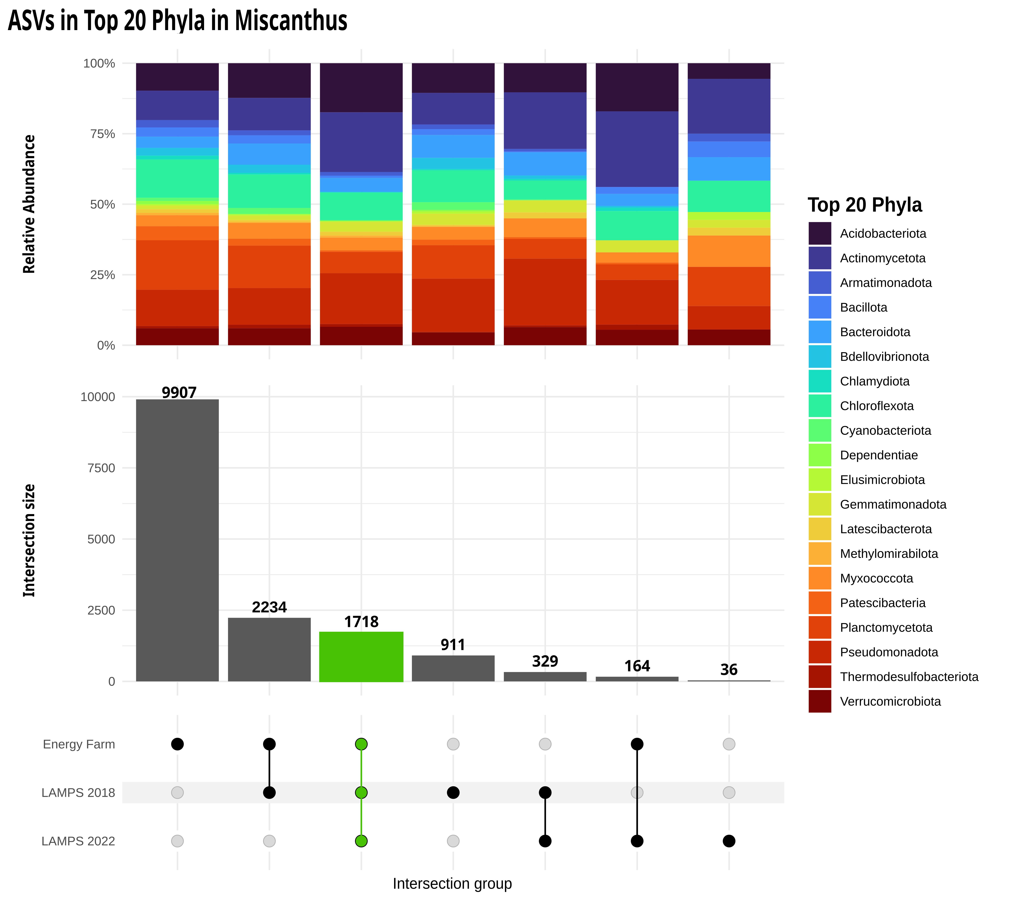
>1700 16S ASVs: a substantial number that persists across different sites and years in Miscanthus spp.
Temporal vs Spatial Effects
LAMPS: 2018 vs LAMPS 2022 intersection shows temporal stability.
Energy Farm vs LAMPS comparisons show spatial variation

